Slide 1


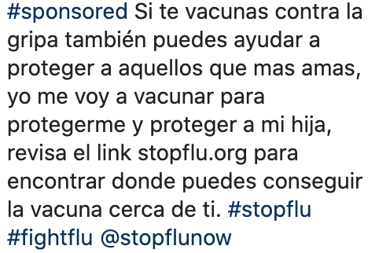



  Sample Post 1: Sample Post 2: Sample Post 3:

