Slide 1
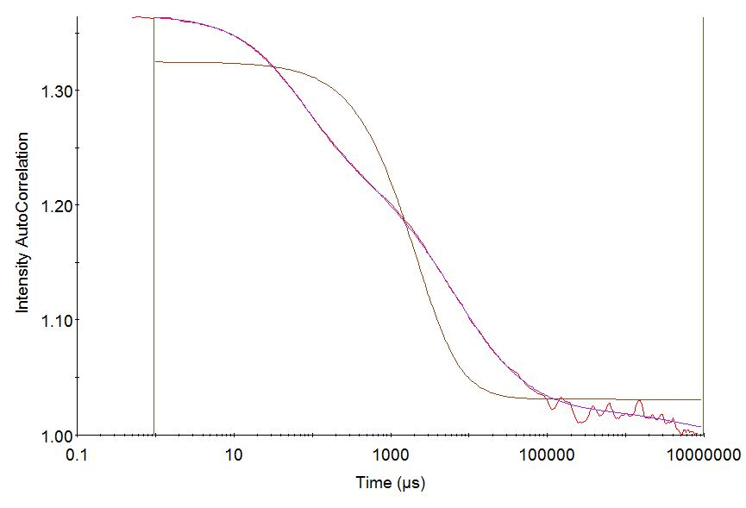
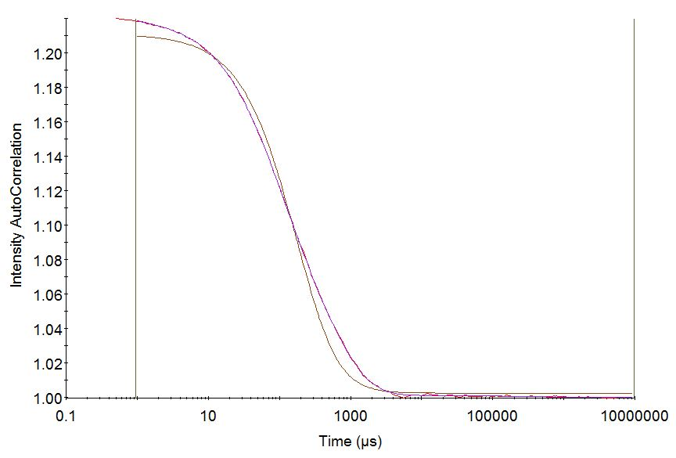
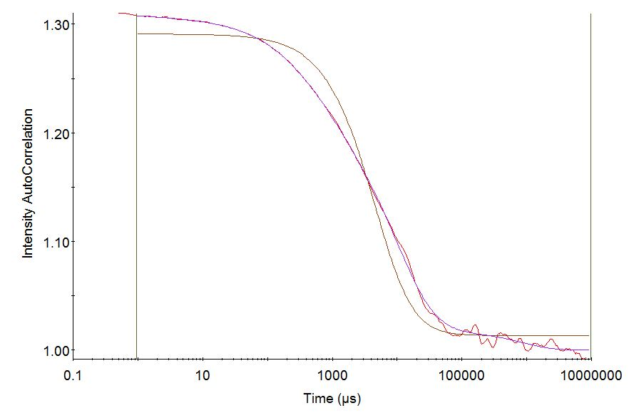
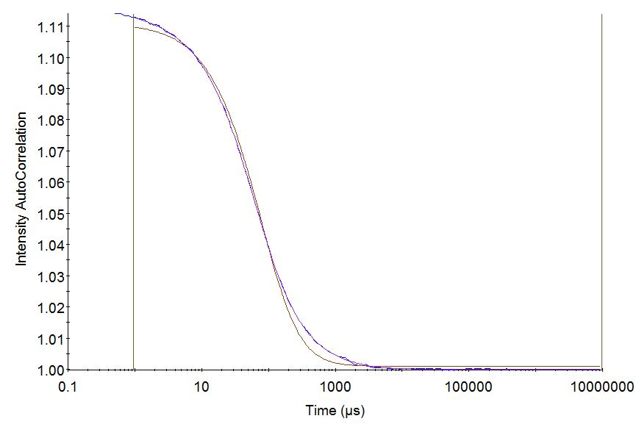
A
Rat Serum + Nanocomplex without biotin PEG-Peptide
B
Rat Serum + Nanocomplex with biotin-PEG-Peptide
No significant change in relaxation
Change in relaxation
Individual Correlation function
Intensity Auto Correlation
Intensity Auto Correlation
Individual Correlation function
Correlation function of mixture
Correlation function of mixture
Time (us)
Time (us)
C
Human Serum + Nanocomplex without biotin-PEG-Peptide
D
Human Serum + Nanocomplex with biotin-PEG-Peptide
Change in relaxation
No significant change in relaxation
Intensity Auto Correlation
Intensity Auto Correlation
Individual Correlation function
Correlation function of mixture
Individual Correlation function
Correlation function of mixture
Time (us)
Time (us)
Figure S1

