Slide 1
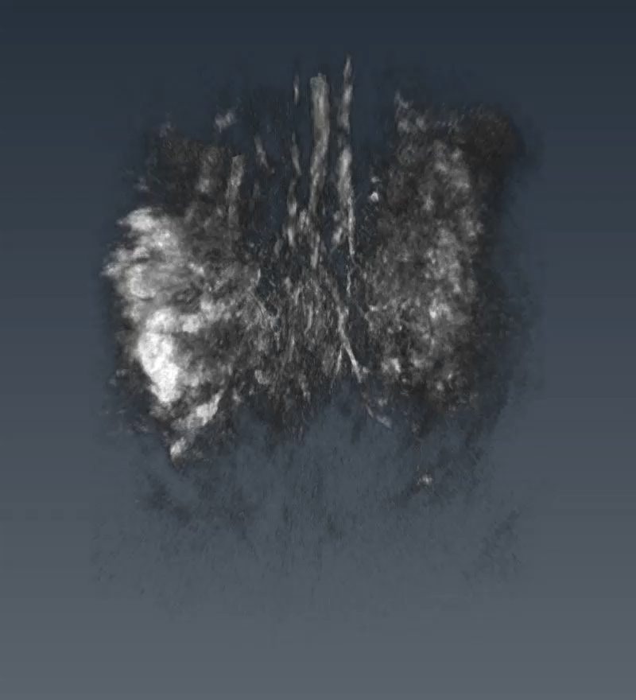
Figure 3(a): Video of reconstructed 3D volume of PA data of mouse lower abdomen at 808 nm. Scale bar is 3 mm.

Slide 2
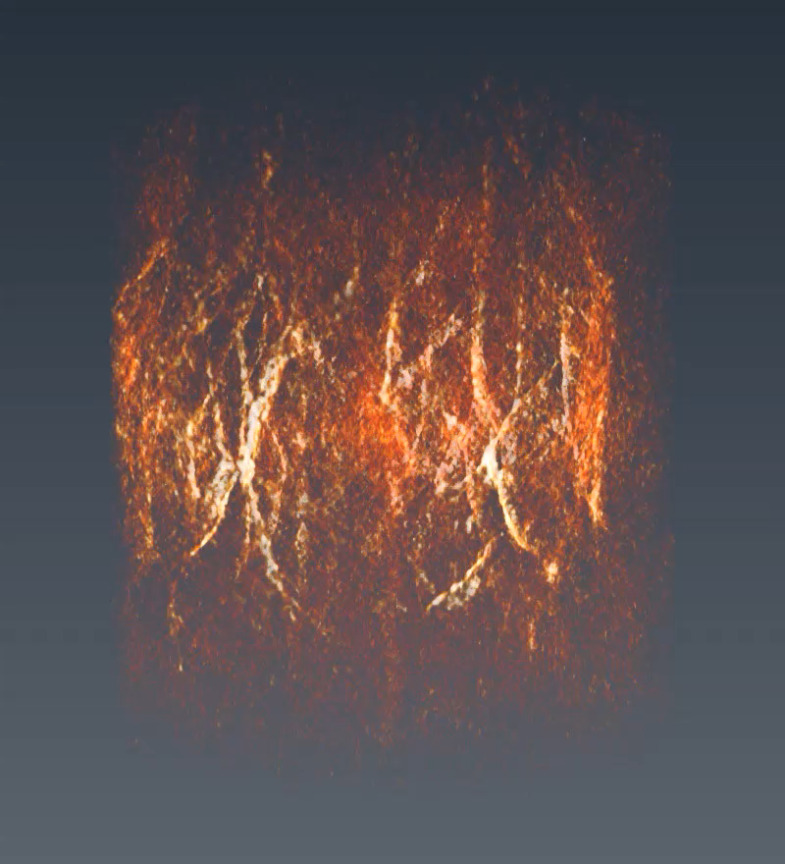
Figure 3(b): The skin vasculature of mouse acquired at 532 nm. Scale bar is 3 mm.

Slide 3
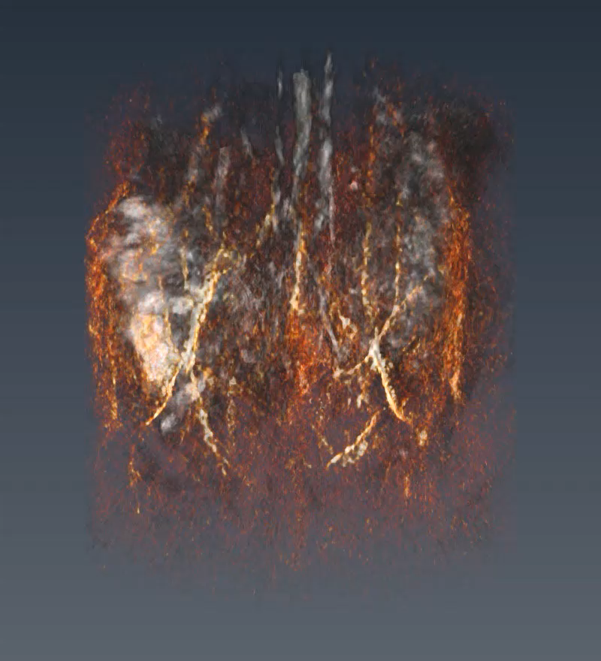
Figure 3(c): Overlay of reconstructed PA data of mouse at 808 nm and 532 nm. Scale bar is 3 mm.

Slide 4
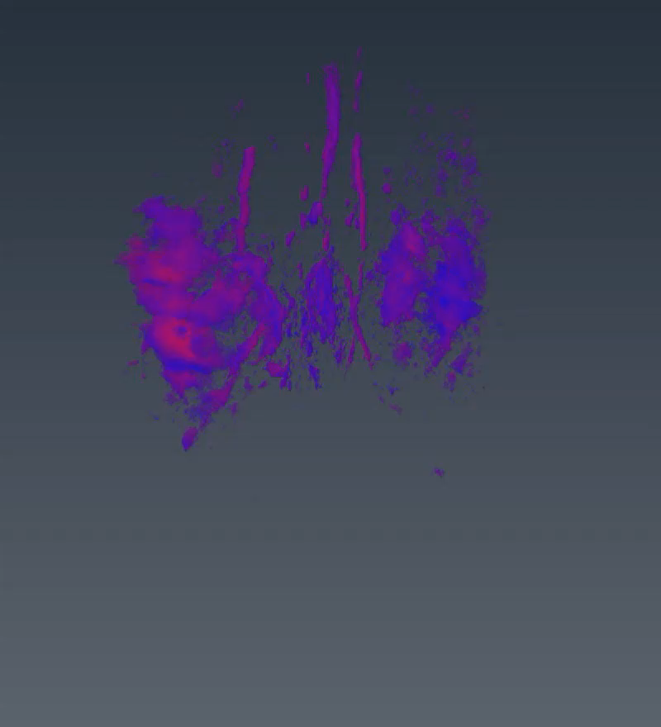
Figure 4(a): Hemoglobin oxygenation measured using PA data at 100% oxygen supply. Scale bar is 3 mm.

Slide 5
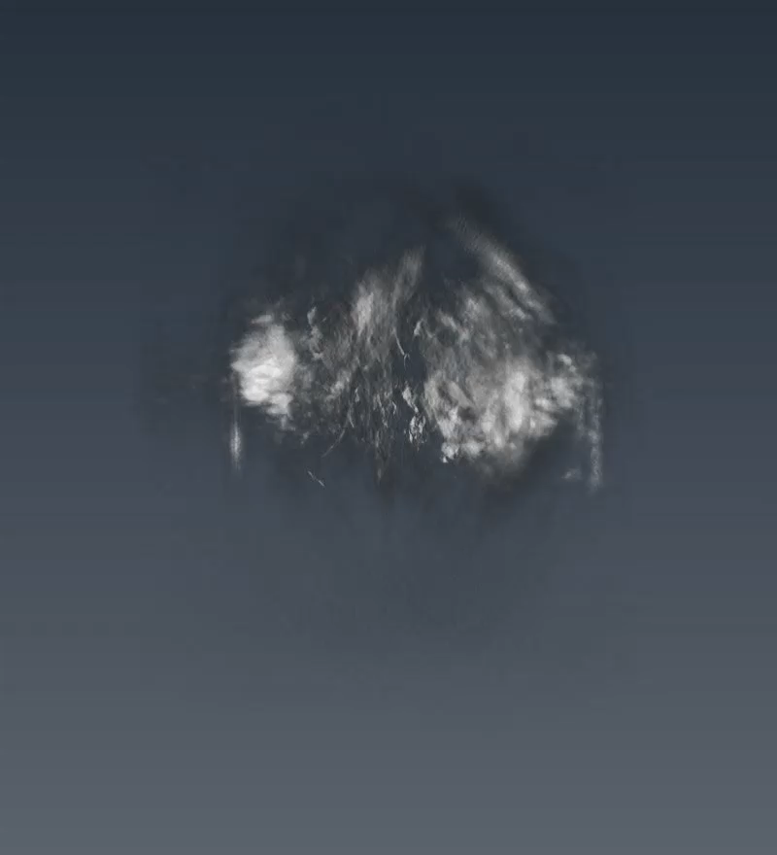
Figure 5(a): Reconstructed 3D volume of PA data of mouse lower abdomen at GD 17 before injection of FA-PEG-ICG at 740 nm. Scale bar is 3 mm.

Slide 6
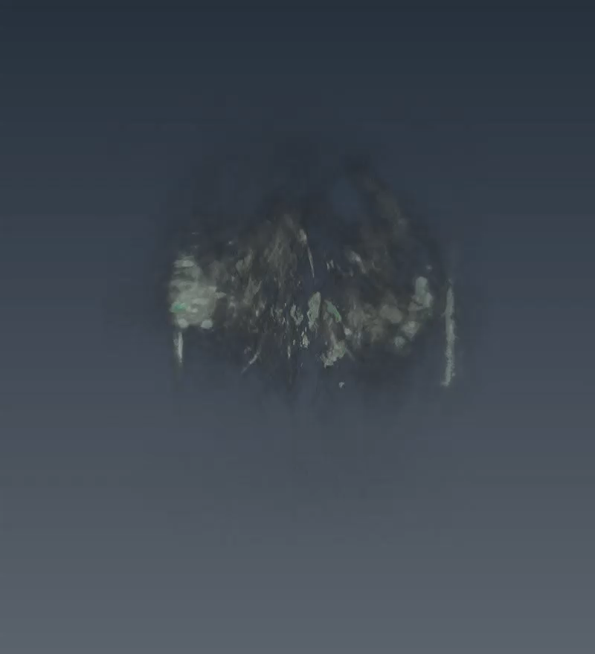
Figure 5(b): 3D volume of PA data of mouse at t= 5 minutes time point post injection. Scale bar is 3 mm.

Slide 7
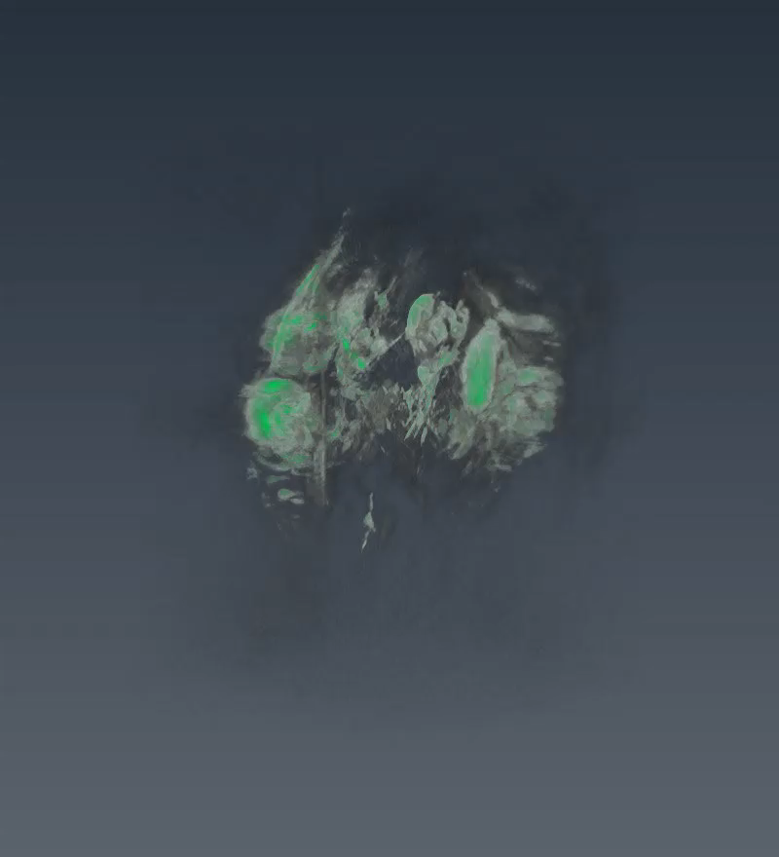
Figure 5(c): 3D volume of PA data of mouse at t= 90 minutes time point post injection. Scale bar is 3 mm.

