Slide 1



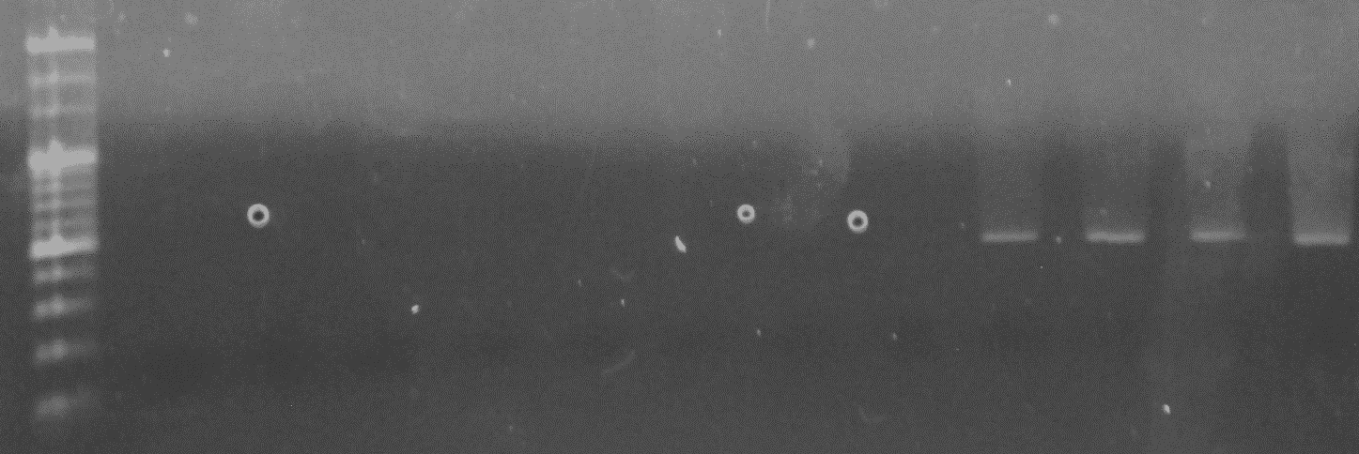

Fig. S1
a
b
c
*
Ctrl
**
*
LA
**
☨☨
☨
Pg
Ctrl
Arthritis score
Pg/LA
ABL against Ctrl (%)
**
**
☨☨
**
LA
LA
Pg W83
-
-
+
-
-
+
+
+
weeks after LA immunization
d
Pg
positive ctrl
stomach
marker
kidney
intestine
blood
lung
gingiva
Pg/LA
spleen
colon
tongue
liver
feces

Slide 2
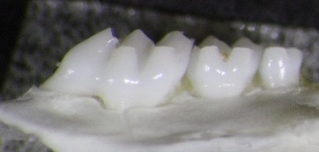
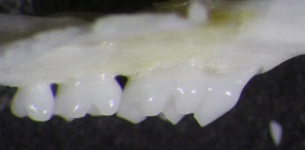
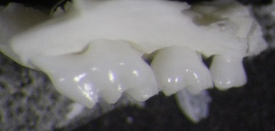
Fig. S2
Ctrl
LA FMT
Pg/LA FMT

Slide 3
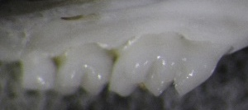
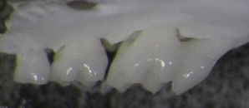
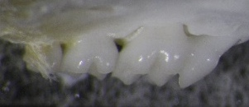
Fig. S3
a
b
Ctrl
LA
Pg
-
-
+
-
+
+
+
W83
Positive
33277
⊿pad
Pg WT/LA
Pg ⊿pad/LA

