Slide 1
Nkx2-5 defines distinct scaffold and recruitment phases during formation of the cardiac Purkinje fiber network
Choquet et al.

Slide 2

a
Cx40
b
Cx40-CreERT2::R26R-YFP
CreERT2-RFP
Tamoxifen
Analysis
x
Rosa26
Stop
eYFP
E10-E11
E13-E14
P1
P21
loxP
loxP
c
Cx40-CreERT2::R26R-YFP
Tam E10-11
Tam E13-14
Tam P1
Left ventricle
P21
*
*
*
YFP / CNTN2
IVS
IVS
*
IVS
*
*
Supplementary Figure 1: Inducible genetic tracing of Cx40+ derivative cells during embryonic development or postnatal stages. a, Schematic illustration of the genetic lineage tracing strategy. R26R-YFP reporter mouse line is crossed with tamoxifen inducible Cx40-CreERT2 mice. Injection of tamoxifen induces the recombination of loxp sites resulting in the expression of the fluorescent protein YFP in Cx40+cells. b, Time course of tamoxifen injections and analyses of Cx40+ derived-cells are represented on a time scale. Analysis are made on transverse sections in the middle region of ventricles. c, Immunostaining for YFP and CNTN2 on Cx40-CreERT2::R26R-YFP heart transverse sections at P21, show progressive restriction of Cx40+ derived-cells (YFP+) to the VCS (CNTN2+) during ventricular morphogenesis. Asterisks represent papillary muscles; IVS: interventricular septum. Scale bar= 500µm. (n=4 Ctrl and Nkx2-5^{+/-})

Slide 3
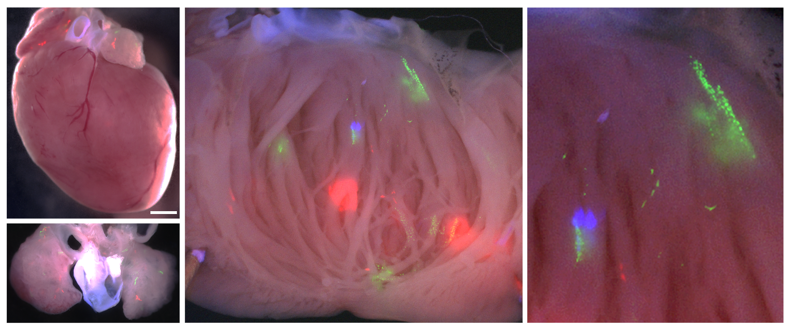
nGFP YFP RFP mCFP
a
Cx40-CreERT2 ; R26R-Confetti
RA
Left-ventricle
Magnification
LA
nGFP
RV
LV
4’OH E10.5
pm
pm
mCFP
YFP
P21
Atria
RFP
b
Control
E9.5+E10.5-derived clones
Nkx2-5 ^{+/-}
Basal LPF
Medial LPF
P21
Distal LPF
Control
E18.5-derived clones
Nkx2-5 ^{+/-}
P21
RA
LA
Mixed
Cond.
Small clone (<10cells)
Intermediate clone (10-30cells)
Large clone (>30cells)
Supplementary Figure 2: Whole-mount fluorescence views of P21 hearts with multicolor clusters from R26R-Confetti reporter line.
a, Whole-mount views of an Cx40-CreERT2::R26R-Confetti heart induced by 4’OH injection at E10.5. The four fluorescent reporters (mCFP, YFP, nGFP, RFP) form independent unicolor clones distributed in the atria and along the left ventricular part of interventricular septum (IVS). Injection of 4’OH induces the recombination of loxp sites resulting in the expression of the fluorescent protein YFP in Cx40+ cells. pm: papillary muscle; arrow heads show individual clones in atria and left ventricular myocardium. Scale bars = 1mm. (n=16 Ctrl; n=10 Nkx2-5^{+/-}) b, Spatial location of clones within the IVS left-ventricular domain. Schemas represent the spatial distribution of the total mixed (squares) and conductive (rounds) clones analyzed along the apico-basal axis. Each clone sizes are represented. The two first panels represent total E9.5 and E10.5-derived clones analyzed in control and Nkx2-5^{+/-} hearts. The two lower panels represent total E18.5-derived clones analyzed in control and Nkx2-5^{+/-} hearts.

Slide 4
a
Conductive clones
Non-conductive clones
Cx40-CreERT2
Sma-CreERT2
Cx40-CreERT2
P=0.99
P=0.87
P>0.99
P=0.99
**
P=0.99
P=0.92
P=0.99
P=0.065
P=0.61
P=0.0062
P>0.99
Ctrl
Nkx2-5^{+/-}
#cells/clone
P>0.99
E9.5
E10.5
E14.5
E18.5
E7.75
E8.75
E9.5
E10.5
E9.5
E10.5
E14.5
E18.5
Time of induction
Time of induction
Time of induction
b
Mixed clones
Cx40-CreERT2
4’OH E9.5 → P21
Cx40-CreERT2
4’OH E10.5 → P21
Cx40-CreERT2
4’OH E14.5 → P21
P=0.4074
P=0.125
P=0.98
#cells/clone
#cells/clone
#cells/clone
Sma-CreERT2
4’OH E7.75 → P21
Sma-CreERT2
4’OH E9.5 → P21
Sma-CreERT2
4’OH E10.5 → P21
4’OH E10.5 → P21
P=0.115
P=0.129
P=0.019
*
#cells/clone
#cells/clone
#cells/clone
Supplementary Figure 3: Size of temporally distinct Cx40+ and Sma+ derived-clones. a, Dot plot graphs represent cell number per conductive and non-conductive individual clones. Quantification is made in P21 control (ctrl) or Nkx2-5^{+/-} mice and after 4’OH induction using either Cx40-CreERT2::R26R-Confetti or Sma-CreERT2::R26R-Confetti mouse lines. Each dots represent individual clone. Red bars represent the Mean ± SD. P values are derived ordinary one-way ANOVA test (Tukey test),**P<0.01. b, Graphs represent distribution of mixed clone size after induction at different time point. P value is derived from non-parametric Mann-Withney t-Test, *p<0.05.

Slide 5
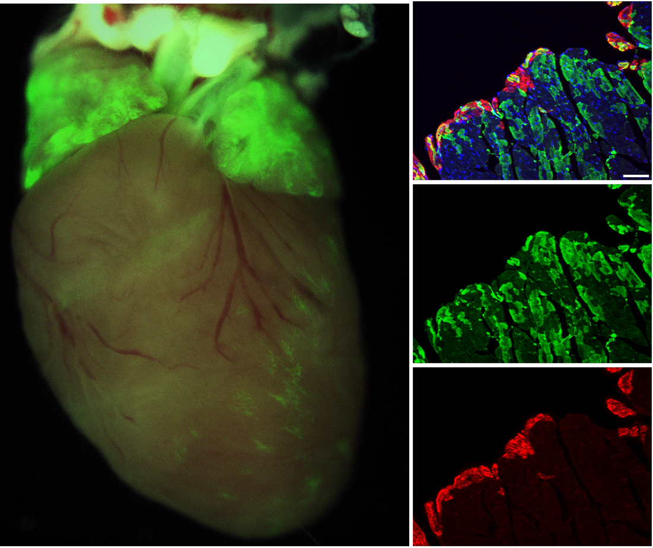
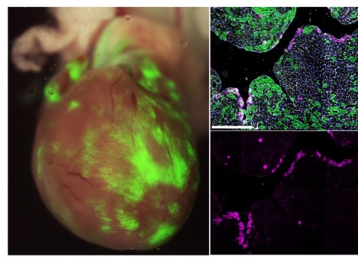
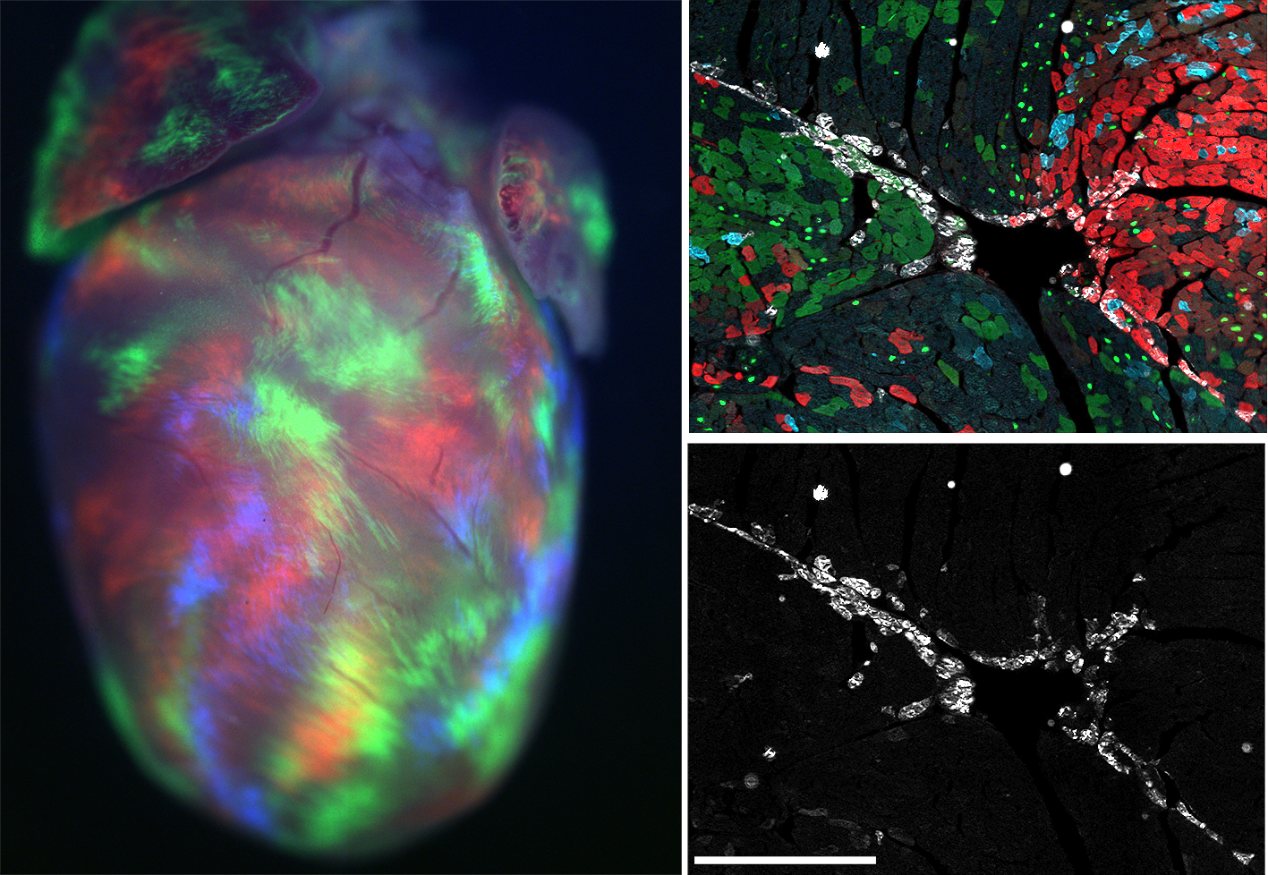
a
Cx40-CreERT2::R26R-YFP
b
Nb of Cx40+ trabecular derived-cells per section
c
Relative contribution of Cx40+ trabecular cells to PFs
LV
800
600
400
200
0
p = 0.0074
p = 0.33
Ctrl
Nkx2-5^{+/-}
100
80
60
40
20
0
p <0.0001
Ctrl
Nkx2-5^{+/-}
RA
LA
IVS
**
****
#YFP+ cells/section
%(YFP+CNTN2+/YFP total)
p = 0.044
*
Tam E9.5→P21 →P21
TamE9.5
TamE18.5
TamE9.5
TamE18.5
YFP / CNTN2
d
Sma-CreERT2::R26R-YFP
e
E8.0 Sma+ lineage contribution cells to adult PF network
RA
LA
LV
IVS
p = 0.2790
Ctrl
Nkx2-5^{+/-}
%(YFP+ CNTNT2+/CNTN2 total)
Tam E8.0 →P21
YFP / WGA/CNTN2
f
Mesp1-Cre::R26R-Confetti
g
Mesp1+ lineage contribution to adult PF network
RA
LA
p = 0.0649
% (Confetti+ PF cells/tot PF cells)
Ctrl
Nkx2-5^{+/-}
YFP/nGFP/RFP/CFP/CNTN2
h
Frequency of Mesp1+ derived-colors within left PF network
i
Frequency of Mesp1+ derived-colors within left working myocardium
p = 0.0178
p = 0.0329
Ctrl
Nkx2-5^{+/-}
**
*
GFP
CFP
YFP
RFP
GFP
CFP
(YFP+GFP)
RFP

Slide 6
Supplementary Figure 4: Contribution of different progenitors population to the VCS. a, Whole-mount view of an P21 Cx40-CreERT2::R26R-YFP heart induced by tamoxifen injection at E9.5. Right panels show high magnification of left ventricular transverse sections after immunostaining using CNTN2 antibody. b-c, Graphs represent the quantification from (a) images. The total number of trabecular derived cells (YFP+) (b) and the relative contribution of trabecular cells to PFs ((YFP+CNTN2+)/YFP+) (c) are quantified in middle sections. Mean of 4 sections/heart TamE9.5 and 3sections/heart TamE18.5. (n=3 TamE9.5 Ctrl and TamE18.5 Ctrl and Nkx2-5^{+/-}; n=4 TamE9.5 Nkx2-5^{+/-}). P values are derived ordinary one-way ANOVA test,*P<0.05; **P<0.01; ****P<0.0001. Scale bar = 50µm. d, Whole-mount view of an P21 Sma-CreERT2::R26R-YFP heart induced by tamoxifen injection at E8.0. Right panels show high magnification of left ventricular transverse sections after immunostaining using CNTN2 and WGA antibodies. e, Graph represents the percentage of YFP-labelled adult PFs according to Sma+ lineage traced by Tam injection at E8.0( YFP+CNTN2+)/CNTN2+). Quantifications are made from (d) images using control (ctrl) or Nkx2-5^{+/-} heart transverse sections. Mean of 3sections/heart; (n=4 Ctrl; n=3 Nkx2-5^{+/-}). P values are derived ordinary one-way ANOVA test (Tukey test). f, Whole-mount view of an P21 Mesp1-CreERT2::R26R-Confetti. Right panels show high magnification of left ventricular transverse sections after immunostaining using CNTN2 antibody. g, Graph represents the percentage of Confetti-labelled adult PFs according to Mesp1+ lineage (Confetti+CNTN2+)/CNTN2+). Quantifications are made from (f) images using control (ctrl) or Nkx2-5^{+/-} heart transverse sections. Mean of 3sections/heart; (n=4 Ctrl and Nkx2-5^{+/-}). P values are derived ordinary one-way ANOVA test (Tukey test). h-i, Diagrams represent the individual Mesp1+ confetti colors percentage contribution to the left Purkinje network (h) or the working myocardium (i) in control or Nkx2-5^{+/-} hearts (n=4). P values are derived ordinary one-way ANOVA test (Tukey test),*P<0.05; **P<0.01.

Slide 7
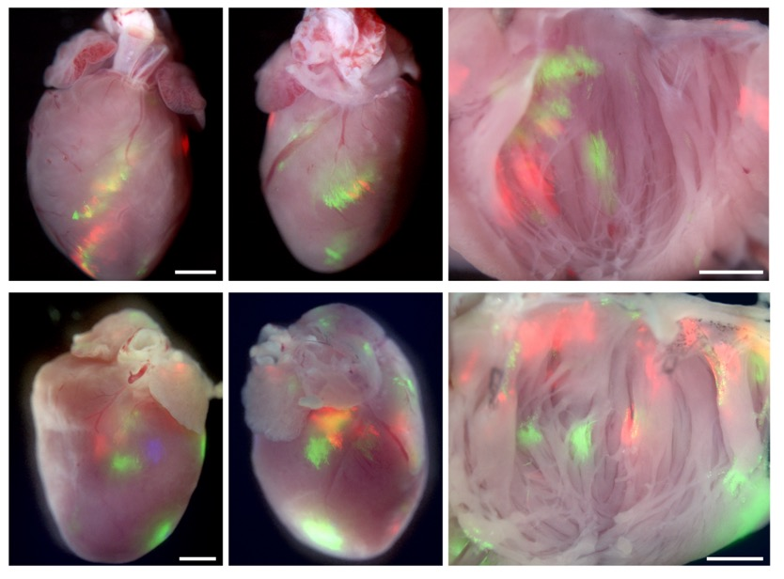
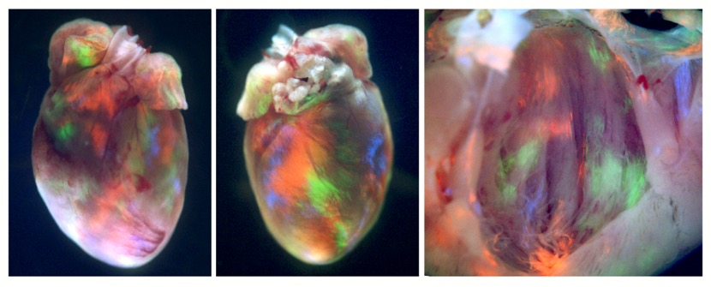
a
Sma-CreERT2 ; R26R-Confetti
ventral
dorsal
RA
Left-ventricle
RA
LA
LA
RV
IVS
pm
pm
4’OH E7.75
IVS
LV
RA
RA
Left-ventricle
LA
RV
RV
LA
pm
4’OH E8.75
pm
IVS
LV
LV
IVS
b
Mesp1-Cre ; R26R-Confetti
ventral
dorsal
Left-ventricle
RA
LA
RV
pm
pm
LV
P21
Supplementary Figure 5: Whole-mount fluorescence views of P21 hearts with multicolor clusters from R26R-Confetti reporter line. a, Whole-mount views of Sma-CreERT2::R26R-Confetti hearts injected at E7.75 or E8.75. The E7.75 Sma+ derived clones are mostly distributed within the IVS and some in the left ventricle. The E8.75 Sma+ derived clones are distributed within the IVS, the left ventricle, the atria and some within the right ventricle. b, Whole-mount views of Mesp1-Cre::R26R-Confetti hearts. Clones derived form Mesp1 expression (E6.25 to E7.5) participate to the different regions of the heart. Scale bars= 1mm.

Slide 8
Sma-CreERT2::R26R-Confetti
nuclei
4’OHE8.5 → P21
CNTN2 / RFP
Supplementary Figure 6: 3D confocal imaging reconstruction of a conductive clone induced during embryonic stages and observed in P21 left Purkinje fiber network. RFP+ clone from R26R-Confetti::Sma-CreERT2 crossing after 4’OH injection at E8.5 helps to appreciate the cellular morphology of conductive cells that present several cell extensions (arrow heads) within the left ventricular PF network. Whole-mount immunostaining for CNTN2 shows accumulation of CNTN2 within peripheral membrane of the conductive cell body that establish contact with other conductive cells (arrows). CNTN2 is less present within the cell extensions of conductive cells. Scale bar = 50µm

Slide 9
a
Cx40-CreERT2::R26R-YFP
Control
Nkx2-5^{+/-}
Nkx2-5^{flox/+}
Tam E10.5 → P21
YFP / CNTN2
Left ventricle
b
Control
Nkx2-5^{+/-}
Nkx2-5^{flox/+}
Tam E18.5 → P21
YFP / CNTN2
Supplementary Figure 7: Cx40+ lineage tracing reveals that a maximal level of Nkx2-5 is required during embryonic stages for proper Purkinje network development. a-b, Confocal imaging of whole-mount immunostaining of Cx40-CreERT2::R26R-YFP opened-left ventricles at P21, after E10.5 (a) or E18.5 (b) tamoxifen injection. Immunostaining for YFP and CNTN2 on control, Nkx2-5^{+/-} or Nkx2-5^{flox/+} mice show affected participation of Cx40+ derived-cells to the PF network when Nkx2-5 expression is reduced during E10.5 embryonic stage. Scale bars=500µm

