Slide 1






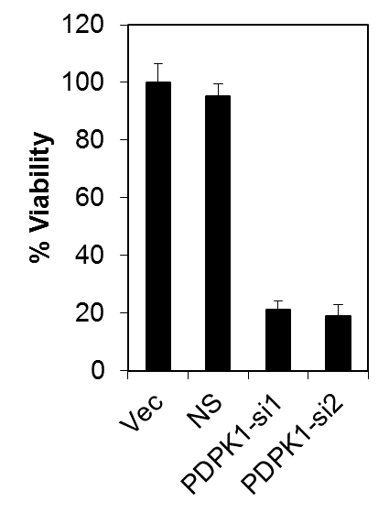
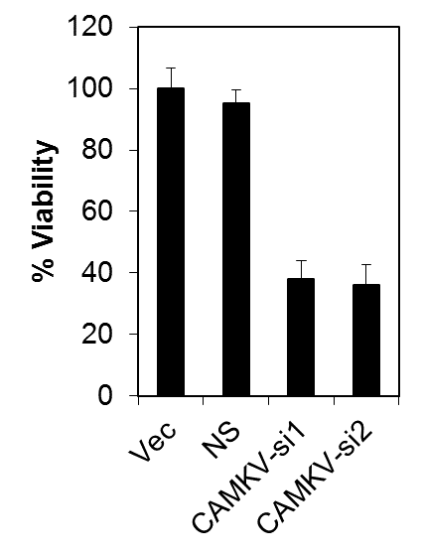
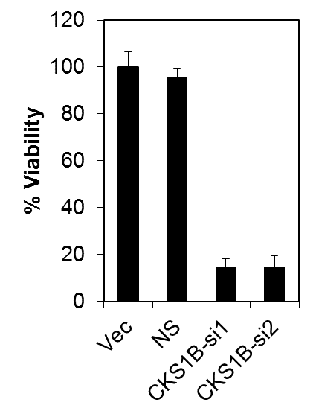
Supplemental Figure 1
A
B
C
CAMKV-si1
CKS1B-si1
PDPK1-si1
CAMKV-si2
CKS1B-si2
Vector
PDPK1-si2
Vector
Vector
NS
NS
NS
PDPK1
CAMKV
CKS1B
β-actin
β-actin
β-actin
*
*
*
*
*
*

Slide 2
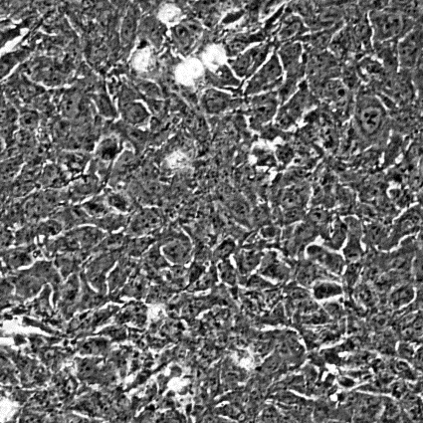
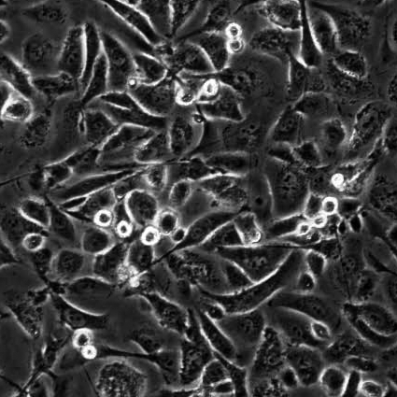
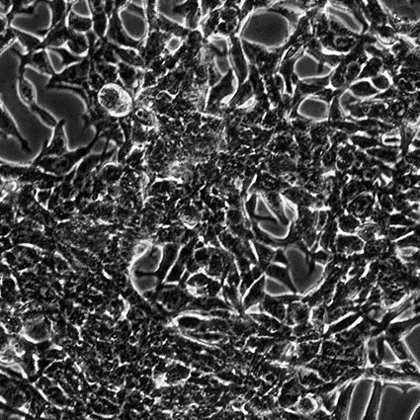
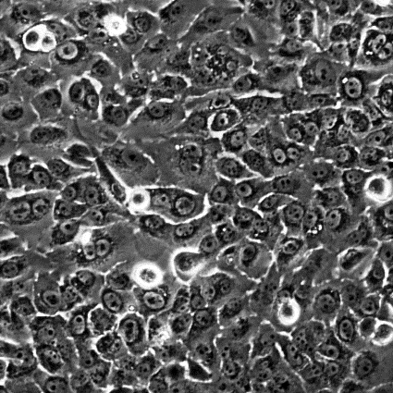
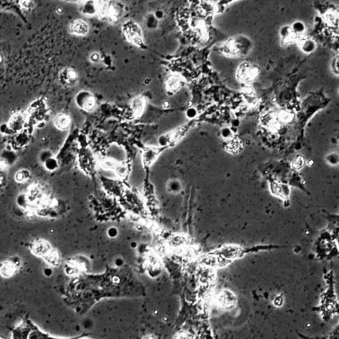
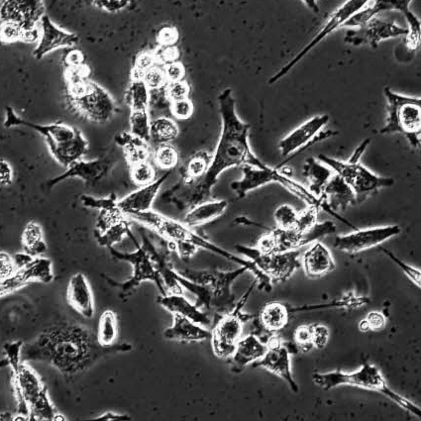
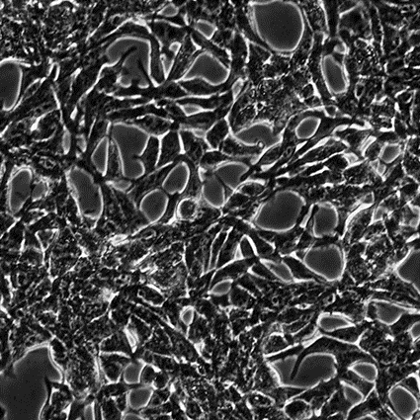
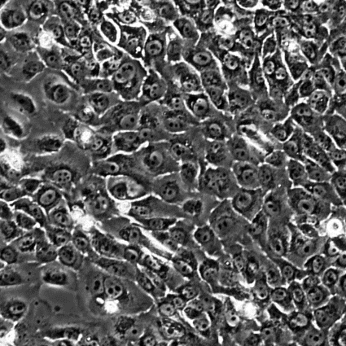
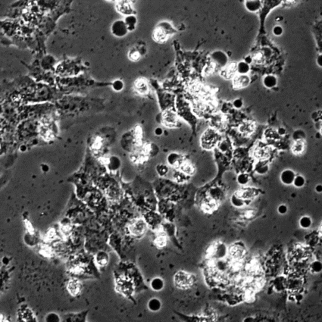
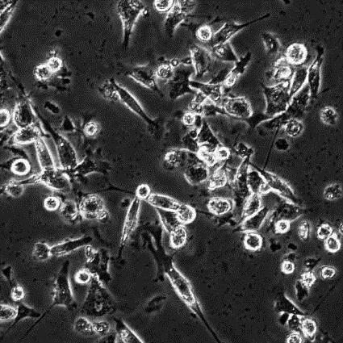
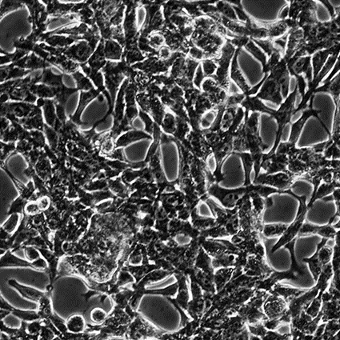
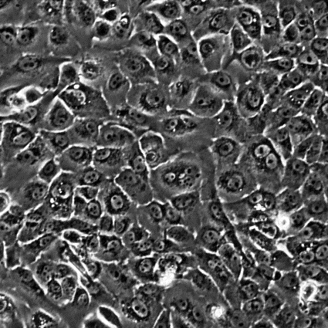
Supplemental Figure 2
DU145
PC3
LNCaP
RWPE1
NS
PDPK1-si1
PDPK1-si2

Slide 3
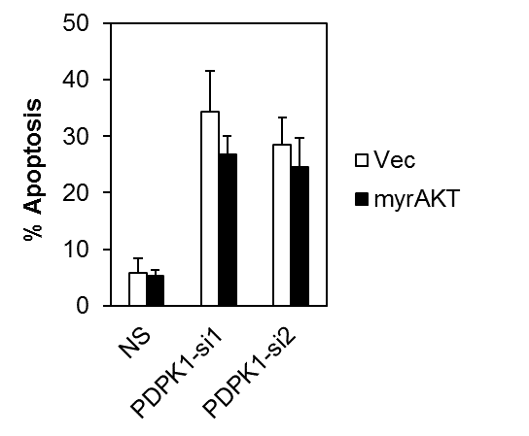
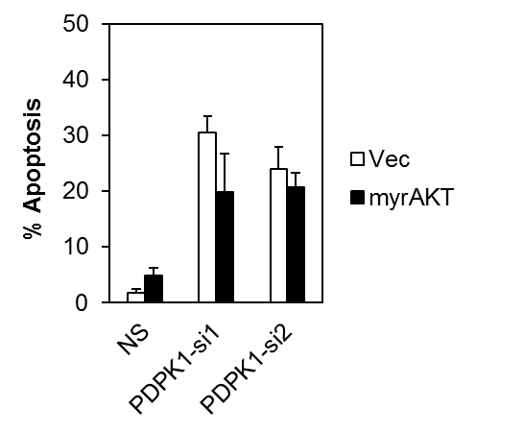
Supplemental Figure 3
A
DU145
PC3
Vec
myrAKT
Vec
myrAKT
PDPK1-si2
PDPK1-si1
PDPK1-si2
PDPK1-si1
PDPK1-si2
PDPK1-si1
PDPK1-si2
PDPK1-si1
NS
NS
NS
NS
PDPK1
p-AKT (S473)
p-AKT (S308)
AKT
β-actin
B

