Slide 1
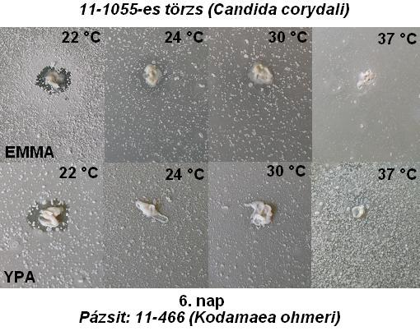
Inhibitory zone
(A) Test-strain
( B) Test-strain
Normal growth of the lawn
(C) species
Normal growth of the lawn
(C) species
a
b

