Slide 1
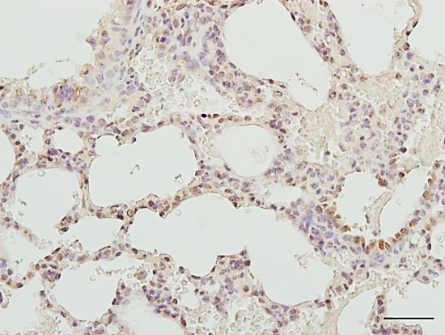
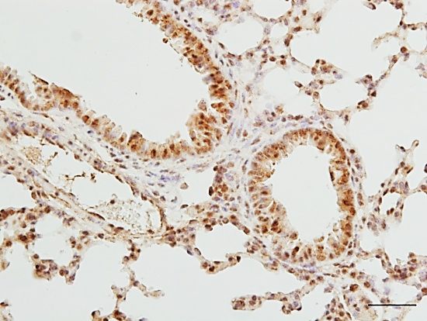
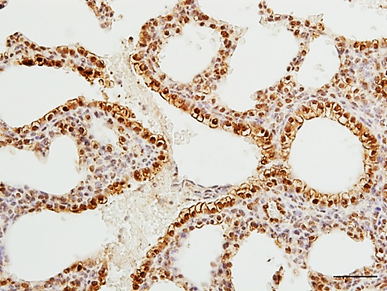
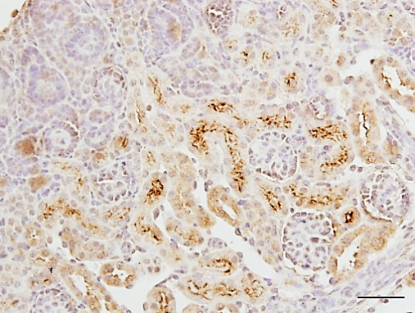
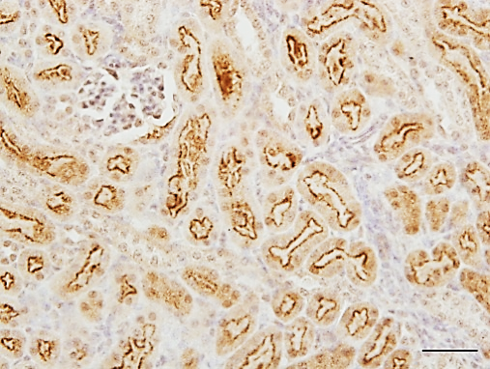
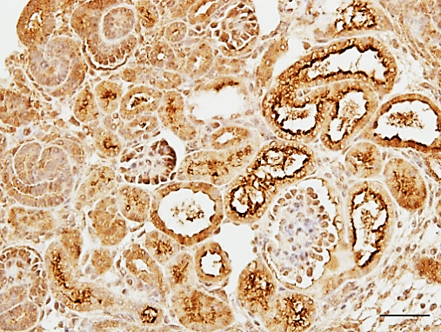
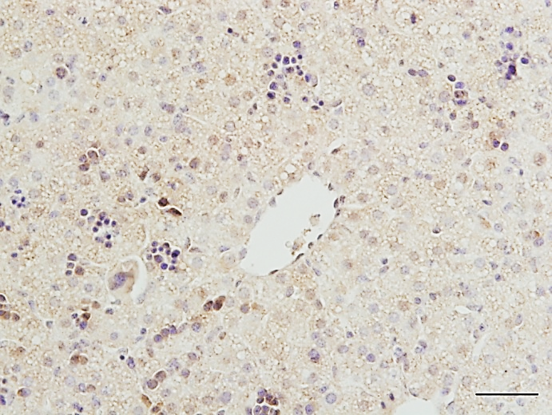
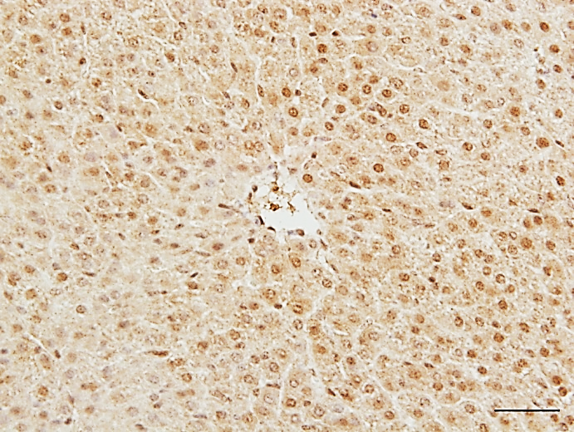
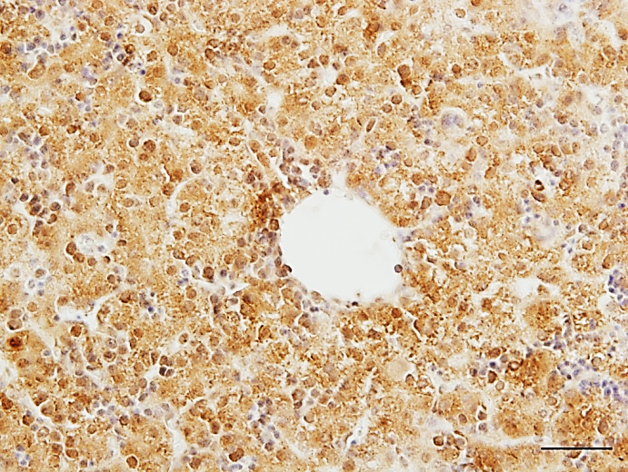
Nrf2^{-/-}
Wild-type
Keap1^{-/-}
Lung
Kidney
Liver
Figure S1. NRF2 regulates ACSS2 expression in multiple tissues. ACSS2 IHC of lung, kidney and liver tissues from Nrf2^{-/-}, wild-type, and Keap1^{-/-} mice showed overexpression of ACSS2 when NRF2 was hyperactive (Keap1^{-/-}) and downregulation of ACSS2 when NRF2 was deficient (Nrf2^{-/-}). Scale bar = 50 µm.
Notes:
Figure S1. NRF2 regulates ACSS2 expression in multiple tissues. ACSS2 immunohistochemistry of lung, kidney and liver tissues from Nrf2^{-/-}, wild-type, and Keap1^{-/-} mice showed overexpression of ACSS2 when NRF2 was hyperactive (Keap1^{-/-}) and downregulation of ACSS2 when NRF2 was deficient (Nrf2^{-/-}). Scale bar = 50 µm.

Slide 2
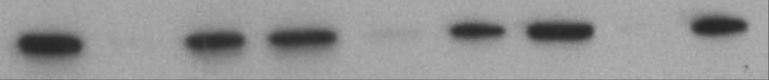
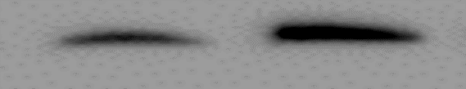
A
B
KYSE70
Control
siRNA
ACSS2
siRNA
NRF2
siRNA
ACSS2 (75 kDa)
GAPDH (37 kDa)
C
KYSE410
D
Control
siRNA
KEAP1
siRNA
NRF2 (100 kDa)
ACSS2 (75 kDa)
GAPDH (37 kDa)
E
F
G
Figure S2. Effect of siRNA transfection on NRF2 and ACSS2 expression in KYSE70 and KYSE410 cells. (A, B) Western blot of ACSS2 protein expression in KYSE70 cells shows that ACSS2 was significantly knocked down via ACSS2 siRNA transfection. There was a significant decrease in ACSS2 expression when NRF2 was knocked down. (C) NRF2 hyperactivation by KEAP1 siRNA knockdown reduced acetate concentration. (D) NRF2 hyperactivation also significantly increased acetyl-CoA. (E) Ethanol exposure significantly increased acetyl-CoA in NRF2high KYSE410 cells. (F, G) NRF2 hyperactivation significantly reduced acetate. (G) NRF2 activation significantly increased acetyl-CoA. *P <0.05, **P <0.01, ***P <0.001
Notes:
Figure S2. Effect of siRNA transfection on NRF2 and ACSS2 expression in KYSE70 and KYSE410 cells. (A, B) Western blot of ACSS2 protein expression in KYSE70 cells shows that ACSS2 was significantly knocked down via ACSS2 siRNA transfection. Moreover, there was a significant decrease in ACSS2 expression when NRF2 was knocked down. (C) NRF2 hyperactivation by KEAP1 siRNA knockdown reduced acetate concentration. (D) NRF2 hyperactivation also significantly increased acetyl-CoA. (E) Ethanol exposure significantly increased acetyl-CoA in NRF2^{high} KYSE410 cells. *p<0.05, **p<0.01, ***p<0.001

Slide 3
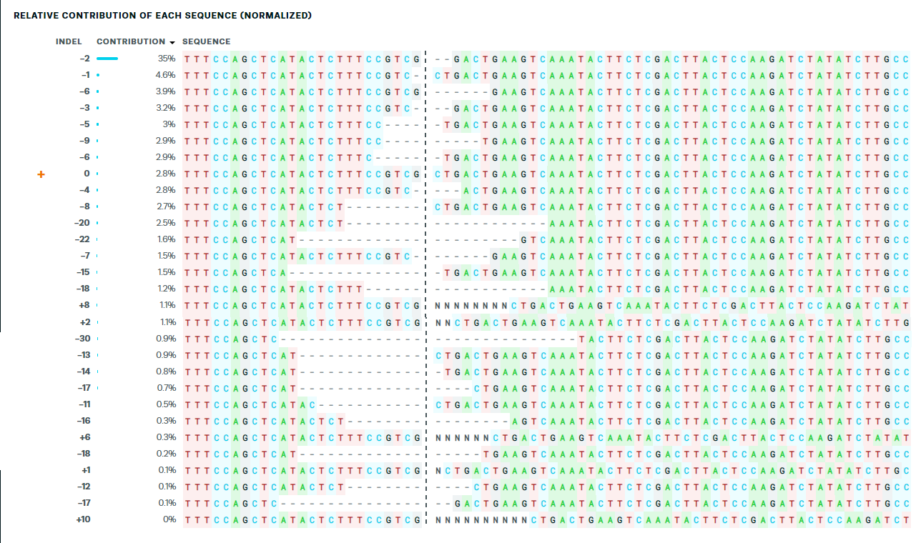
Figure S3. A mixed population of KYSE70 CRISPR Cas9 NRF2 mutants. The contributions show the inferred sequences present in CRISPR Cas9 edited population and their relative proportions. Cut sites are represented by black vertical dotted lines, and the wild-type sequence is marked by a “+” symbol on the left. A mutant missing two bases at the target site (indicated by “-2”) had the highest contribution (35%).
Notes:
Figure S3. Mixed population of KYSE70 CRISPR Cas9 NRF2 mutants. The contributions show the inferred sequences present in CRISPR Cas9 edited population and their relative proportions (in contrast to the Indel plot (Indel Distribution tab) that does not specify sequence contributions). Cut sites are represented by black vertical dotted lines, and the wild-type sequence is marked by a “+” symbol on the far left. Mutant missing two bases has the highest contribution (35%).

Slide 4
A
B
C
KYSE70
Figure S4. NRF2 regulates the metabolic effect of ethanol exposure on KYSE70 cells. (A, B) CRISPR Cas9 NRF2KD downregulates OXPHOS and ECAR in KYSE70 cells exposed to ethanol. (C) NRF2 knockdown led to a less energetic phenotype in KYSE70 cells. *P <0.05, **P <0.01, ***P <0.001, ****P<0.0001
Notes:
Figure S3. NRF2 regulates the metabolic effect of ethanol exposure on KYSE70 cells. (A, B) CRISPR Cas9 NRF2KD downregulates OXPHOS and ECAR in KYSE70 cells exposed to ethanol. (C) NRF2 knockdown led to a less energetic phenotype in KYSE70 cells.*p<0.05, **p<0.01, ***p<0.001, ****p<0.0001

