Slide 1
Supplementary Information
Functional Interaction between Ghrelin and GLP-1 Regulates Feeding through Vagal Afferent System
Weidong Zhang¹, T M Zaved Waise^{1,2}, Koji Toshinai^{1, 3}, Wakaba Tsuchimochi¹, Farhana Naznin^{1, 4}, Md Nurul Islam¹, Ryota Tanida^{1, 5}, Hideyuki Sakoda¹, Masamitsu Nakazato^{1, 6, *}
¹Division of Neurology, Respirology, Endocrinology, and Metabolism,
Department of Internal Medicine, Faculty of Medicine, University of Miyazaki,
5200 Kihara, Kiyotake, Miyazaki 889-1692, Japan
²Toronto General Hospital Research Institute, UHN, Toronto, ON, M5G 1L7, Canada.
³Department of Sports and Fitness, Faculty of Wellness, Shigakkan University,
55 Nakoyama, Yokone, Obu 474-8651, Japan
⁴Department of Pharmacology and Therapeutics, University of Manitoba, Winnipeg, Manitoba, R3E 0J9, Canada
⁵Department of Endocrinology and Metabolism, Kanazawa University Graduate School of Medical Sciences,
13-1 Takara-machi, Kanazawa, Ishikawa 920-8640, Japan
⁶AMED-CREST, Japan Agency for Medical Research and Development,
1-7-1 Otemachi, Chiyoda-ku, Tokyo 100-0004, Japan
Weidong Zhang and T M Zaved Waise contributed equally.
*Correspondence address:
Masamitsu Nakazato, M.D., Ph.D.
Division of Neurology, Respirology, Endocrinology, and Metabolism,
Department of Internal Medicine, Faculty of Medicine, University of Miyazaki,
5200 Kihara, Kiyotake, Miyazaki 889-1692, Japan
TEL: +81-985-85-2965, FAX: +81-985-85-1869
E-mail: nakazato@med.miyazaki-u.ac.jp

Slide 2


Supplementary Figure S1
food
food
food
deprivation
food intake
measurement
food
deprivation
food intake
measurement
0
1
2 h
‒12
0
1
2 h
3 nmol GLP-1
or saline
1.5 nmol ghrelin
or saline
1.5 nmol ghrelin
or saline
3 nmol GLP-1
or saline
1.5
***
1.0
1-h food intake (g)
n.s.
0.5
***
n.s.
0
saline saline
saline saline
saline GLP-1
saline ghrelin
ghrelin GLP-1
GLP-1 ghrelin
12-h fasted
ad libitum
Supplementary Figure S1. Ghrelin failed to cancel GLP-1’s anorectic effect in a 60 min interval of administration, and vice versa. In 12-h fasted mice, ghrelin administration 60 min before GLP-1 failed to abolish GLP-1’s anorectic effect (n = 8). In mice fed ad libitum, GLP-1 administration 60 min before ghrelin failed to abolish ghrelin’s orexigenic effect (n = 8). ***P < 0.001 , n.s. not significant.

Slide 3
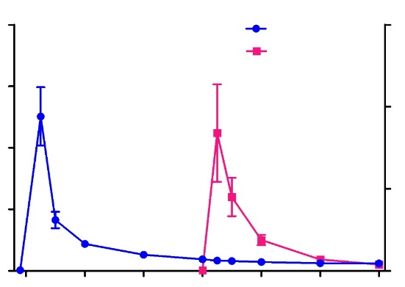
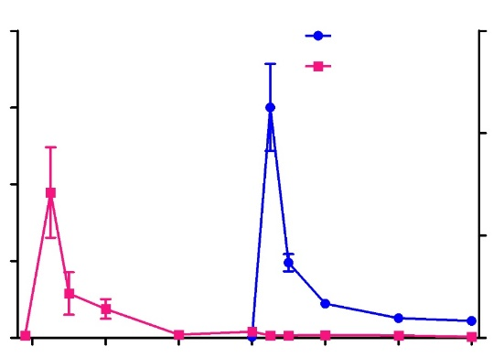
Supplementary Figure S2
A
B
800
GLP-1
6000
800
GLP-1
6000
600
ghrelin
600
ghrelin
4000
4000
GLP-1 (pmol/L)
400
ghrelin (pmol/L)
ghrelin (pmol/L)
GLP-1 (pmol/L)
400
200
2000
200
2000
0
0
10
20
30
40
50
0
0
0
0
60
10
20
30
40
50
60
GLP-1
ghrelin
ghrelin
GLP-1
Time (min)
Time (min)
Supplementary Figure S2. Plasma profiles of i.v. administered GLP-1 and ghrelin. (A) Time courses of plasma GLP-1 and ghrelin when GLP-1 (3 nmol) was administered at 0 min and ghrelin (1.5 nmol) was administered at 30 min to the same rats (n = 3). (B) Time courses of plasma ghrelin and GLP-1 when ghrelin (1.5 nmol) was administered at 0 min and GLP-1 (3 nmol) at 30 min to the same rats (n = 3). Values are means ± SEM.

Slide 4
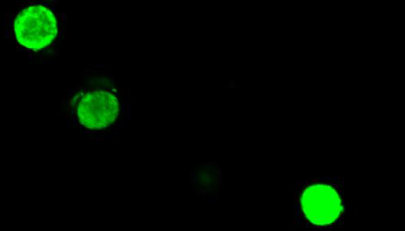
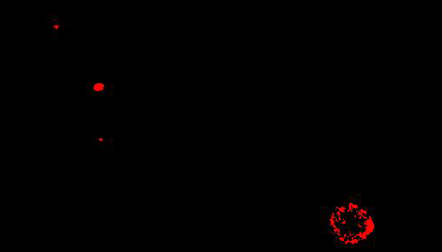
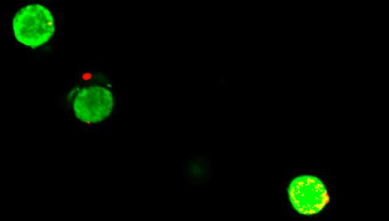
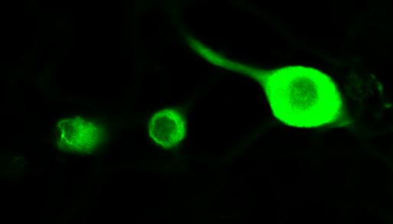
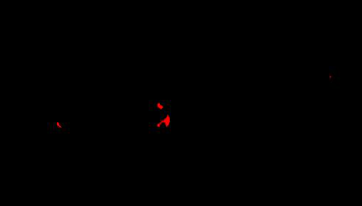
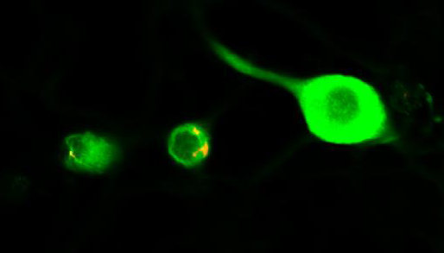
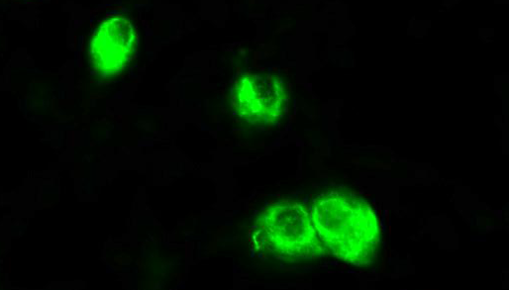

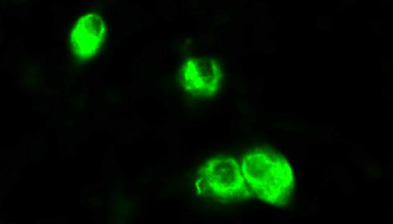
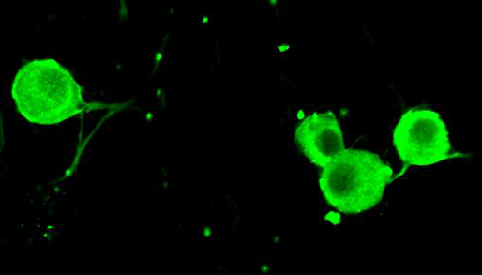

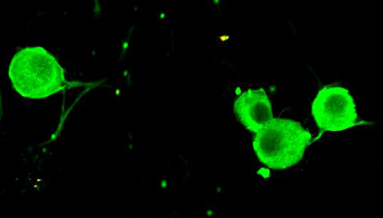
Supplementary Figure S3
A
B
Neuron
GHSR
Merged
Neuron
GLP-1R
Merged
wild-type
wild-type
Ghsr‒/‒
Glp1r‒/‒
Supplementary Figure S3. Specificity determination of anti-GHSR and anti-GLP-1R antibodies used in immunostaining of dispersed NG neurons. (A) GHSR immunostaining of NG neurons of wild-type and Ghsr‒/‒ mice. (B) GLP-1R immunostaining of NG neurons of wild-type and Glp1r‒/‒ mice. Arrows, GHSR or GLP-1R positive neurons; Scale bars, 25 μm.

Slide 5
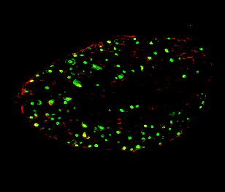
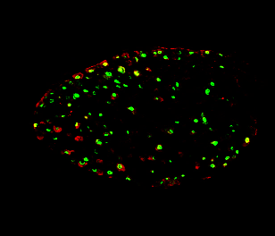
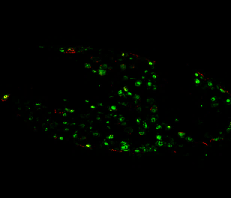
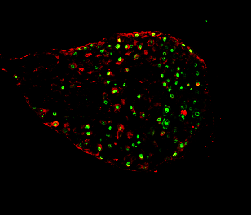
Supplementary Figure S4
A
B
saline saline
saline GLP-1
ghrelin GLP-1
100
80
***
n.s.
***
n.s.
60
LNG
40
Fos–positive neurons (%)
20
0
saline
GLP-1
saline
GLP-1
RNG
ghrelin GLP-1
ghrelin GLP-1
LNG
RNG
Supplementary Figure S4. Representative fluorescence images of GLP-1–induced Fos expression (yellow) in the NG neurons (green) in responses to GLP-1 (middle) and GLP-1 60 min after ghrelin (left). (A) Fos immunostaining of mouse LNG and RNG. (B) Average percentage of Fos-positive neurons; Scale bar, 100 μm.

Slide 6
Supplementary Figure S5
A
KCl
100 mM
B
Glp1r ⁺Ghsr ‒
Glp1r ⁺Ghsr ‒
180
ghrelin
10 nM
300
n.s.
160
GLP-1
10 nM
***
140
200
Fura-2 ratio (340/380)
(% of baseline)
vehicle
AUC of Fura-2 ratio
(%, 10 min)
120
100
100
80
0
0
10
20
30
32
control
GLP-1
Time (min)
GLP-1 ghrelin
C
KCl
100 mM
D
Glp1r ‒Ghsr ‒
Glp1r ‒Ghsr ‒
180
ghrelin
10 nM
60
160
GLP-1
10 nM
n.s.
n.s.
40
140
AUC of Fura-2 ratio
(%, 10 min)
Fura-2 ratio (340/380)
(% of baseline)
vehicle
120
20
100
80
0
0
10
20
30
32
control
GLP-1
Time (min)
GLP-1 ghrelin
E
KCl
100 mM
F
Glp1r ‒Ghsr ⁺
60
Glp1r ‒ Ghsr ⁺
180
GLP-1
10 nM
n.s.
160
ghrelin
10 nM
n.s.
40
140
AUC of Fura-2 ratio
(%, 10 min)
Fura-2 ratio (340/380)
(% of baseline)
vehicle
120
20
100
80
0
0
10
20
30
32
control
ghrelin
Time (min)
ghrelin GLP-1
Supplementary Figure S5. Representative profiles of calcium response and corresponding AUC of Glp1r- or Ghsr-expressing NG neurons. n = 6－8 neurons per group.

Slide 7
Supplementary Table S1
Primary antibodies used for immunohistochemistry.
Antibodies | Origin | Manufacturer | Dilution
GLP-1R GHSR Pan Neuronal Marker c-Fos Goat anti-Rabbit Alexa Fluor 488 secondary Goat anti-Mouse Alexa Fluor 488 secondary Donkey anti-Goat Alexa Fluor 594 secondary Goat anti-Rabbit Alexa Fluor 594 secondary Alexa Fluor 488-conjugated Anti-NeuN IgG Alexa Fluor 555-conjugated Anti-NeuN IgG | Rabbit Goat Mouse Rabbit Goat Goat Donkey Goat Mouse Mouse | Medical ＆ Biological Laboratories (LMC-1208) Santa Cruz Biotechnology (sc-10359) Millipore (MAB2300) Santa Cruz Biotechnology (sc-52) Invitrogen (A11008) Invitrogen (A11001) Invitrogen (A11058) Invitrogen (A11012) Millipore (MAB377X) Millipore (MAB377A5) | 1:500 1:500 1:1,000 1:500 1:1,000 1:1,000 1:1,000 1:1,000 1:1000 1:1000

Slide 8
Supplementary Table S2
The sequences of the oligonucleotides for qPCR.
Gene (mouse) | Sequence
Glp1r Ghsr Gapdh | Forward 5'-ATGGTGGCTATCCTGTACTGCTTTG-3' Reverse 5'-GCTGCTGGTGGGACACTTGA-3' Forward 5'-AATGCCCTGGTCACCCAGA-3' Reverse 5'-TGAGGACCATAACCTTGACTTTGAG-3' Forward 5'-TCAAGAAGGTGGTGAAGCAG-3' Reverse 5'-TGGGAGTTGCTGTTGAAGTC-3'

