Slide 1
A
B
µM
µM
C
OCI-AML2
OCI-AML2 R50
*
*
*
*
55.88%
38.93%
*
*
32.25%
11.87%
37.82%
23.25%
OCI-AML2 + Ara-C
OCI-AML2 R50 + Ara-C
Vector
69.50%
30.50%
53.19%
26.00%
0.00%
20.81%
OCI-AML2 Vector
OCI-AML2 p21KD
57.76%
44.68%
46.05%
35.13%
7.11%
9.27%
OCI-AML2 Vector + Ara-C
OCI-AML2 p21KD + Ara-C
81.74%
59.17%
18.26%
0.00%
34.45%
6.38%
Figure. S1.Cell drug sensitivities and cell cycle were tested across cell lines.
Two chemoresistant cell lines were generated from sensitive lines. MTS assay was performed in OCI-AML2 (A) and MV4-11(B) cells with their chemoresistant cell lines respectively after 72h Ara-C treatment with indicated concentrations. OCI-AML2 R50 represents chemoresistant cells that generate from OCI-AML2 cells, which can survive in 50 µM Ara-C. MV4-11 R4 represents chemoresistant cells that generate from MV4-11 cells, which can survive in 4 µM Ara-C. (C) Cell cycle was analyzed in OCI-AML2, OCI-AML2 R50, OCI-AML2 vector control and OCI-AML2 p21KD cells with or without 1µM Ara-C treatment for 48h. Results were summarized in the right panel. Bars indicate the standard error of mean. *P < 0.05

Slide 2
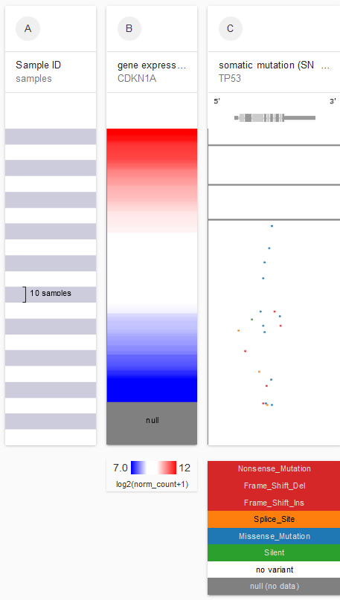
A
Samples
Gene expression CDKN1A
Somatic mutation TP53
S Figure 2
5’
3’
B
TP53
TP53
TP53
TP53
TP53
C
Log-rank (Mantel-Cox) test WT VS MUTATION P value < 0.0001
(n=168)
(n=4)
(n=11)
Figure. S2. Patients with TP53 mutation have lower p21 expression, and these patient tend to have worse outcome.
(A) Patient data from TCGA shows patients have TP53 mutations have lower p21 gene expression. (B) Distribution of TP53 mutation type in AML patient. Results are based on cBioPortal, Acute Myeloid Leukemia (TCGA, PanCancer Atlas). Within clinic defined TP53 wild type patient, deep sequencing data was analyzed to find the subclonal mutation (results were shown in right pie chart). (C) Patients were grouped based on TP53 status (TP53 wild type, TP53 mutation and subclonal TP53 mutation). Patient survivals were shown in these three groups.
Notes:
Please cite Gao et al. Sci. Signal. 2013 & Cerami et al. Cancer Discov. 2012 when publishing results based on cBioPortal.
Acute Myeloid Leukemia (TCGA, PanCancer Atlas)

Slide 3
A
B
*
*
*
C
MV4-11 parental cells
MV4-11 TP53 mut GFP
99.90%
100.00%
TP53
MV4-11 + MV4-11 TP53 mut GFP
Mix+100nM Ara-C
*
% Cells
94.19%
5.81%
67.22%
32.78%
GFP
D
MV4-11
MV4-11 R4
14.59%
46.82%
CD47
CD123
Figure. S3. Cells with TP53 mutation are more resistant to drug treatment and higher leukemia stem cell markers.
(A) Cell growth is tested in C3, m14 single cell clones with TP53 mutation and MV4-11 cells. Bars indicate the standard error of mean. (B) MTS assay was performed to test drug sensitivity in C3, m14 and m21 single cell clones with TP53 mutation and MV4-11 cells with or without 1µM Ara-C treatment for 72h. Bars indicate the standard error of mean. *P < 0.05 compared with MV4-11 cells treated with Ara-C. (C) MV4-11 parental cells and MV4-11 cells with TP53 mutation labeled with GFP were first tested by FACS separately (Top panel). Then cells were mixed and treated with either vehicle or low concentration Ara-C. Cells were tested by FACS analysis on day 35. Results were summarized in the right panel. Bars indicate the standard error of mean. *P < 0.05 (D) Parental and chemoresistant cells were analyzed by FACS for leukemia stem cell markers CD123 and CD47.

Slide 4
A
Figure S4
R square = 0.5052
P value = 0.1134
B
*
*
*
*
*
#
$
$
#
$
#
$
#
MV4-11
MV4-11 R4
MV4-11
MV4-11 R4
MV4-11 TP53 mut
MV4-11 TP53 mut
Figure. S4. Correlation of GADD45A gene expression with Ara-C IC50 in AML cells and p53 targeted genes have lower gene expressions and less responsive to Ara-C treatment
(A) Pearson correlation coefficient of GADD45A gene expressions in different cell lines and Ara-C IC50 (shown in Figure 1C) was calculated with GraphPad Prism 6. (B) Gene expressions were tested by Real-time qPCR for p53 target genes PLK2 and Bax in indicated cells. Bars indicate the standard error of mean. *P < 0.05 between indicated group. #P<0.05 compared with MV4-11 group. $P<0.05 compared with MV4-11 treated with Ara-C group.

Slide 5
*
*
*
*
*
*
*
Figure. S5. Chromatin immunoprecipitation for p53, Ac-H3 and Ac-H4 in OCI-AML2 and OCI-AML2 R50 cells at p21 promoter region.
Bars indicate the standard error of mean. *P<0.05 compared with WT group

Slide 6
A
*
*
*
Romi
Romi
*
*
*
B
*
*
Romi
Romi
C
*
Figure. S6. Romidepsin treatment can restore promoter histone acetylation of p53 target genes, but not p53 recruitment.
(A) Chromatin immunoprecipitation for Ac-H4 and Ac-H3 in chemoresistant cells with or without Romidepsin treatment at p21 promoter region. (B) Chromatin immunoprecipitation for p53 in chemoresistant cells with or without Romidepsin treatment at p21 promoter region. (C) Chromatin immunoprecipitation for p53 in OCI-AML2 R50 cells with or without Romidepsin treatment at GADD45A promoter region. Bars indicate the standard error of mean. *P < 0.05

Slide 7
Mix + vehicle
Mix + 2nM Romi
7.66%
1.49%
Mix + 0.1µM DAC
10.02%
Figure. S7. Hypomethylating agent decitabine can not target TP53 mut cells as efficient as Romidepsin.
MV4-11 parental cells and MV4-11 cells with TP53 mutation labeled with GFP were mixed and treated with either vehicle, Romidepsin or decitabine (DAC). Cells were tested by FACS analysis on day 4. Cell viability was shown on the right under indicated treatment. Bars indicate the standard error of mean.

