Slide 1





Rubidium-82 Generator Yield and Efficiency for PET Perfusion Imaging: Comparison of Two Clinical Systems
Journal of Nuclear Cardiology | Official Journal of the American Society of Nuclear Cardiology
  Ali Ahmadi, MD, PhD, Ran Klein, PhD,
  Howard C Lewin, MD, Rob S.B. Beanlands, MD, and
  Robert A. deKemp, PhD
Head shot of author
required
Copyright American Society of Nuclear Cardiology

Slide 2
BACKGROUND
Journal of Nuclear Cardiology | Official Journal of the American Society of Nuclear Cardiology
Strontium-82/Rubidium-82 (⁸²Sr/⁸²Rb) generators are used widely for positron emission tomography (PET) imaging of myocardial perfusion.
⁸²Sr/⁸²Rb generators have different shelf-lives influenced by available daily ⁸²Rb isotope yield.
The aims of the current study were to assess the isotope production efficiency (⁸²Rb yield / ⁸²Sr parent activity) of two FDA-approved ⁸²Sr/⁸²Rb generators (RUBY-FILL® and CardioGen-82®) during their clinical shelf-life.
Copyright American Society of Nuclear Cardiology

Slide 3
METHODS
Journal of Nuclear Cardiology | Official Journal of the American Society of Nuclear Cardiology
Sequential daily quality assurance (QA) reports from 9 CardioGen-82® and 9 RUBY-FILL® generators were reviewed over a period of 2 years.
Test elutions were performed at different flow-rates on the RUBY-FILL® system to determine an empirical correction-factor used to convert CardioGen-82® daily QA values of ⁸²Rb yield to RUBY-FILL® equivalent values.
The generator yield (⁸²Rb) and production efficiency (⁸²Rb yield / ⁸²Sr parent activity) were compared.
Copyright American Society of Nuclear Cardiology

Slide 4
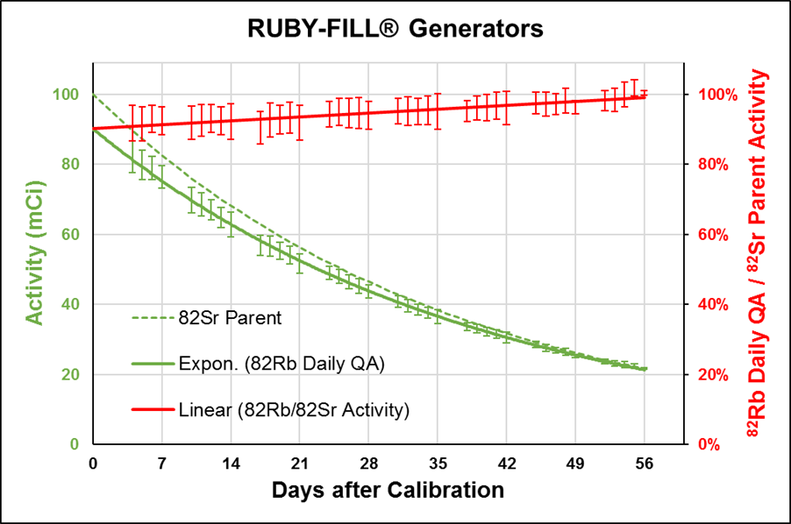
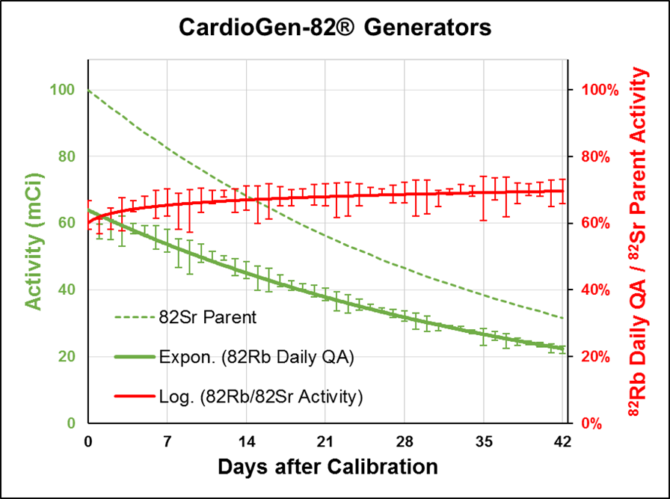
RESULTS
Journal of Nuclear Cardiology | Official Journal of the American Society of Nuclear Cardiology
A
B
⁸²Rb daily QA activity (solid green lines) measured on RUBY-FILL® (A) and
CardioGen-82® (B) generator systems. Activity is shown in mCi (GBq÷37) on the left
axis, and as a percent (right axis) of the ⁸²Sr parent activity (dashed greed lines)
available on each day of use.
Copyright American Society of Nuclear Cardiology

Slide 5
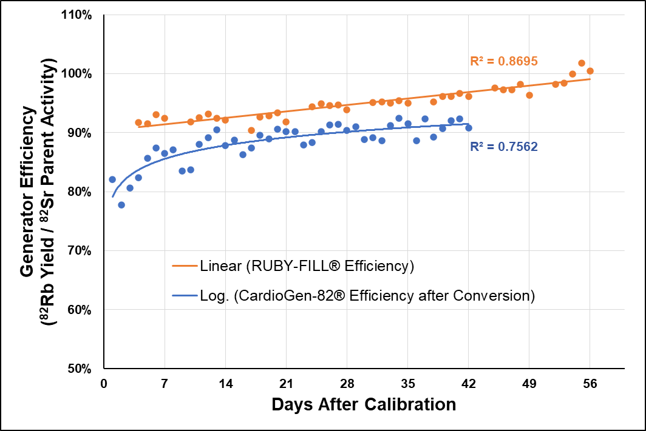
RESULTS
Journal of Nuclear Cardiology | Official Journal of the American Society of Nuclear Cardiology
⁸²Rb isotope production efficiency of the RUBY-FILL® and CardioGen-82® systems
over the clinical shelf-life of N=9 generators each. ⁸²Rb yield values were measured
for RUBY-FILL® (and estimated for CardioGen-82®) using 35 mL elution at 20 mL/min.
Copyright American Society of Nuclear Cardiology

Slide 6
CONCLUSIONS
Journal of Nuclear Cardiology | Official Journal of the American Society of Nuclear Cardiology
⁸²Rb generator yield was significantly under-estimated using the CardioGen-82® vs RUBY-FILL® daily QA procedure.
When generator yield was expressed as the integrated total activity for both systems, the estimated ⁸²Rb production efficiency of the CardioGen-82® system was ~7% lower than RUBY-FILL® over the full period of clinical use.
Copyright American Society of Nuclear Cardiology

