Slide 1
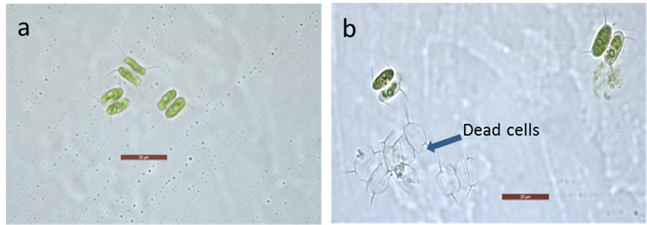
Supplementary Figures
Targeted metabolomic and biochemical changes during nitrogen stress mediated lipid accumulation in Scenedesmus quadricauda CASA CC202
Sujitha Balakrishnan Sulochana^{1,2} and Muthu Arumugam^{1,2*}
¹Microbial Processes and Technology Division, CSIR-National Institute for Interdisciplinary Science and Technology, Industrial Estate P.O., Trivandrum 695019, India
² Academy of Scientific and Innovative Research (AcSIR), Ghaziabad, India
*Corresponding Author: Senior Scientist, CSIR-NIIST, Tel: +91-471-2515 424; Fax: +91-471-2491 712, Email ID: arumugam@niist.res.in; aasaimugam@gmail.com
Fig S1: Microscopic images of a; control (N⁺) and b; nitrogen starved (N⁻) S. quadricauda.

