Slide 1
Why the Best Mitotic Inhibitors Make the Worst Cancer Drugs and How to Remedy This: The Pro-drug Concept Applied to Mitotic Kinase Inhibitors
Victoria C. Yan, Hannah E. Butterfield, Anton H. Poral, Matthew J. Yan, Kristine L. Yang, Cong-Dat Pham, and Florian L. Muller
Supplementary Table S1: The Cell Cycle Gene Expression Module Annotated with CRISPR Essentiality Scores from DepMap.
Supplementary Table S2: The Cell Cycle Gene Expression Module Annotated with RNAi Essentiality Scores from DepMap.
Supplementary Figure S3. Key mitotic kinases are more frequently expressed in rapidly proliferating normal tissue compared to most tumors.
Supplementary Figure S4. Ki67 expression indicates that the cell cycling rates of many rapidly proliferating normal tissues are higher than most tumors.
Supplementary Figure S5. 5-FU exhibits selectivity for cancer cells due to differential expression of TK1, TYMS, and DYPD in cancer cells versus normal (stem) cells
Supplementary Figure S6. Electronegativity, inductive effects, and resonance stabilization are key components of an ideal pro- drug group.
Supplementary Figure S7. Comparing the mechanisms of hydrolysis and beta-elimination leave groups.
Notes:
NEEDS TO INCLUDE THE TMZ FIGURE FOR SUBMISSION

Slide 2
Supplementary Table S1
CRISPR (AVANA) | G1/S | G2 | G2/M | M/G1
DNA replication initiation | CDC45 - 100.00% ; MCM3 - 98.40% ; ORC1 - 97.51% CDC6 - 99.64% ; MCM4 - 99.64% ; ORC3 - 73.53% ; CDC7 - 100.00% MCM5 - 100.00% ; ORC6 - 99.82% ; MCM2 - 100.00% ; MCM6 - 100.00% GINS1 - 100.00% ; GINS2 - 100.00% |  | MCM7 - 100.00% | MCM10 - 25.58%
Nucleotide metabolism | ADA - 0.00% ; CTPS1 - 78.69% ; PRPS2 |  | DTYMK - 98.93% ; RRM2 - 100.00% ; DHFR - 67.85% ; RRM1 - 100.00%
DNA replication and repair | BARD1 - 79.57% ; FEN1 - 97.69% ; POLE2 - 100.00% ; BLM - 3.20% GMNN - 55.06% ; PRIM2 ; RECQL4 ; DNA2 ; BRCA1 - 81.53% ; ING2 - 1.07% RAD51AP1 - 0.00% ; BRIP1 - 36.59% ; MLH3 - 0.00% ; RAD54B - 0.00% DCLRE1B - 90.05% ; MSH2 - 1.95% ; DCLRE1A - 0.00% ; MSH5 - 0.18% RFC3 - 100.00% ; DDX11 - 98.05% ; MSH6 - 0.18% ; RFC4 - 88.28% PARP2 - 0.00% ; RPA2 - 99.82% ; EXO1 - 4.44% ; PCNA - 100.00% TOPBP1 - 96.45% ; FANCG - 8.53% ; POLD3 - 100.00% ; TREX1 - 0.00% FANCL - 8.88% ; POLE - 100.00% ; UNG - 0.00% ; USP1 - 15.28% |  | FANCA - 12.61% ; RAD51B - 5.86% ; H2AFX - 75.84% RAD54L - 9.06% ; HMGB2 - 0.00% ; RFC2 - 100.00% MRE11 - 68.38% ; TDP1 - 0.18% ; NEIL3 - 0.00% TOP2A - 99.64% ; POLK - 34.10% ; XRCC4 - 10.48% RAD51C - 83.66% | DCLRE1C - 0.00% ; PRIM1 - 100.00% ; RAD1 - 39.96% ; RFC5 - 99.82% RNASEH2A - 41.92%
Chromatin assembly and disassembly | CHAF1A - 99.82% ; NCAPD3 - 95.56% ; CHAF1B - 100.00% HIST2H2AA3 - 47.25% ; EZH2 - 1.42% ; HIST2H4A SUPT16H - 99.11% | ATF7IP - 5.51% BRD4 - 97.69% ; H1F0 - 0.18% DNMT3B - 0.18% HMG20B - 0.00% | H2AFV - 0.18% ; HIST1H4C - 2.31% ; HAT1 - 1.07% HMGB3 HIRIP3 - 0.18% ; NSD2 - 0.36% ; HIST1H1C - 3.55% | SAP30 - 0.36% SUV39H1
Cell cycle regulation - Interphase | CCNE1 - 7.46% ; E2F1 - 16.52% ; NPAT - 95.56% CCNE2 - 0.71% ; E2F8 - 0.89% ; RBBP8 - 98.22% CDC25A - 11.19% ; IGF1R - 19.01% ; RBL1 - 0.00% CLSPN - 79.57% ; LCMT2 - 2.66% ; TFDP1 - 74.96% |  | CCNA2 -100.00% ; CDKN2D - 0.00% ; CKS2 - 2.49% CDK2 - 88.45% ; CHEK2 - 0.00% ; E2F5 - 0.00% CDK4 - 50.09% ; CIZ1 - 7.46% ; MKI67 - 1.78% CDKN2C - 0.00% ; CKS1B - 15.63% | DBF4 - 84.01% ; CDKN1B - 0.36% ; RBBP6 - 98.22% SKP2 - 81.35%
Cell cycle regulation - Mitosis | FBXO5 - 99.47% |  | CCNB2 - 0.00% ; CDC25C - 1.78% ; KIF20B - 21.31% CCNF - 8.88% ; CIT - 43.34% ; MPHOSPH9 - 0.00% CDK1 - 100.00% ; MELK - 0.89% ; PKMYT1 - 94.32% CDC20 - 100.00% ; UBE2C - 51.51% ; CDC25B - 20.60% ; WEE1 - 100.00% | CCNB1 - 91.12%
Microtubules and spindle formation | TTLL7 - 0.00% |  | CDCA8 - 99.82% ; KIF23 - 100.00% ; TPX2 - 99.82% ; KIF11 - 100.00% ; KIFC1 - 5.51% TUBA4A - 18.29% ; KIF14 - 75.31% ; KIF2C - 42.81% ; TUBB - 99.64% ; KIF15 - 12.08% NUSAP1 - 0.53% ; TUBD1 - 43.34% ; KIF22 - 27.53% ; SPAG5 - 27.89% | KIF18A - 95.20% ; KIF4A ; KIF18B - 44.94% ; TUBGCP3 - 99.11%
Spindle regulation |  |  | BUB1 - 91.83% ; NDC80 - 100.00% ; PRC1 - 99.82% ; BUB1B - 99.64% MAD2L1 - 93.96% ; RABGAP1 - 0.00% ; AURKB - 100.00% ; NEK2 - 11.72% AURKA - 99.82% ; DLGAP5 - 7.99% ; PLK1 - 100.00% ; TTK - 98.05% ; PLK4 - 98.93% | ASPM - 33.04%
Chromosome condensation/ segregation | DSCC1 - 25.40% |  | NCAPH - 97.34% ; PTTG1 - 33.21% ; CENPA - 97.69% ; RAD21 - 100.00% CENPE - 81.71% ; SMC4 - 99.64% ; NCAPG - 100.00% | CENPF - 16.16% ; NCAPD2 - 98.93% ; SMC3 - 99.82% ; ESPL1 - 100.00%
Cytoskeleton | KRT7 - 3.37% |  | CKAP2 - 13.32% ; GAS2L1 - 0.00% ; KRT19 - 0.36% | DST - 0.18%
Nuclear membrane | NUP62 - 98.76% |  | LMNB2 - 0.36% ; NUP37 - 15.81% ; LMNB1 - 5.68%
RNA transcription and processing | A1CF - 0.00% ; MYBL1 - 0.71% ; SP1 - 21.14% ; BCLAF1 - 98.40% NR1D1 - 0.36% ; YEATS4 - 98.76% ; EAF2 - 1.24% ; NR2F1 - 0.18% ZNF250 - 0.36% ; EXOSC9 - 81.88% ; SRSF6 - 80.82% ; RBMXL2 - 0.00% SLBP - 45.47% |  | CDK19 - 0.36% ; MAD1L1 - 0.18% ; STAT1 - 0.00% ; CLK4 - 0.00% ; PSIP1 - 0.71% TRIP13 - 29.66% ; LUC7L3 - 100.00% ; TRIM27 - 0.18% ; ETV1 - 0.18% SFPQ - 100.00% ; FOXM1 - 29.13% ; HNRNPUL1 - 0.00% | APOBE - 0.18% ; BPTF - 30.20% ; HOXA9 - 1.24% ; BRD8 - 53.11% ; FOSL2 - 7.46% NFE2L2 - 12.97% ; C3 - 0.00% ; GATA2 - 0.53% ; RBM5 - 18.65% ; DDX39A - 9.41% GLE1 - 92.90% ; SRSF7 - 100.00% ; EMX2 - 0.00% ; GLI3 - 0.00% ; ETV5 - 1.78%
Signal transduction | CTGF - 0.00% ; PRKD1 - 0.00% ; FGFR3 - 1.07% ; RAB23 - 2.13% ; IL7R - 0.00% RANGAP1 - 99.47% ; MET - 2.31% ; RGS7 - 0.00% ; NEDD9 - 1.42% TNFRSF10D - 0.00% | CALM3 - 0.18% ; FYN - 0.00% | MAP3K6 - 0.53% ; PASK - 0.36% ; PBK - 0.00% ; PRKD2 - 0.36% ; RAB27A - 0.00% | KLF11 - 0.00% ; RACGAP1 - 100.00% ; MC4R - 0.00% ; RHOBTB3 - 0.18% PITPNC1 - 0.18% ; SMAD3 - 0.00% ; PTGFR - 0.00% ; TGFBR3 - 0.00%
Metabolism | ABHD10 - 0.00% ; FBXO11 - 12.08% ; MAN1A2 - 2.66% ; ABHD3 - 0.18% GCLC - 3.02% ; MRPS16 - 93.78% ; ABHD5 - 0.00% ; PRMT3 - 0.00% MTHFD1 - 16.34% ; AMACR - 0.00% ; ICMT - 16.16% ; STC2 - 0.00% ASPH - 0.00% ; IMPA2 - 6.39% ; SUCLG2 - 0.00% ; ATP6V1A - 99.82% LRP8 - 4.80% ; TXNRD1 - 63.94% | FBXO3 - 2.66% SLC25A36 - 0.36% | GCLM - 0.53% ; UBE2S - 30.91% ; GOT1 - 0.18% ; USP13 - 0.36% ; RPS6KA5 - 0.00% SLC7A11 - 0.89% ; SEPHS1 - 41.03% | RPL39L - 0.00% ; SLC24A1 - 0.00% ; SLC38A2 - 24.69%
Apoptosis | CASP2 - 0.00% ; FAF1 - 1.07% ; CASP8AP2 |  | ARL6IP1 - 0.00% ; BIRC5 - 100.00% ; CASP6 - 0.00% ; BIRC3 - 0.18% ; GTSE1 - 19.36% | STK17B - 0.36%
Trafficking | DNAJB9 - 0.18% ; NASP - 54.00% ; XPO1 - 100.00% ; AGFG2 - 2.13% PEX13 - 2.66% |  | DNAJC13 - 20.96% ; CSE1L - 100.00%
Notes:
Supplementary Table I: The Cell Cycle Gene Expression Module Annotated with CRISPR Essentiality Scores from DepMap
Ref ** identified a set of genes that are expressed exclusively in cycling cells and mapped them by expression during specific phase and function. We systematically interrogated the genes of this mitotic expression module for which were scored as essential by CRISPR drop-out screening in Dept Map (note that some gene names were updated from Figure ** in ref **). The % of cell lines, out of 567 screened, in which a given gene met the “essential” threshold of dropscore, are indicated. E.g. CDK1/cdc2 met the essentially threshold in 567 out of 567 cell lines tested. The genes meeting the “Common Essential” criteria by both RNAi and CRISPR are shown in Red whilst those meeting the Common Essential criteria only by CRIPSR of Dept Map are shown in Purple.

Slide 3
Supplementary Table S1: The Cell Cycle Gene Expression Module Annotated with CRISPR Essentiality Scores from DepMap. Bar-Joseph et al. [48] identified a set of genes that are expressed exclusively in cycling cells and mapped them by expression during specific phase and function. Systematic interrogation of the genes within this mitotic expression module which were scored as essential by CRISPR drop-out screening in DepMap. Note that some gene names were updated from Supplementary Table S3 in [48]. The percentage of cell lines, out of 567 screened, in which a given gene met the “essential” threshold of drop score, are indicated. For instance, CDK1/cdc2 met the essentially threshold in 567 out of 567 cell lines tested. The genes meeting the “Common Essential” criteria by both RNAi and CRISPR are shown in red while those meeting the “common essential” criteria only by CRIPSR of DepMap are shown in purple.

Slide 4
Supplementary Table S2
RNAi (DMETER2) | G1/S | G2 | G2/M | M/G1
DNA replication initiation | CDC45 - 34.78% ; MCM3 - 1.55% ; ORC1 - 36.45% CDC6 - 1.84% ; MCM4 - 11.39% ; ORC3 - 0.17% ; CDC7 - 26.02% MCM5 - 41.04% ; ORC6 – 0.00% ; MCM2 – 46.55% ; MCM6 – 56.70% GINS1 – 15.72% ; GINS2 – 60.83% |  | MCM7 – 84.06% | MCM10 – 0.00%
Nucleotide metabolism | ADA - 0.00% ; CTPS1 – 0.00% ; PRPS2 – 0.28% |  | DTYMK – 0.87% ; RRM2 – 62.06% ; DHFR – 0.00% ; RRM1 – 95.63%
DNA replication and repair | BARD1 – 0.71% ; FEN1 – 0.14% ; POLE2 – 43.16% ; BLM – 0.14% GMNN – 4.15% ; PRIM2 - 8.16%; RECQL4 – 0.71% ; DNA2 – 5.20% ; BRCA1 – 1.97% ; ING2 - 1.69% ; RAD51AP1 - 0.20% ; BRIP1 – 0.00% ; MLH3 - 0.00% ; RAD54B - 0.14% DCLRE1B - 0.00% ; MSH2 – 0.00% ; DCLRE1A - 0.00% ; MSH5 - 0.42% RFC3 – 11.42% ; DDX11 ; MSH6 - 0.00% ; RFC4 – 83.85% PARP2 - 0.00% ; RPA2 – 90.31% ; EXO1 – 0.00% ; PCNA – 82.28% TOPBP1 – 34.56% ; FANCG – 0.00% ; POLD3 - 0.98% ; TREX1 - 0.00% FANCL – 0.14% ; POLE – 70.60% ; UNG - 0.14% ; USP1 – 0.14% |  | FANCA – 0.50% ; RAD51B – 0.00% ; H2AFX – 0.00% RAD54L – 0.00% ; HMGB2 - 0.00% ; RFC2 – 11.38% MRE11 – 0.56% ; TDP1 - 0.14% ; NEIL3 - 0.14% TOP2A – 49.70% ; POLK – 0.14% ; XRCC4 – 0.14% RAD51C – 0.84% | DCLRE1C – 4.07% ; PRIM1 – 44.65% ; RAD1 – 0.00% ; RFC5 – 51.00% RNASEH2A – 0.37%
Chromatin assembly and disassembly | CHAF1A – 76.51% ; NCAPD3 – 18.08% ; CHAF1B – 57.95% HIST2H2AA3 ; EZH2 – 0.98% ; HIST2H4A SUPT16H – 66.53% | ATF7IP – 1.05% BRD4 – 55.98% ; H1F0 - 0.52% DNMT3B - 0.70% HMG20B - 0.14% | H2AFV – 54.84% ; HIST1H4C – 0.91% ; HAT1 - 0.00% HMGB3 – 0.00% ; HIRIP3 ; NSD2 - 0.14% ; HIST1H1C – 0.00% | SAP30 - 0.00% SUV39H1 – 1.33%
Cell cycle regulation - Interphase | CCNE1 – 2.67% ; E2F1 – 1.13% ; NPAT – 2.66% CCNE2 - 0.28% ; E2F8 - 0.00% ; RBBP8 – 2.10% CDC25A – 0.70% ; IGF1R – 4.63% ; RBL1 - 0.28% CLSPN – 69.55% ; LCMT2 – 0.00% ; TFDP1 – 26.30% |  | CCNA2 -25.18% ; CDKN2D - 0.00% ; CKS2 – 0.00% CDK2 – 12.48% ; CHEK2 - 0.00% ; E2F5 – 2.11% CDK4 – 11.50% ; CIZ1 – 0.29% ; MKI67 CDKN2C - 0.00% ; CKS1B - 2.67% | DBF4 – 6.63% ; CDKN1B - 0.00% ; RBBP6 – 10.24% SKP2 – 12.10%
Cell cycle regulation - Mitosis | FBXO5 – 58.53% |  | CCNB2 - 0.28% ; CDC25C – 0.56% ; KIF20B – 0.50% CCNF – 0.00% ; CIT – 16.10% ; MPHOSPH9 - 0.00% CDK1 – 84.57% ; MELK - 0.00% ; PKMYT1 – 0.00% CDC20 – 3.52% ; UBE2C – 0.00% ; CDC25B – 5.63% ; WEE1 – 32.54% | CCNB1 – 4.80%
Microtubules and spindle formation | TTLL7 - 0.00% |  | CDCA8 – 0.55% ; KIF23 – 44.31% ; TPX2 – 57.81% ; KIF11 – 96.35% ; KIFC1 – 0.28% TUBA4A – 0.00% ; KIF14 – 3.10% ; KIF2C – 0.00% ; TUBB – 75.67% ; KIF15 – 11.90% NUSAP1 - 0.58% ; TUBD1 - 0.14% ; KIF22 – 2.31% ; SPAG5 – 17.20% | KIF18A – 34.78% ; KIF4A – 0.28% ; KIF18B – 0.12% ; TUBGCP3 – 41.91%
Spindle regulation |  |  | BUB1 – 13.90% ; NDC80 – 13.12% ; PRC1 – 81.40% ; BUB1B – 89.20% MAD2L1 – 95.49% ; RABGAP1 ; AURKB – 38.43% ; NEK2 – 0.98% AURKA – 9.82% ; DLGAP5 – 0.18% ; PLK1 – 81.21% ; TTK – 36.43% ; PLK4 – 2.95% | ASPM – 0.29%
Chromosome condensation/ segregation | DSCC1 – 0.87% |  | NCAPH – 6.12% ; PTTG1 – 0.00% ; CENPA – 5.63% ; RAD21 – 34.71% CENPE – 16.17% ; SMC4 - 93.48% ; NCAPG – 9.91% | CENPF – 0.14% ; NCAPD2 – 0.18% ; SMC3 – 63.27% ; ESPL1 – 28.15%
Cytoskeleton | KRT7 – 0.00% |  | CKAP2 – 0.35% ; GAS2L1 - 0.29% ; KRT19 - 0.00% | DST - 0.18%
Nuclear membrane | NUP62 - 0.18% |  | LMNB2 – 3.52% ; NUP37 – 0.17% ; LMNB1 – 0.73%
RNA transcription and processing | A1CF – 1.55% ; MYBL1 - 0.42% ; SP1 – 4.22% ; BCLAF1 – 15.94% NR1D1 - 0.84% ; YEATS4 – 0.00% ; EAF2 – 0.28% ; NR2F1 - 0.42% ZNF250 – 5.30% ; EXOSC9 – 65.08% ; SRSF6 – 1.13% ; RBMXL2 SLBP – 13.99% |  | CDK19 - 0.00% ; MAD1L1 - 0.00% ; STAT1 - 0.14% ; CLK4 - 0.00% ; PSIP1 – 1.13% TRIP13 - 9.70% ; LUC7L3 – 4.94% ; TRIM27 - 0.85% ; ETV1 - 0.28% SFPQ – 94.37% ; FOXM1 – 1.55% ; HNRNPUL1 - 0.00% | APOBE - 0.00% ; BPTF – 12.66% ; HOXA9 – 0.00% ; BRD8 – 0.00% ; FOSL2 – 0.42% NFE2L2 – 2.11% ; C3 - 0.14% ; GATA2 - 0.14% ; RBM5 – 0.00% ; DDX39A – 3.39% GLE1 – 4.94% ; SRSF7 – 54.85% ; EMX2 - 0.14% ; GLI3 - 0.00% ; ETV5 – 0.42%
Signal transduction | CTGF - 0.00% ; PRKD1 - 0.00% ; FGFR3 – 0.56% ; RAB23 – 0.00% ; IL7R - 0.00% RANGAP1 – 22.19% ; MET – 0.42% ; RGS7 - 0.00% ; NEDD9 – 0.00% TNFRSF10D - 0.14% | CALM3 - 0.28% ; FYN – 1.69% | MAP3K6 - 0.85% ; PASK - 0.56% ; PBK - 0.42% ; PRKD2 – 1.55% ; RAB27A – 2.52% | KLF11 - 0.00% ; RACGAP1 – 49.09% ; MC4R - 0.00% ; RHOBTB3 - 0.15% PITPNC1 - 0.42% ; SMAD3 - 0.00% ; PTGFR - 0.70% ; TGFBR3 - 0.00%
Metabolism | ABHD10 - 0.91% ; FBXO11 – 1.55% ; MAN1A2 – 0.00% ; ABHD3 - 0.00% GCLC – 0.56% ; MRPS16 – 0.00% ; ABHD5 – 0.18% ; PRMT3 - 0.00% MTHFD1 - 5.34% ; AMACR - 0.00% ; ICMT – 0.00% ; STC2 – 3.34% ASPH - 0.28% ; IMPA2 – 0.00% ; SUCLG2 – 1.54% ; ATP6V1A – 25.74% LRP8 – 0.42% ; TXNRD1 – 0.00% | FBXO3 – 0.00% SLC25A36 - 1.33% | GCLM - 0.00% ; UBE2S – 2.53% ; GOT1 - 0.00% ; USP13 - 0.00% ; RPS6KA5 - 0.15% SLC7A11 - 0.28% ; SEPHS1 – 0.00% | RPL39L - 0.58% ; SLC24A1 - 0.28% ; SLC38A2 – 0.18%
Apoptosis | CASP2 - 0.00% ; FAF1 – 0.00% ; CASP8AP2 – 36.85% |  | ARL6IP1 - 0.00% ; BIRC5 – 64.61% ; CASP6 – 1.55% ; BIRC3 - 0.14% ; GTSE1 – 1.46% | STK17B - 0.00%
Trafficking | DNAJB9 - 0.00% ; NASP - 0.00% ; XPO1 – 79.43% ; AGFG2 – 0.00% PEX13 - 2.11% |  | DNAJC13 ; CSE1L – 96.71%
Notes:
Supplementary Table II: The Cell Cycle Gene Expression Module Annotated with RNAi Essentiality Scores From DepMap.

Slide 5
Supplementary Table S2: The Cell Cycle Gene Expression Module Annotated with RNAi Essentiality Scores From DepMap.

Slide 6
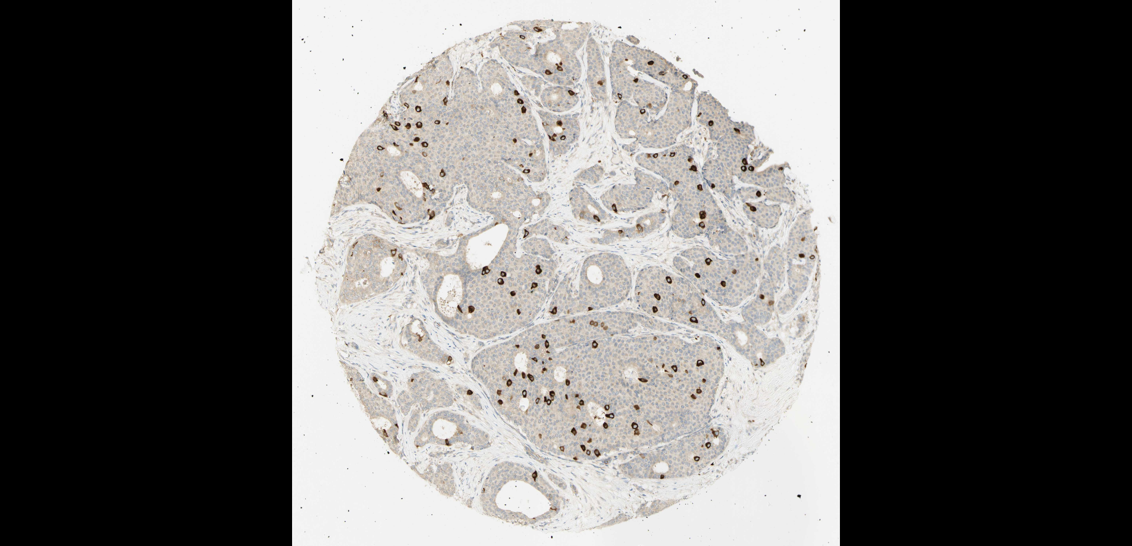
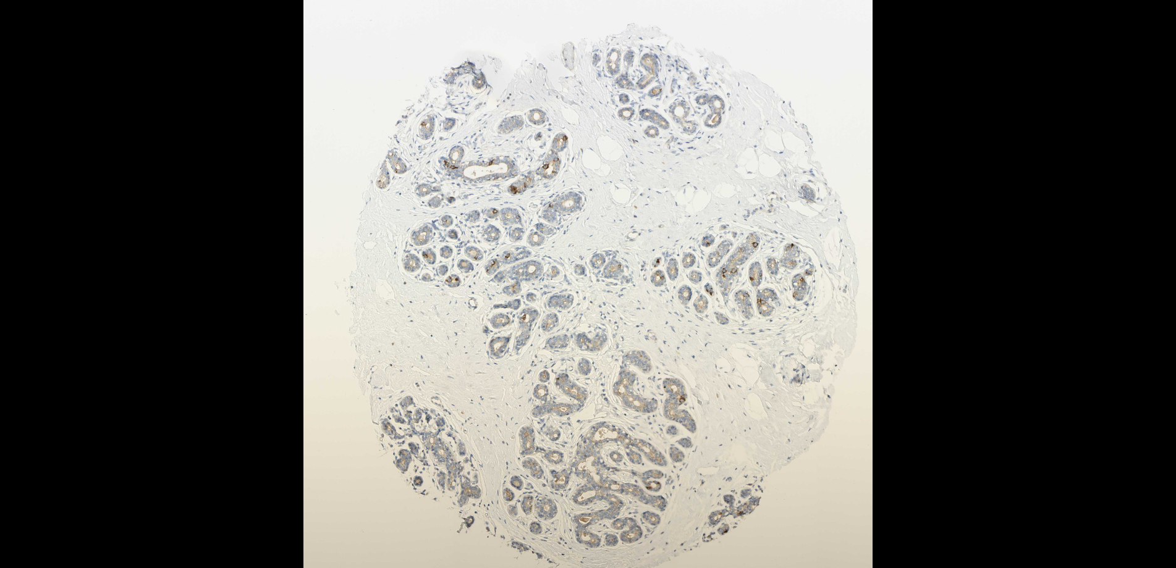
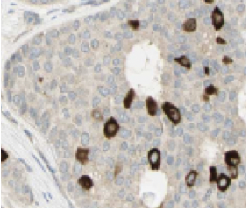
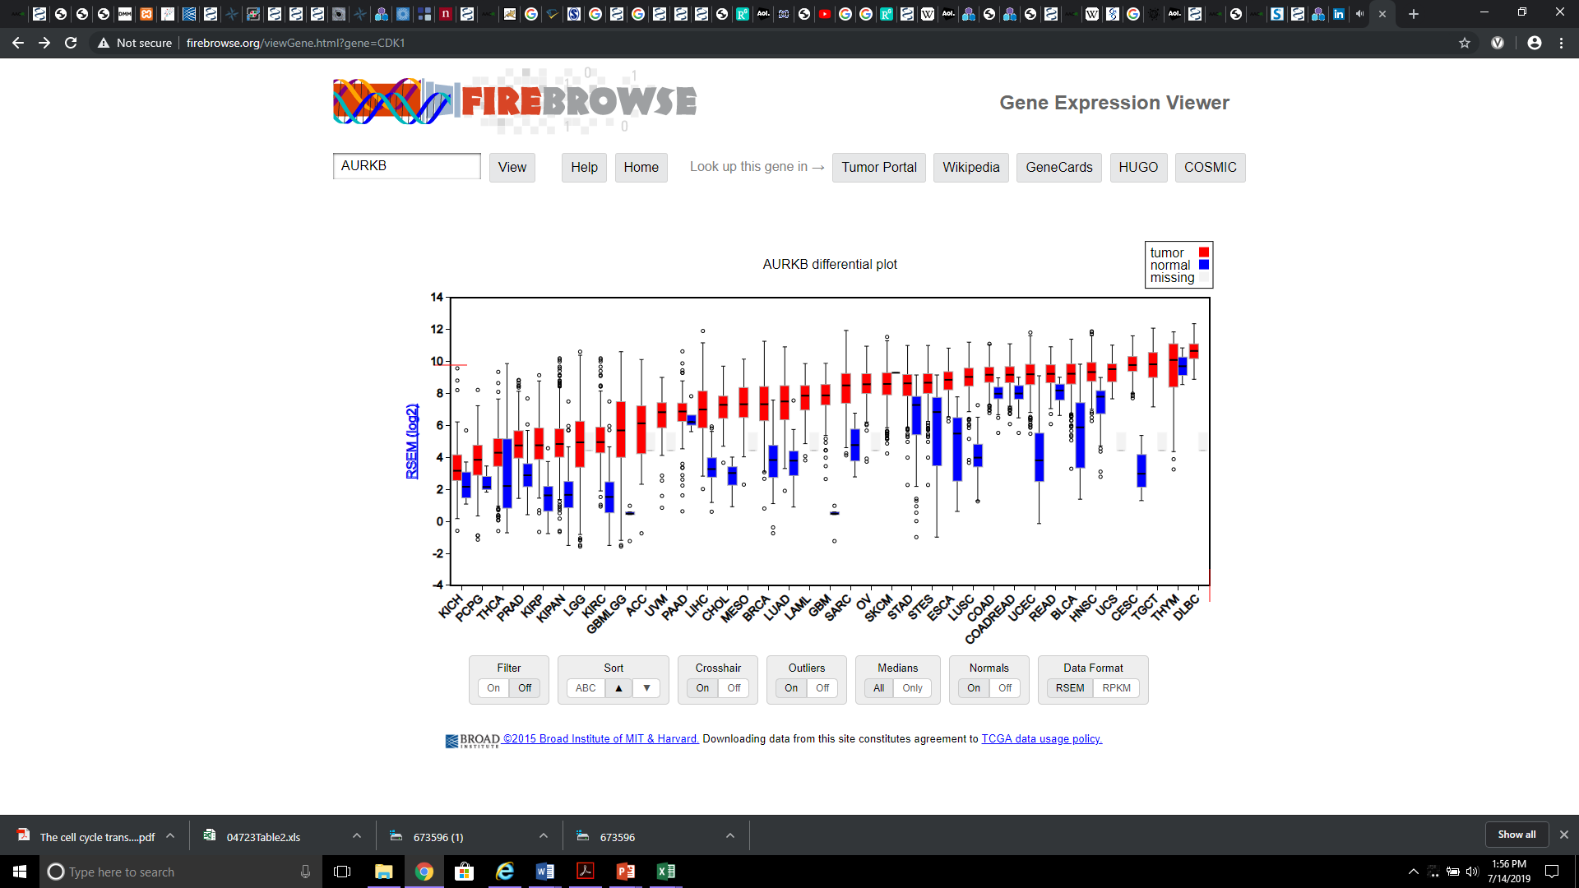
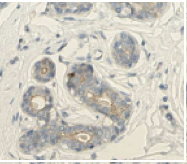
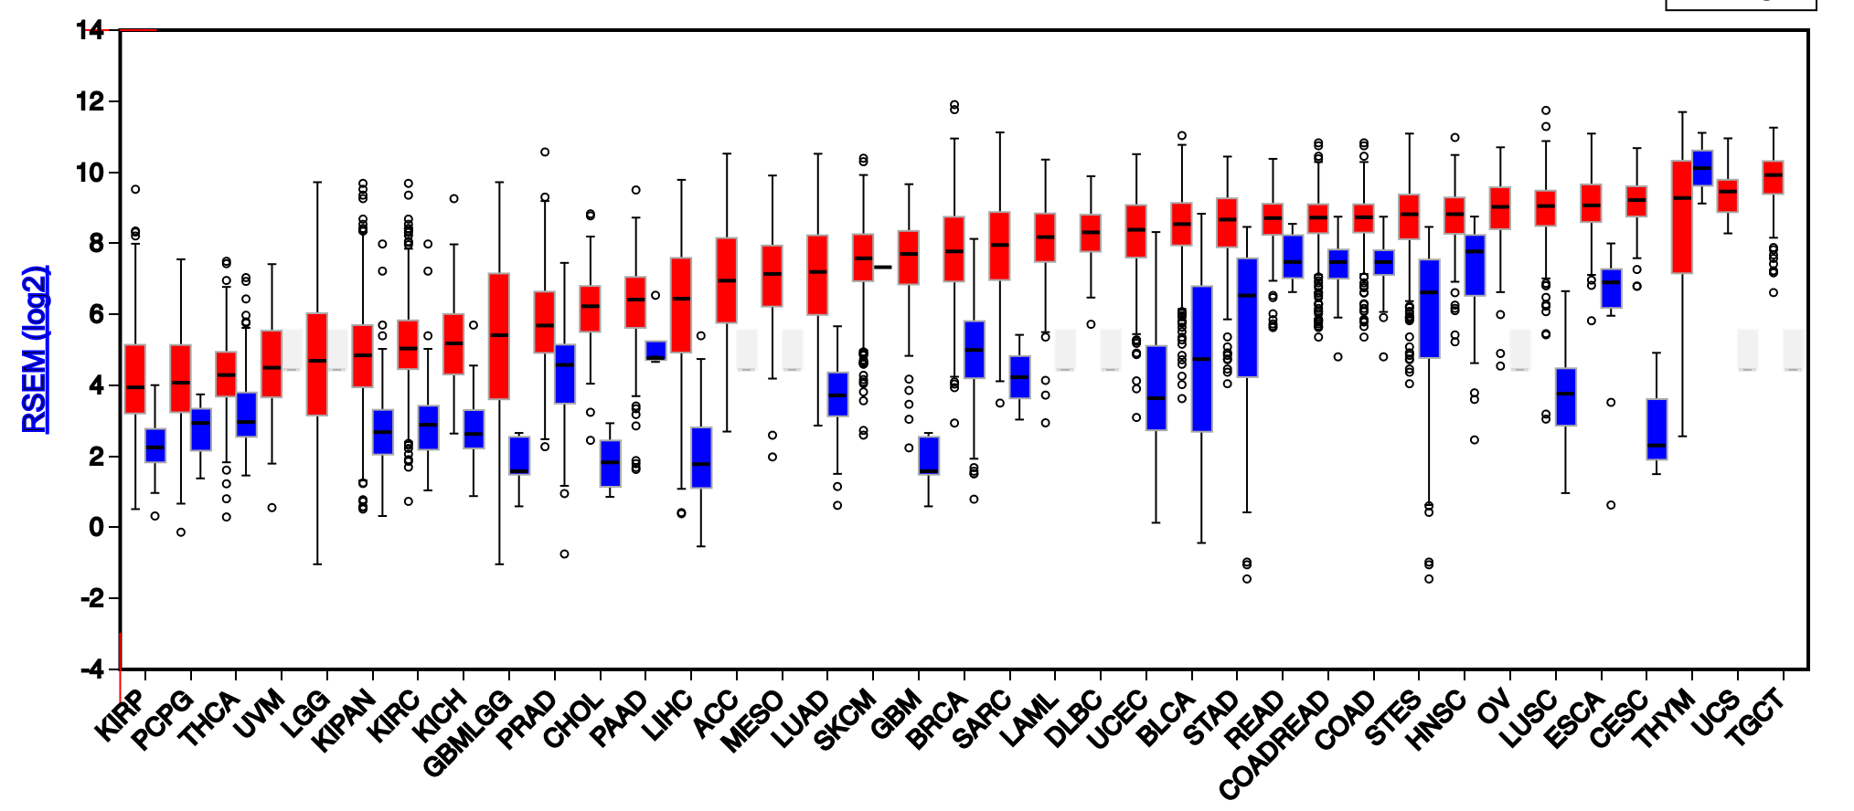
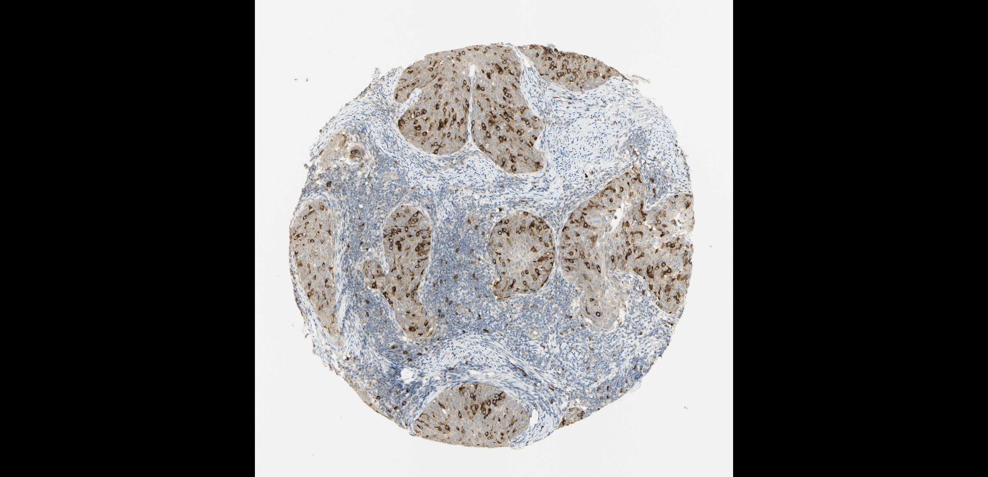
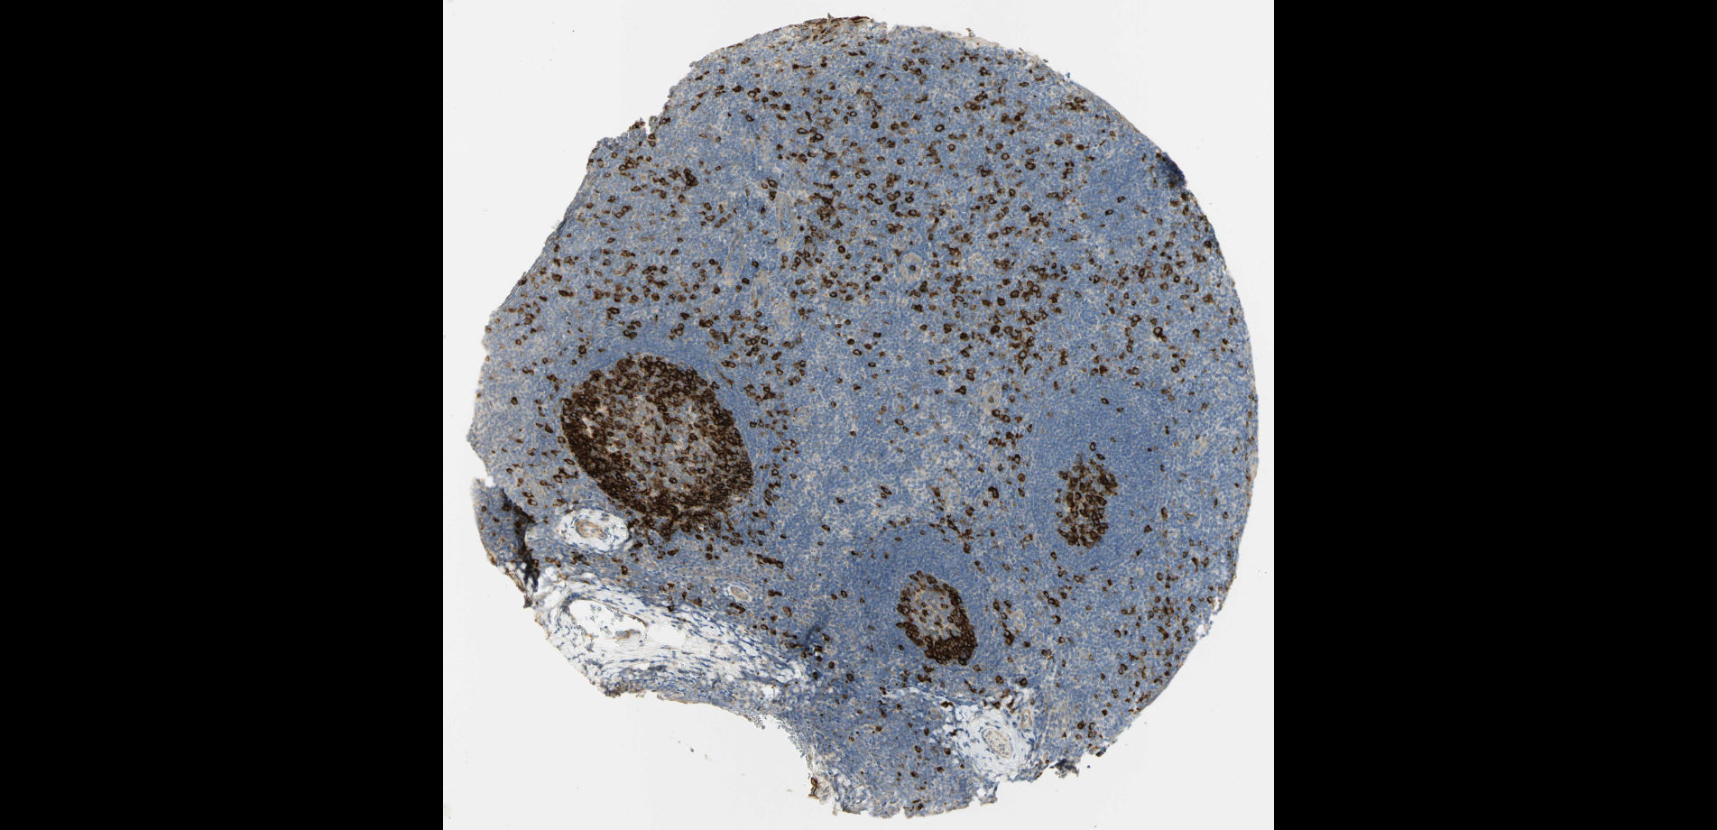
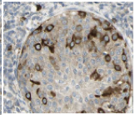
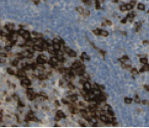

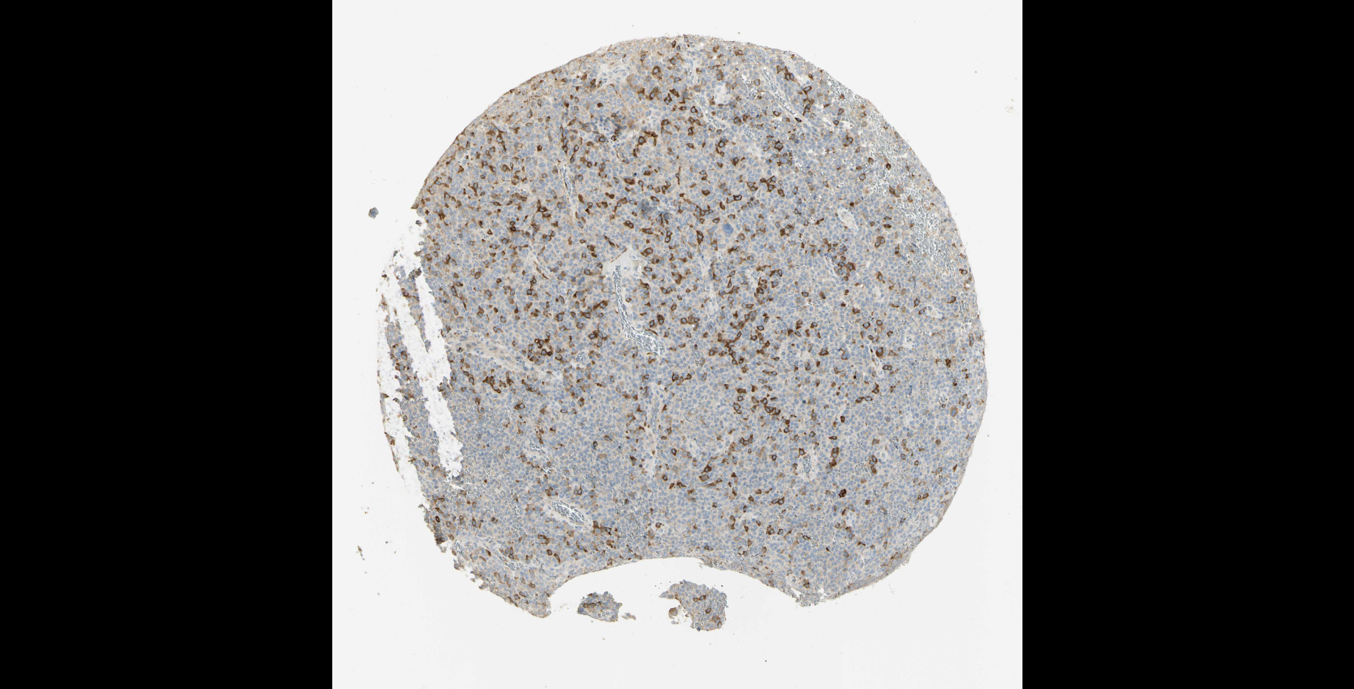
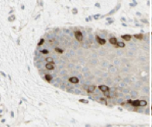
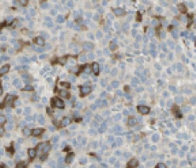
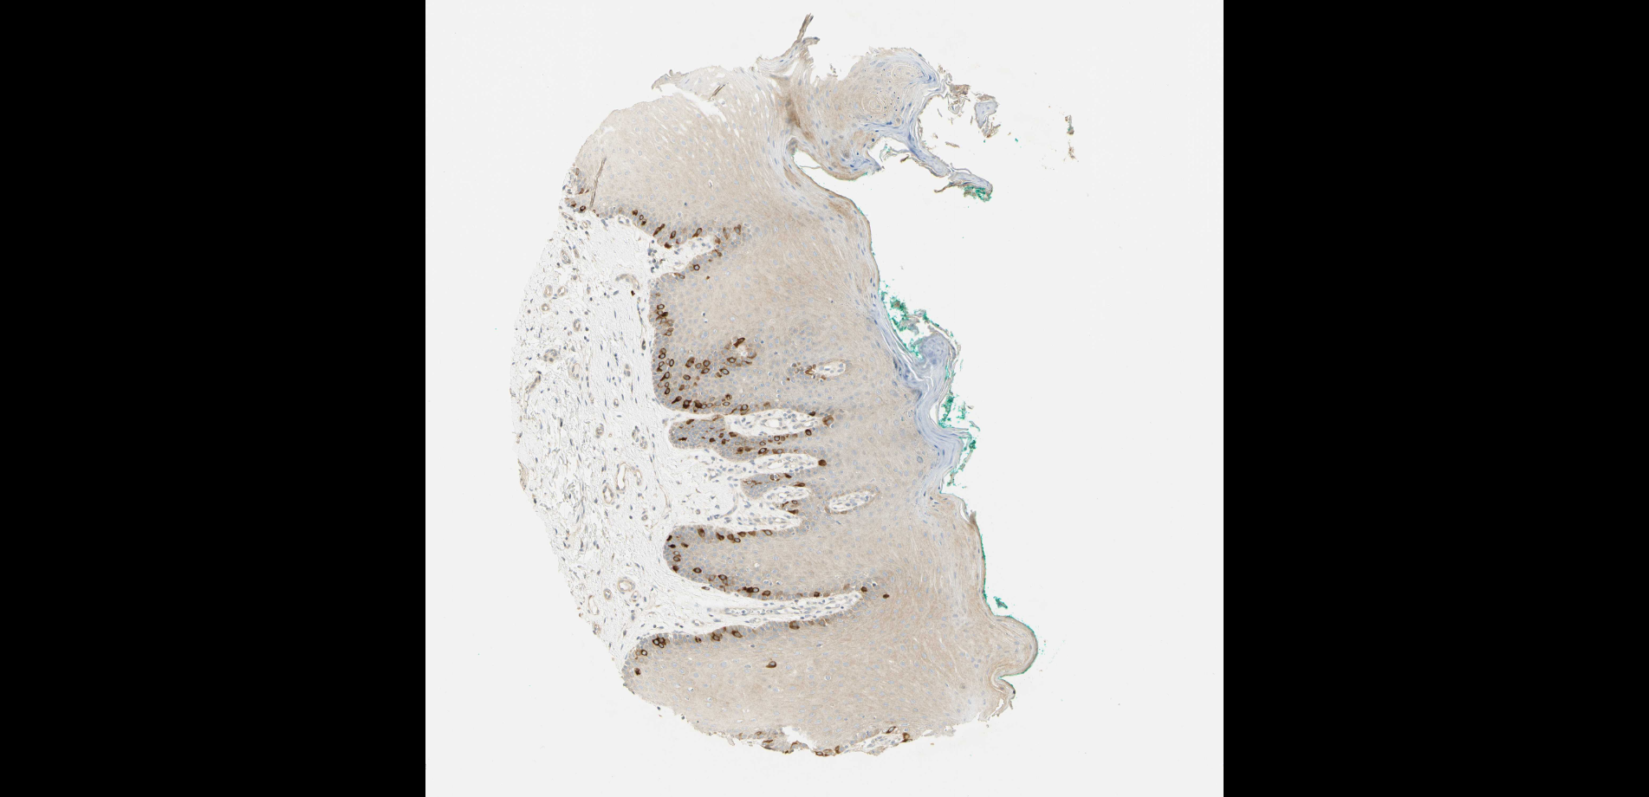
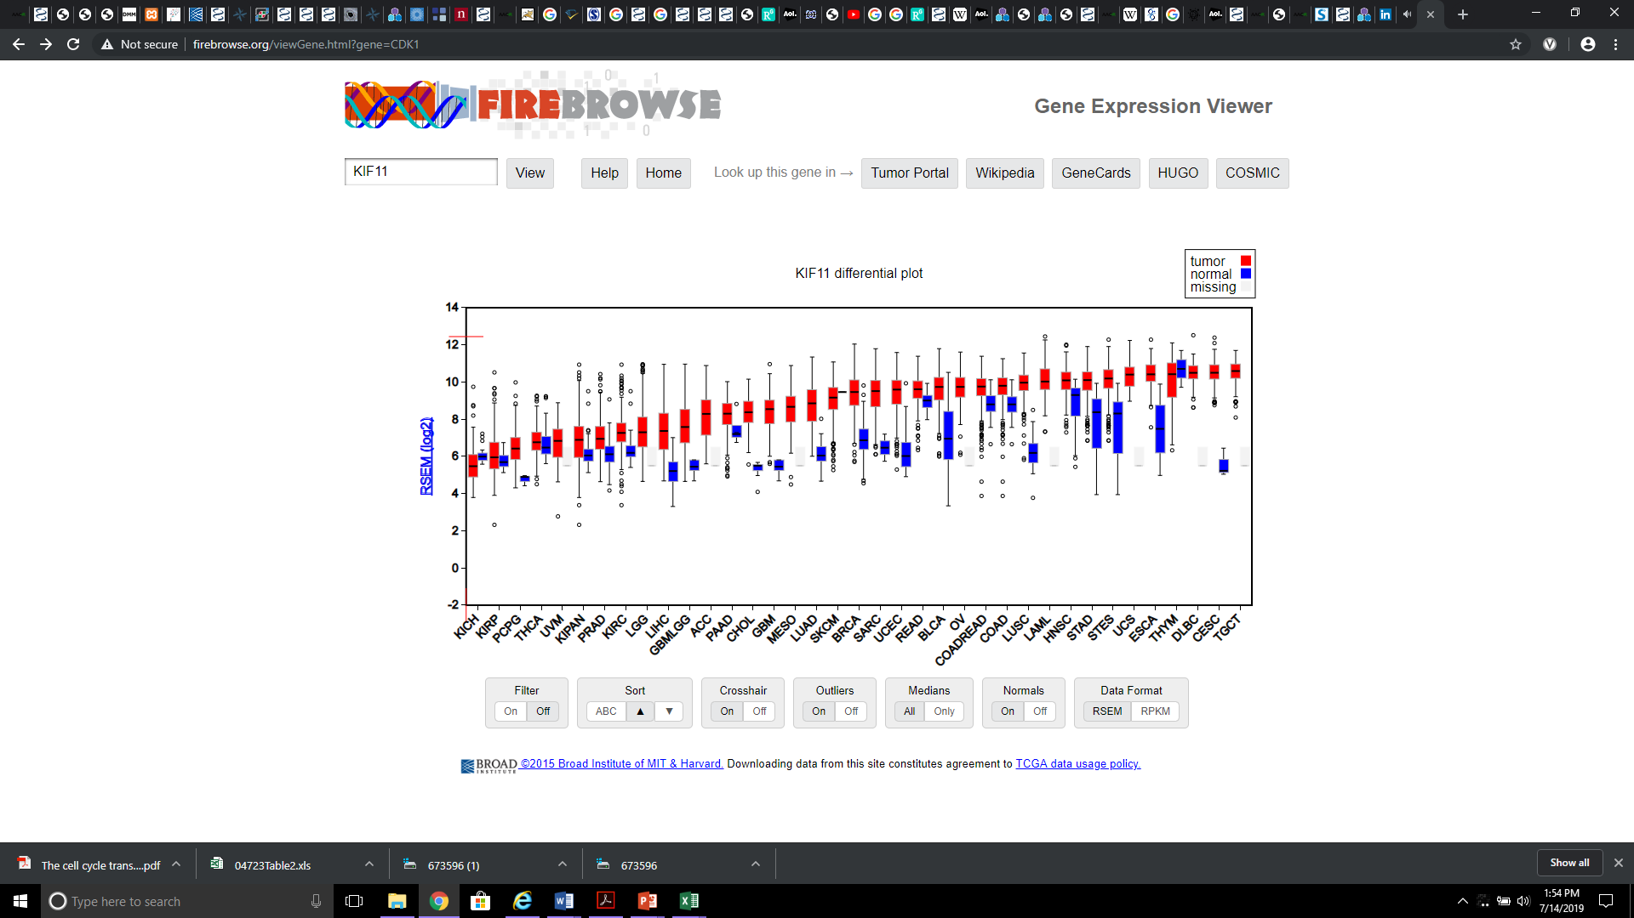
Supplementary Figure S1
Normal Breast
BRCA
Cancer
E
F
Matched normal tissue
AURKB
Breast (T-04000)
Normal tissue, NOS
(M-00100)
Patient ID: 2773
HPA010568
Female, age 75
Breast (T-04000)
Duct carcinoma (M-85003)
Patient ID: 2428
Normal Tonsil
CESC
TTK
G
H
HPA010568
Male, age 37
Tonsil (T-61100)
Normal tissue, NOS (M-00100)
Patient ID: 2512
HPA010568
Female, age 51
Cervix (T-83000)
Squamous cell carcinoma,
NOS (M-80703)
Patient ID: 3491
PLK1
Normal Oral Mucosa
SKCM
I
J
KIF11
Male, age 58
Oral tissue (T-51000)
Skeletal muscle (T-13000)
Normal tissue, NOS (M-00100)
Patient ID: 3135
HPA010568
Female, age 82
Skin (T-01000)
Malignant melanoma,
NOS (M-87203)
Patient ID: 3060
IHC: KIF11
Notes:
Supplementary Figure 1. Key mitotic kinases are more frequently expressed in rapidly proliferating normal tissue compared to most tumors. mRNA expression data was compiled from the TCGA for key representative proteins involved in the cell cycle. Top (A-D): A comparison of the levels of mRNA expression for control tissue (blue) and corresponding cancerous tissue (red) across various tissue types are given using normalized RSEM values. In each panel, mRNA expression for the normal thymus, known for having a high proliferative index, is indicated in by the light blue dashed line. AURKB (panel A), TTK (panel B), PLK1 (panel C), and KIF11 (panel D) were chosen as representative markers for proliferation, as they were once the focus of drug development efforts against mitotic kinases. Bottom (E-J): Representative IHC images of normal and cancerous tissue stained with an anti-KIF11 antibody were obtained from the Human Protein Atlas. KIF11 is only expressed during the M phase of the cell cycle; thus, only positively stained cells are undergoing active division. For each IHC image, a focused image of a key subsection of the tissue is given in the top right corner. Consistent with the mRNA expression levels of KIF11 (panel D), these representative examples indicate that a variety of cancers do not express this key mitotic kinase compare to their normal tissue counterparts.

Slide 7
Supplementary Figure S1. Key mitotic kinases are more frequently expressed in rapidly proliferating normal tissue compared to most tumors. mRNA expression data was compiled from the TCGA for key representative proteins involved in the cell cycle. Top (A-D): A comparison of the levels of mRNA expression for control tissue (blue) and corresponding cancerous tissue (red) across various tissue types are given using normalized RSEM values. In each panel, mRNA expression for the normal thymus, known for having a high proliferative index, is indicated in by the light blue dashed line. AURKB (A), TTK (B), PLK1 (C), and KIF11 (D) were chosen as representative markers for proliferation, as they were once the focus of drug development efforts against mitotic kinases. Bottom (E-J): Representative IHC images of normal and cancerous tissue stained with an anti-KIF11 antibody were obtained from the Human Protein Atlas. KIF11 is only expressed during the M phase of the cell cycle; thus, only positively stained cells are undergoing active division. For each IHC image, a focused image of a key subsection of the tissue is given in the top right corner. Consistent with the mRNA expression levels of KIF11 (D), these representative examples indicate that a variety of cancers do not express this key mitotic kinase compare to their normal tissue counterparts.

Slide 8
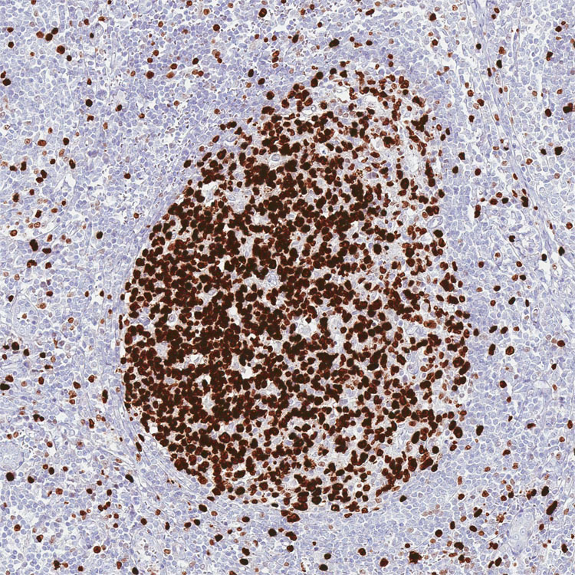
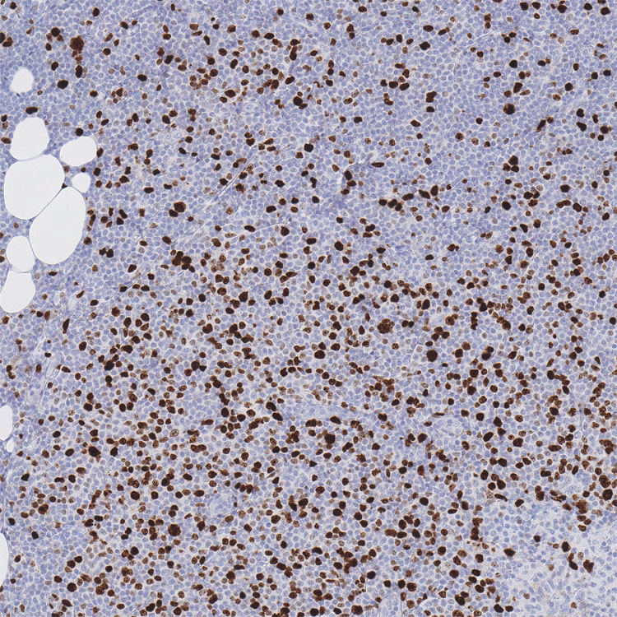
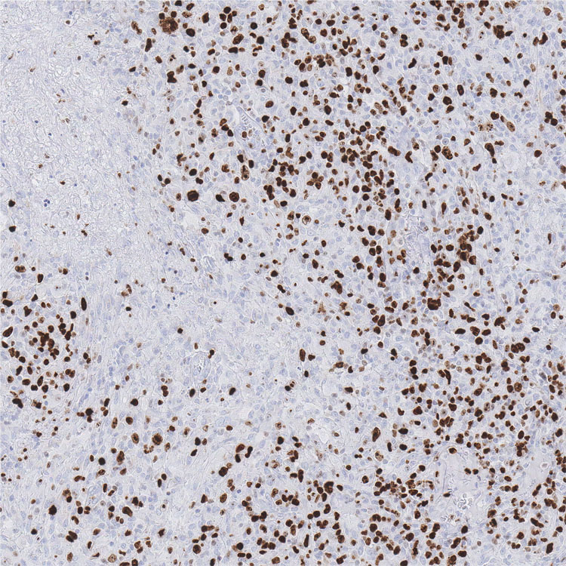
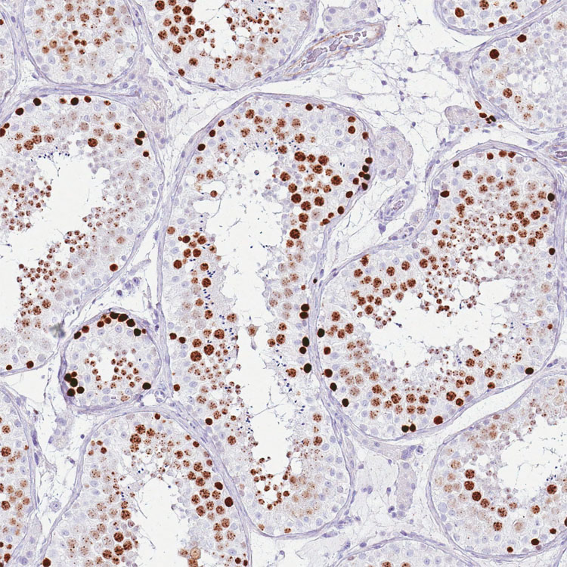
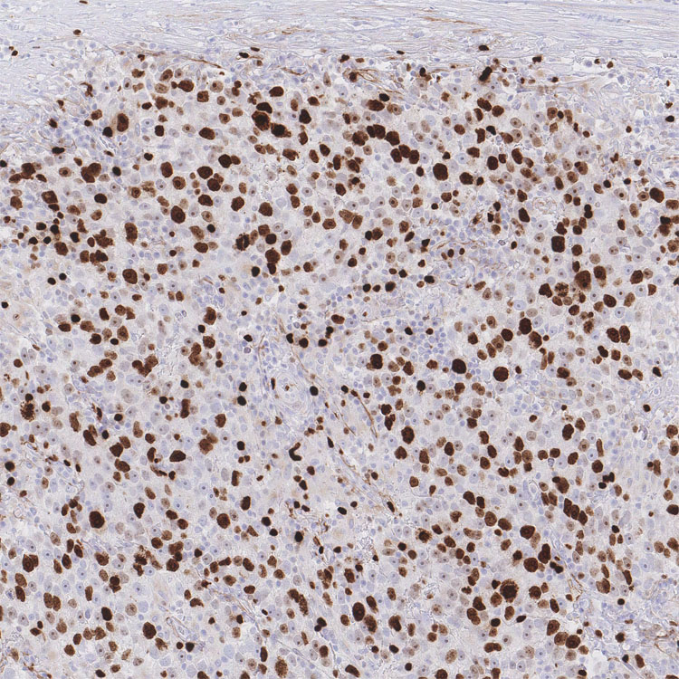
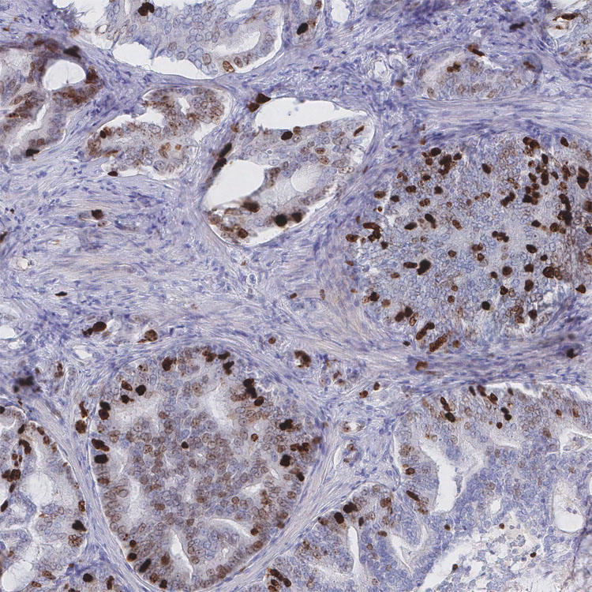
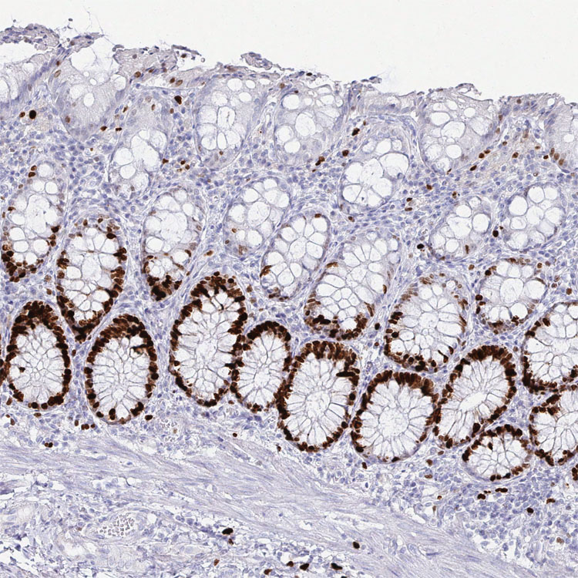
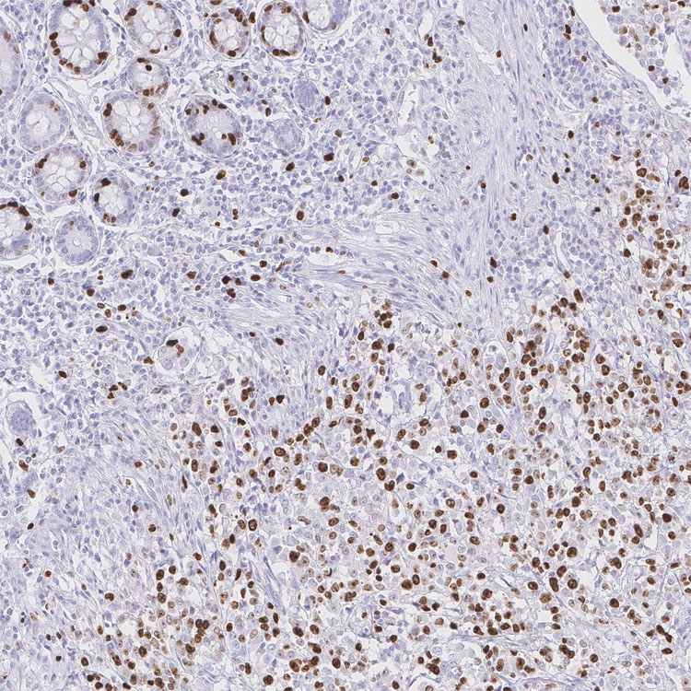
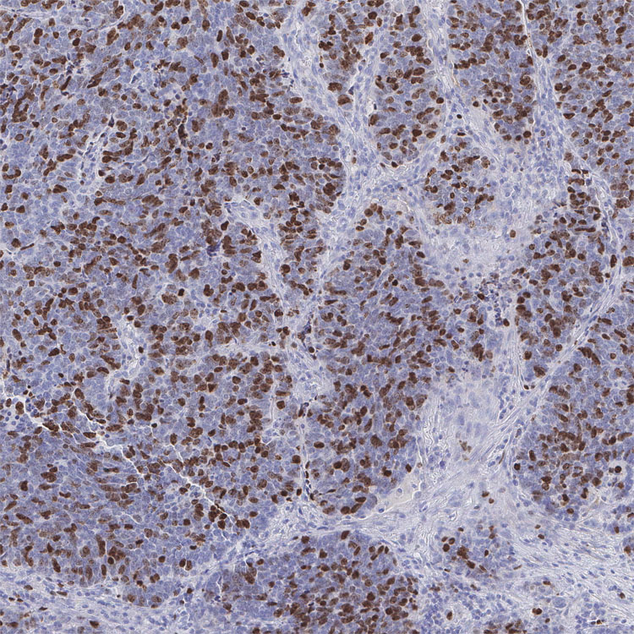
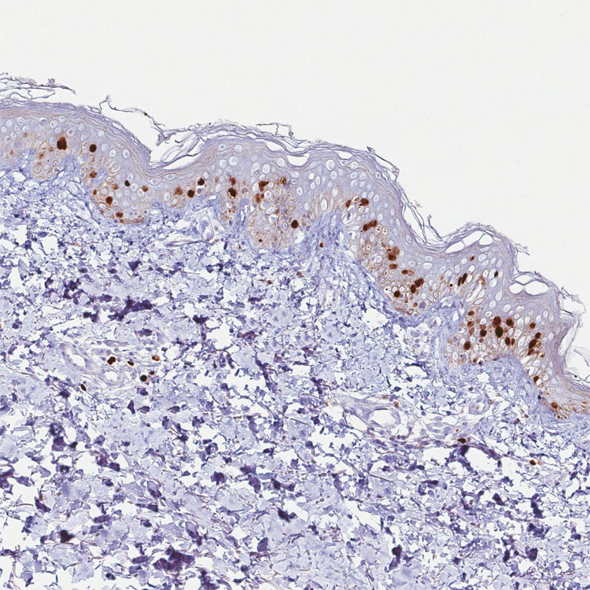
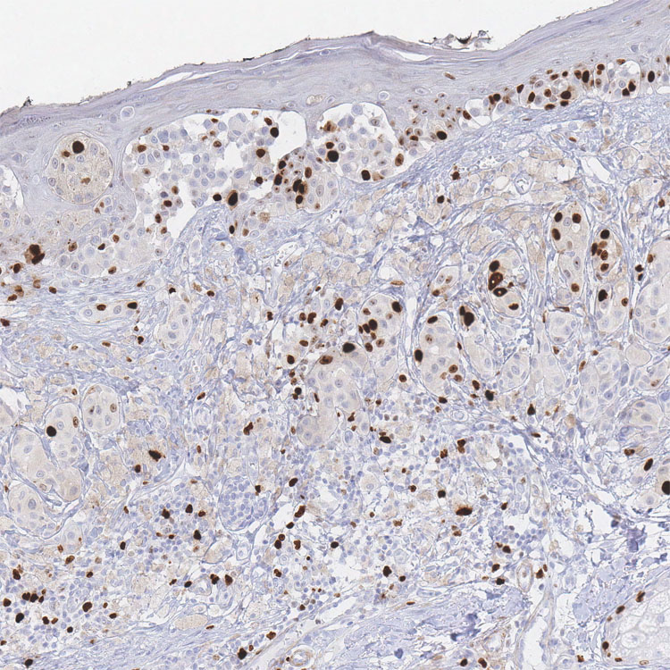
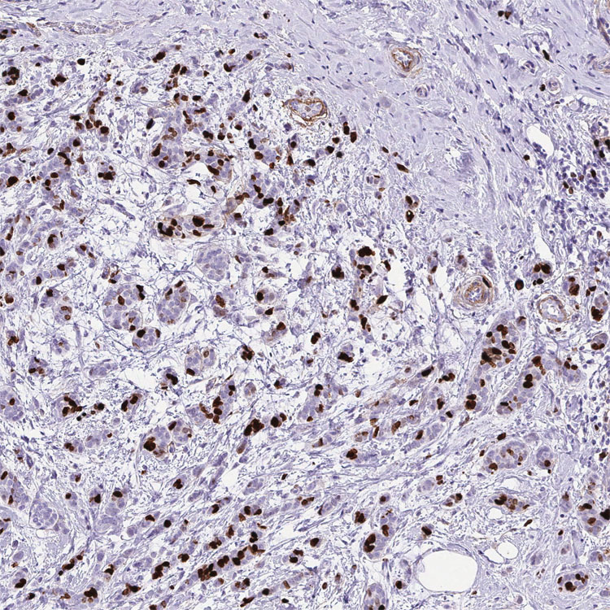
Supplementary Figure S2
Normal Lymph node
Chronic lymphocytic leukemia
Hodgkin lymphoma
Normal Testicle
Testis Cancer
Prostate Cancer
v
Normal Colon
Colorectal Adenocarcinoma
Lung Small Cell Adenocarcinoma
Normal Skin
Melanoma
Breast Cancer
Normal Skin
SKCM
Breast Cancer
Notes:
Supplementary Figure 2. Ki67 labeling index is higher in many normal proliferative tissues as compared to tumors. Compiled immunohistochemistry images staining for the established proliferation marker, Ki67 (MKI67) was obtained from the Human Protein Atlas (antibody CAB000058; https://www.proteinatlas.org/learn/dictionary/expression/MKI67). Within each set of tissue, Ki67 staining of two types of cancerous tissue (red) is compared to Ki67 of a specified rapidly proliferating, non-malignant tissue (blue). All positively stained cells (brown) are undergoing proliferation while unstained cells (blue) are in G0. Remarkably, in the normal tissue of the lymph node, intestinal crypts, and upper layer of the skin, the vast majority of the cells are undergoing proliferation, with the percentage of Ki67 staining being higher than most cancerous tissues.

Slide 9
Supplementary Figure S2. Ki67 labeling index is higher in many normal proliferative tissues as compared to tumors. Compiled immunohistochemistry images staining for the established proliferation marker, Ki67 (MKI67) was obtained from the Human Protein Atlas (antibody CAB000058). Within each set of tissue, Ki67 staining of two types of cancerous tissue (red) is compared to Ki67 of a specified rapidly proliferating, non-malignant tissue (blue). All positively stained cells (brown) are undergoing proliferation while unstained cells (blue) are in G0. Remarkably, in the normal tissue of the lymph node, intestinal crypts, and upper layer of the skin, the vast majority of the cells are undergoing proliferation, with the percentage of Ki67 staining being higher than most cancerous tissues.

Slide 10
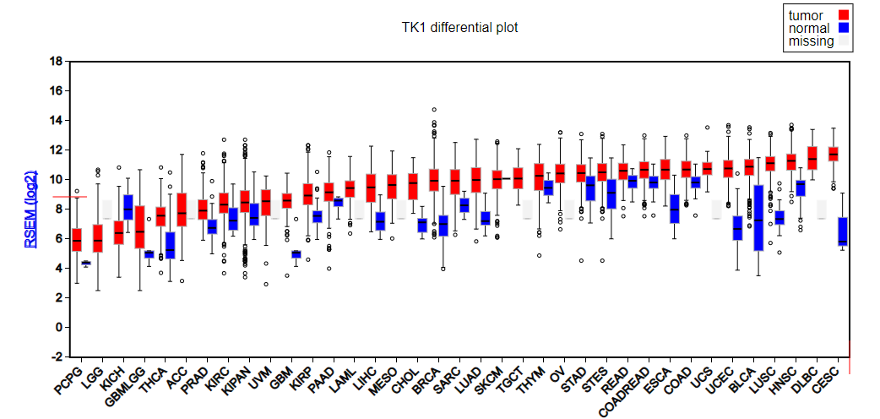
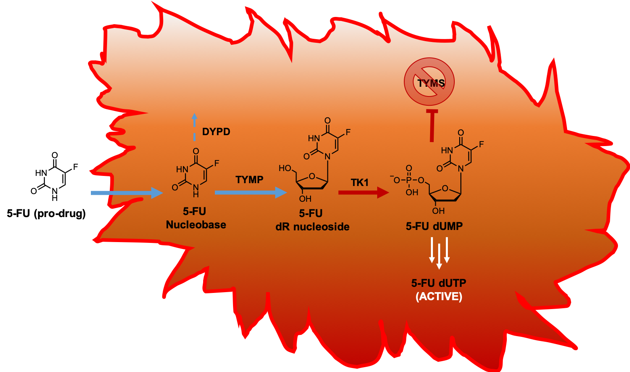
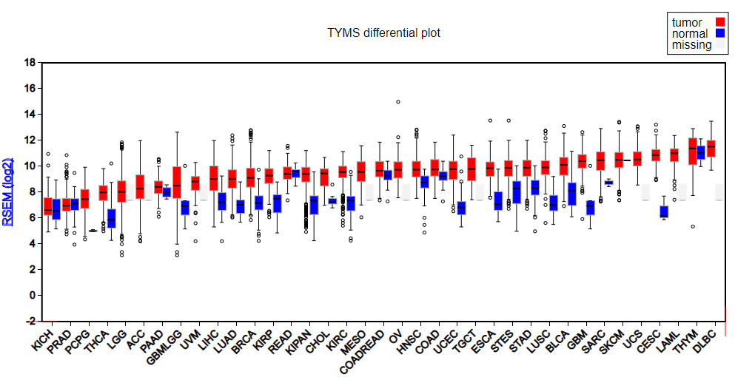
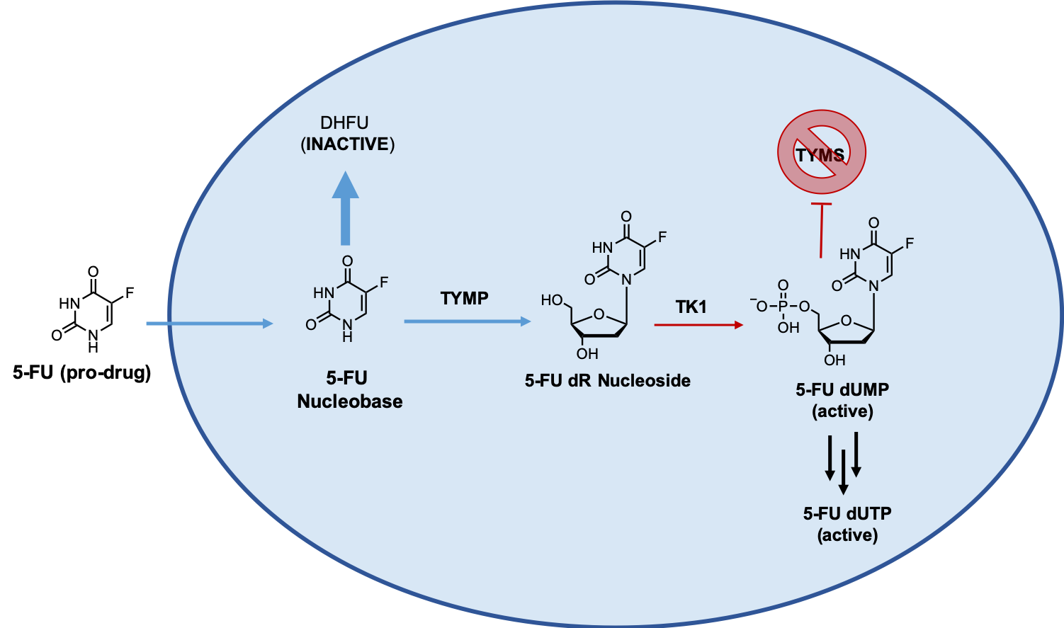
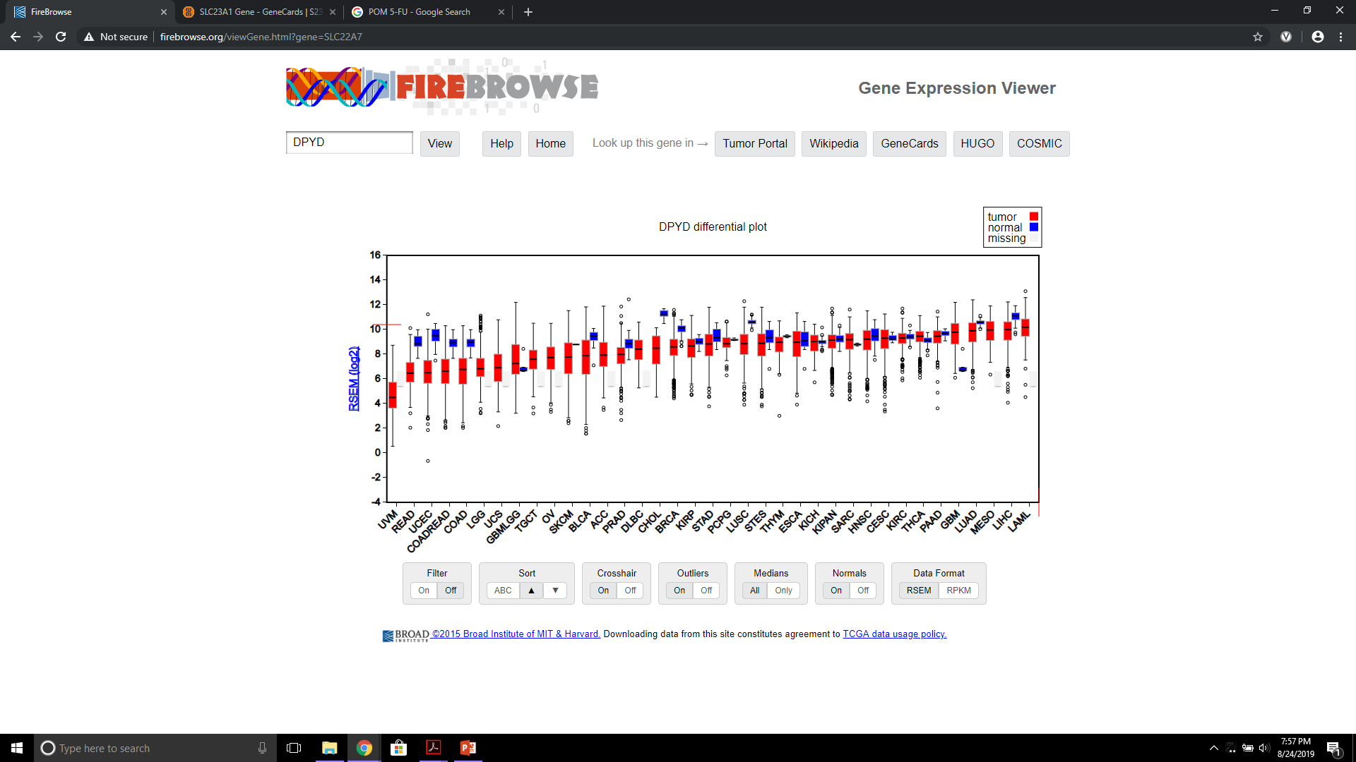
Supplementary Figure S3
C
Higher TK1 expression = More sensitive
A
Susceptible Cancer Cell
DHFU
(inactive)
Higher TYMS expression = Less sensitive
B
Resistant Normal Hemopoietic Stem Cell
DYPD
Higher DPYD expression = Less sensitive
Notes:
Supplementary Figure S3. 5-FU exhibits selectivity for cancer cells due to differential expression of TK1, TYMS, and DYPD. A: Cancer cells susceptible to 5-FU exhibit elevations in TK1, which converts 5-FU deoxyribose nucleoside into the active 5-FU monophosphate form and inhibits TYMS. 5-FU dUMP can be further phosphorylated to 5-FU dUTP, which is also active. B: Resistant cells express high levels of DYPD, which inactivates the 5-FU nucleobase upon entry into the cell and prevents further biotransformation to the active mono- and tri-phosphate. C: RNA-Seq data from TCGA Firebrowse for TK1, TYMS, and DPYD. Bars (red, tumor; blue, normal control) represent mRNA expression (median, first and third quartiles, and 95% CI) of primary human tumors sequenced from diverse cancers in the TCGA. High expression of TK1 correlates with increased sensitivity to 5-FU while high expression of TYMS (target of 5-FU dUMP) and/or DPYD (inactivating enzyme) correlates with lesser sensitivity to 5-FU.

Slide 11
Supplementary Figure S3. 5-FU exhibits selectivity for cancer cells due to differential expression of TK1, TYMS, and DYPD in cancer cells versus normal (stem) cells. A: Cancer cells susceptible to 5-FU exhibit elevations in TK1, which converts 5-FU deoxyribose nucleoside into the active 5-FU monophosphate form and inhibits TYMS. 5-FU dUMP can be further phosphorylated to 5-FU dUTP, which is also active. B: Resistant cells express high levels of DYPD, which inactivates the 5-FU nucleobase upon entry into the cell and prevents further biotransformation to the active mono- and tri-phosphate. C: RNA-Seq data from TCGA Firebrowse for TK1, TYMS, and DPYD. Bars (red, tumor; blue, normal control) represent mRNA expression (median, first and third quartiles, and 95% CI) of primary human tumors sequenced from diverse cancers in the TCGA. High expression of TK1 correlates with increased sensitivity to 5-FU while high expression of TYMS (target of 5-FU dUMP) and/or DPYD (inactivating enzyme) correlates with lesser sensitivity to 5-FU.

Slide 12
Supplementary Figure S4
Hydrolysis leaving groups
Beta-elimination moieties
a
b
c
R = mesylate, tosylate, etc.
Notes:
Supplementary Figure 4. Comparing the mechanisms of hydrolysis and beta-elimination leave groups. Left (a, b) pH-labile hydrolysis leave groups can be broadly characterized as those containing a good leave group (R group) which are directly displaced by water under slightly alkaline conditions. Right (c) Beta-elimination groups are are characterized by the presence of an electrophilic moiety two carbons away from the released drug. Here, the model electrophilic moiety is the trifluorocarbonyl. Under slightly alkaline conditions, abstraction of the alpha proton (red) can lead to the collapse of the pro-drug moiety to release the mitotic kinase inhibitor.

Slide 13
Supplementary Figure S4. Comparing the mechanisms of hydrolysis and beta-elimination leave groups. Left (A, B) pH-labile hydrolysis leave groups can be broadly characterized as those containing a good leave group (R group) which are directly displaced by water under slightly alkaline conditions. Right (C) Beta-elimination groups are are characterized by the presence of an electrophilic moiety two carbons away from the released drug. Here, the model electrophilic moiety is the trifluorocarbonyl. Under slightly alkaline conditions, abstraction of the alpha proton (red) can lead to the collapse of the pro-drug moiety to release the mitotic kinase inhibitor.

