Slide 1
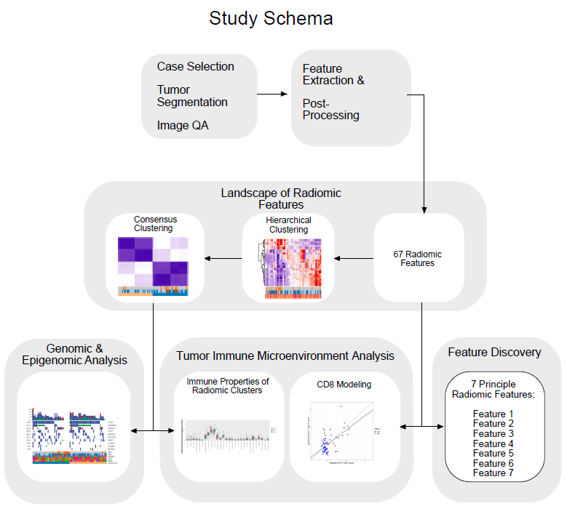
Supplemental Figure 1: Data analysis pipeline
Notes:
Supplemental Figure 1: Additional Radiomic Analysis
a.) Consensus clustering (Gaussian?) using hierarchal clustering. Samples are hierarchically clustered by using distances derived from consensus clustering matrix entries, colored from light blue (samples are never in the same cluster) to dark blue (samples are always in the same cluster). with XX distance metric, and XX% resampling, demonstrates two stable and coherent clusters.
b.) Cumulative Distribution Function plots corresponding to the consensus matrices in the range k = 2-6
c.) Delta area plot showing the change in Area under CDF with increasing number of clusters, comparing k and k-1. The relative increase in consensus is with k=2 clusters and there is no appreciable increase in consensus clustering with increasing clusters.
d.) An alternative approach to clustering data, with multi-dimensional scaling, continues two demonstrate two distinct classes of HNSCC
e.) Hierichal clustering with reduced feature set continues to reveal 2 features.

Slide 2
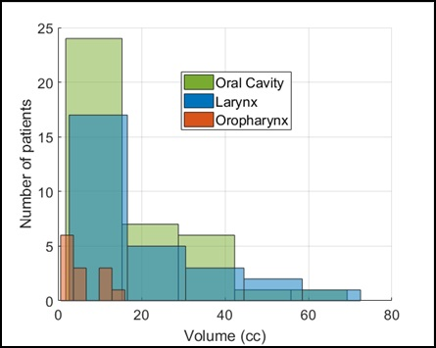
Supplemental Figure 2: Additional radiomics analysis
A
B
C
Notes:
Supplemental Figure 1: Additional Radiomic Analysis
a.) Consensus clustering (Gaussian?) using hierarchal clustering. Samples are hierarchically clustered by using distances derived from consensus clustering matrix entries, colored from light blue (samples are never in the same cluster) to dark blue (samples are always in the same cluster). with XX distance metric, and XX% resampling, demonstrates two stable and coherent clusters.
b.) Cumulative Distribution Function plots corresponding to the consensus matrices in the range k = 2-6
c.) Delta area plot showing the change in Area under CDF with increasing number of clusters, comparing k and k-1. The relative increase in consensus is with k=2 clusters and there is no appreciable increase in consensus clustering with increasing clusters.
d.) An alternative approach to clustering data, with multi-dimensional scaling, continues two demonstrate two distinct classes of HNSCC
e.) Hierichal clustering with reduced feature set continues to reveal 2 features.

Slide 3
Supplemental Figure 3: Imaging subtypes correlate with
biologic subtypes identified using the TCGA data
A
B
C
Notes:
A) Correlation of Radiomic cluster and Copy Number Clustering. Consensus NMF Clustering of CNV TCGA for k=4 clusters. Bar graph shows the percentage of each CNV cluster between the two image clusters (sum equals 100%). Using Chi-square test and we found significant difference in CNV cluster between the two radiomic groups (p=0.011). CNV cluster 2 appears to be driving the difference between the 2 radiomic clusters.
Broad Institute TCGA Genome Data Analysis Center (2016): Clustering of copy number data by focal peak region with absolute value: consensus NMF. Broad Institute of MIT and Harvard. doi:10.7908/C13R0S8P
B) Correlation of Radiomic cluster and Gene expression clustering. We used Chi-squared test and found significant difference in gene expression between the two radiomic groups (p=0.055) and it appears as though cluster 3 and 4 are driving the differences between the two radiomic clusters.
Broad Institute TCGA Genome Data Analysis Center (2016): Clustering of mRNAseq gene expression: consensus NMF. Broad Institute of MIT and Harvard. doi:10.7908/C1V40TKR Unfortunately this does not match the TCGA nature supplement data Cluster 3 appears to be Atypical (HPV like & immunoreactive); Cluster 2 appears to be basal (Hypoxia and defense response); CANOT tell Cluster 1 and cluster 2 are??? The clusters firebrowser do not correlate with TCGA. Classical correlate with smoking in general and Mesenchymal have worse prognosis and survival. Appears as though “0ther “ category has more numbers in cluster 2 which makes sense clustering with worse players.
Regardless of anatomic site HPV+ HNSCC share similar gene expression and DNA methylation profiles; nonkeratinizing, basaloid histopathological features; and lack of TP53 or CDKN2A alterations. JCO Chakravarthy found that improved overall survival restricted to HPV driven OPSCCs, which were associated with increased levels of tumor-infiltrating lymphocytes compared with HPV driven non-OPSCC. HPV driven non-OPSCCs display distinct immune microenvironment and clinical behavior compared with HPV-driven OPSCCs.
In their study hallmark genomic alterations by anatomic site and HPV status indicated that
HPV+OPSCC TP53 0/50 0% mutation , CDKN2A 0/50 0% mutated, CCND1 amplified 6/54 (11%) and CDKN2A deleted 4/54 (7.4).
HPV+nonOPSCC TP53 mutation 1/18 (5.5%), CDKN2A mutation 0/18 (0%), CCDN1 amplified 3/21 (14.2%); and CDKN2A deletion 3/21 (14.2%)
HPV- OPSCC TP53 mutation 23/25 (92%), CDKN2A mutation 5/25 (20%), CCDN1 amplification 19/26 (73.7%), CDKN2A 22/26 (84%)
HPV- nonOPSCC TP53 mutation 336/409 (82%), CDKN2A mutation 107/409 (26%), CCDN1 amplification 197/413 (47.6%), CDKN2A deletion 281/413 (68%).
C) Correlation of Radiomic cluster and Methylation Clustering. Consensus NMF Clustering of Methylation TCGA for k=7 clusters. Bar graph shows the percentage of each methylation cluster between the two image clusters (sum equals 100%). There is one sample in methylation cluster 7 not depicted on graph. We used Chi-square test and found significant difference in methylation cluster between the two radiomic grousp (p=0.0219).
Reference: Broad Institute TCGA Genome Data Analysis Center (2016): Clustering of Methylation: consensus NMF. Broad Institute of MIT and Harvard. doi:10.7908/C1HT2NQ1.
Epigenetic mechanism in carcinogenesis documented: CgG island hyper-methylation silences tumor suppressor genes, hypo-methylation promotes transcriptional activation of oncogenes and induces chromosome instability.
In a study by Ankur Chakravarthy et al JCO 2016 “Human Papillomavirus Drives Tumor Development Throughout the Head and Neck: Improved Prognosis is Associated with an immune response largely restricted to Oropharynx” . HPV Transcript-Positive OPSCC and Non-OPSCC Display similar genome-wide DNA Methylation Landscapes.
Also consider examining top 10 methylation genes associated with survival 1) CDK5R1 2)DAD1 3) GZMM 4)CHAC2 5)SPIB 6)FTCD 7)ESCO2 8)AK3L1 9)LTK 10)CCKBR

Slide 4
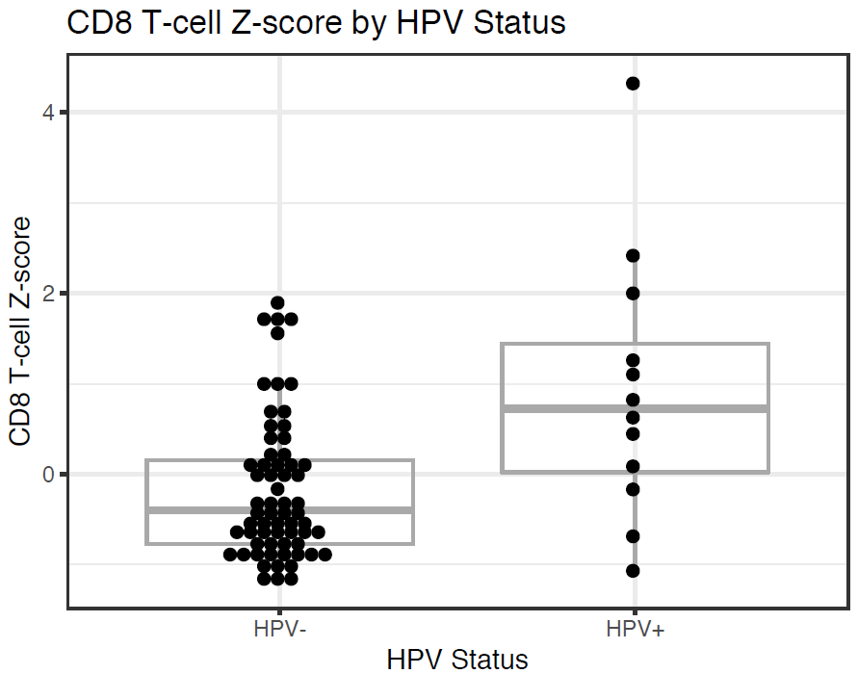
Supplemental Figure 4: Correlation between CD8 T-cells and HPV status

Slide 5
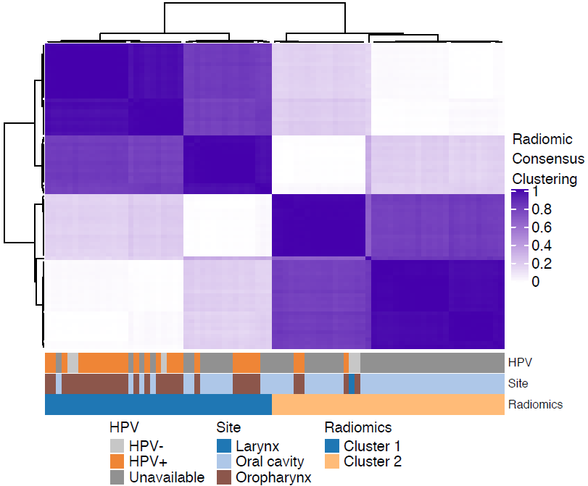

Supplemental Figure 5: Simulation test assuming the HPV-positive prevalence of 10% within oral cavity cases
Simulation
Iter 1
-> p-value
Iter 2
-> p-value
Iter 3
-> p-value
.
.
.
Iter 1000
-> p-value
HPV
HPV-
HPV+
Simulated HPV-
Simulated HPV+

