Slide 1
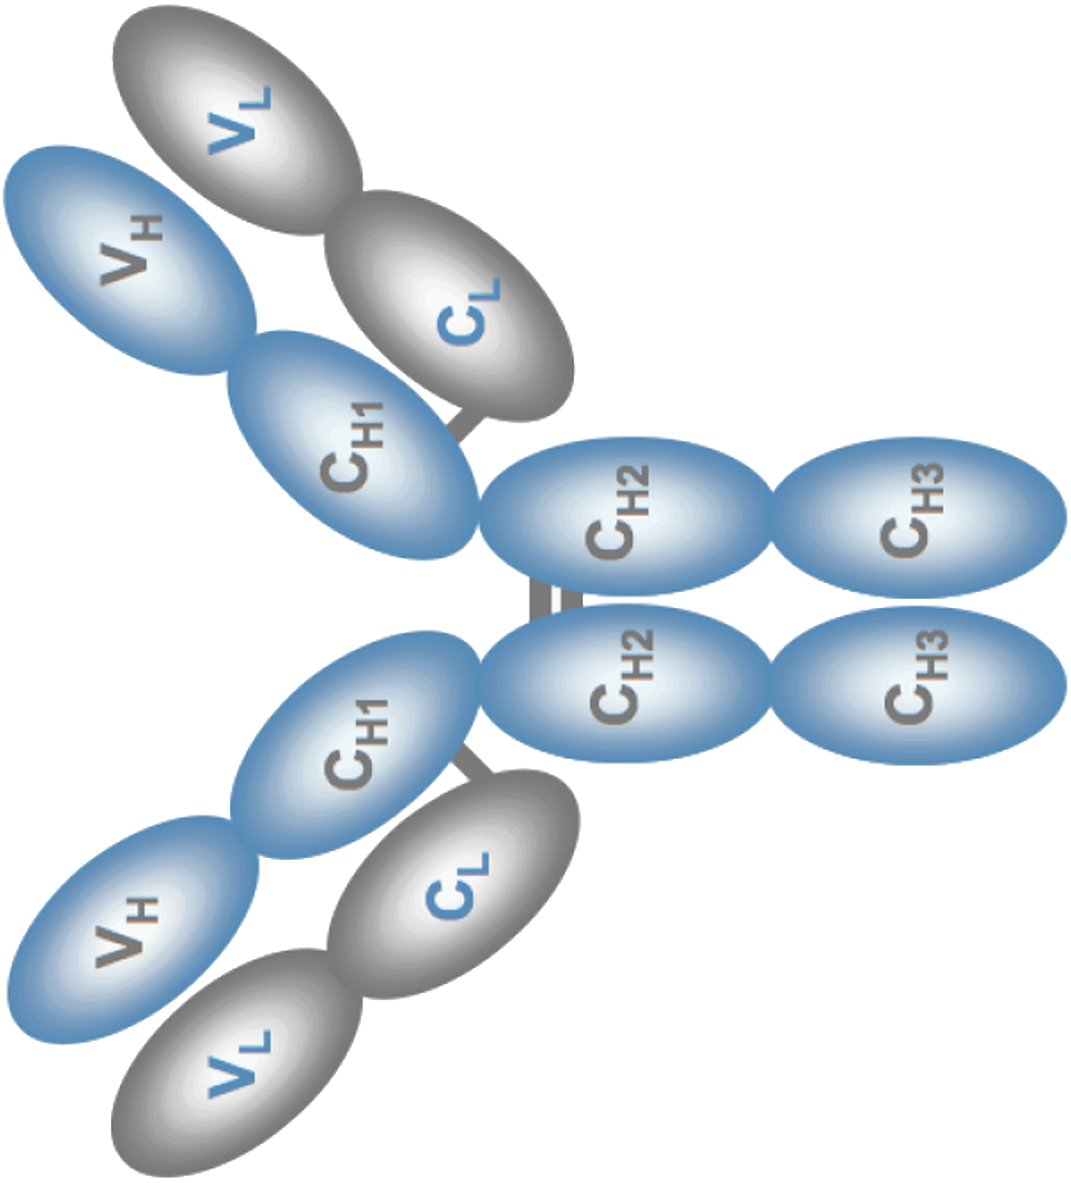
CH2
CH3
SD232-294
SD286-345
SD339-397
SD390-447
SD286-397
SD307-345
SD339-378
SD286-306 + 339-378
i88G1, i129G1 = DI1
+
Supplementary Figure 1. Cartoon representation of the key Fc-engineered constructs
Cartoon (not drawn to scale) of Fc-engineered 88mAb regions (SD, subdomain). Dashed arrow (SD307-345) denotes a reduction in functionality when compared to SD286-345. DI1: ‘o’ denotes the three murine residues at positions 294, 300 and 305, that were reverted back to human sequence as part of the deimmunization (DI) strategy (outlined in Supplementary Figure 2).

