Slide 1
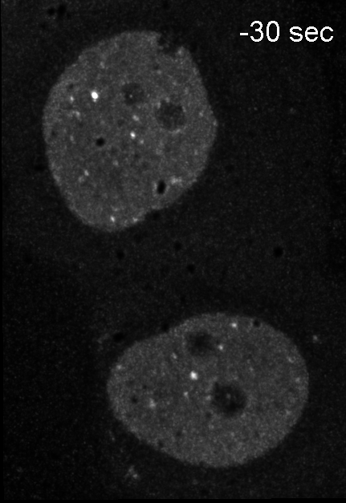
supplementary materials
S1

Slide 2
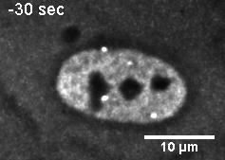
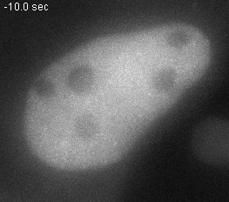
supplementary materials
S2
U2OS-53BP1_GFP + 0.7 Gy
A
B

Slide 3
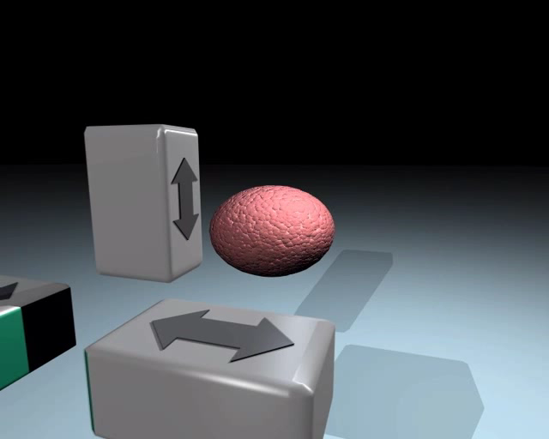
supplementary materials
S3

