Slide 1
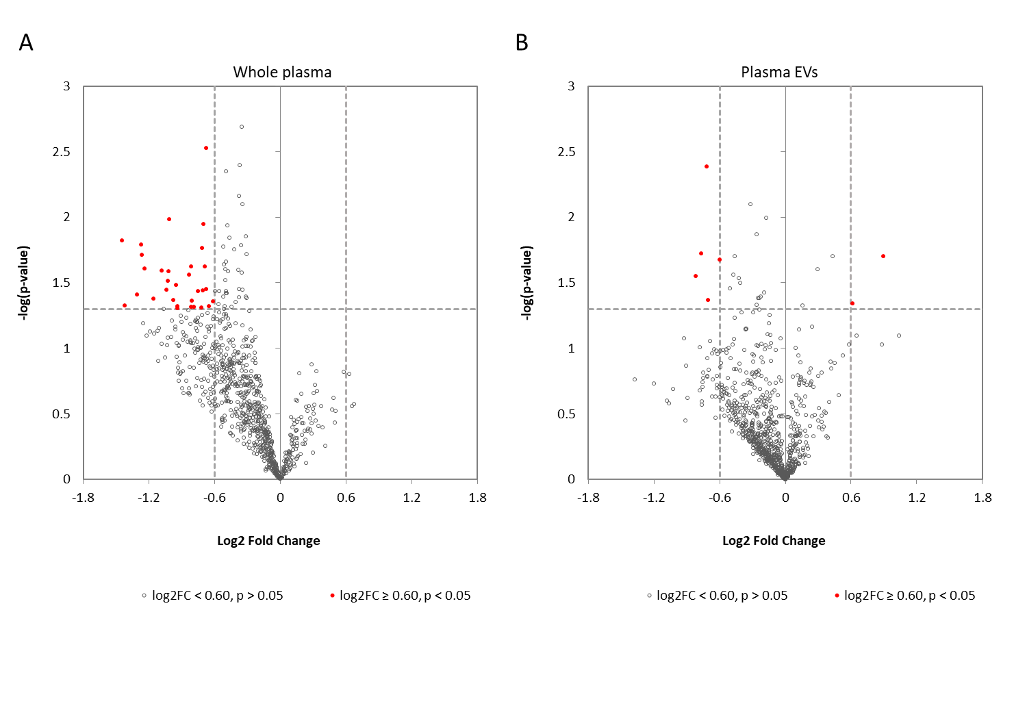
Figure 1

Slide 2
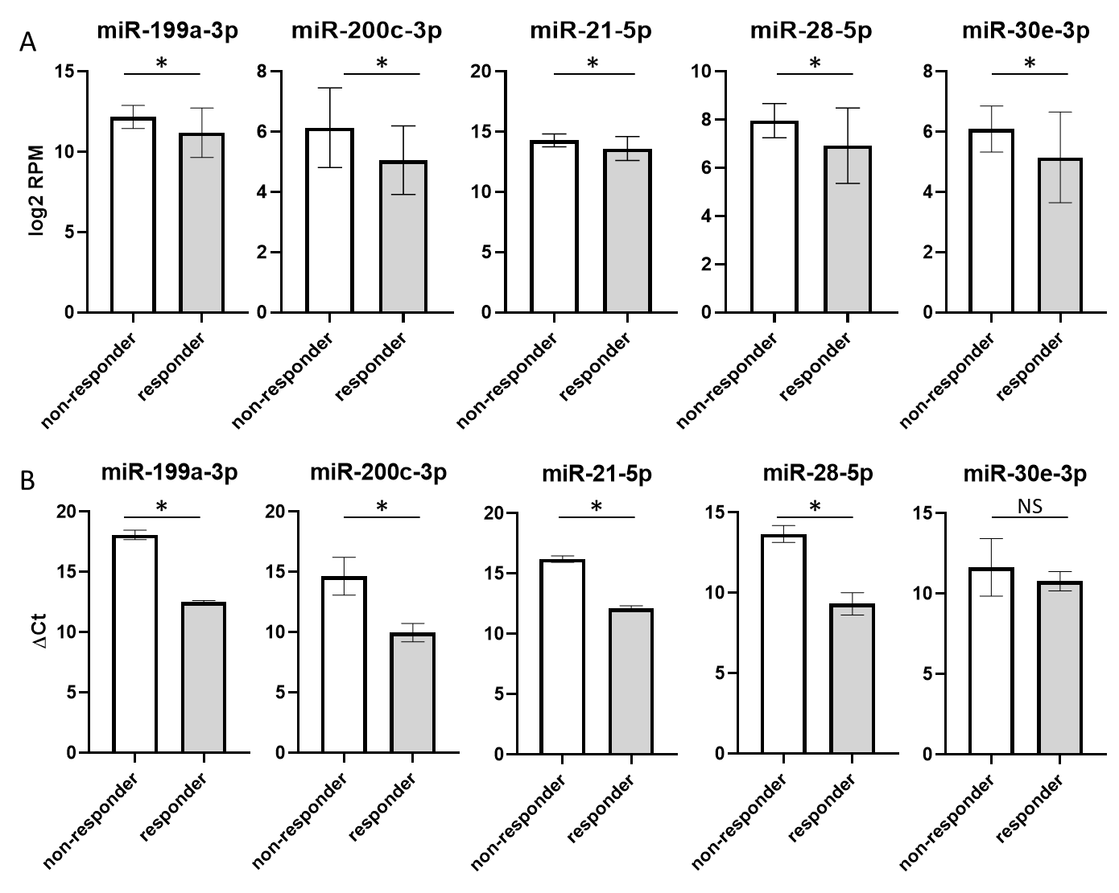
Figure 2

Slide 3
Figure 3
A
NS
*
*
*
NS
B
C
D

