Slide 1
A
B
*#
*#
*#
Supplemental Figure 1. COX inhibition significantly decreased the levels of COX products PGE₂ and the PGI₂ metabolite 6-keto-PGF1α in the urine. WT BALB/c mice were placed in metabolic cages and treated with indomethacin (Indo (30 µg/ml) or vehicle (Veh) in drinking water and challenged intranasally with Alternaria extract at day 0 and day 1. Mouse urine was collected daily for 3 days. The levels of (A) PGE₂ and (B) 6-keto-PGF1α were measured by ELISA. * p<0.05 Indo vs. Veh, # P<0.05 vs. day 0 (Veh group), n=4 cages (3 mice in each cage).

Slide 2
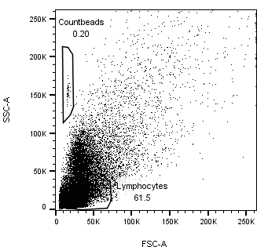
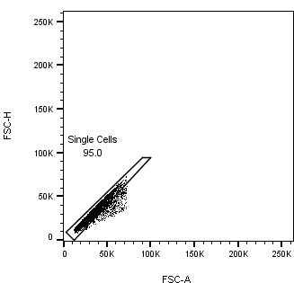
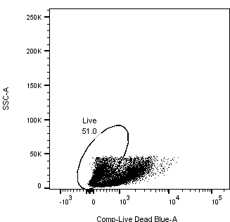
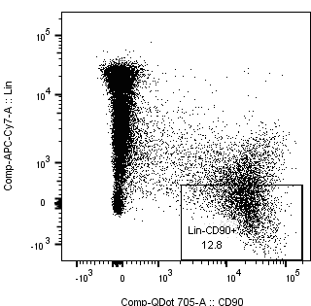
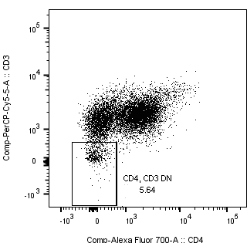
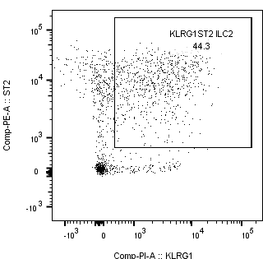
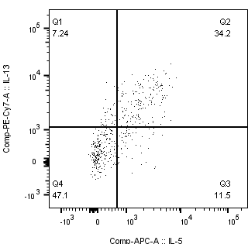
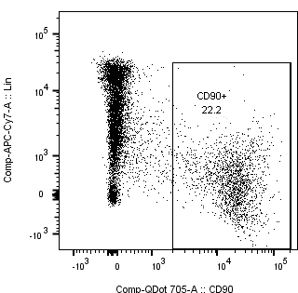
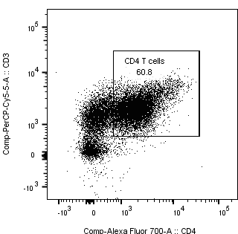
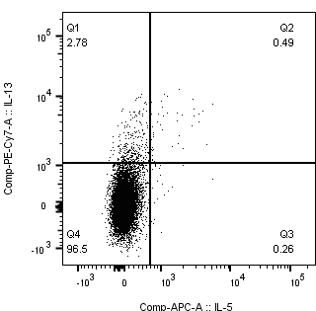
A
SSC-A
FSC-H
SSC-A
SSC-A
Live/dead
FSC-A
SSC-A
Live/dead
FSC-A
FSC-A
SSC-A
CD3
Lin
CD3
ST2
IL-13
ILC2
CD90
CD4
KLRG1
IL-5
CD4
CD3
IL-13
Lin
CD90
CD4
IL-5
B
C
D
E
F
G
H
Supplemental Figure 2. The effect of COX inhibition on Alternaria-induced lung inflammation. WT BALB/c mice were treated with Indo or Veh and challenged intranasally with heat-inactivated Alternaria extract (HIA) or Alternaria extract (Alt) daily for 4 days. Mouse lungs were harvested 24 h after the last Alt challenge for flow cytometry. (A) ILC2 (Lin⁻CD90⁺KLRG1⁺ST2+ cells) and CD4 T cell gating strategy. (B) Total numbers of live cells in the lung. (C)-(D) Percentages of IL-5⁺IL-13⁺ ILC2 and IL-5⁺IL-13⁻ ILC2 in the lung. (E) Total numbers of CD4 T cells in the lung. (F)-(H) The numbers of IL-5⁺ and/or IL-13⁺ CD4 T cells in the lung.

Slide 3
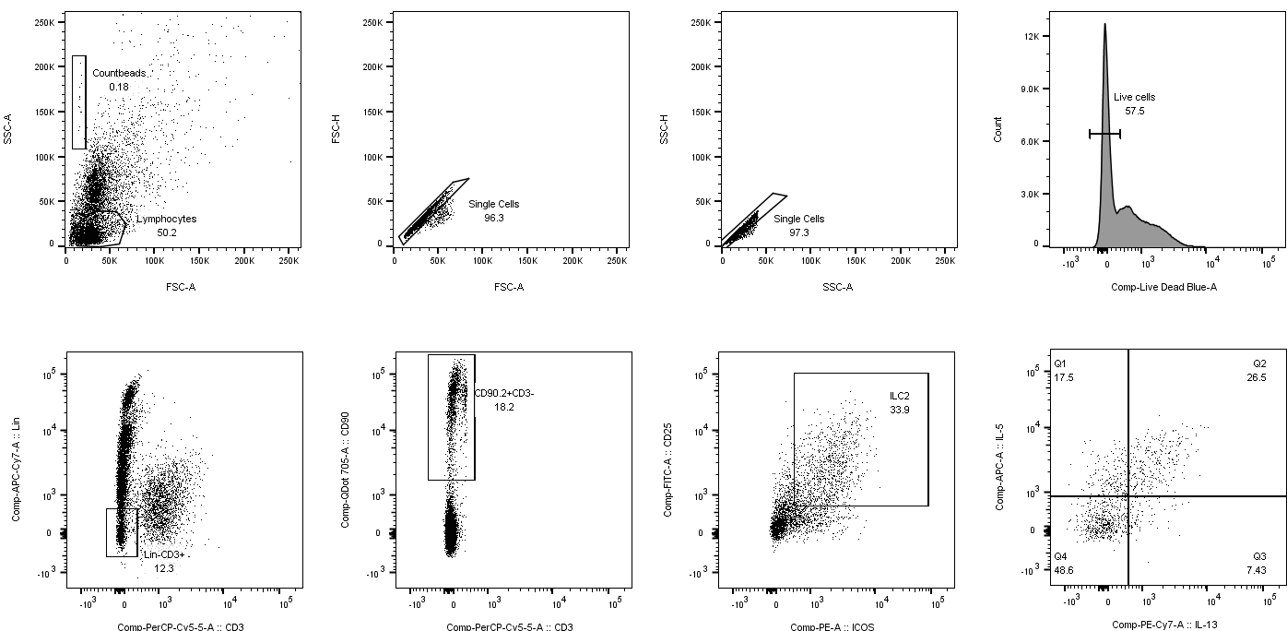
A
SSC-A
FSC-H
SSC-H
Counts
FSC-A
FSC-A
SSC-A
Live/dead
Lin
CD90.2
CD25
IL-5
CD3
CD3
ICOS
IL-13
B
C
D
E
*
*
*
*
Supplemental Figure 3. COX inhibition increased ILC2 responses. WT BALB/c mice were treated with Indo or Veh and challenged intranasally with HIA or Alt daily for 4 days. Mouse lungs were harvested 24 h after the last Alt challenge for flow cytometry. (A) ILC2 (Lin⁻CD90⁺ICOS⁺CD25⁺ cells) gating strategy. (B)-(E) Total numbers of ILC2, IL-5⁻IL-13⁺ ILC2, IL-5⁺IL-13⁺ ILC2, and IL-5⁺IL-13⁻ ILC2 in the lung. Data are combined data of 2 independent experiments. * p<0.05, n=6-10 mice.

Slide 4
A
B
C
*
*
D
E
*
*
F
G
*
*
PBS + - - - - -
Alt (μg/ml) - 50 50 50 50 -
GSH (mg/ml) - - 1.2 6 30 30
PBS + - - - - -
Alt (μg/ml) - 50 50 50 50 -
NAC (mg/ml) - - 1.2 6 30 30
Supplemental Figure 4. COX inhibition decreased the numbers of total cells, macrophages, lymphocytes, and neutrophils in the lung, and L-Glutathione and N-acetyl-L-cysteine inactivated Alt proteases. (A)-(E) WT BALB/c mice were treated with Indo or Veh and challenged intranasally with HIA or Alt daily for 4 days. BALF was harvested 24h after the last Alt challenge. (A-E) The numbers of total cells, macrophage, eosinophils, lymphocytes, and neutrophils in BALF. (F)-(G) Alt was mixed with either (F) reduced L-Glutathione (GSH) or (G) N-acetyl-L-cysteine (NAC) and incubated at r.t. for 10 min followed by protease assay. Combined data of three independent experiments were shown (A)-(E). * p<0.05, n=6-21 mice (A)-(E), or n=3 (F)-(G),.

