Slide 1
N-acetylcysteine prevents olanzapine-induced oxidative stress in mHypoA-59 hypothalamic neurons
Zehra Boz¹, Minmin Hu², Yinghua Yu^{1,2}, and Xu-Feng Huang^{1*}
¹ Illawarra Health and Medical Research Institute and School of Medicine, University of Wollongong, NSW 2522, Australia and ² Jiangsu Key Laboratory of Immunity and Metabolism, Xuzhou Medical University, Jiangsu 221004, China

Slide 2
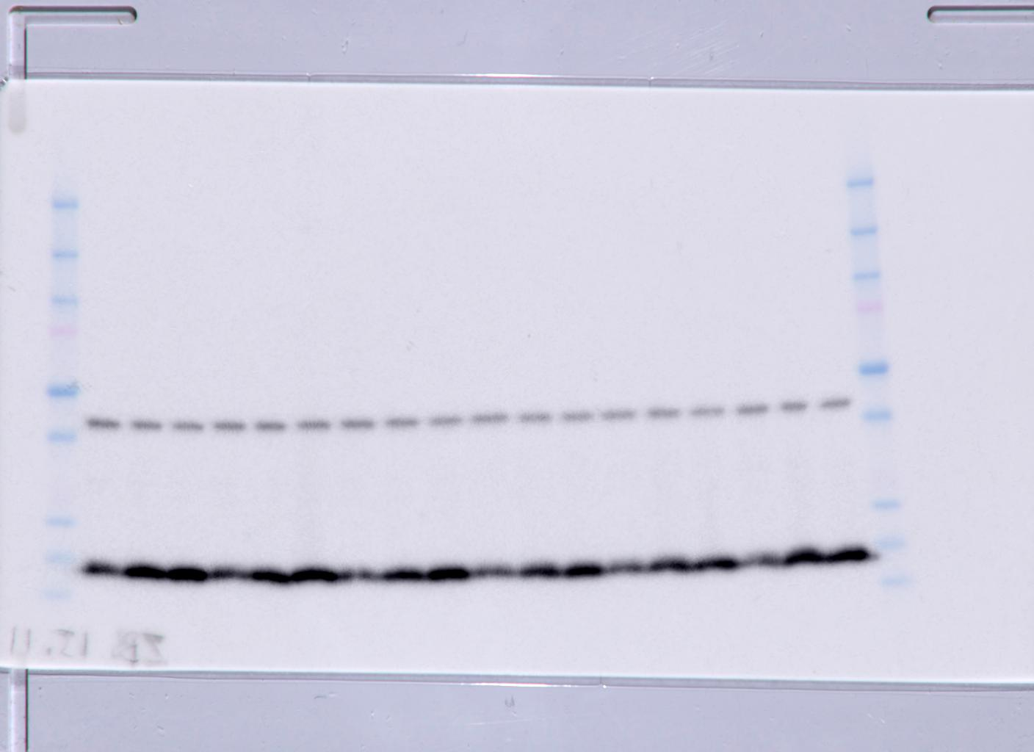
Fig 2– LC3B-II & Actin
Actin
LC3B-II
0,25,100

Slide 3
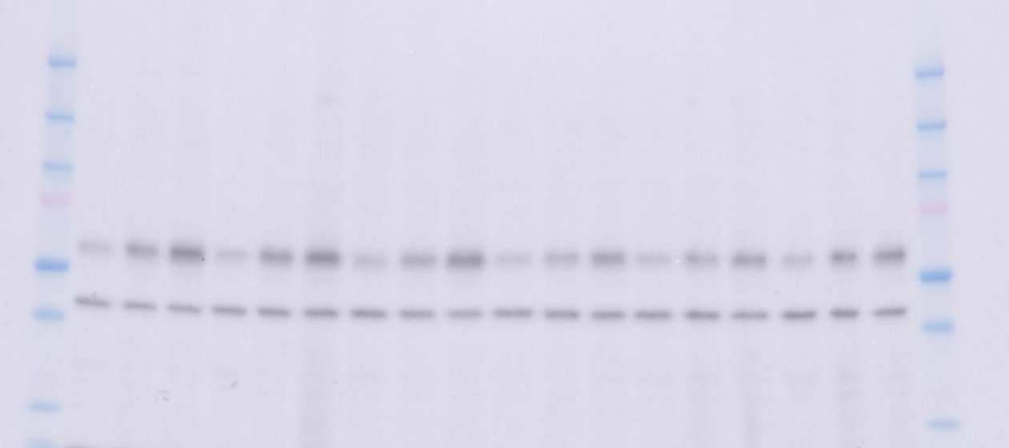
Fig.2 P62 and Actin
p62
Actin
0,25,100
Notes:
Perfect western!

Slide 4
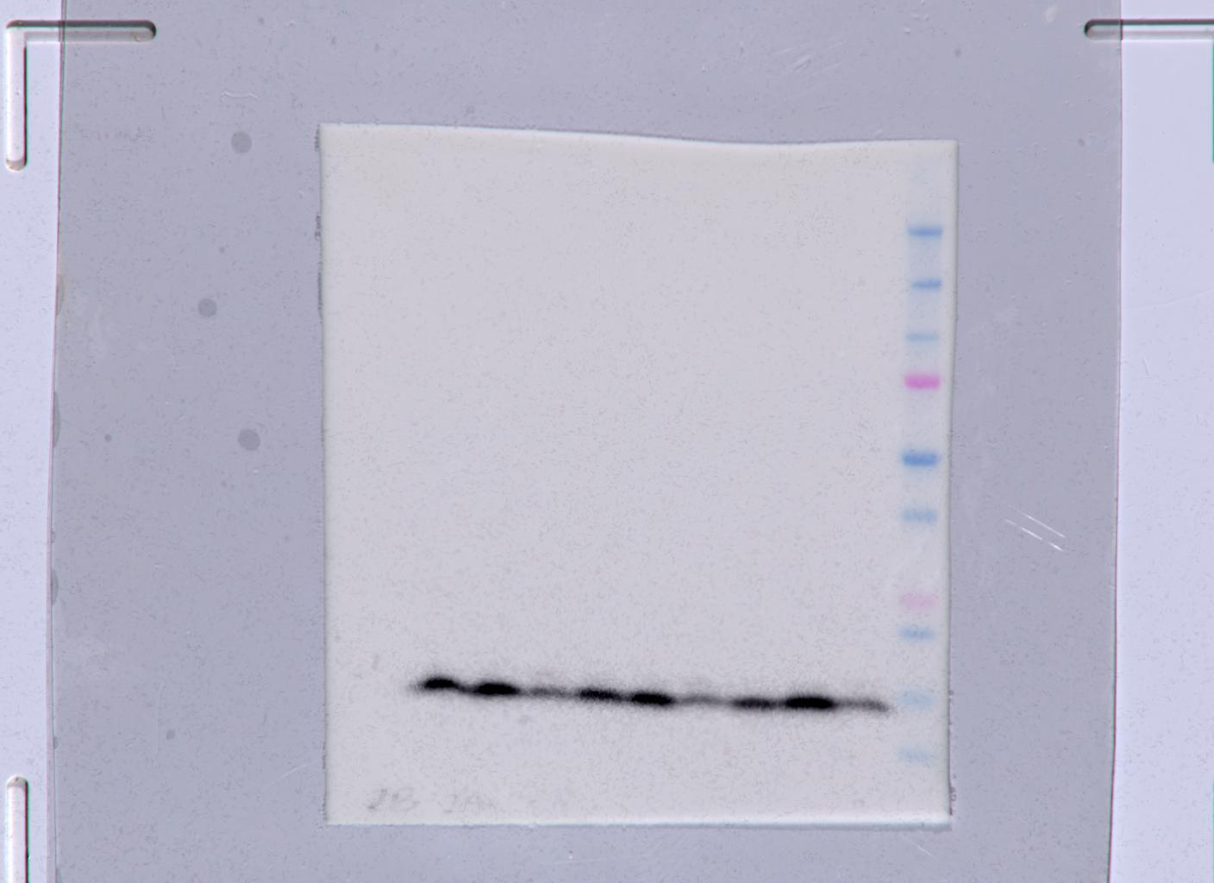
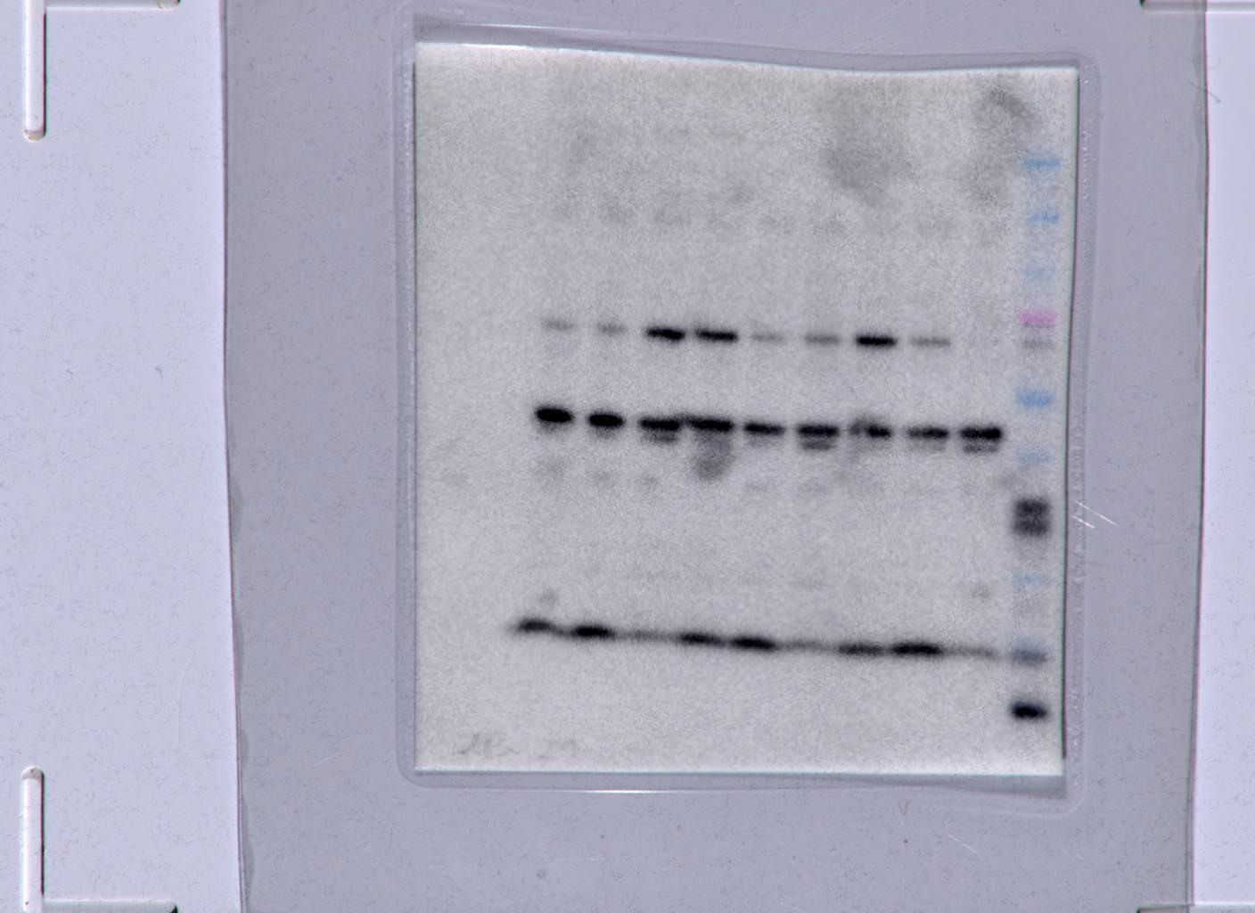
Fig.5
Actin
LC3B
LC3B
0, 100uM Ola, NAC + ola100uM

