Slide 1
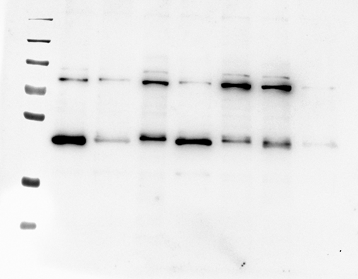
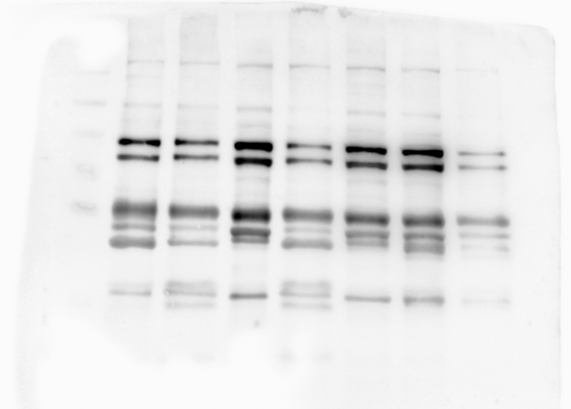
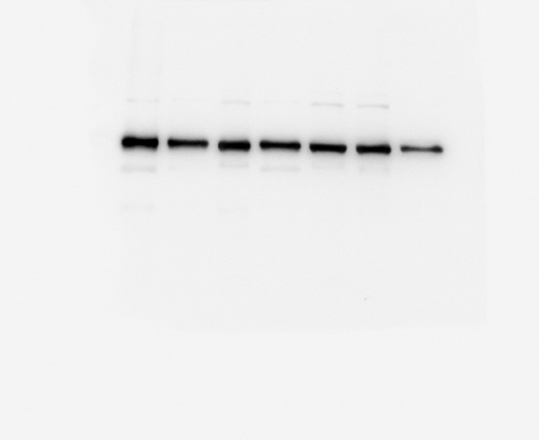
Source Data - Figure 1B
P#NF
P#71
P#36
P#49
P#50
P#106
P#110
kDa
kDa
130
95
130
72
80 kDa
95
88 kDa
55
hMENAΔv6
72
80 kDa
55
hMENA(t)
36
36
28
28
Pan-hMENA
hMENAΔv6
kDa
130
95
72
55
52 kDa
TUBULIN
36
28
TUBULIN

Slide 2
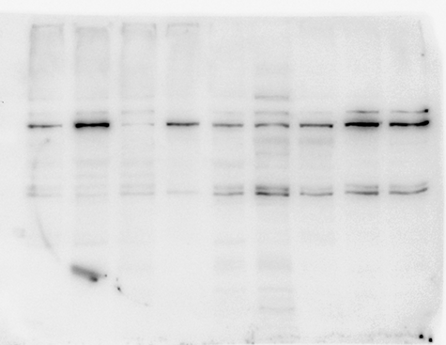
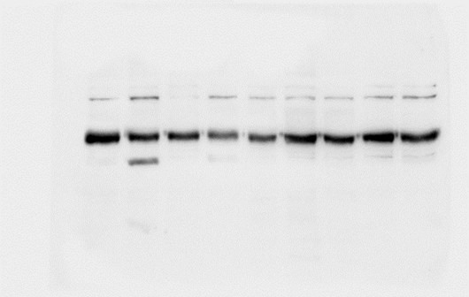
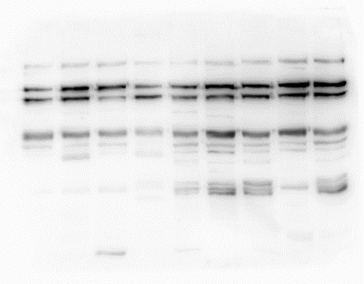
Source Data file-Figure 1B
P#44
P#93
P#97
P#67
130
130
95
95
72
80 kDa
55
hMENAΔv6
72
55
52 kDa
TUBULIN
36
36
28
hMENAΔv6
28
TUBULIN
130
88 kDa
95
80 kDa
72
hMENA(t)
55
36
28
Pan-hMENA

Slide 3
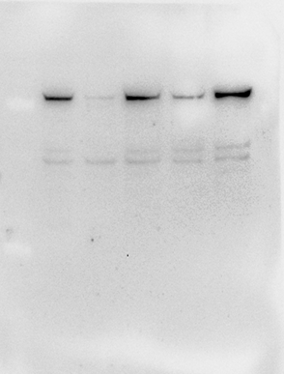
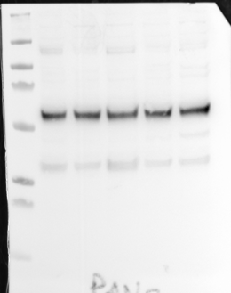
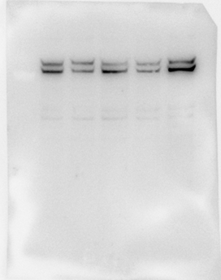
Source Data - Figure 1B
P#36
P#44
P#50
P#110
P#138
kDa
130
88 kDa
95
72
80 kDa
80 kDa
72
55
36
28
hMENAΔv6
TUBULIN
Pan-hMENA

Slide 4
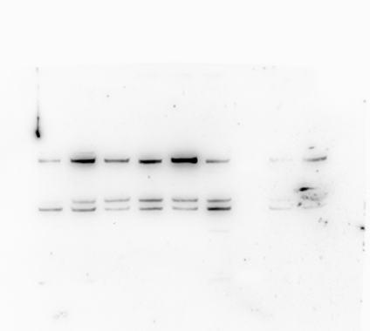
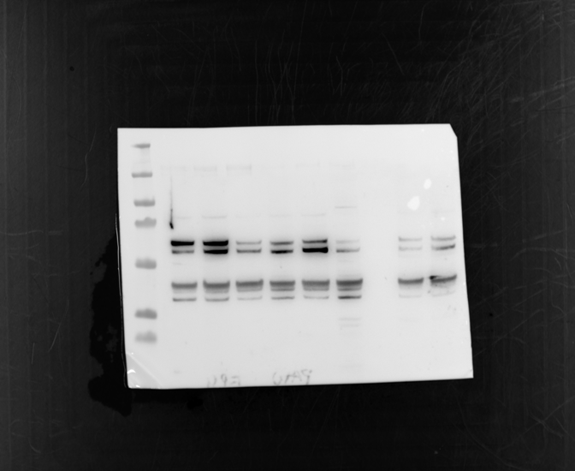
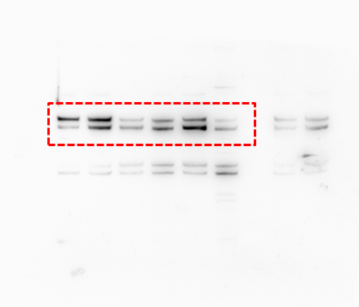
Source Data - Figure 1C
L-#189
kDa
L-#400
L-#450
L#NF
L-#484
HNF
L-#189
L-#400
L-#450
kDa
L#NF
L-#484
kDa
HNF
130
95
80
88
80
72
55
36
28
hMENAΔv6
TUBULIN
TUBULIN
Pan-hMENA

