Slide 1
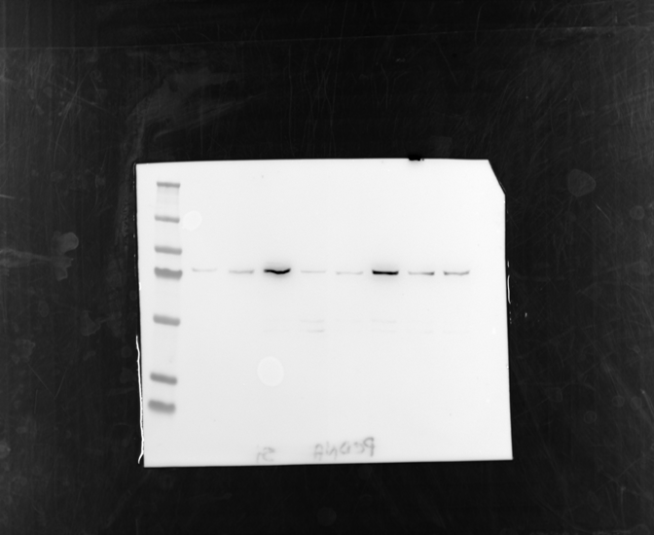
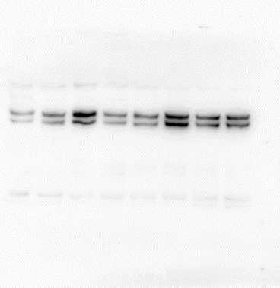
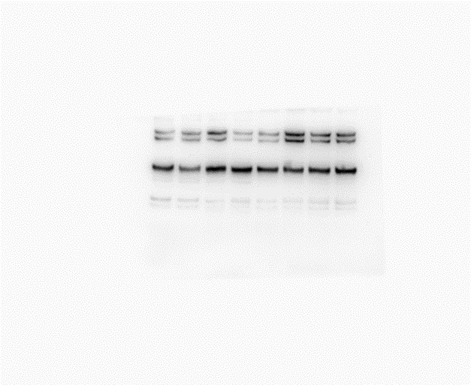
Source Data - Figure 3A
P#36 CAF
kDa
hMENA(t)
130
CNT
95
88 kDa
72
80 kDa
80 kDa
52 kDa
hMENAΔv6
hMENA(t)
55
TUBULIN
36
28
hMENAΔv6
Pan-hMENA
TUBULIN
P#138 CAF
hMENA(t)
CNT
kDa
130
95
88 kDa
72
80 kDa
80 kDa
55
hMENAΔv6
52 kDa
hMENA(t)
TUBULIN
36
28
hMENAΔv6
Pan-hMENA
TUBULIN

Slide 2

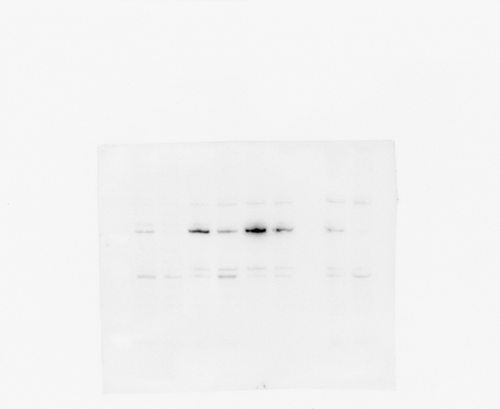
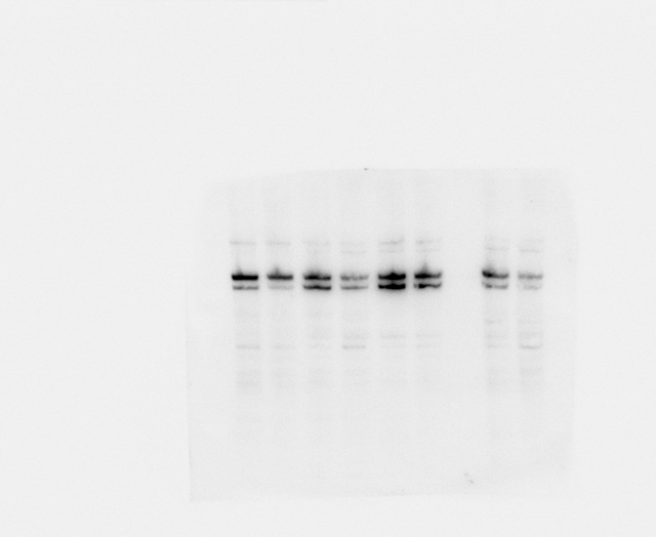
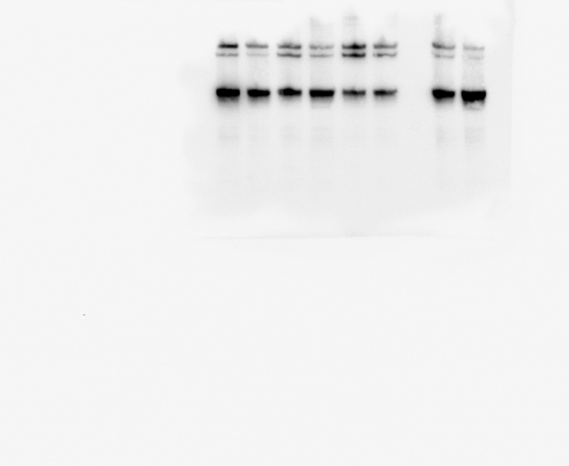
Source Data - Figure 3A
L#189 CAF
hMENA(t)
kDa
CNT
130
95
88 kDa
72
80 kDa
80 kDa
55
hMENA(t)
hMENAΔv6
36
28
Pan-hMENA
hMENAΔv6
TUBULIN
L#484 CAF
hMENA(t)
CNT
80 kDa
88 kDa
hMENAΔv6
80 kDa
hMENA(t)
hMENAΔv6
Pan-hMENA
TUBULIN

Slide 3
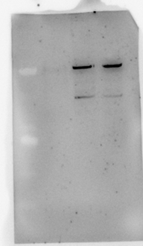
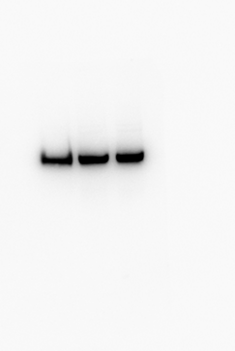
Source Data - Figure 3B
P-NF
hMENAΔv6
CNT
130
130
95
95
72
80 kDa
72
55
hMENAΔv6
55
52 kDa
TUBULIN
36
36
28
28
hMENAΔv6
TUBULIN
P#110 CAF
hMENAΔv6
CNT
130
130
95
80 kDa
95
72
hMENAΔv6
72
55
55
52 kDa
TUBULIN
36
36
28
28
hMENAΔv6
TUBULIN

Slide 4
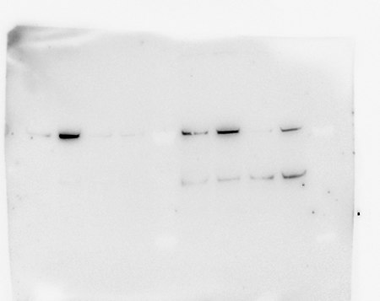
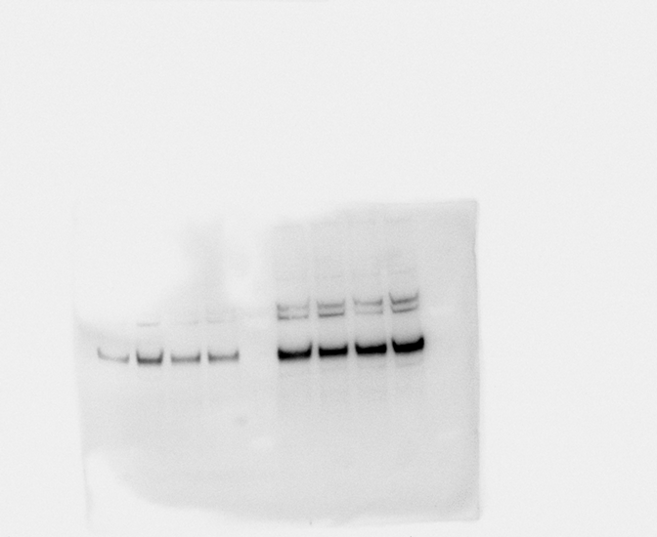
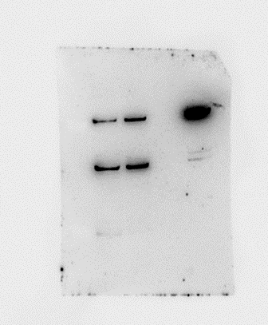

Source Data - Figure 3B
L-NF
hMENAΔv6
CNT
130
130
95
95
72
80 kDa
72
52 kDa
hMENAΔv6
55
55
TUBULIN
36
36
28
28
hMENAΔv6
TUBULIN
L#400 CAF
hMENAΔv6
CNT
130
95
80 kDa
130
72
hMENAΔv6
95
55
72
55
52 kDa
36
TUBULIN
28
36
28
TUBULIN

