Slide 1
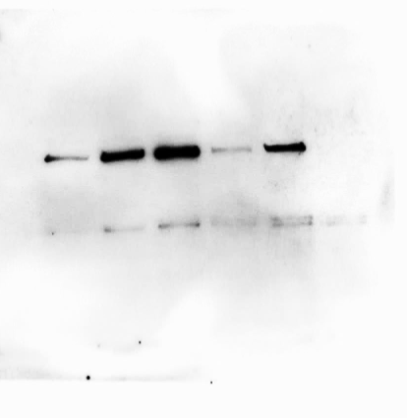
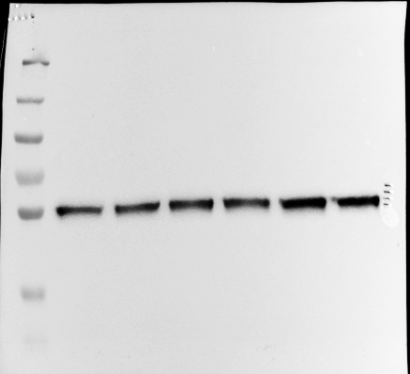
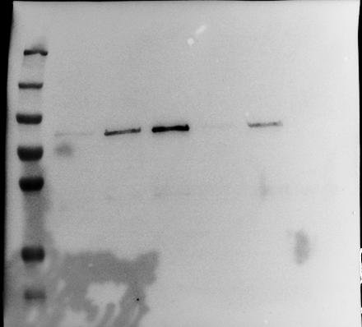
Source Data - Figure 4E
kDa
130
130
95
80 kDa
95
72
hMENAΔv6
72
55
55
52 kDa
TUBULIN
36
36
28
hMENAΔv6
28
TUBULIN
Lower exposure with markers

Slide 2
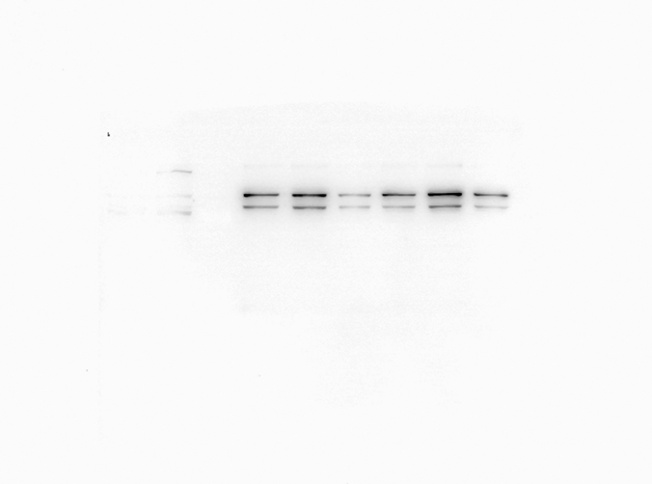
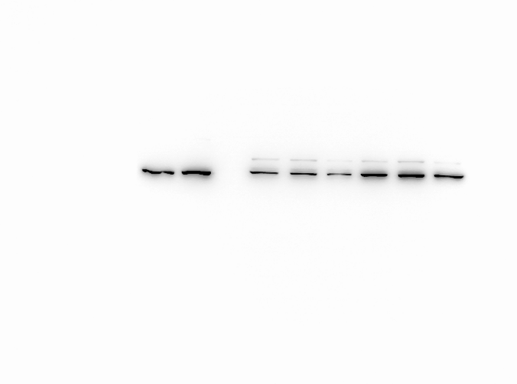
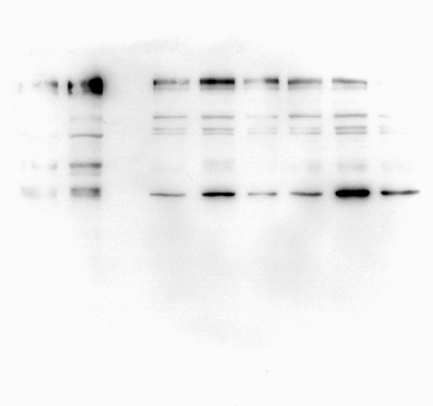
Source Data - Figure 4G
sihMENA(t) PANC-1
siCNT PANC-1
kDa
CM
kDa
130
130
95
95
72
88
72
80
55
70 kDa
55
hMENA(t)
HSP-70
36
36
28
28
Pan-hMENA
HSP-70
130
95
72
55
42 kDa
36
α-SMA
28
α-SMA

