Slide 1
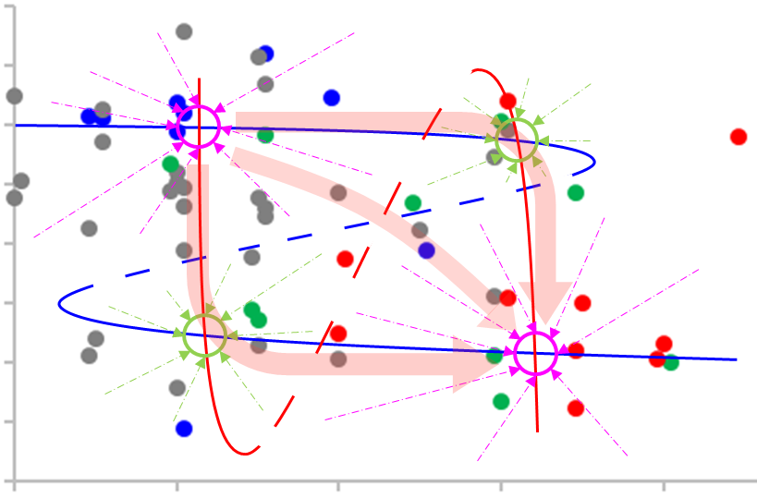
0.04
healthy
0.02
basal state
0.00
-0.02
-0.04
Microbiota status (PCoA1)
-0.06
-0.08
alternative state
-0.10
(pre-)disease
-0.12
0
2
4
6
8
basal state
alternative state
Host status (inflammation)
0% DSS 0.25% / 0.5% / 1% DSS 2% DSS 3% DSS
Additional Fig. 9

