Slide 1
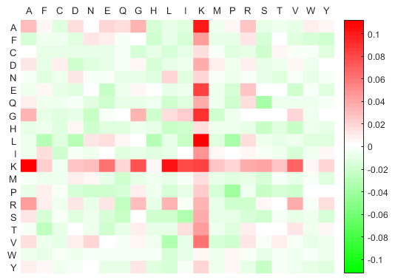
Second residue of a dipeptide
Enriched
First residue of a dipeptide
Difference of AAPC frequency between positive and negative datasets
Depleted

