Slide 1
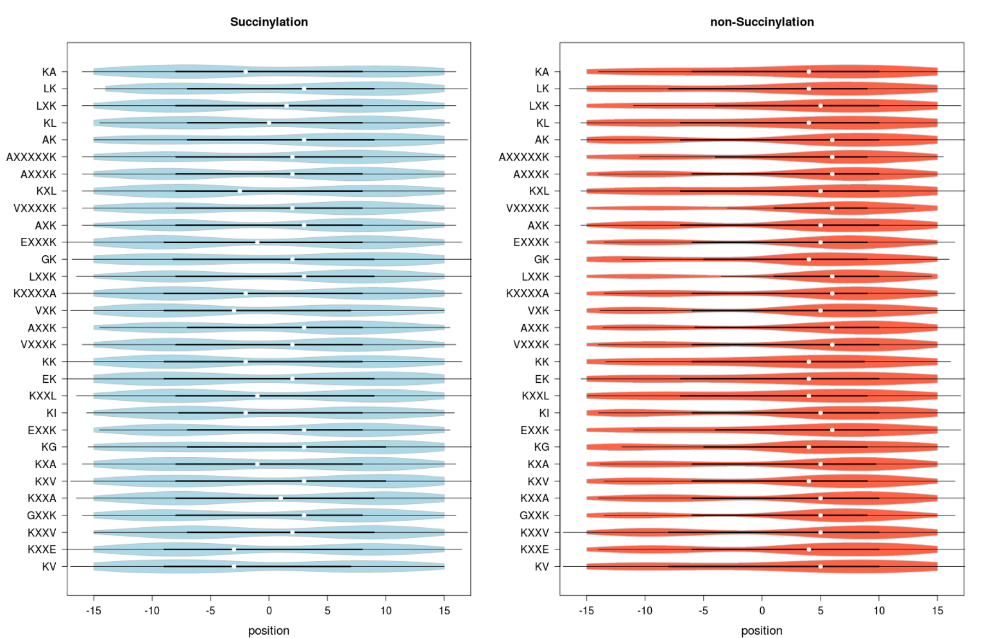
Succinylated
Non-succinylated
Position
Position

