Slide 1
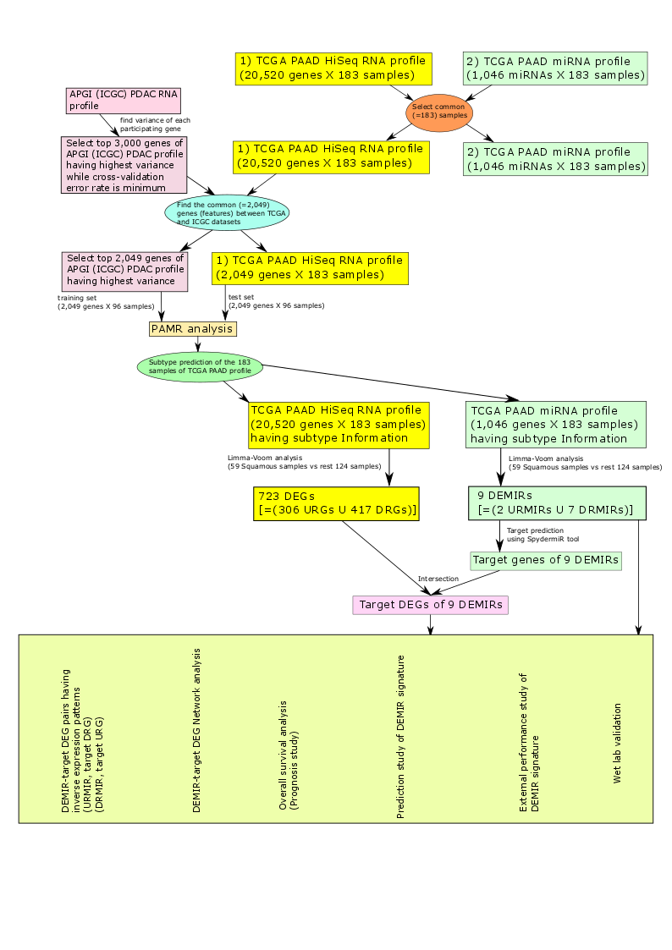
Supplementary Figure 1
test set
(2,049 genes X 183 samples)
Discovery phase
Target DEGs of 9 DEMIRs (miR-205-5p, -934, -192-5p, -194-5p, -194-3p, -215-5p, -375-3p, -552-3p, and -1251-5p)
Tissue cohort (n=199)
Individual and combined miRNA risk score for overall prognosis
Validation phase
Serum cohort (n=51)
Individual and combined miRNA risk score for overall prognosis

Slide 2
Supplementary Figure 2
A
B
100
100
80
80
Sensitiv ity
60
Sensitiv ity
60
40
Basal subtype (Moﬃtt)
AUC = 0.89
95%CI: 0.82-0.94
p < 0.0001
20 40 60 80 100
100-Speciﬁcity
40
Quasimesenchymal subtype (Collisson)
AUC=0.83 95%CI: 0.76-0.89
p < 0.0001
20 40 60 80 100
100-Speciﬁcity
20
20
0
0
0
0
C
Alive
Dead
1
0
-1
-2
-3
-4
-5
Risk score

Slide 3
Supplementary Figure 3
miR-205-5p
miR-934
miR-192-5p
100
Low
100
100
90
90
Low
90
High
80
High
80
High
80
Low
70
p = 0.001
70
p = 0.005
70
p = 0.009
60
60
Survival probability (%)
60
Survival probability (%)
50
Survival probability (%)
50
40
50
40
30
40
30
20
30
10
20
20
0
500
1000
1500
2000
10
0
500
1000
1500
2000
10
0
500
1000
1500
2000
Number at risk
Time
Number at risk
Time
Number at risk
Time
High miR-205-5p
High miR-934
High miR-192-5p
121
34
4
2
2
49
14
3
1
1
134
51
15
10
5
Low miR-205-5p
Low miR-934
Low miR-192-5p
42
24
11
8
3
114
44
12
9
4
29
7
0
0
0
miR-194-5p
miR-194-3p
miR-215-5p
100
100
100
90
High
90
High
High
80
Low
80
Low
80
Low
70
p = 0.04
70
p = 0.04
60
p = 0.06
60
60
Survival probability (%)
Survival probability (%)
Survival probability (%)
50
50
40
40
40
30
30
20
20
20
10
0
500
1000
1500
2000
10
0
500
1000
1500
2000
0
0
500
1000
1500
2000
Number at risk
Time
Number at risk
Time
Number at risk
Time
High miR-194-5p
High miR-194-3p
High miR-215-5p
74
32
8
6
3
74
32
8
6
3
73
26
5
3
2
Low miR-194-5p
Low miR-194-3p
Low miR-215-5p
89
26
7
4
2
89
26
7
4
2
90
32
10
7
3
miR-375-3p
miR-552-3p
miR-1251-5p
100
High
100
High
100
High
80
Low
90
Low
80
Low
p = 0.003
80
p = 0.41
p = 0.05
60
70
60
60
Survival probability (%)
Survival probability (%)
Survival probability (%)
40
50
40
40
20
30
20
20
0
0
500
1000
1500
2000
10
0
500
1000
1500
2000
0
0
500
1000
1500
2000
Number at risk
Time
Number at risk
Time
Number at risk
Time
High miR-375
High miR-552-3p
High miR-1251-5p
49
18
8
5
2
44
16
3
1
1
32
11
6
6
2
Low miR-375
Low miR-552-3p
Low miR-1251-5p
114
40
7
5
3
119
42
12
9
4
131
47
9
4
3

Slide 4
Supplementary Figure 4
miR-205-5p
miR-934
miR-192-5p
100
High
100
High
100
High
80
Low
80
Low
80
Low
60
60
60
Survival probability (%)
Survival probability (%)
Survival probability (%)
40
40
40
20
20
p = 0.007
20
0
p = 0.03
p = 0.01
0
500
1000
1500
2000
0
0
500
1000
1500
2000
0
0
500
1000
1500
2000
Number at risk
Time
Number at risk
Time
Number at risk
Time
High miR-205-5p
High miR-934
10
8
5
2
0
30
20
9
3
1
High miR-192-5p
Low miR-205-5p
Low miR-934
10
9
5
2
1
39
21
5
1
0
21
10
2
1
0
Low miR-192-5p
41
21
6
2
0
miR-194-5p
miR-194-3p
miR-215-5p
100
High
100
High
100
High
90
Low
90
Low
Low
80
80
80
70
70
60
60
Survival probability (%)
60
Survival probability (%)
50
Survival probability (%)
40
50
40
30
40
p = 0.21
30
20
20
p = 0.31
p = 0.17
10
20
0
0
500
1000
1500
2000
10
0
500
1000
1500
2000
0
500
1000
1500
2000
Number at risk
Time
Number at risk
Time
Number at risk
Time
High miR-194-5p
High miR-194-3p
High miR-215-5p
27
18
7
3
1
14
9
4
2
1
29
19
7
3
1
Low miR-194-5p
Low miR-194-3p
Low miR-215-5p
24
12
4
1
0
37
21
7
2
0
22
11
4
1
0
miR-375-3p
miR-552-3p
miR-1251-5p
100
High
100
Low
100
High
80
Low
90
High
90
Low
80
80
60
70
70
60
Survival probability (%)
Survival probability (%)
Survival probability (%)
60
40
50
50
40
40
p = 0.02
30
30
20
p = 0.33
p = 0.29
20
20
0
0
500
1000
1500
2000
10
0
500
1000
1500
2000
10
0
500
1000
1500
2000
Number at risk
Time
Number at risk
Time
Number at risk
Time
High miR-375
High miR-552-3p
High miR-1251-5p
13
11
4
2
1
24
13
4
2
1
11
7
3
2
1
Low miR-375
Low miR-552-3p
Low miR-1251-5p
38
19
7
2
0
25
16
7
2
0
40
23
8
2
0

