Slide 1
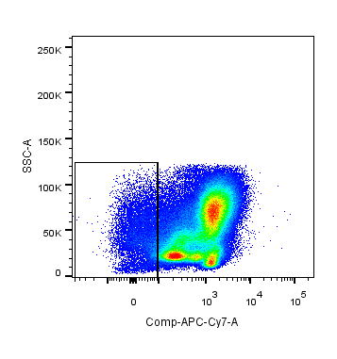
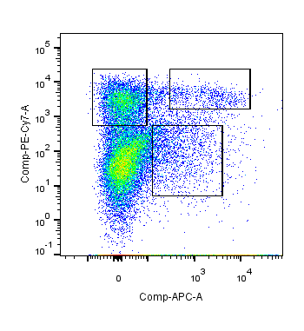
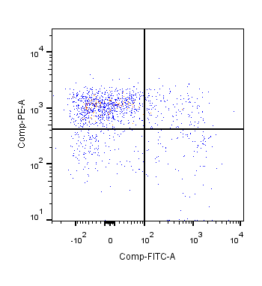
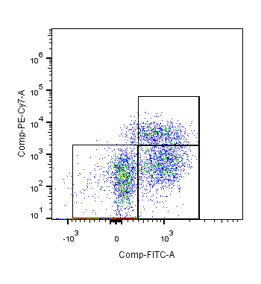
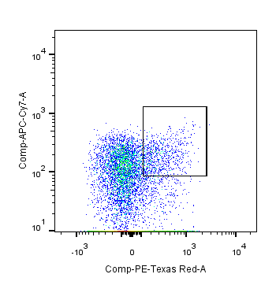
Supplemental information
Figure S1. Atf3^{fl/fl}Vav1Cre mice display normal hematopoiesis
A
B
MP
LSK
MPP
3/4
MPP2
Atf3^{fl/fl}
Atf3^{fl/fl}Vav1Cre
Lin-
ATF3
SSA
C-kit
CD48
ST-
HSC
LT-HSC
β-actin
Lin
Sca-1
CD150
GMP
CLP
CD16/32
MEP
CMP
CD127
CD34
Flk2
(A) Western blotting showing deficiency of ATF3 in mouse Lineage⁻(Lin⁻) cells. (B) Scheme for FCM gating strategies to identify various HSPCs in the BM, including Lin⁻ cells, MPs, LSKs, LT-HSCs, ST-HSCs, MPPs, CMPs, GMPs, MEPs and CLPs.

Slide 2
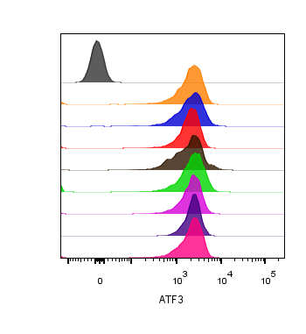
Figure S2. The dynamic expression pattern of ATF3 is not in MPs
MP
Isotype
D0
D1
D2
D3
D4
D5
D6
ATF3
D7
Representative flow cytometry histogram (left) and mean fluorescence intensity (MFI, right) of ATF3 expression in MPs (Lin⁻Sca1⁺C-kit⁻) from WT BM cells at the indicated time points after 5-FU (150 mg/kg) treatment (n=5). Data are representative of two independent experiments. Error bars show mean± SD. P values was determined using one-way analysis of variance followed by Tukey-Kramer multiple-comparisons test.

Slide 3
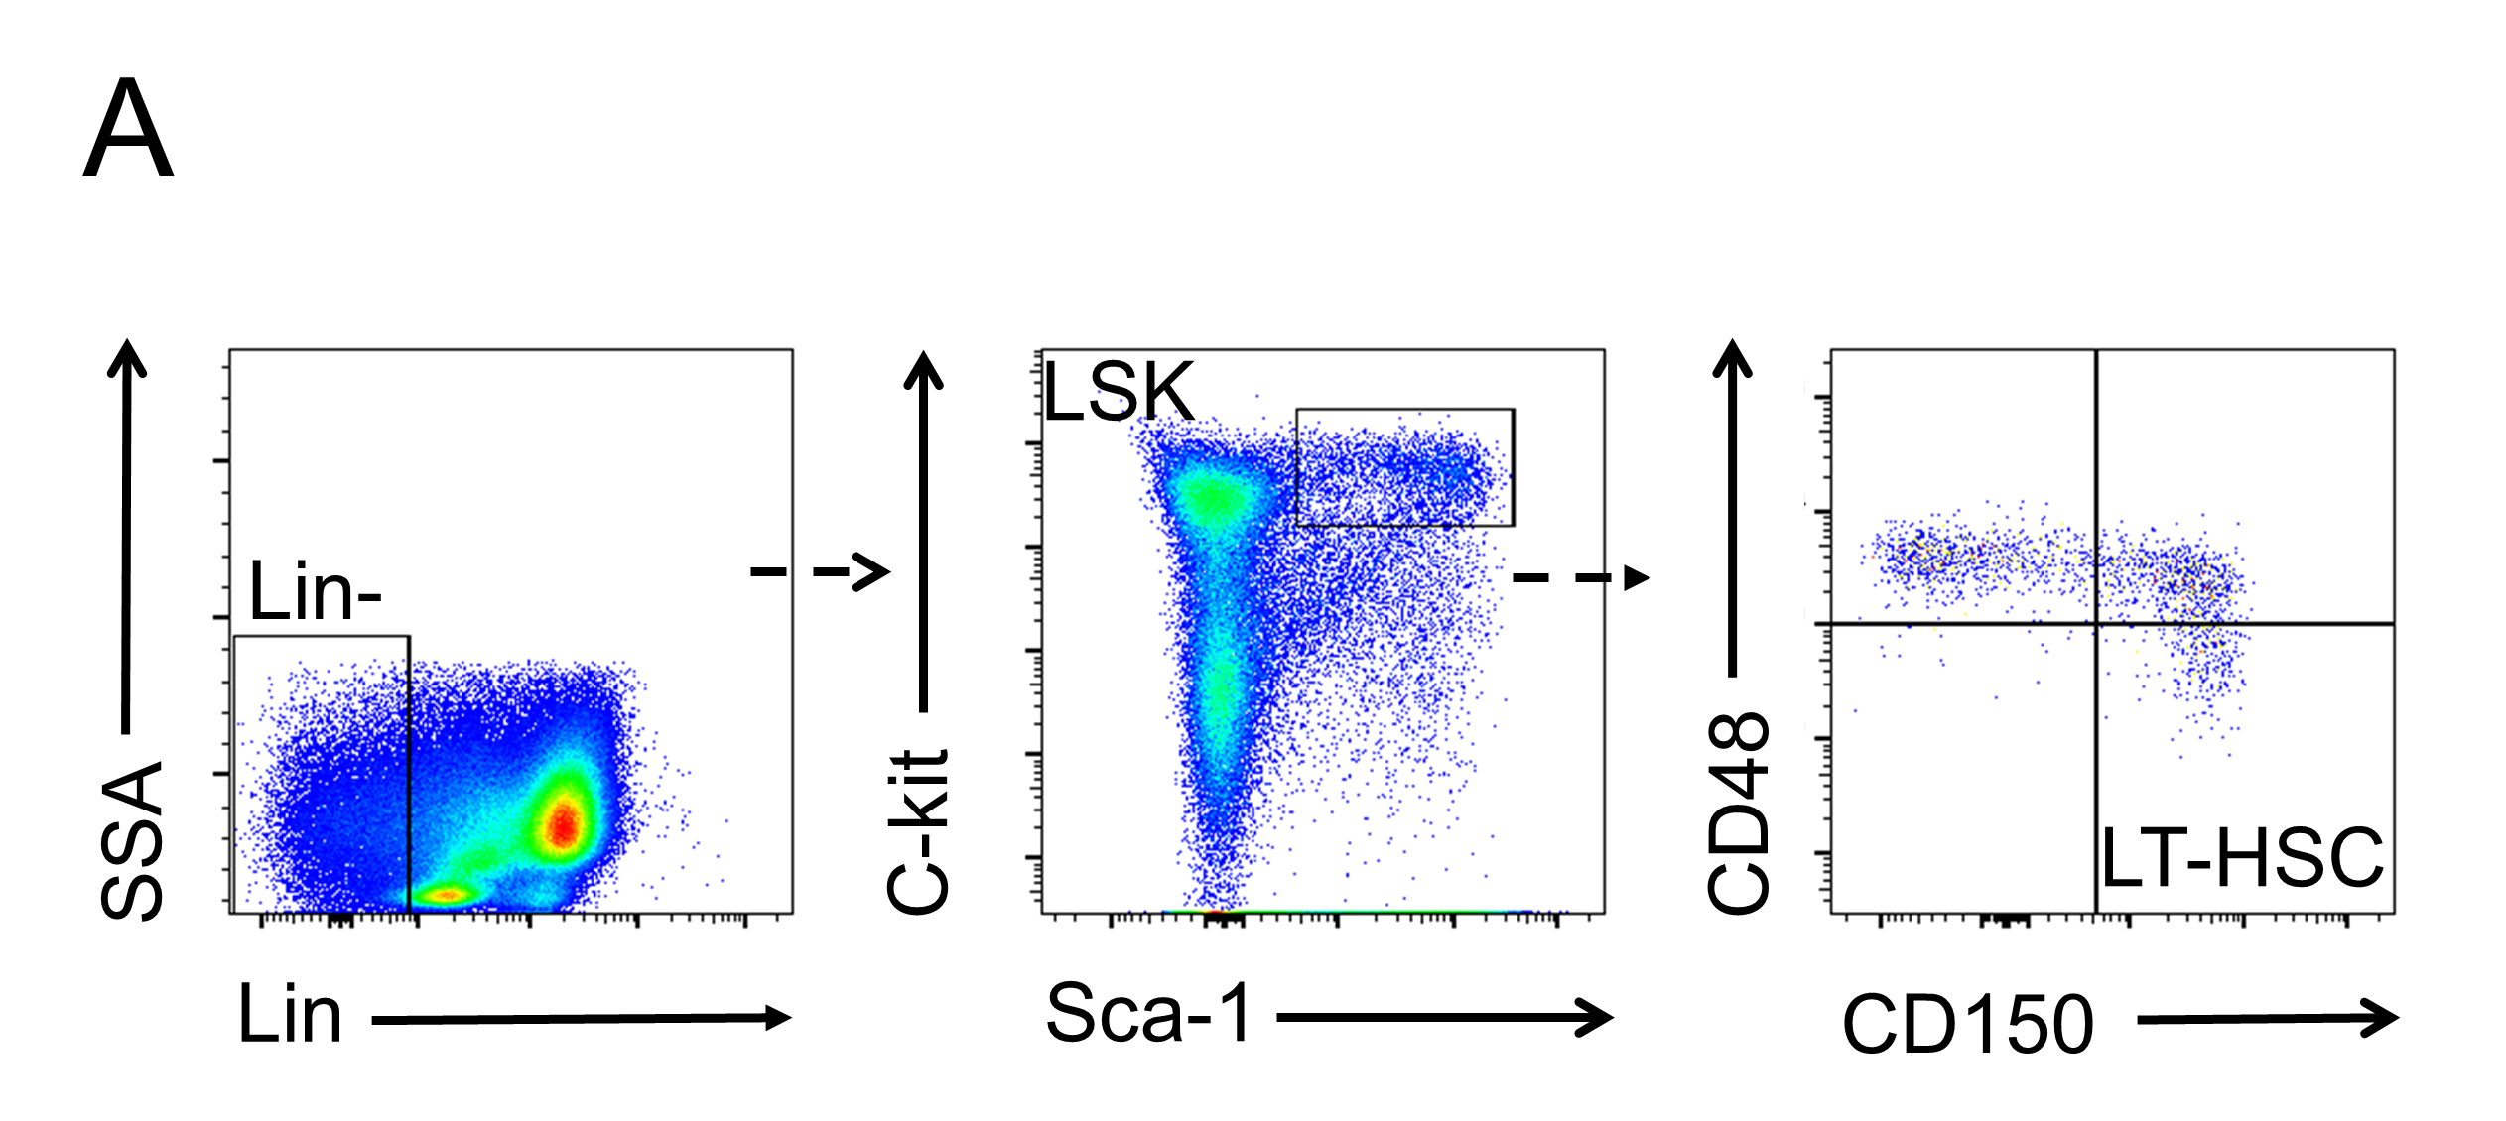


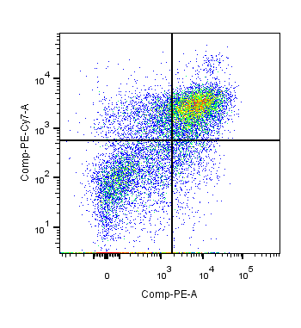
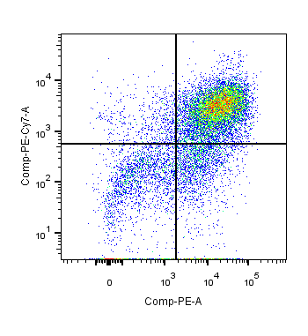
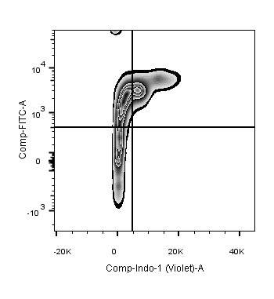
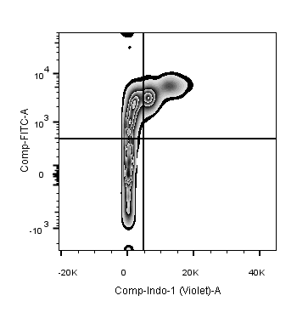
Figure S3. ATF3 deficiency improves resistance to irradiation
B
C
5 Gy
Days
0 3 6 9 12 15 18
Atf3^{fl/fl}
or Atf3^{fl/fl}Vav1Cre
analysis
D
E
F
Gated on Lin⁻
G
Gated on LSK
Atf3^{fl/fl}
Atf3^{fl/fl}Vav1Cre
Atf3^{fl/fl}
Atf3^{fl/fl}Vav1Cre
43.5
63.8
36.0
20.2
48.5
25.6
C-kit
Ki67
43.7
25.8
Sca-1
DAPI
(A) Scheme for FCM gating strategies for 5FU treatment. (B) Schematic overview about the experiment of sublethal irradiation. (C) Absolute numbers of LSKs (upper，n=5) and LT-HSCs (lower, n=6) from BM at day 10 after 5 Gy irradiation. (D) The percentages of different cell cycle stages in LT-HSCs from BM at day 10 after 5 Gy irradiation (n=6). (E) The complete blood cell counts of Atf3^{fl/fl} and Atf3^{fl/fl}Vav1Cre mice after treated with 5 Gy irradiation (n =4-10). (F and G) Atf3^{fl/fl} or Atf3^{fl/fl}Vav1Cre derived-BM cells cultured for 10 d in SCF, TPO, FLT3L, and IL-6 in vitro, percentages (F) and cell cycle status (G) of LSKs were analysis by FCM (n=6). Data are represent mean± SD from two independent experiments. P values was determined using two-sided Student’ s t tests. *P < 0.05; ** P < 0.01.

Slide 4
Table S1. Primer sequences used in qRT-PCR
Names | Forward | Reverse
Atf3 | GAGGATTTTGCTAACCTGACACC | TTGACGGTAACTGACTCCAGC
β-Actin | GACGGCCAGGTCATCACTATTG | AGGAAGGCTGGAAAAGAGCC

