Slide 1
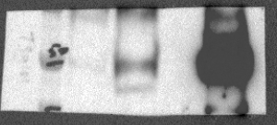
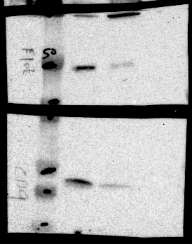
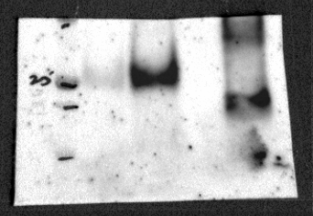
Tsg101
Flotillin-1
CD81
CD9
Supplementary Figure S6. Full-length images of blots shown in Figure 2C.

