Slide 1
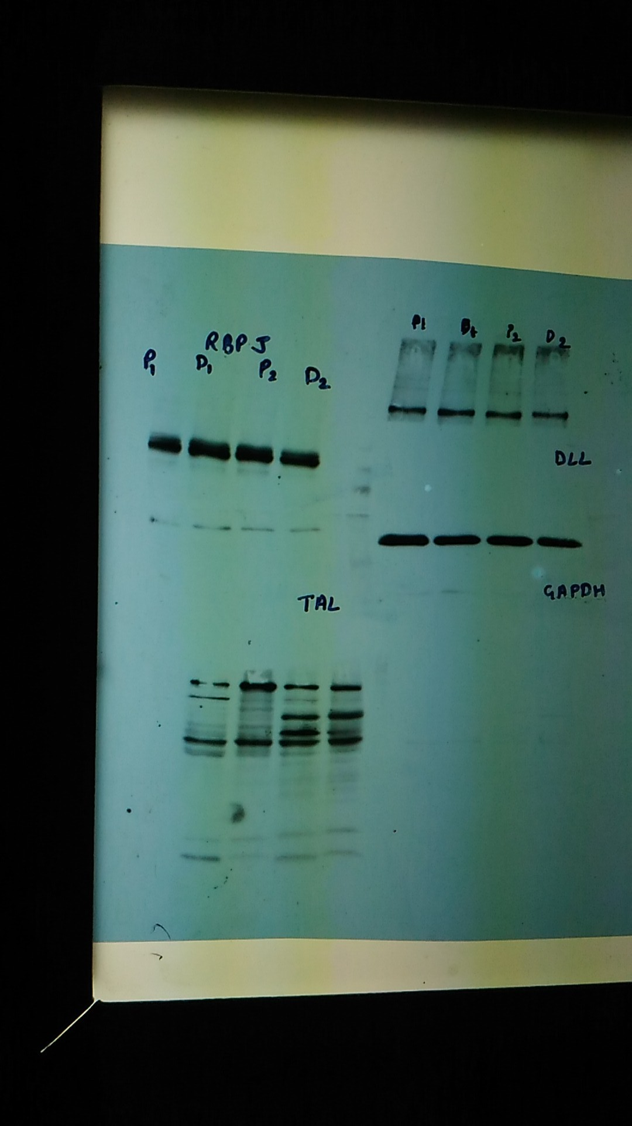
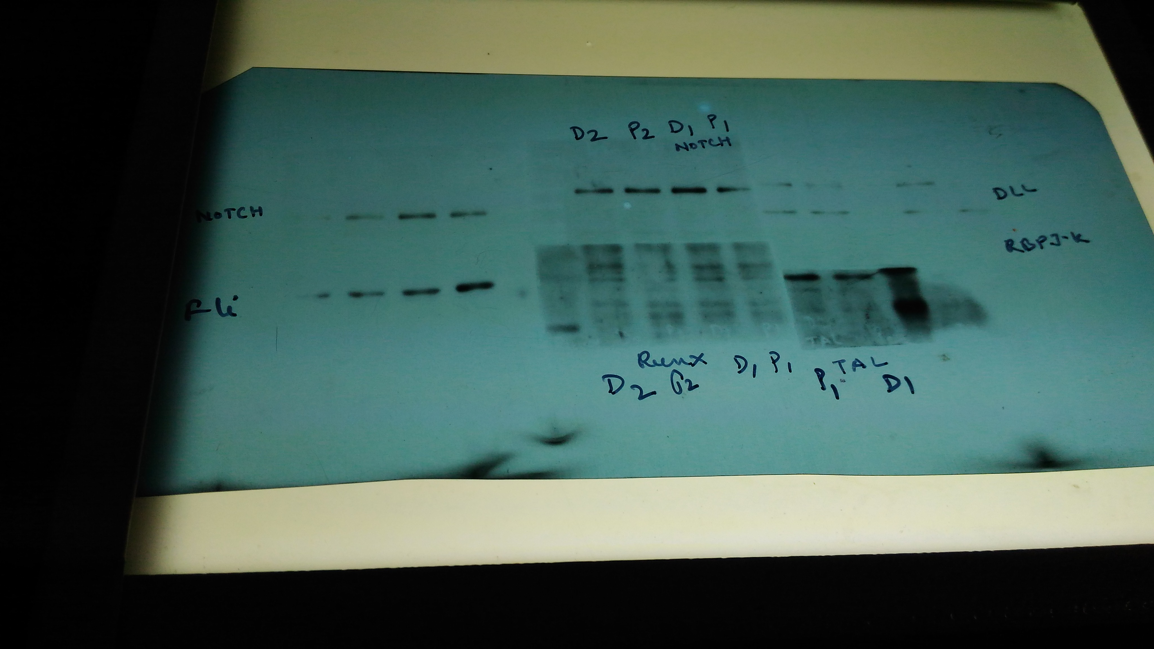
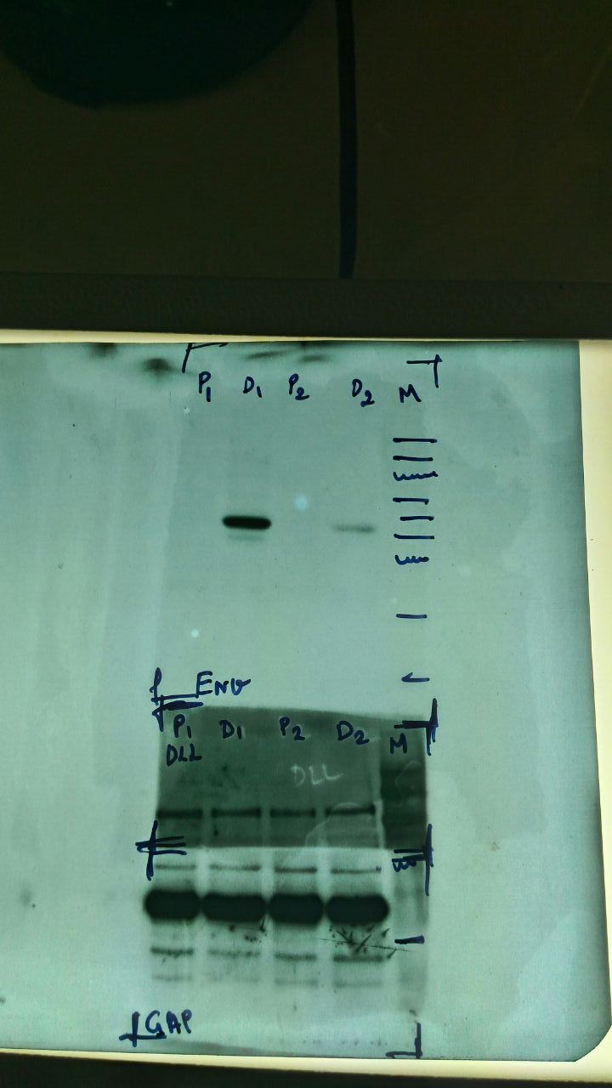
Figure 5b
DLL
RBPJK
GAPDH
Notch
DENV E

Slide 2



Figure 5c
TAL-1
Actin
Histone
Fig. 6a
TAL-1
DENV E

