Slide 1
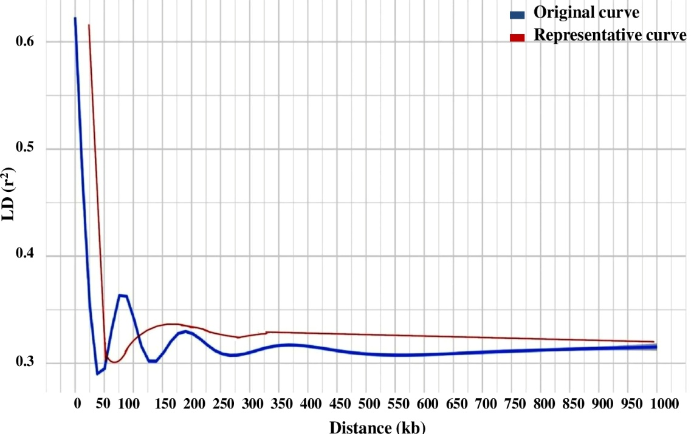
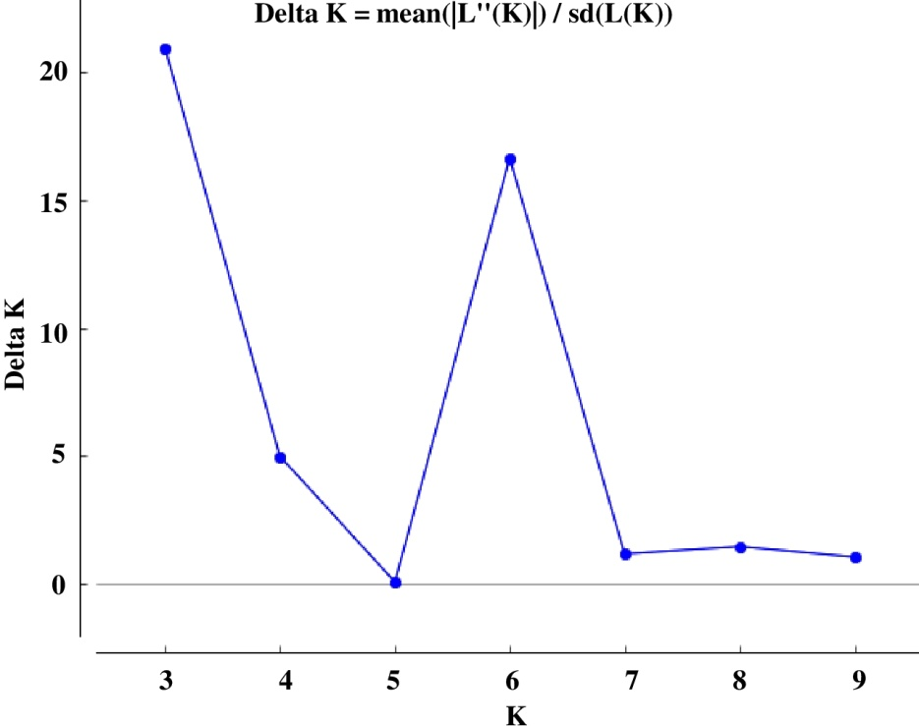
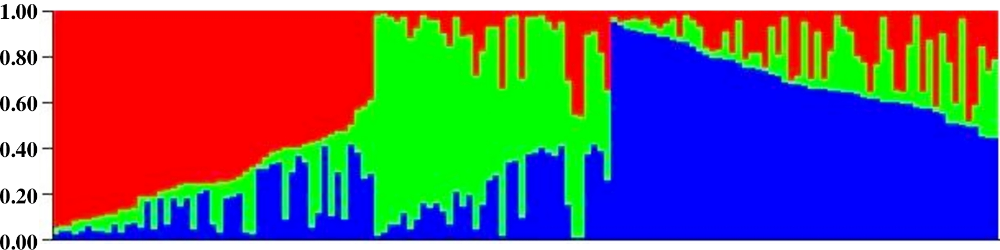
(A)
(B)
(C)
FIGURE 3 (A) 4 LD decay measured in association panel of 144 diverse mungbean genotypes (B) Delta K plot showing best peak at K = 3 (C) Population genetic structure plot of mungbean association mapping panel (optimal population number k=3 with three different colors

