Slide 1






Feasibility Study of PET Dynamic Imaging of [¹⁸F]DHMT for Quantification of Reactive Oxygen Species in the Myocardium of Large Animals
Journal of Nuclear Cardiology | Official Journal of the American Society of Nuclear Cardiology
Jing Wu, PhD,^{a,}* Nabil E. Boutagy, PhD,^{b,}* Zhengxin Cai, PhD,ª Shu-fei Lin, PhD,ª Ming-Qiang Zheng, PhD,ª Attila Feher MD, PhD,^{b} John Stendahl, MD, PhD,^{b} Michael Kapinos,ª Jean-Dominique Gallezot, PhD,ª Hui Liu, PhD,ª Tim Mulnix, PhD,ª Wenjie Zhang, MD, PhD,ª Marcel Lindemann, PhD,ª Jo-ku Teng,ª Edward J. Miller, MD, PhD,^{b} Yiyun Huang, PhD, ª Richard E. Carson, PhD,ª Albert J. Sinusas, MD,^{a,b} Chi Liu, PhD,ª
ªDepartment of Radiology and Biomedical Imaging, Yale School of Medicine, New Haven, Connecticut
^{b}Section of Cardiovascular Medicine, Department of Medicine, Yale Translational Research Imaging Center, Yale School of Medicine, New Haven, Connecticut
*Jing Wu and Nabil E. Boutagy contributed equally to this work.
Jing Wu, PhD
Nabil E. Boutagy, PhD
Copyright American Society of Nuclear Cardiology

Slide 2
BACKGROUND
Journal of Nuclear Cardiology | Official Journal of the American Society of Nuclear Cardiology
1- Excessive reactive oxygen species (ROS) production has been implicated in the development and progression of a variety of cardiovascular diseases (CVDs).
2- Currently, the noninvasive measurement of ROS is limited to circulating or urinary biomarkers that are not specific to the myocardium.
3- For specific measurement of myocardial ROS production, our group has recently demonstrated the ability of static PET imaging for a novel tracer, [¹⁸F]DHMT, to detect an elevation in myocardial superoxide production in a rodent model of progressive anthracycline-induced cardiotoxicity.
4- In this study, we aimed to develop a dynamic PET imaging technique for [¹⁸F]DHMT to allow for absolute quantification of myocardial ROS production in a large animal model.
Copyright American Society of Nuclear Cardiology

Slide 3
METHODS
Journal of Nuclear Cardiology | Official Journal of the American Society of Nuclear Cardiology
Study type:(Select all that apply)
  Prospective/retrospective/randomized/double blind/placebo controlled/observational/case control/cohort/experimental
Study subjects: (one sentence summarizing included and/or excluded subjects):
  Seven retired female beagle breeders were included in this study. Of these, one animal also underwent a chronic-doxorubicin (DOX) dosing protocol to elicit progressive systolic dysfunction by receiving weekly doses of DOX HCl (1 mg/kg/week).
Study endpoints (chronic study):
  Primary end point(s): Cumulative DOX dose of 15 mg/kg was reached
  Secondary end point(s): A decline in LVEF below 50%.
Study variables
  Myocardial [¹⁸F]DHMT uptake (K_{i}, SUV, LV-to-blood pool SUV ratio)
  Plasma [¹⁸F]DHMT metabolite analysis
Copyright American Society of Nuclear Cardiology

Slide 4
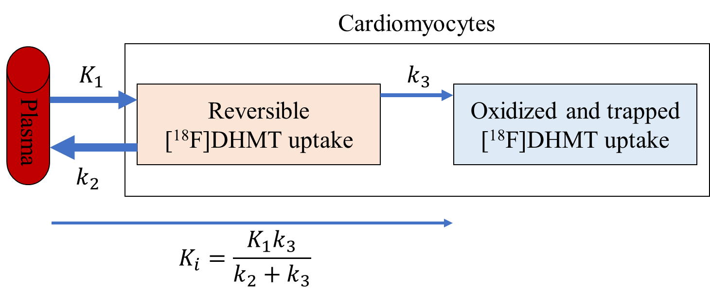
RESULTS
Journal of Nuclear Cardiology | Official Journal of the American Society of Nuclear Cardiology
Figure. Illustration of the kinetics of [¹⁸F]DHMT in the cardiomyocytes following the irreversible two-tissue (2Ti) compartment model. K₁, k₂ and k₃ are the rate constants of [¹⁸F]DHMT movement between compartments, and K_{i} is the net influx rate of [¹⁸F]DHMT from the plasma into the irreversibly bound compartment.
Copyright American Society of Nuclear Cardiology

Slide 5
RESULTS
Journal of Nuclear Cardiology | Official Journal of the American Society of Nuclear Cardiology
Table. LV SUV (60 - 90 min), LV-to-blood pool SUV ratio (60 - 90 min) and 2Ti derived K_{i} values for each study.
Study | Subject | DOX Dose (mg/kg) | SUV (g/mL) | SUV ratio | K_{i} (mL/min/cm³)
1 | Dog #1 | 0 | 1.91 | 2.56 | 0.0161
2 | Dog #2 | 0 | 1.61 | 2.08 | 0.0096
3 | Dog #3 | 0 | 2.15 | 1.90 | 0.0078
4 | Dog #4 | 0 | 1.13 | 2.01 | 0.0094
5 | Dog #5 | 0 | 1.51 | 1.99 | 0.0101
6 | Dog #6 | 0 | 2.22 | 3.17 | 0.0226
7 | Dog #7 | 3 | 1.09 | 2.00 | 0.0092
8 | Dog #7 | 7 | 1.21 | 1.88 | 0.0108
9 | Dog #7 | 12 | 1.30 | 2.07 | 0.0133
mean | Dogs #1-6 | 0 | 1.76 | 2.29 | 0.0126
SD | Dogs #1-6 | 0 | 0.42 | 0.49 | 0.0057
Copyright American Society of Nuclear Cardiology

Slide 6
CONCLUSIONS
Journal of Nuclear Cardiology | Official Journal of the American Society of Nuclear Cardiology
1- We developed a dynamic PET imaging technique with full kinetic modeling and metabolite analysis for absolute quantification of the superoxide tracer, [¹⁸F]DHMT, in a large animal model.
2- We demonstrated that [¹⁸F]DHMT is an irreversible tracer and selected 2Ti as the optimal compartment model for kinetic modeling.
3- Patlak analysis was selected as the simplified graphical analysis method and was successfully used for generating high-quality parametric K_{i} images that had superior myocardium-to-blood contrast than static images.
4- The proposed technique for quantifying in vivo myocardial superoxide production from dynamic PET imaging of [¹⁸F]DHMT may provide prognostic information in CVD, such as heart failure, in which oxidative stress plays a key role in disease development and progression.
Copyright American Society of Nuclear Cardiology

