Slide 1
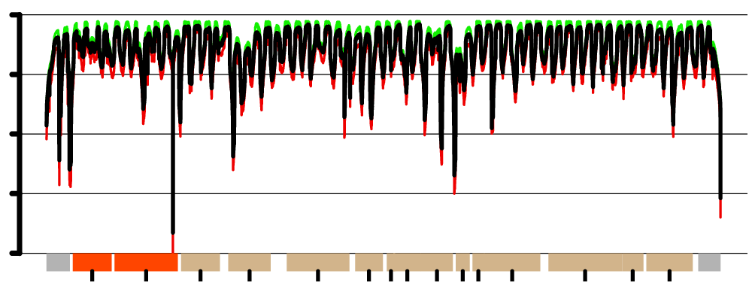
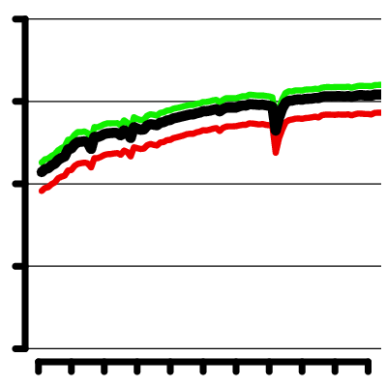
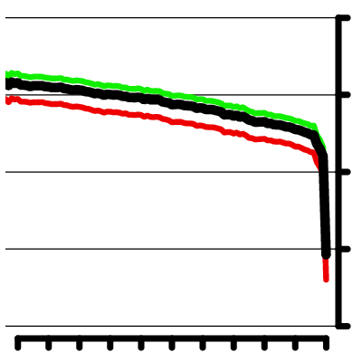
A
4
3
2
log₁₀(D)
1
0
12S
16S
ND1
ND2
ND3
ND4
ND5
ATP8
ND6
COX1
ATP6
ND4L
CYTB
COX2
COX3
B
4
4
log₁₀(D)
0
0
0
50
100
16469
16519
16569
Figure S1. mtDNA-Seq sequencing depth. (A) Shown is the linearized version of the mitochondrial chromosome, with annotated genomic features: rRNA (orange), protein coding genes (tan), control region or D-loop (grey). Depth of sequencing (D) displayed on the log10 scale, for mean sequencing (black), first (red) and third (green) quartiles of depth. (B) Zoom into the first and last 100 nucleotides regions.

