Slide 1








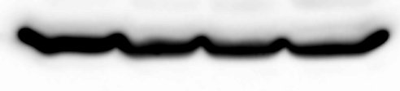
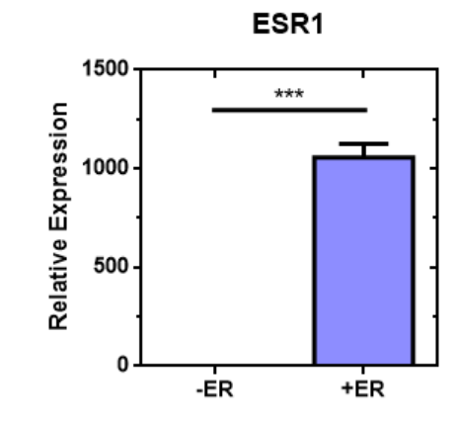
Supplemental Figure 1
A.
B.
MDA-MB-231
SUM149
T47D
HCC1428
20% O₂
1% O₂
O₂(%)
₂₀
₁
₂₀
₁
₂₀
₁
8
16
24
48
EGFR -
EGFR -
HIF-1α -
Actin -
Actin -
C.
D.
MCF-7
Hypoxia
20% O₂
1% O₂
1 cm
Fulvestrant
-
+
-
+
EGFR -
EGFR
TFF-1 -
Actin -
MCF-7
BT-474
E.
20% O₂
1% O₂
F.
20% O₂
1% O₂
OHT
-
+
-
+
OHT
-
+
-
+
EGFR -
EGFR -
TFF-1 -
HIF-1α -
Actin -
Actin -
-ER
+ER
G.
20% O₂
1% O₂
20% O₂
1% O₂
H.
EGFR -
Actin -

Slide 2





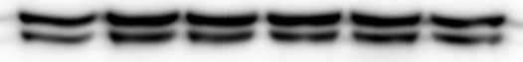










Supplemental Figure 2
BT-474
HIF1-1
HIF1-2
HIF2-1
HIF2-2
A.
NTC
B.
20% O₂
1% O₂
EGF
0
30
60
0
30
60
Min.
HIF-1α -
EGFR -
HIF-1α -
HIF-2α -
pAkt^{S473} -
Akt -
Actin -
pErk^{T202/Y204} -
Erk -
Actin -
HCC1428
C.
20% O₂
1% O₂
D.
EGF (min): 0 30 60 0 30 60
20% O₂
1% O₂
EGFR -
0
.01
.05
.1
.2
.5
1
μM
EGFR -
HIF-1α -
HIF -
pAkt^{S473} -
pAkt^{S473} -
Akt -
Akt -
pErk^{T202/Y204} -
pErk^{T202-Y204} -
Erk -
Erk -
Actin -
Actin -

Slide 3
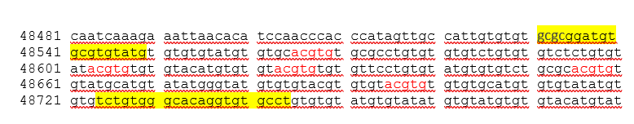
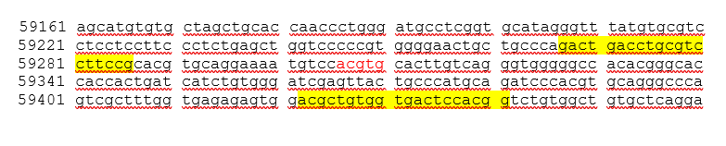
Supplemental Figure 3
A.
IgG
HIF-1α
HIF-2α
HIF-1β
B.
IgG
HIF-1α
HIF-2α
HIF-1β
C.
IgG
HIF-1α
HIF-2α
HIF-1β

Slide 4
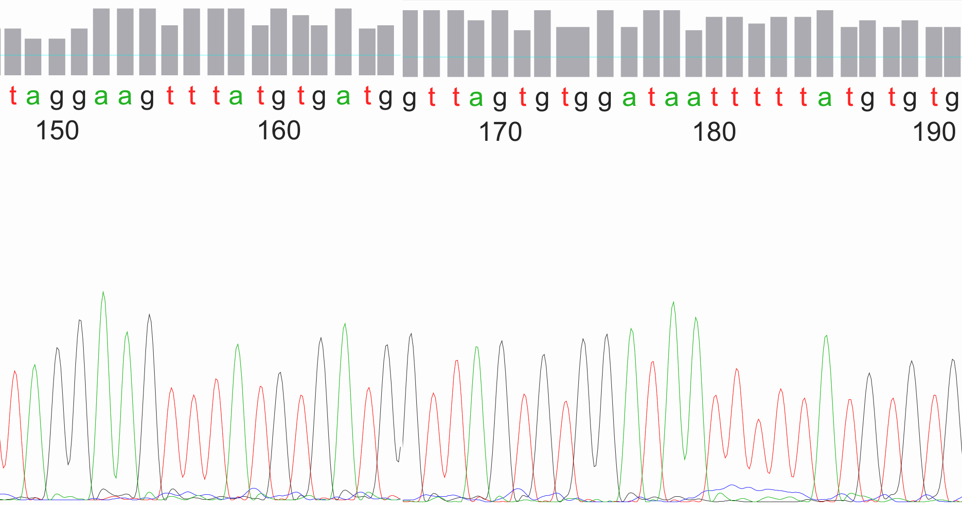
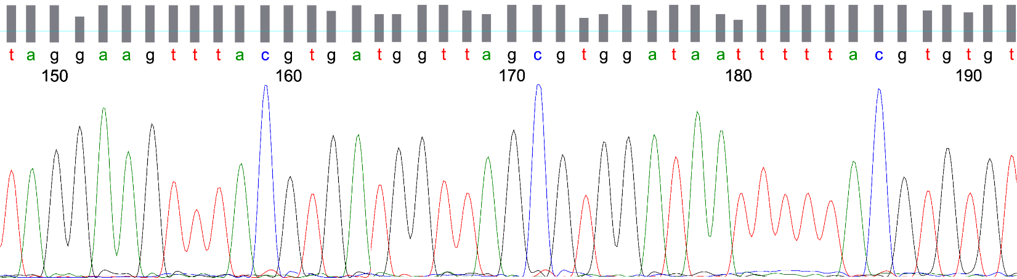
Supplemental Figure 4
A.
*
*
B.
*
*

Slide 5
Supplemental Figure 5
A.
B.
C.

Slide 6
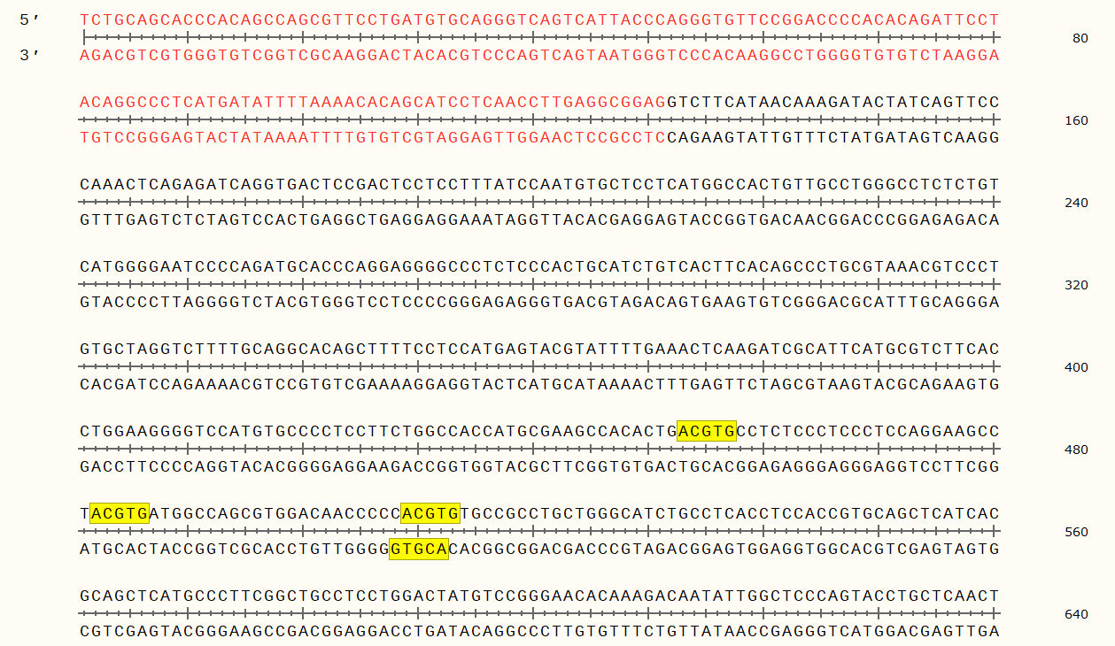
Supplemental Figure 6
A.
Probe: cg20062492
chr7:55180819-55180940, GRCh38.p13 Primary Assembly

Slide 7
Supplemental Figure 7
A.
B.
C.
D.

Slide 8
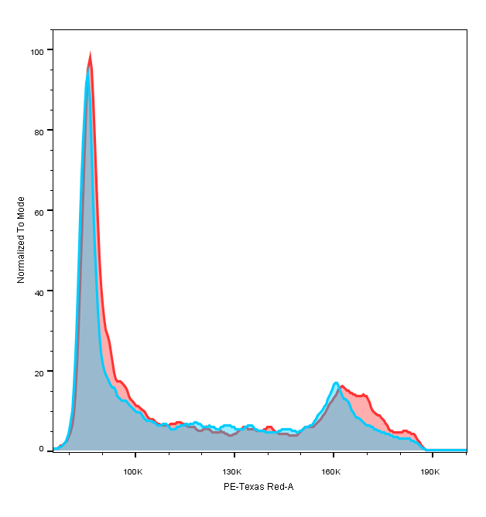
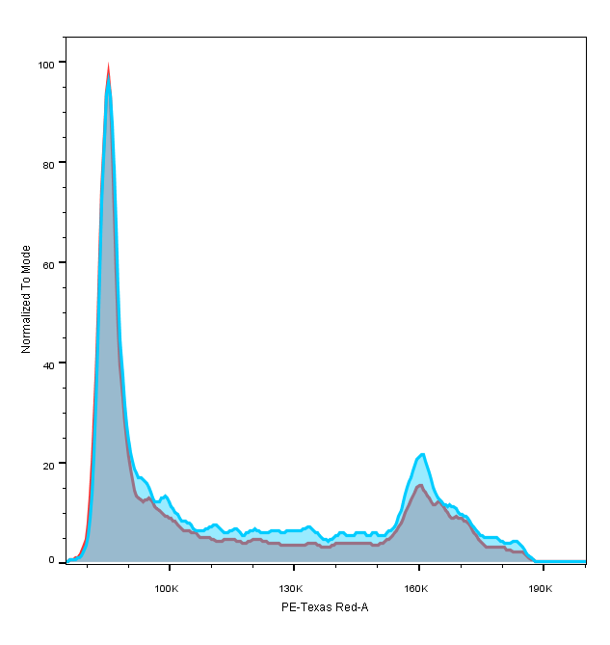


Supplemental Figure 8
A.
B.
1% O₂
C.
HIF1-1
HIF1-2
HIF1-1
HIF1-2
20% O₂
1% O₂
EGF(h)-
0 h
2 h
100
100
NTC
NTC
-EGF: 25.5% in S
+EGF: 28.6% in S
-EGF: 22.9% in S
+EGF: 27.7% in S
80
80
HIF-1α-
60
60
Cyclin D1-
% of Mode
Cyclin A-
40
40
c-myc -
20
20
P-Rb -
0
100
130
160
190
0
100
130
160
190
Actin-
Fluorescence (RFU)
Fluorescence (RFU)
D.
E.

