Slide 1
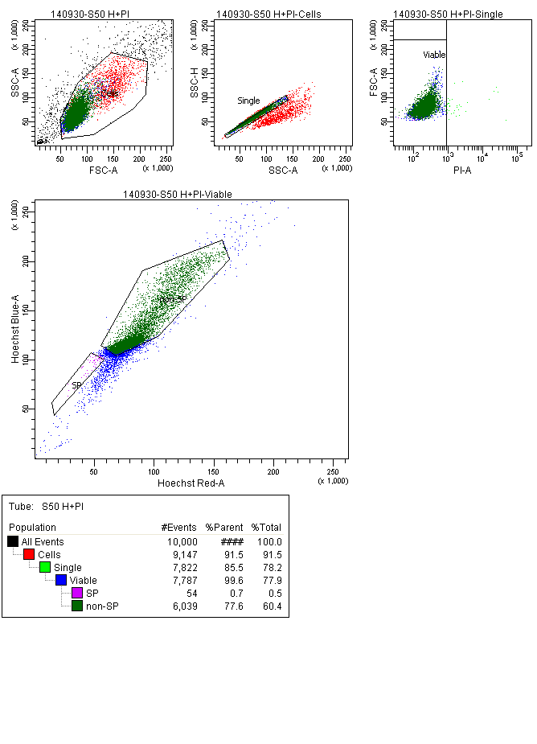
A
Gating strategy
B
Events statistics
Fig. S4

