Slide 1
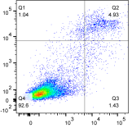


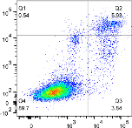
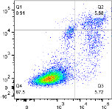
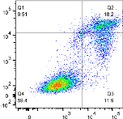
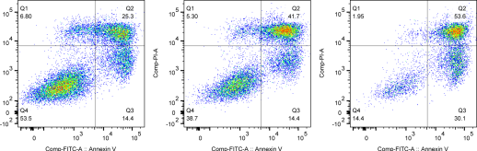

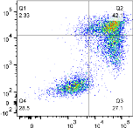
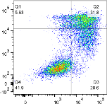
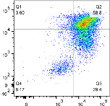
A
B
i)
A2780
i)
A2780-Cp
Control
siRNA
ALDH1A1
siRNA
NEK-2
siRNA
Control
siRNA
ALDH1A1
siRNA
NEK-2
siRNA
4.9%
5.0%
15%
5.9%
5.8%
18%
Control
Control
PI
1.4%
1.5%
4.3%
PI
3.8%
5.7%
12%
25%
42%
54%
42%
32%
59%
Cp-treated
Cp-treated
14%
14%
30%
27%
21%
29%
ii)
Annexin V-FITC
ii)
Annexin V-FITC
**
**
**
**
Early apoptosis (%)
Early apoptosis (%)
iii)
**
iii)
*
**
**
*
Late apoptosis (%)
Late apoptosis (%)
Fig. S7

