Slide 1
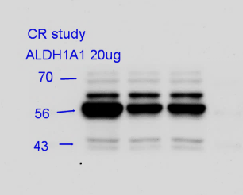
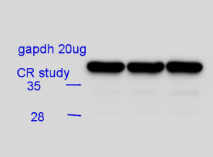
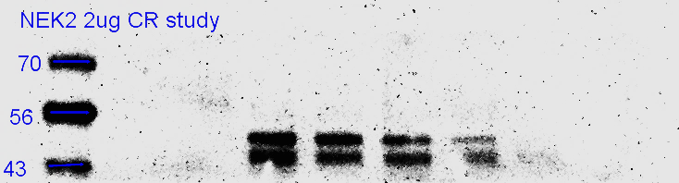
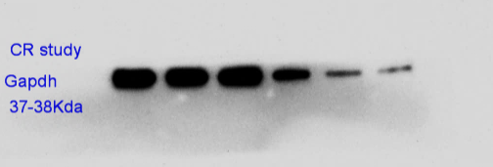
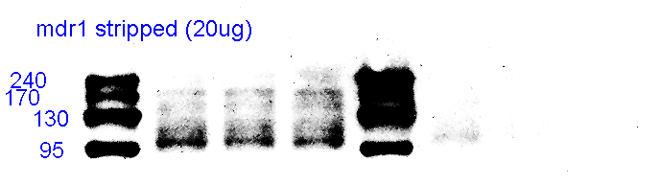
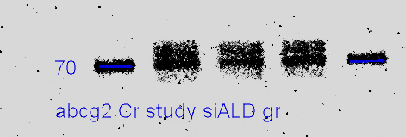
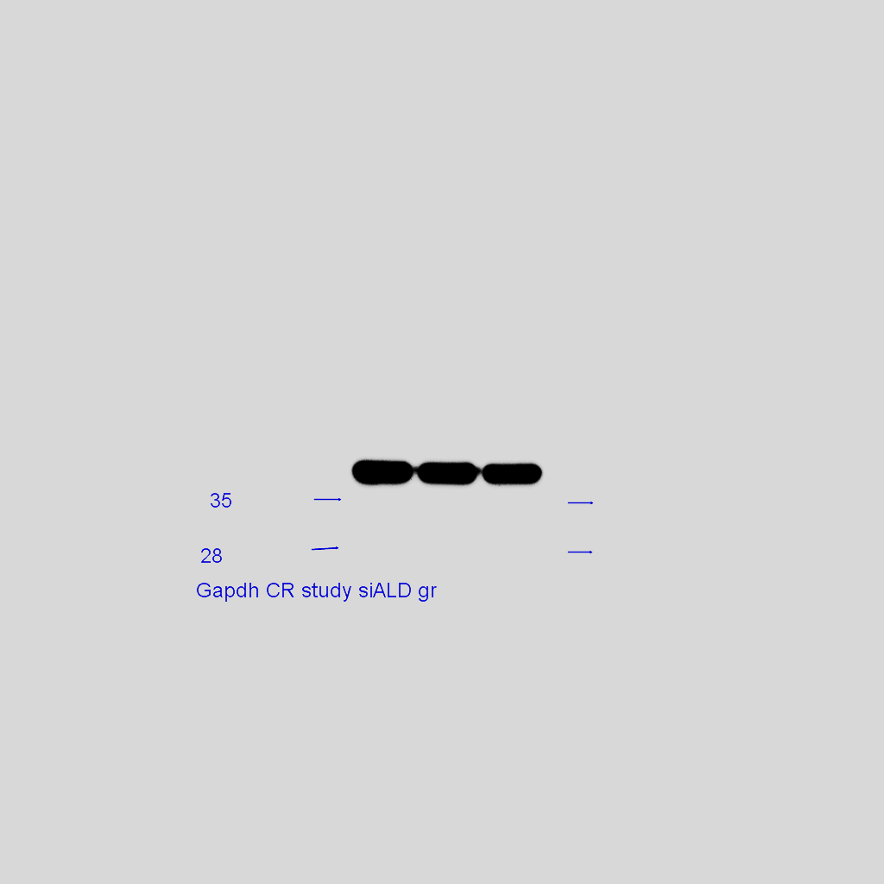
5E
ALDH1A1
siRNA
Ctrl.
ALDH1A1
5E
GAPDHª
siRNA
E
#1
#2
Ctrl.
ALDH1A1
#1
#2
ALDH1A1
GAPDHª
5E
NEK-2
siRNA
Ctrl.
ALDH1A1
#1
#2
NEK-2
5E
GAPDH
siRNA
Ctrl.
ALDH1A1
#1
#2
5E
MDR1
siRNA
GAPDH
Ctrl.
ALDH1A1
#1
#2
MDR1
5E
ABCG2
siRNA
5E
Ctrl.
ALDH1A1
GAPDH
siRNA
#1
#2
Ctrl.
ALDH1A1
ABCG2
#1
#2
GAPDH
Figure S8. The full original immunoblots of cropped images presented in Figure 5E (left panel).

Slide 2
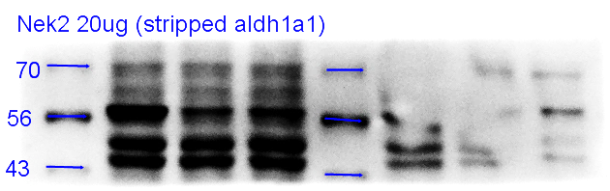
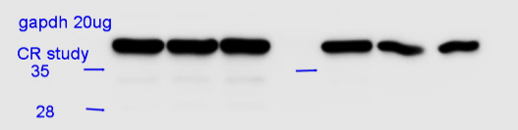
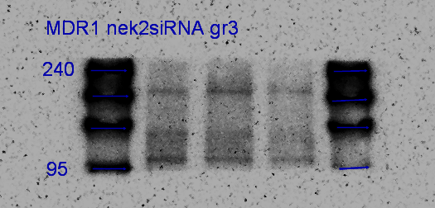
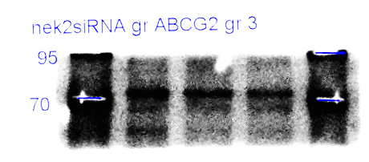
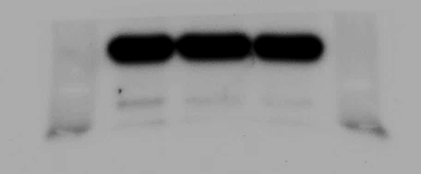
5E
NEK-2
siRNA
Ctrl.
NEK-2
#1
#2
NEK-2
siRNA
5E
GAPDH
Ctrl.
NEK-2
#1
#2
GAPDH
5E
MDR1
siRNA
Ctrl.
NEK-2
#1
#2
MDR1
5E
siRNA
ABCG2
Ctrl.
NEK-2
#1
#2
ABCG2
siRNA
5E
GAPDH
Ctrl.
NEK-2
#1
#2
GAPDH
28
Figure S8. The full original immunoblots of cropped images presented in Figure 5E (right panel).

Slide 3
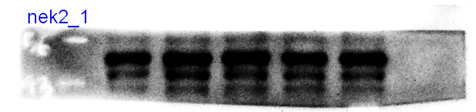
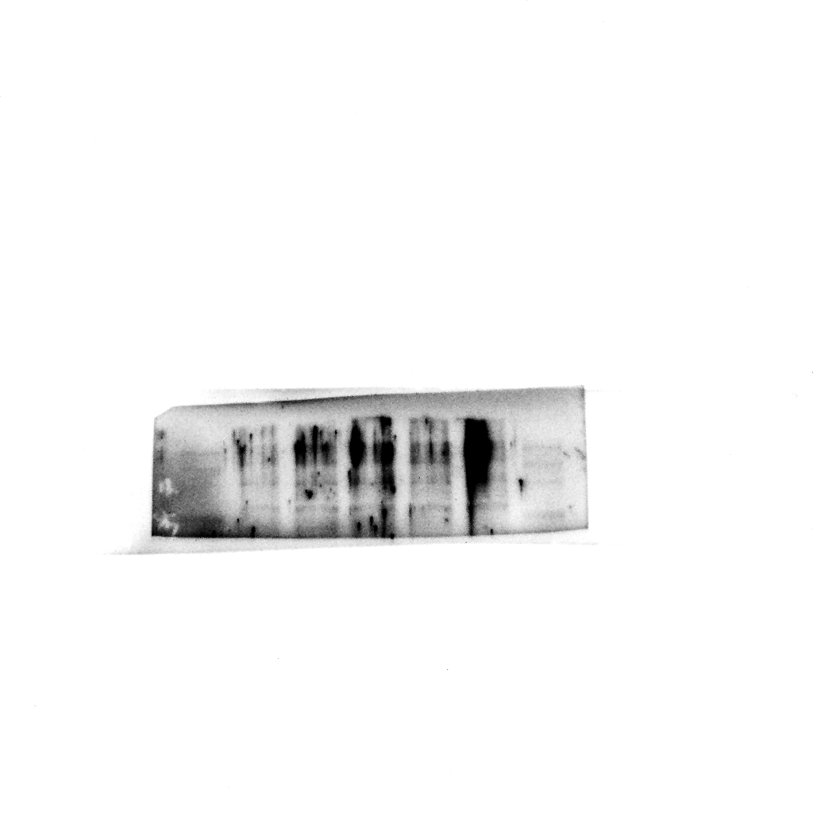
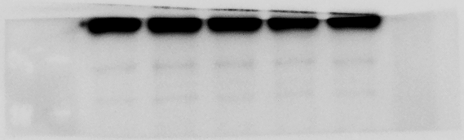
5F
NEK-2
Vector
Empty
NEK-2
#1
#2
NEK-2
5F
MDR1
Vector
Empty
NEK-2
#1
#2
MDR1
5F
GAPDH
Vector
Empty
NEK-2
#1
#2
GAPDH
Figure S8. The full original immunoblots of cropped images presented in Figure 5F.

