Slide 1
Evodiamine suppresses non-small cell lung cancer by elevating CD8+ T cells and downregulating the MUC1-C/PD-L1 axis.

Slide 2
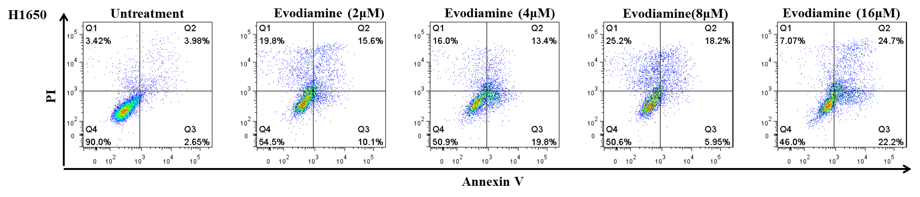
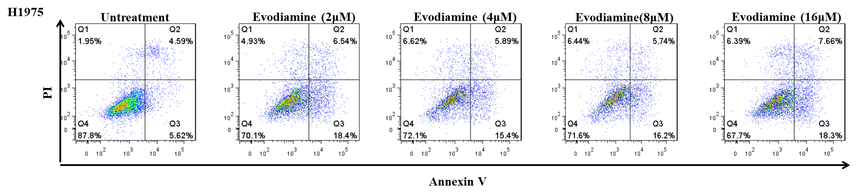
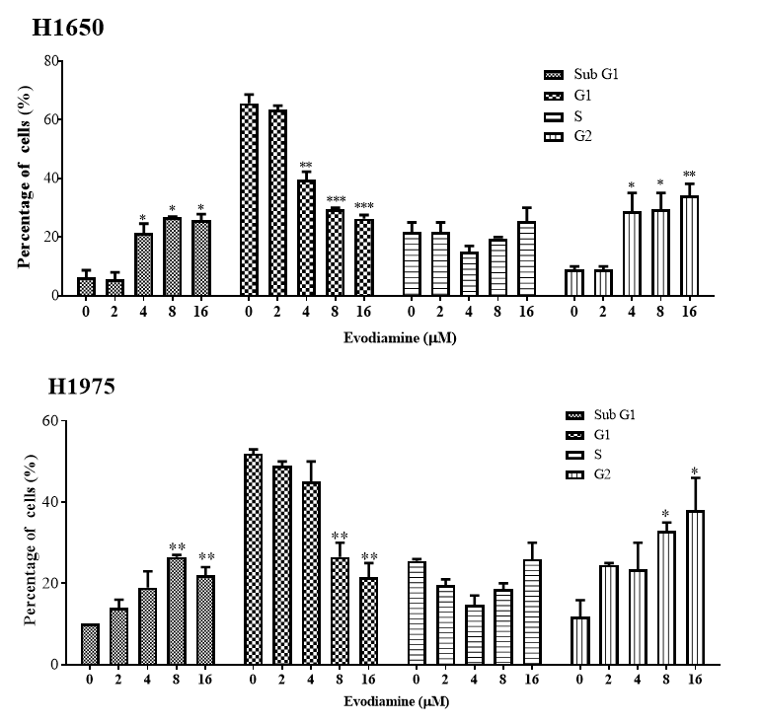
Extended Data Fig.1 Evodiamine can inhibit growth and induce
apoptosis of NSCLC cells
A
B

Slide 3
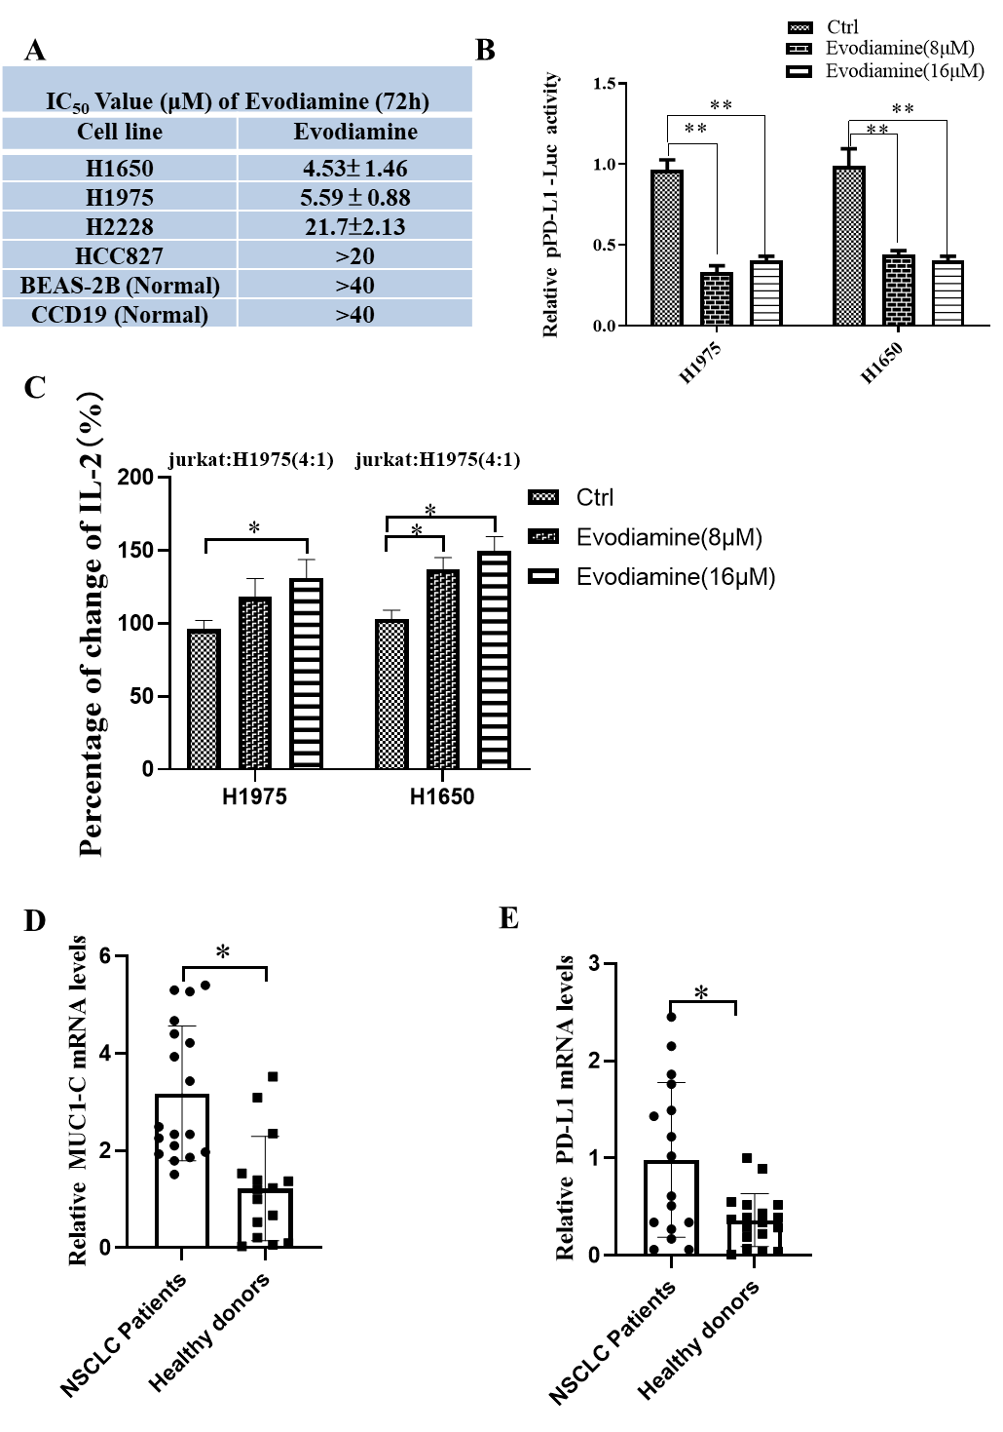
Extended Data Fig.2 Evodiamine inactivates the PD-L1 promoter

Slide 4
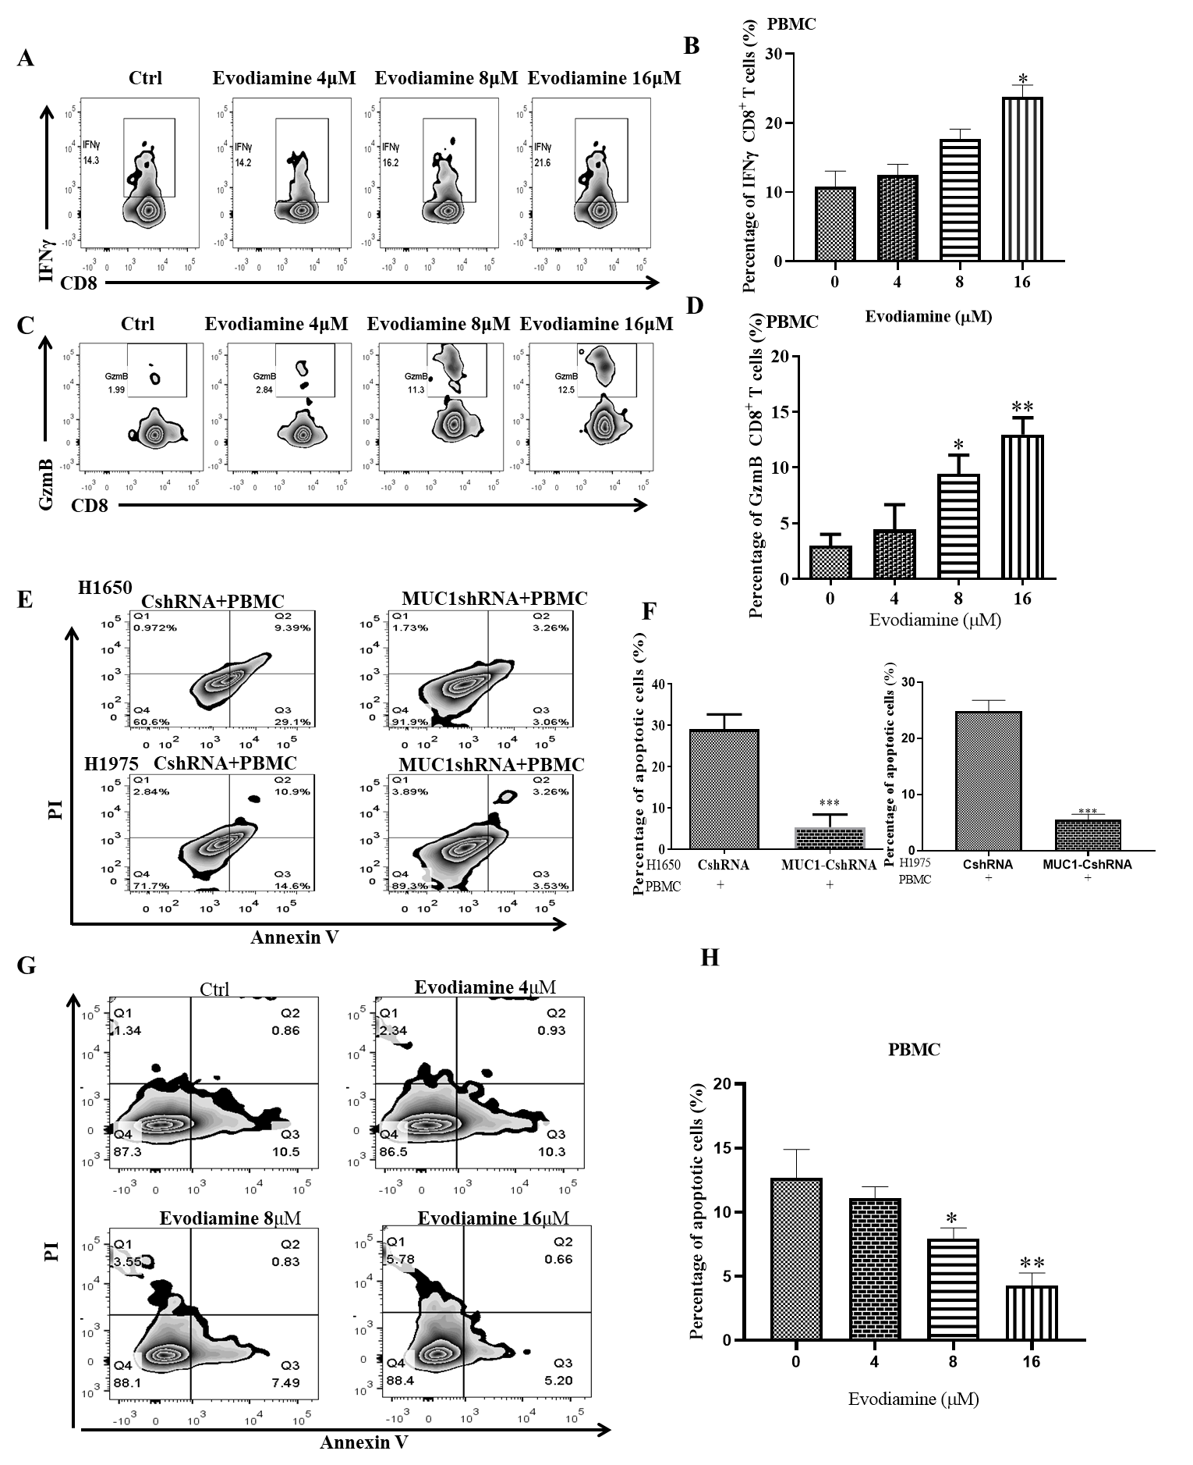
Extended Data Fig.3 MUC1-C inhibition can diminish the PD-L1 expression and decrease the apoptosis levels of CD8+T cells

Slide 5
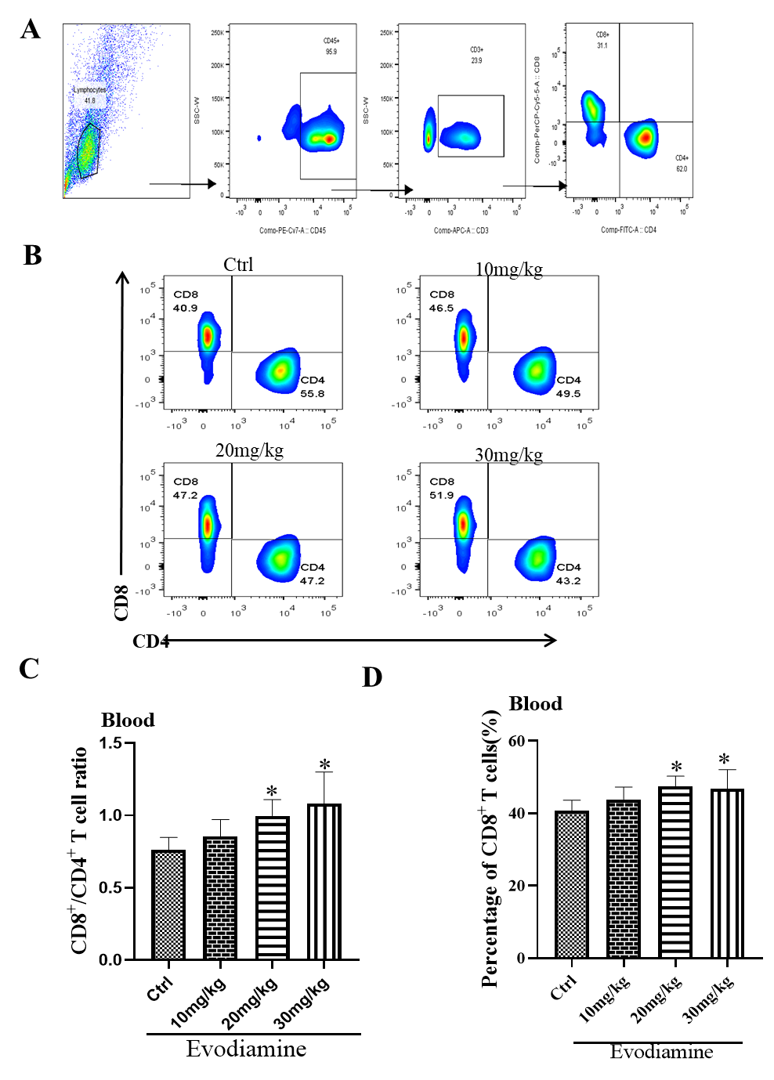
Extended Data Fig4. Evodiamine potentiates the anti-tumor
activity of CD8+ T cells in vivo

Slide 6
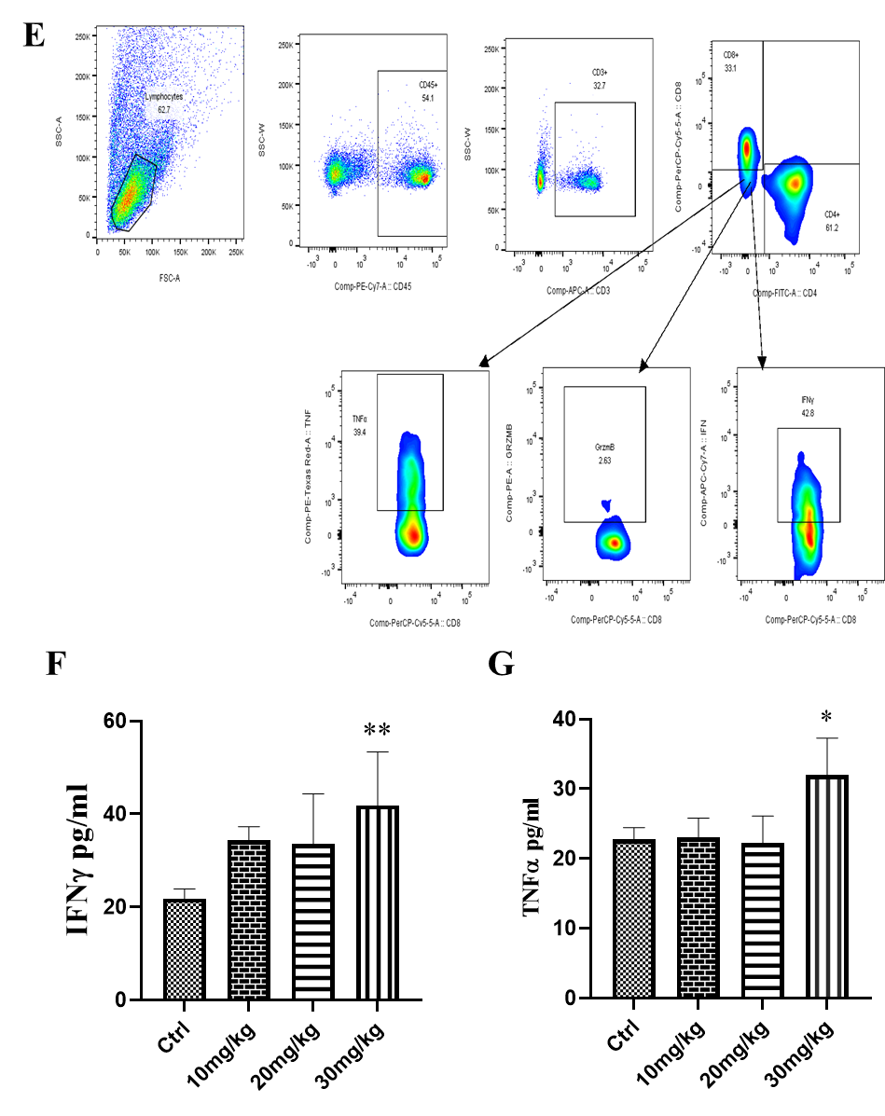
Extended Data Fig.4 Evodiamine potentiates the anti-tumour
activity of CD8+ T cells in vivo

Slide 7
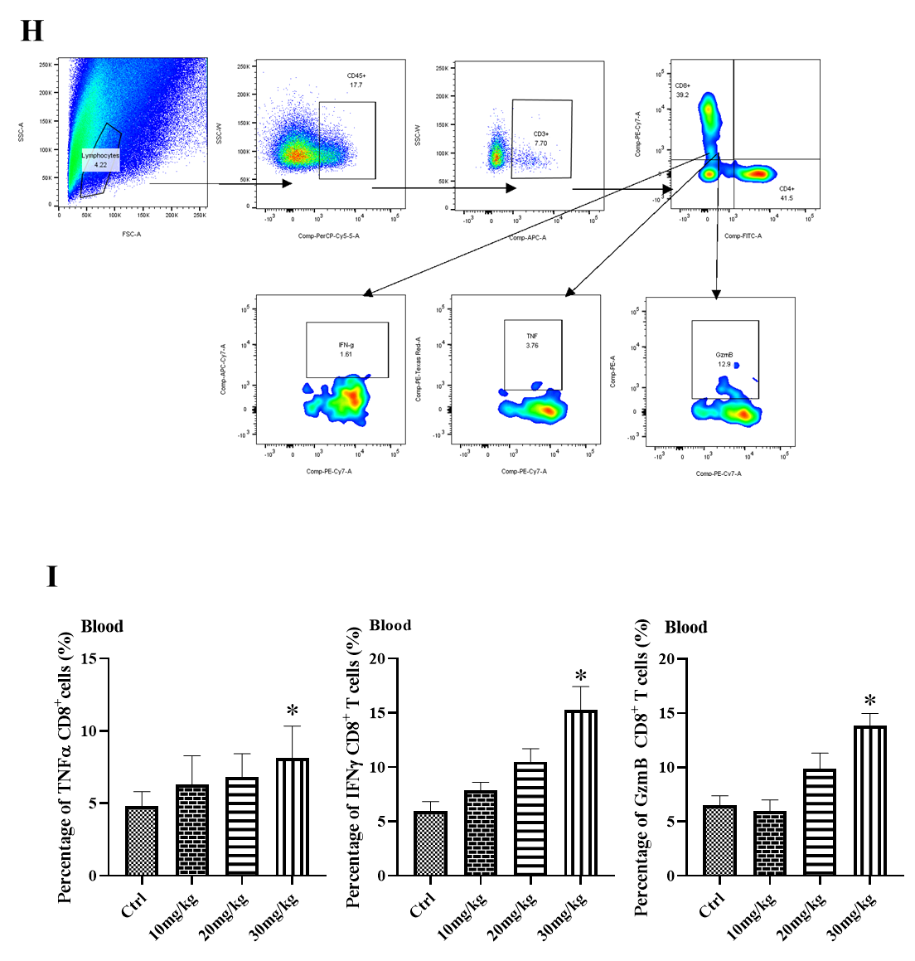
Extended Data Fig.4 Evodiamine potentiates the anti-tumor
activity of CD8+ T cells in vivo

Slide 8
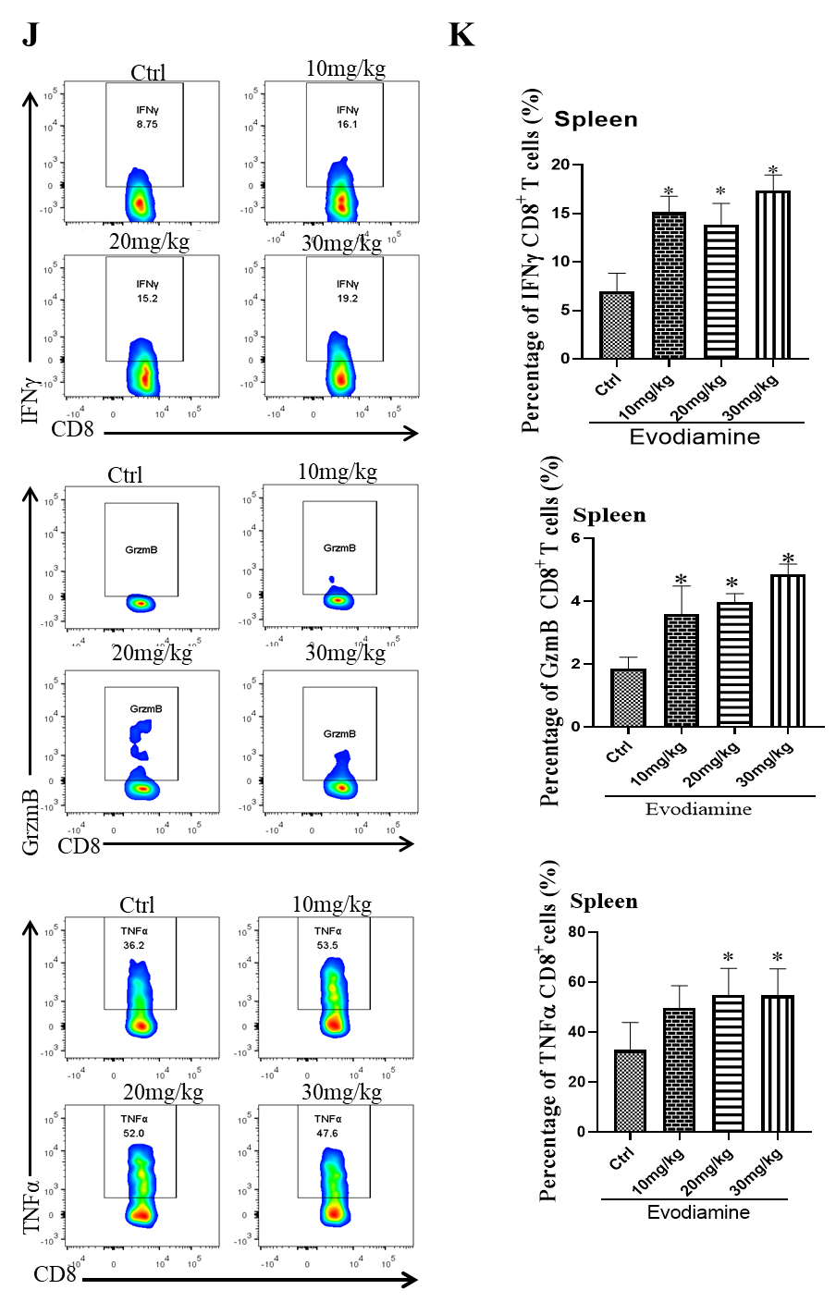
Extended Data Fig.4 Evodiamine potentiates the anti-tumour
activity of CD8+ T cells in vivo

Slide 9
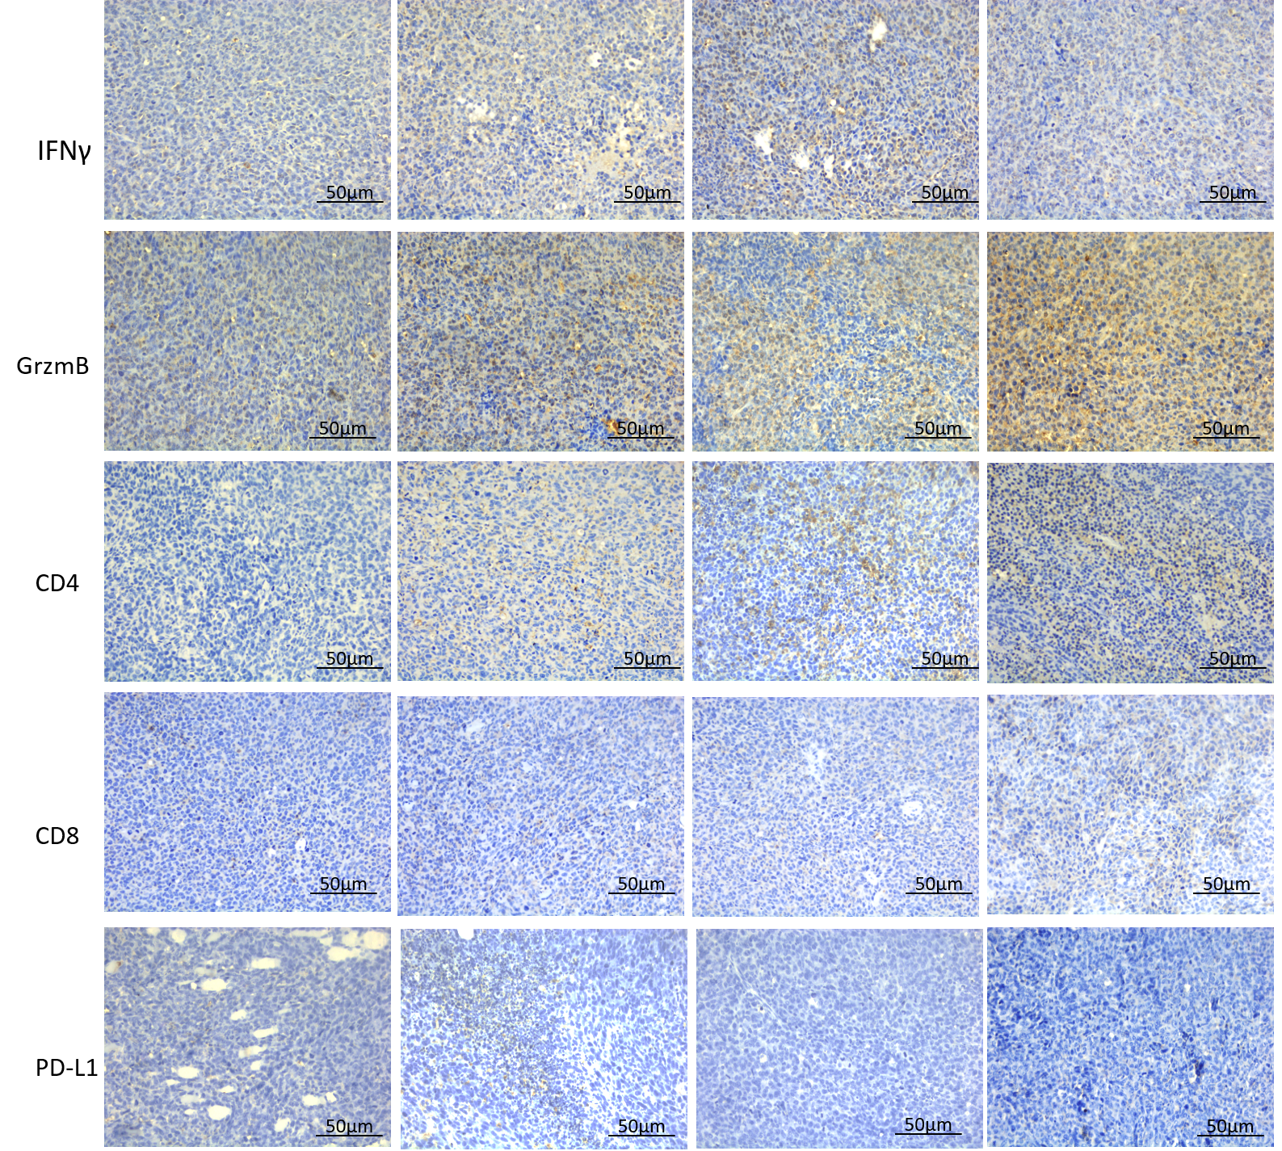
Extended Data Fig.4 Evodiamine potentiates the anti-tumor
activity of CD8+ T cells in vivo
L
Ctrl
10mg/kg
20mg/kg
30mg/kg

Slide 10
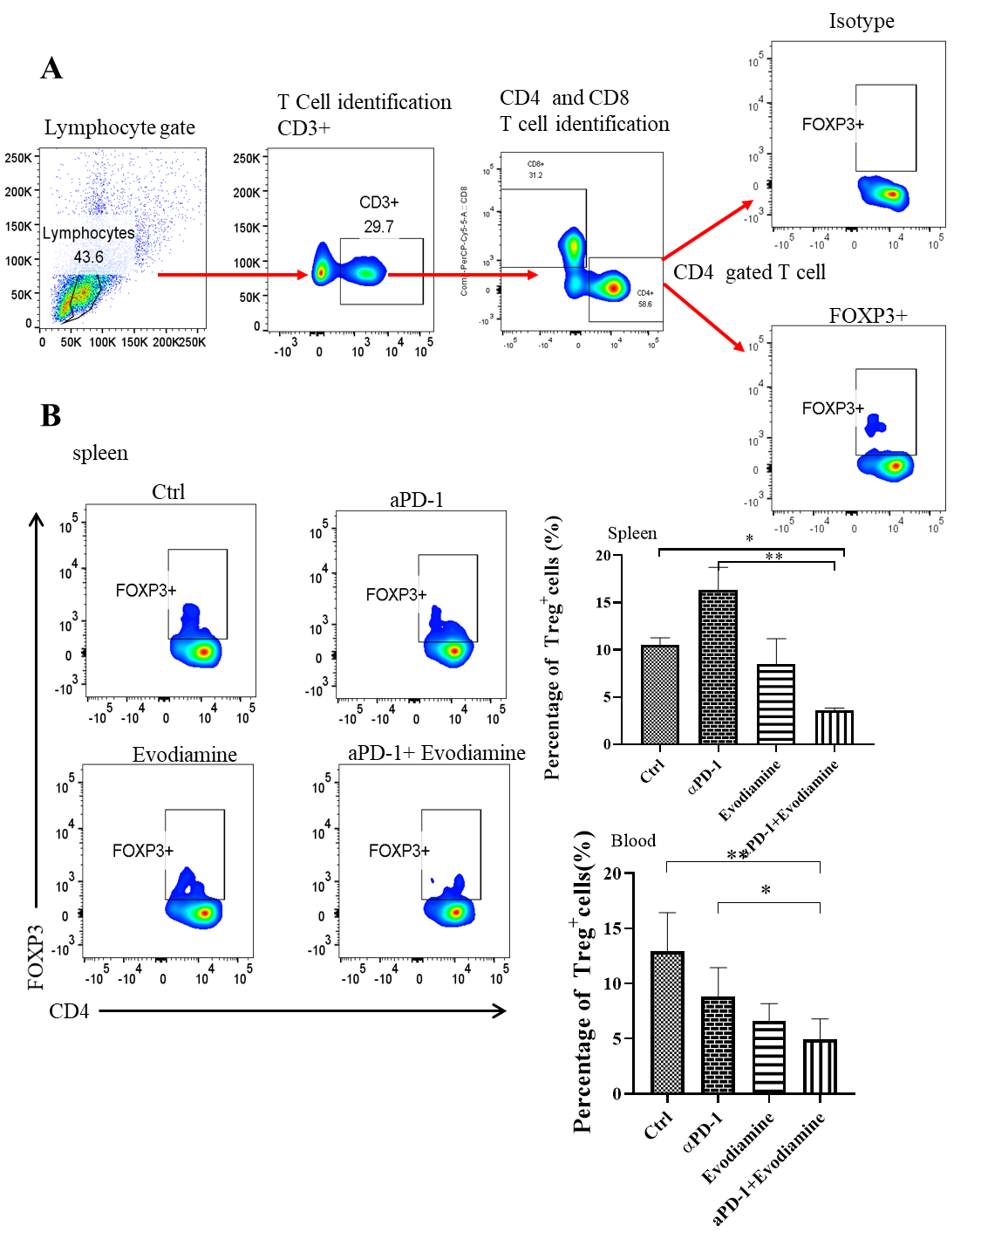
Extended Data Fig.5 Combination Evodiamine and PD-1 mAb treatment can enhance tumor growth control and survival of Lewis lung carcinoma model

Slide 11
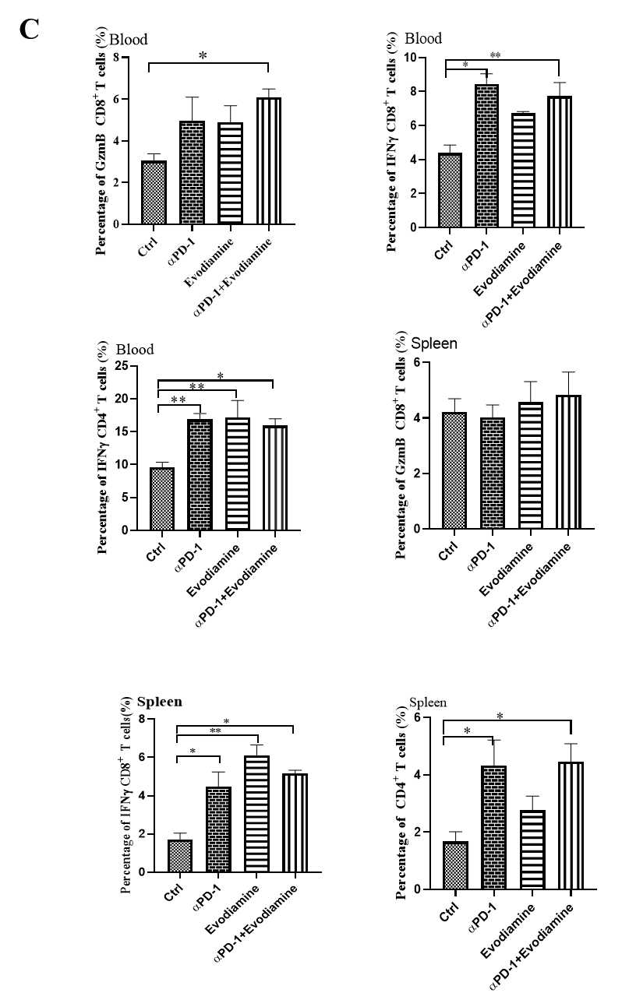
Extended Data Fig.5 Combination Evodiamine and PD-1 mAb treatment can enhance tumor growth control and survival of Lewis lung carcinoma model

Slide 12
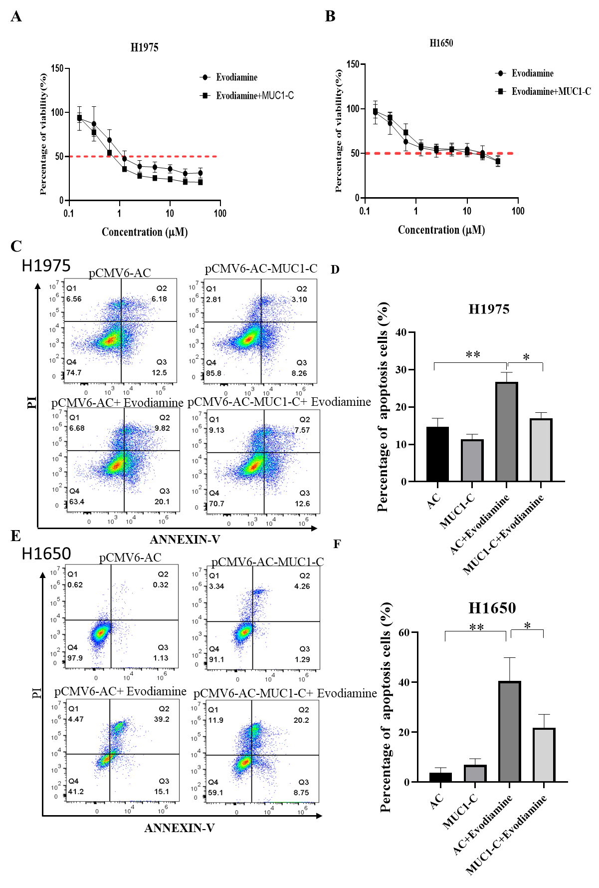
Extended Data Fig.6 MUC1-C is a potential novel mechanism of evodiamine of tumor inhibition

