Slide 1
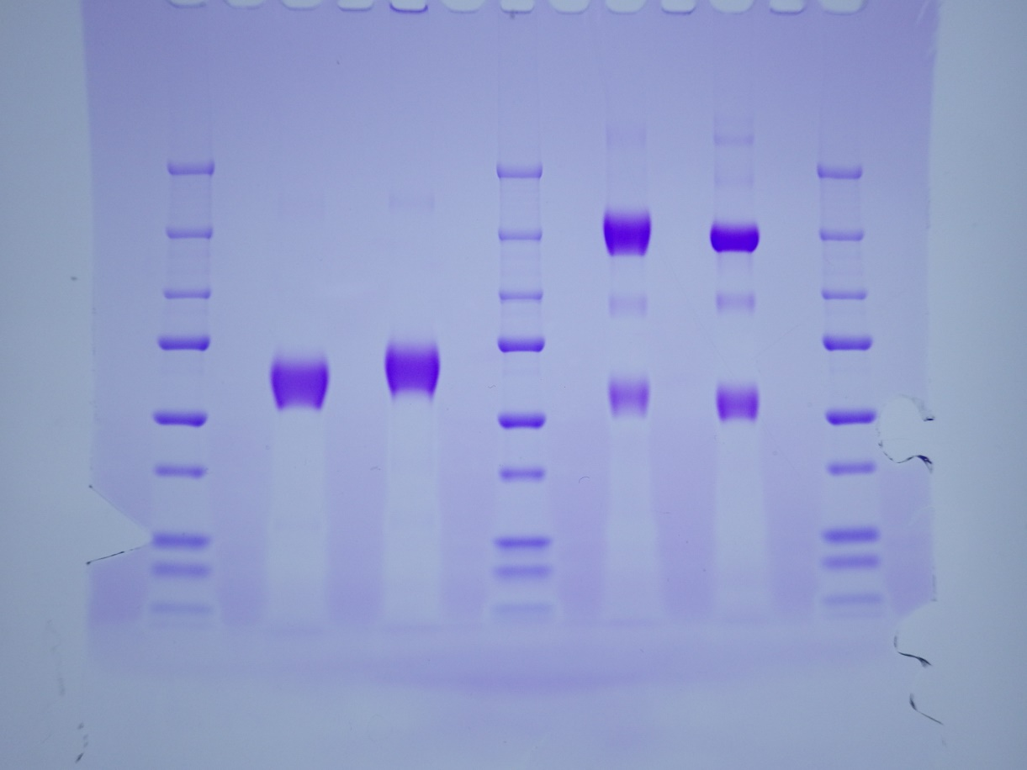
S1 Fig
Reducing
Non-reducing
M
1
2
M
2
1
M
M: marker
1: EqPD-1-Ig
2: EqPD-L1-Ig
(kDa)
250 -
150 -
100 -
75 -
50 -
37 -
25 -
20 -
15 -
S1 Fig.
The original uncropped and unadjusted image of the SDS-PAGE gel, related to Figure 3B.

