Slide 1
Supporting Information
Westernblots

Slide 2
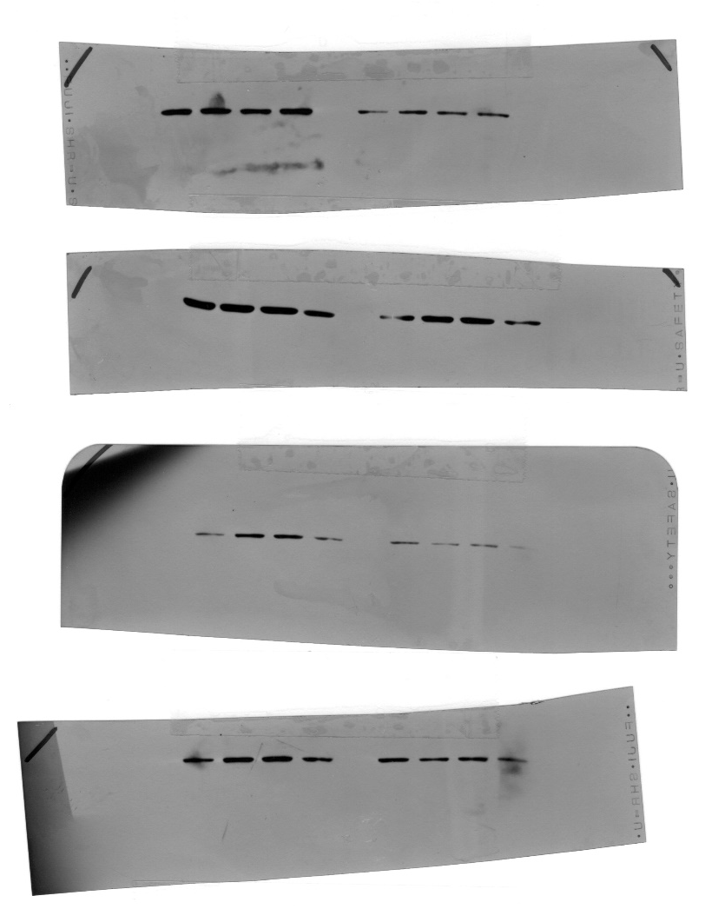
Deiodinase 2
N: NGT, normal glucose tolerant
G: GDM, gestational diabetes mellitus
Group 1
DIO2
N N N N G G G G
β actin
N N N N G G G G
Group 2
DIO2
N N N N G G G G
β actin
N N N N G G G G

Slide 3
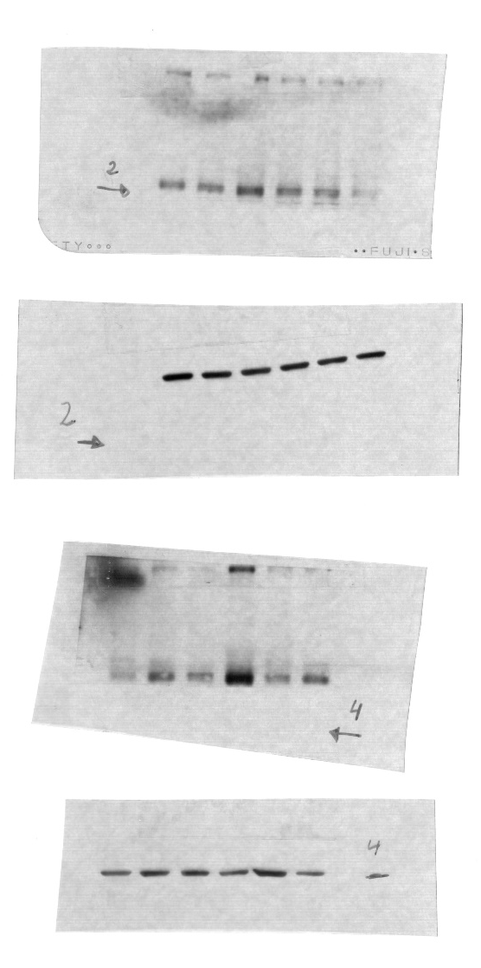
Group 1
Deiodinase 3
N: NGT, normal glucose toletant
G: GDM, gestational diabetes mellitus
DIO3
G N G N G N
β actin
G N G N G N
Group 2
DIO3
N G N G N G
β actin
N G N G N G

Slide 4

Deiodinase 3
N: NGT, normal glucose tolerant
G: GDM, gestational diabetes mellitus
Group 3
DIO3
G G N N N
β actin
G G N N N

