Slide 1
The psychological impact of Stevens-Johnson syndrome and toxic epidermal necrolysis on patients’ lives: A critically appraised topic
P O’Reilly^{1,2,3}, C Kennedy ^{1,4}, P Meskell^{1,2}, A Coffey^{1,2,3} I Delaunois⁵, L Dore⁶, S Howard^{2,7},
B Ramsay⁸, C Scanlon, D M Wilson ^{1,9}, B Whelan¹, S Ryan⁸
¹Department of Nursing and Midwifery, University of Limerick, Limerick, Ireland, ²Health Research Institute, University of Limerick, Limerick, Ireland, ³Health Implementation Science and Technology (HIST) Research Cluster, University of Limerick, Limerick, Ireland, ⁴School of Nursing and Midwifery, Robert Gordon University, Aberdeen, Scotland, ⁵Regional Medical Library, University Hospital Limerick, Ireland, ⁶Glucksman Library, University of Limerick, Limerick, Ireland, ⁷Department of Psychology, University of Limerick, Limerick, Ireland, ⁸Charles Centre for Dermatology, University Hospital Limerick, ULHG, Limerick, Ireland, ⁹Faculty of Nursing, University of Alberta, Edmonton, Alberta, Canada
British Journal of Dermatology. DOI: 10.1111/bjd.18746

Slide 2
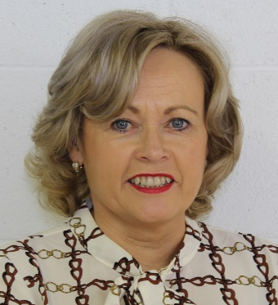
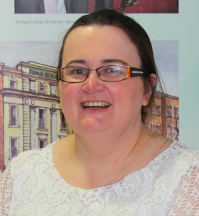
Lead Researchers
Dr. Pauline O’Reilly
Senior Lecturer, Department of Nursing and Midwifery, and Health Research Institute, University of Limerick, Ireland
Sheila Ryan
Advanced Nurse Practitioner in Dermatology, University Hospital Limerick and Adjunct Lecturer, Department of Nursing and Midwifery, University of Limerick, Ireland

Slide 3
Introduction
What’s already known?
Many long-term physical sequelae have been identified in patients with Stevens-Johnson syndrome (SJS) and toxic epidermal necrolysis (TEN), with cutaneous and ocular problems being amongst the most common
A search of existing literature has identified a lack of research relating to the psychological impact on patients

Slide 4
Objective
The objective of this Critically Appraised Topic (CAT) was to
critically appraise existing research related to the psychological impact of SJS and TEN
apply the results to a patient scenario whereby a patient with TEN following a course of chemotherapy for breast cancer, was fearful and anxious.

Slide 5
Methods
The CAT was completed based on four main steps
Formation of a focused question using Population, Exposure, Outcome/Theme (PEO)
  (P) Adults over 18 years of age presenting with SJS or TEN
  (E) Adverse reaction diagnosed as SJS or TEN
  (O) Psychological impact such as emotional upset/trauma, post-traumatic stress, anxiety, or other impact on individuals’ well-being and self-concept
Search for best available evidence
Critical appraisal
Interpreting and applying the results

Slide 6
Database searched between January 2008 – December 2018
Preliminary search on Medline and CINAHL – to determine sensitivity and accuracy of selected search terms
6 studies critically screened and appraised using CASP
Whittemore & Knafl, 2005 – concurrent synthesis
Thematic Framework Analysis

Slide 7
Results
Theme 1
Impact of diagnosis for now and the future
Theme 2
Living with the psychosocial impact
Sub-theme 1
Health Care Practitioners not knowing - the distress on patients
Sub-theme 1
Living with the distress
Sub-theme 2
Minimising the risks
Sub-theme 2
Impact on self and others

Slide 8
Results – Impact of diagnosis for now and the future
I definitely feel that the medical profession is not aware enough of Stevens-Johnson (Internet description 195) (Butt et al., 2012)
But the only thing now is, it's made me so scared of taking pills.... I won't go to the doctors if I can help it now… (Patient 1) (Butt et al., 2011)
11/15 patients had a fear of taking medication (Raspaud, 2014)
47% (n=8) of patients indicated avoidance behaviour (Dodiuk-Gad et al., 2016)

Slide 9
Results – Living with the psychosocial impact
I will never forget. I feel traumatized and sometimes I feel very afraid that this might happen again (Internet description, 34) (Butt et al., 2012)
…I’m scarred in my mind as well as scarred on my body…I have flashbacks to my illness… (Patient 13) (Butt et al., 2011)
71% (n=12) patients’ scores indicated clinical psychological distress and 29% (n=5) had scores consistent with clinical signs of possible PTSD (Dodiuk-Gad et al., 2016)
‘Major long-term, overlooked and treatable psychological complications among survivors after SJS/TEN’ (Dodiuk-Gad et al., 2016)
Of 26 patients diagnosed with SJS/TEN or SJS/TEN overlap 11 had anxiety and 13 were depressed at 6 months, following initial diagnosis (Zitha, 2015)

Slide 10
Discussion
Paucity of studies focused solely on the psychological consequences on patients’ lives.
Evidence suggests SJS/TEN have a psychological impact on quality of life of those affected and their significant others.
Patients can be left with symptoms aligned to PTSD, anxiety and depression.
Often Health Care Practitioners (HCPs) did not know about SJS/TEN and consequently, patients were poorly informed.

Slide 11
Discussion
On discharge from hospital, individuals expressed fear around taking medication and in attending their doctor and consequently engaged in avoidance behaviour.
The findings from the CAT suggested the following actions in the case of our patient scenario:
  Patients should be informed about the condition in order to allay some stresses. Meaningful patient involvement is crucial.

Slide 12
Discussion
  Education to increase HCP awareness and knowledge of SJS/TEN should facilitate their capacity to provide information, support or referral opportunities to patients/family members.
  Patient’s care environment needs to be as stress free and person centred as possible.
  On discharge, a follow-up appointment with relevant HCPs such as a psychologist should be considered to reduce the possibility of PTSD occurring.

Slide 13
Conclusions
What does this study add?
SJS and TEN have long lasting psychosocial impacts on the lives of those affected
Patients were distressed with symptoms aligned to PTSD
HCPs lack of information around the disorder, particularly in terms of its diagnosis, caused stress and anxiety for patients
Following discharge from the hospital, individuals expressed fear of taking medication and in attending their doctor, frequently leading them to engage in avoidance behaviours

Slide 14
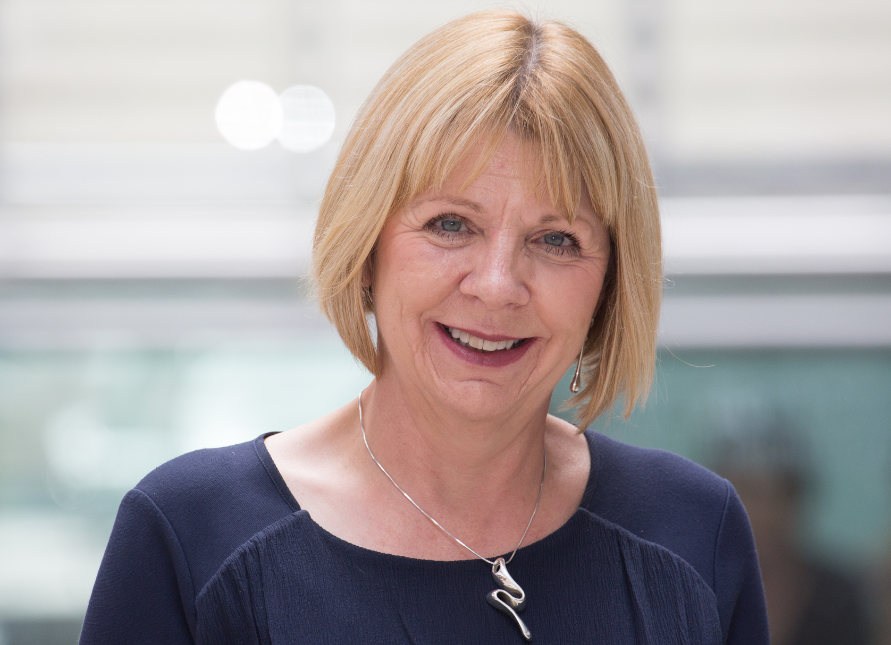
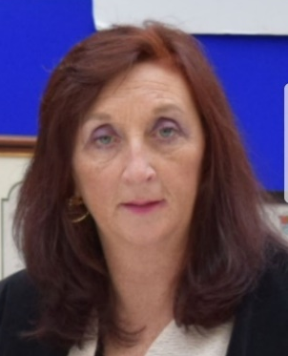
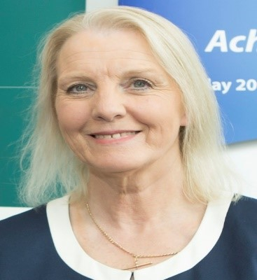

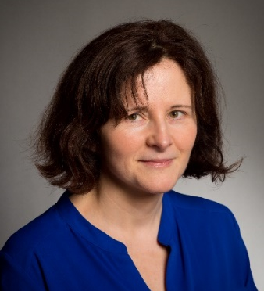
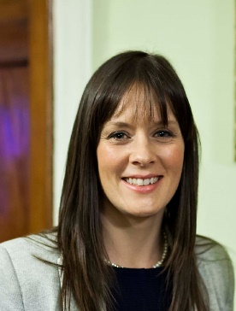
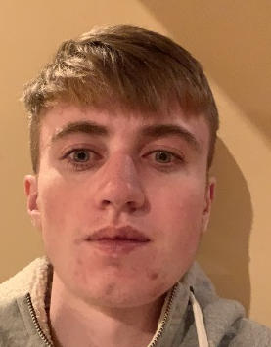

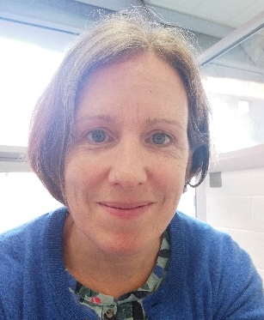
Research Team
Dr. Pauline O’Reilly
Professor Catriona Kennedy
Dr. Pauline Meskell
Professor Alice Coffey
Isabelle Delaunois
Liz Dore
Dr. Siobhán Howard
Professor Bart Ramsay
Cathal Scanlon
Professor Donna Wilson
Dr. Barbara Whelan
Sheila Ryan

Slide 15
Call for correspondence
Why not join the debate on this article through our correspondence section?
Rapid responses should not exceed 350 words, four references and one figure
Further details can be found here

