Slide 1

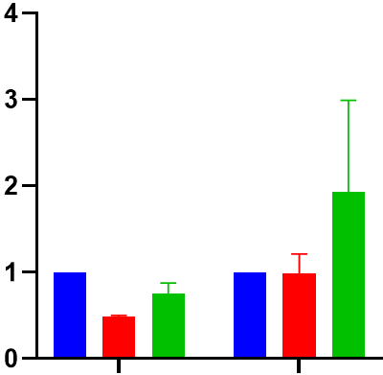
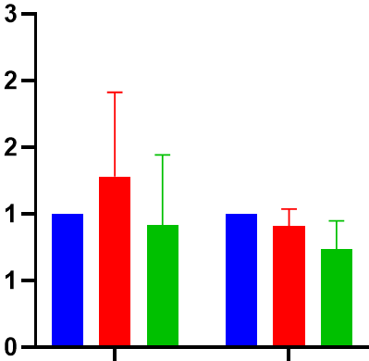



Supplementary Material 11
A
B
C
SF8628
DIPG007
Baseline
DMSO 24h
JQ1 24h
JQ1 24h
JQ1 24h
DMSO 24h
H3K27ac
DMSO 24h
Baseline
H3K27M
Baseline
H3K27ac
p=0.68
p=0.43
Relative expression
Relative expression
H3K27M
p=0.52
p=0.43
Total-H3
SF8628 DIPG007 SF8628 DIPG007

