Slide 1
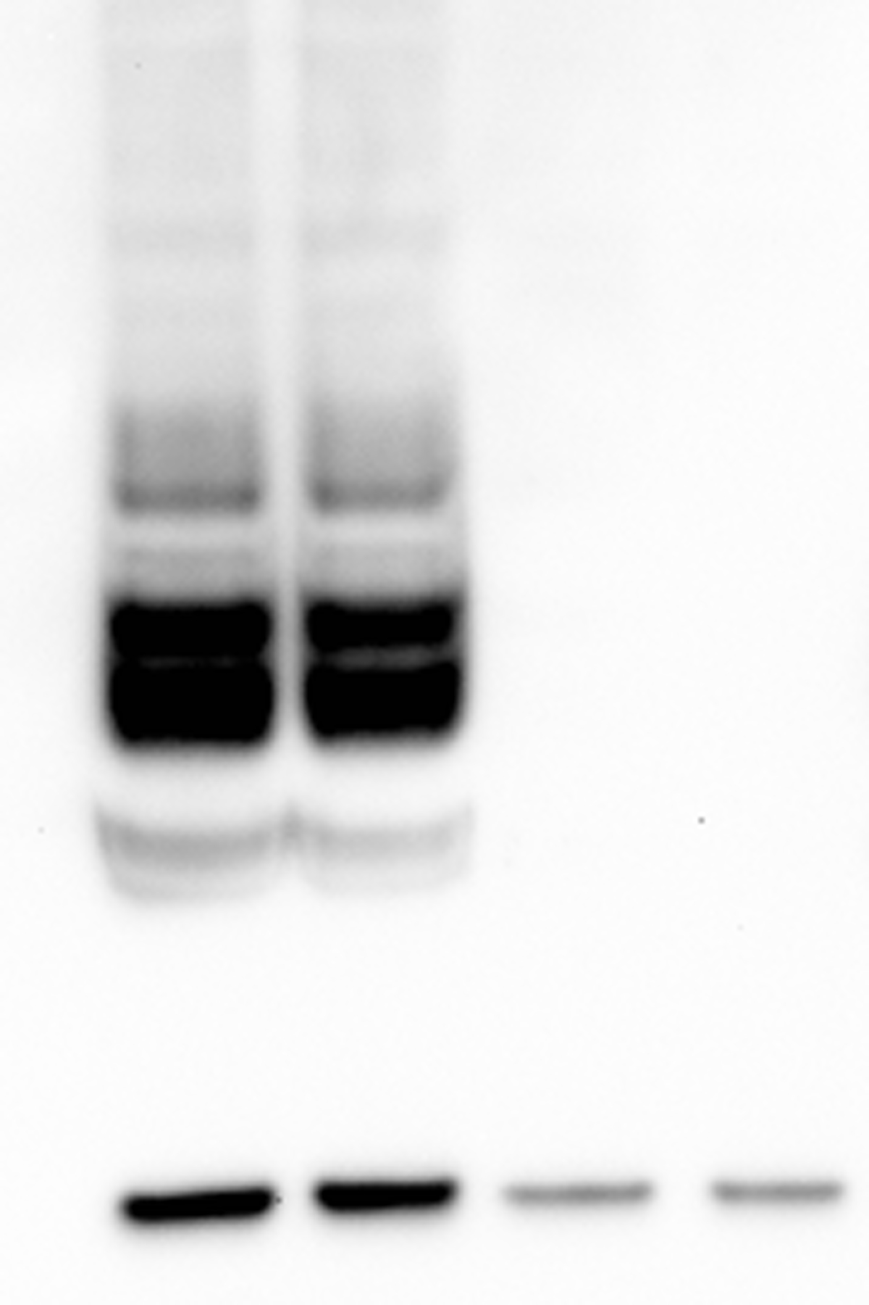
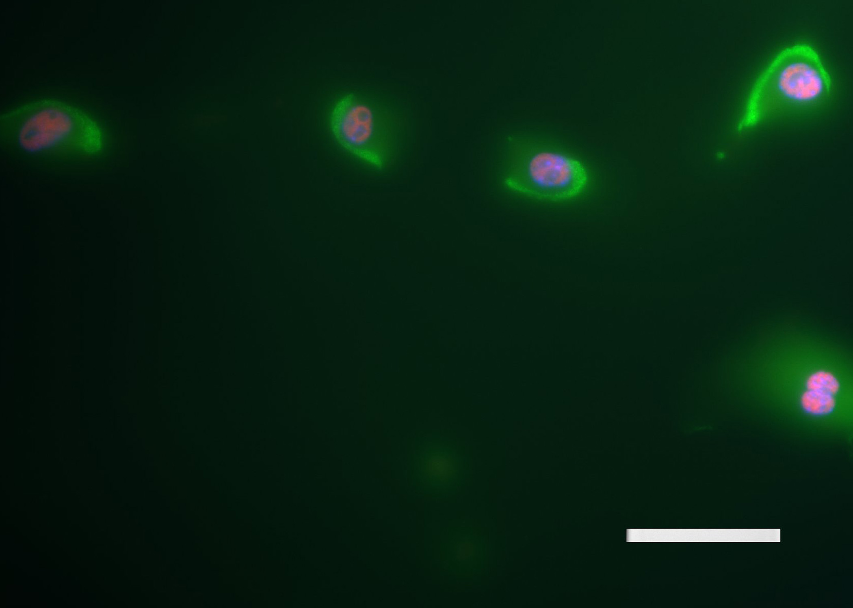
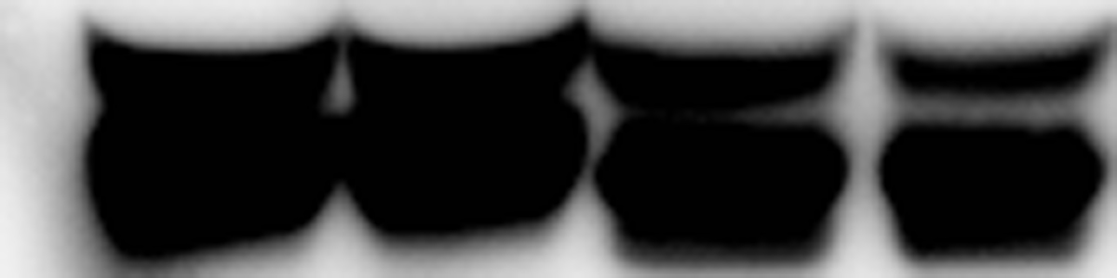
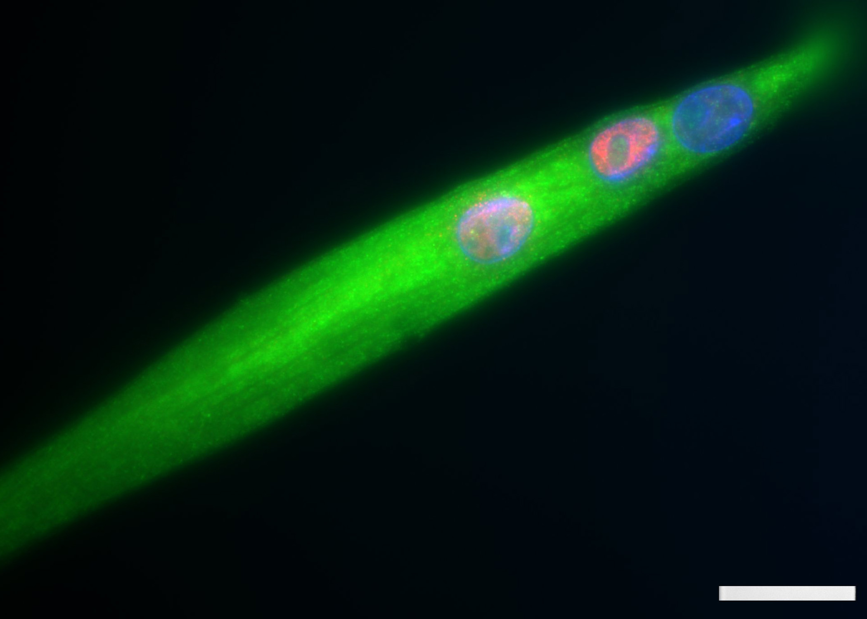
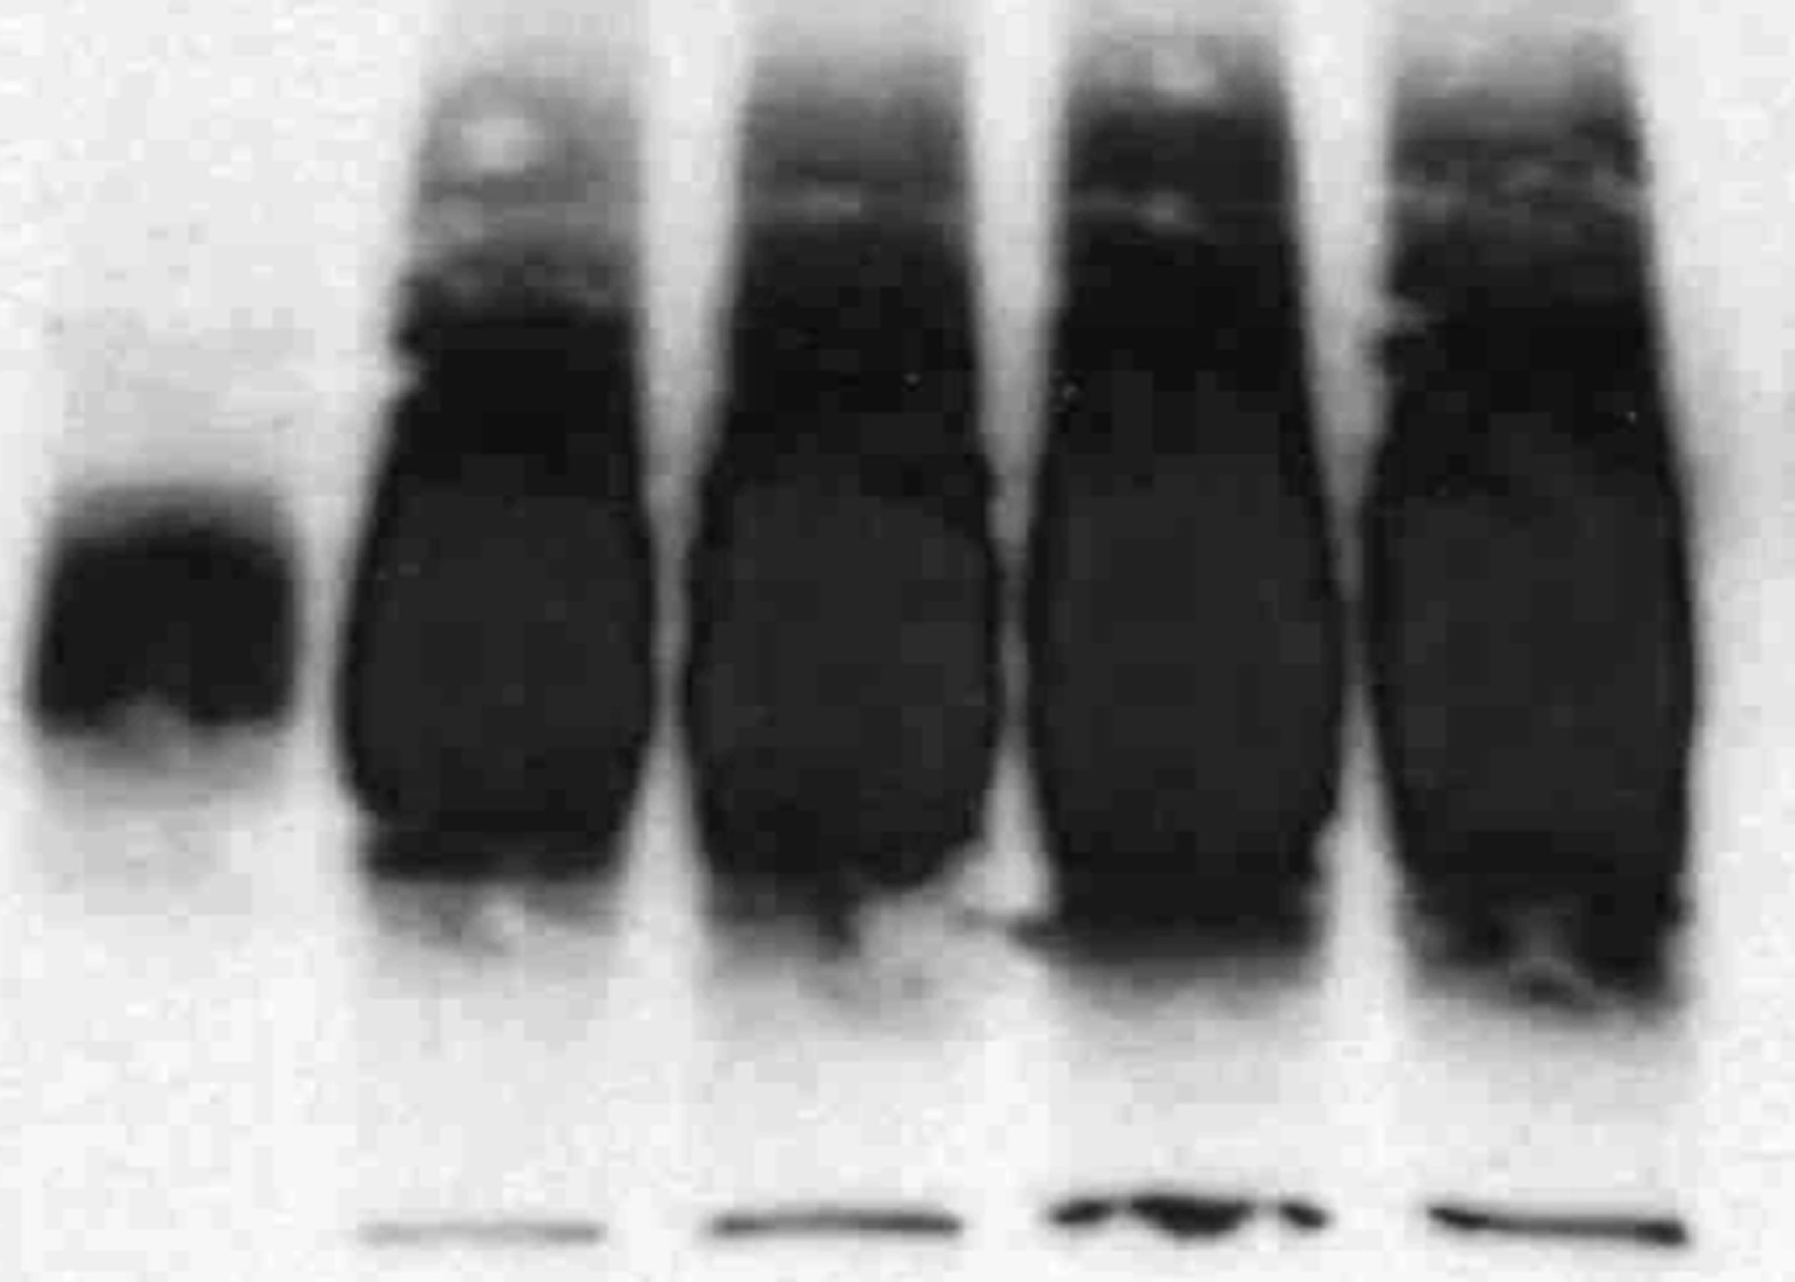
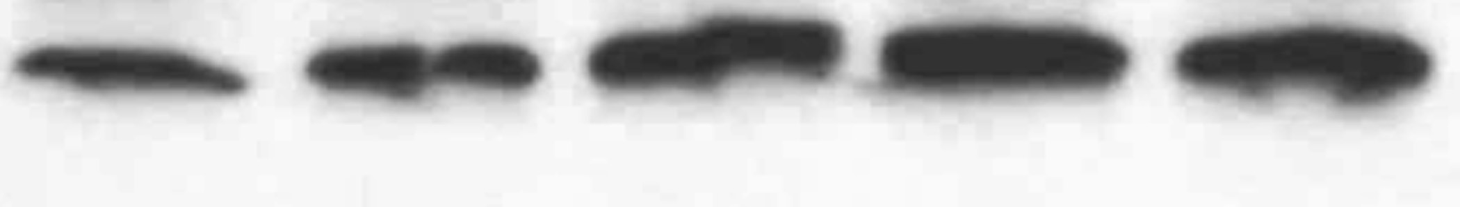
WT
KO
M
WT
KO
A
{
{
B
WT ~400bp
KO ~280bp
80
C
65
50
Glycosylated CD82
30
CD82 ~35Kd
25
10
50µm
CD82 MyoD
GAPDH 37Kd
D
E
d0 d4 d6 d8 d10
65
50
Glycosylated CD82
30
25
CD82 MyoD
50µm
GAPDH 37Kd

