Slide 1
Supplementary material online
Table S1
Primers used in this study
GAPDH | Forward | 5’-CGA CTT CAA CAG CAA CTC CCA CTC TTC C -3’
 | Reverse | 5’-TGG GTG GTC CAG GGT TTC TTA CTC CTT -3’
MCP-1 | Forward | 5’-GGC TCA AGC CAG ATG CAG TTA C-3’
 | Reverse | 5’-GCC TAC TCA TTG GGA TCA TCT T-3’
TNF-α | Forward | 5’-TCT CAT GCA CCA CCA TCA AGG ACT-3’
 | Reverse | 5’-ACC ACT CTC CCT TTG CAG AAC TCA-3’
MMP-2 | Forward | 5’-CAA GTT CCC CGG CGA TGT C-3’
 | Reverse | 5’-TTC TGG TCA AGG TCA CCT GTC-3’
MMP-9 | Forward | 5’-TGA ATC AGC TGG CTT TTG TG-3’
 | Reverse | 5’-GTG GAT AGC TCG GTG GTG TT-3’
GPR109A | Forward | 5’-ATG ACC AAA AAT GGC GAG GC-3’
 | Reverse | 5’-CAT AGC ATC GTG CCA CCT GA-3’

Slide 2

Supplementary material online
Figure S1
A
(GPR109A)
+/-
+/+
-/-
KO allele (500 bp)
WT allele (450 bp)
B
(A) PCR-based genotyping to validate the GPR109A allele. (B) GPR109A gene expression in whole bone marrow cells isolated from WT and GPR109A KO mice.

Slide 3
Supplementary material online
Figure S2
Quantification data of immunostaining
Figure 1D
Figure 2B

Slide 4
Supplementary material online
Figure S2 (continued)
Quantification data of immunostaining
Figure 3B
Figure 4B
Figure 5C
Figure 7C

Slide 5
Supplementary material online
Figure S3
Light intensity (mV)
PMA (100 nM)
PMA + Niacin (50 μM)
PMA + Niacin (300 μM)
Control
Time (sec)
NB4 cells were differentiated into neutrophilic cells by treating with 1 µM of ATRA for 5 days, and then incubated with PMA (100 nM) in the presence or absence of niacin (at 50 µM or 300 µM). Luminescence was quantified over time using a POLARstar luminometer.

Slide 6
Supplementary material online
Figure S4
control
12 hr
36 hr
H₂O₂
H₂O₂
Niacin
*
Niacin promoted viability of aortic smooth muscle cells. Primary smooth muscle cells were treated with hydrogen peroxide (H₂O₂, 100 µM) with or without niacin (10 µM). *p<0.01.

Slide 7
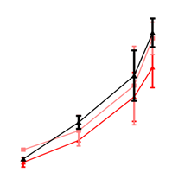
Supplementary material online
Figure S5
Systolic blood pressure (mmHg)
200
190
180
170
N.S
AngII
160
150
AngII + NA
140
130
AngII + Nam
120
110
100
90
80
0 5 12 14 (days)
Blood pressure was measured using a tail cuff method (presented as mean of 30 measurement cycles performed every other day, n=6). NA = niacin, Nam = nicotinamide, N.S. = not significant.

Slide 8
Supplementary material online
Figure S6
A
p=0.16
B
N.S.
Plasma total cholesterol (A) and triglyceride (B) levels in AngII-infused mice in the presence or absence of niacin or nicotinamide. NA = niacin, Nam = nicotinamide, N.S. = not significant.

Slide 9
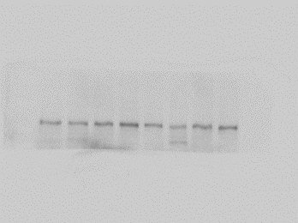
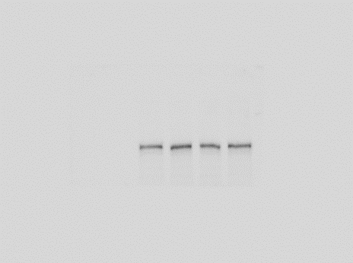
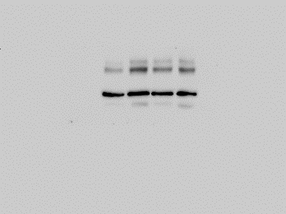
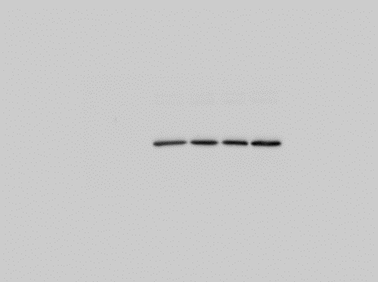
Supplementary material online
Figure S7
Uncropped blot images
CaCl₂+Nam
AngII + Nam
CaCl₂+NA
AngII + NA
Sham
CaCl₂
Figure 6E
Sham
AngII
Figure 6F
150
150
Sirt1
100
Sirt1
100
50
Non-specific
37
GAPDH
50
GAPDH
37

Slide 10
Supplementary material online
Figure S8
EX-527 treatment did not significantly affect AAA formation induced by lower dose of AngII infusion (500 ng/kg/min). NAM = nicotinamide.

Slide 11
Supplementary material online
Figure S9
GPR109A mRNA expression levels in aortas of AngII-infused mice. NA = niacin, Nam = nicotinamide.

