Slide 1
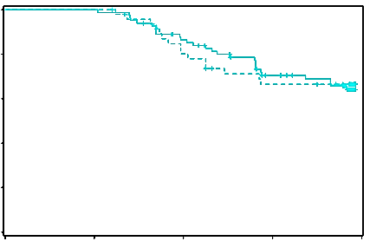
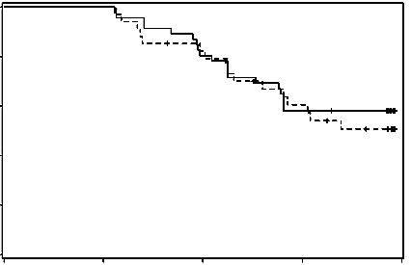
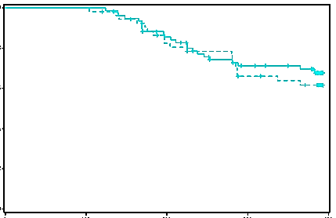
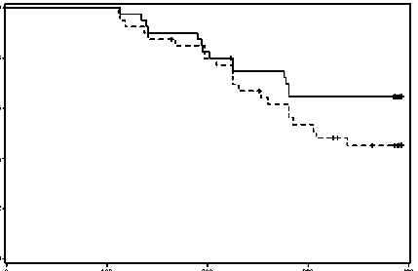
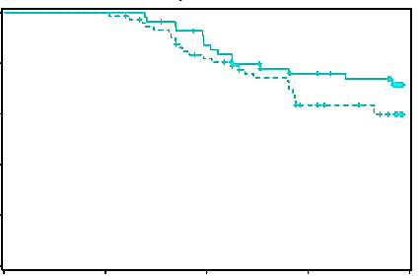
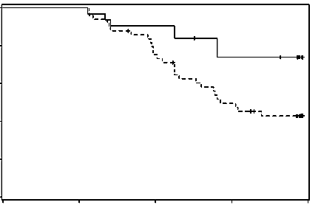
Pirfenidone
Placebo
Figure S1
A) SP-D
1.0
0.8
Stable
Stable
Increase
Increase
0.6
0.4
0.2
P=0.9926
P=0.6282
0
Progression-free survival
B) SP-A
1.0
0.8
0.6
0.4
0.2
P=0.5516
P=0.1381
0
C) KL-6
1.0
0.8
0.6
0.4
0.2
P=0.1896
P=0.0093
0
0
100
200
300
400
0
100
200
300
400
Treatment (days)

Slide 2
Figure S1: Relationship between changes in serum concentration of biomarkers at week 16 and the efficacy of pirfenidone on progression-free survival.
All patients were dichotomized by the change in concentration of (A) SP-D, (B) SP-A and (C) KL-6 at week 16 from baseline to the increase and stable (equal and decrease) biomarker subgroups. Solid lines, stable biomarker; dotted lines, increasing biomarker. The disease progression was defined by a >10% decline in vital capacity from baseline and/or death. Progression-free survival was estimated using the Kaplan-Meier method and compared using the log-rank test.

