Slide 1
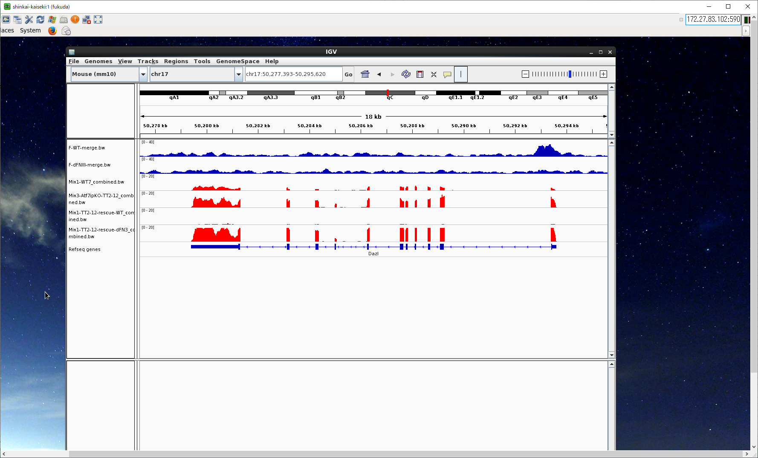
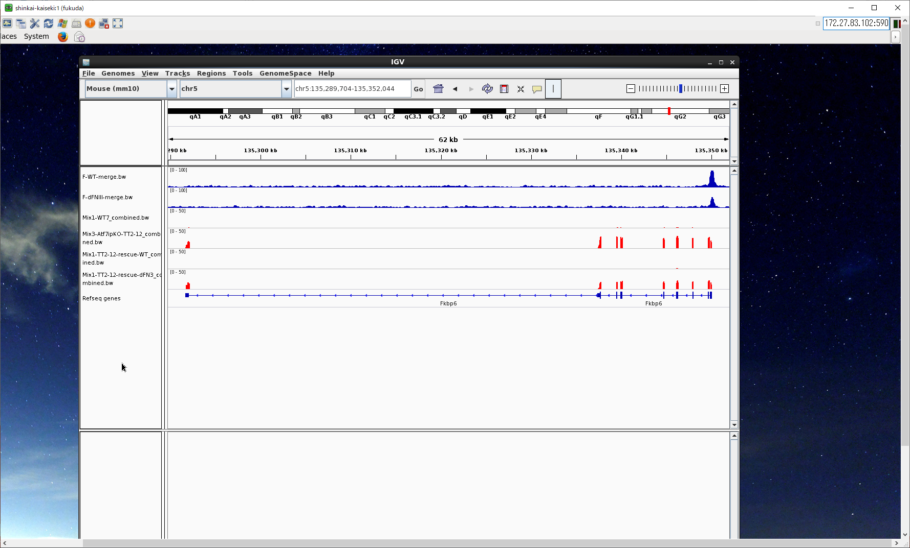
A
WT: rep1+2
6537
dFNIII:
3376
3177
3177/3376=94.1%
B
ChIP
Flag-ATF7IP
Flag-ATF7IP dFNIII
WT mESCs
Atf7ip KO mESCs
RNA
Atf7ip KO + WT
Atf7ip KO + dFNIII
Dazl
ChIP
Flag-ATF7IP
Flag-ATF7IP dFNIII
WT mESCs
Atf7ip KO mESCs
RNA
Atf7ip KO + WT
Atf7ip KO + dFNIII
Fkbp6
Figure S9

