Slide 1
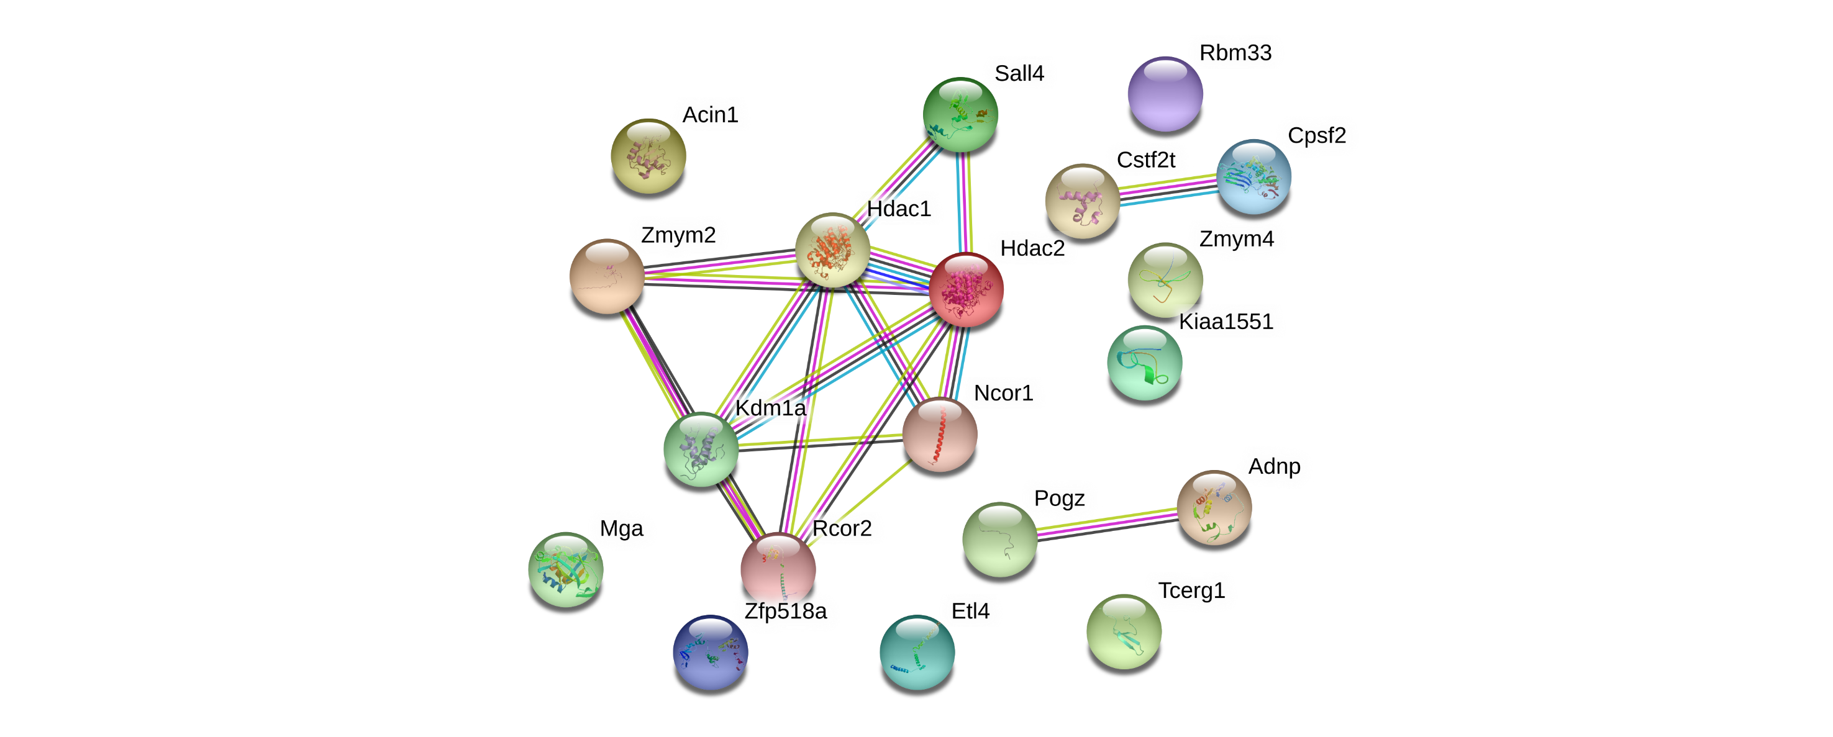
Identified protein network in the top 20 candidate proteins
Figure S3

