Slide 1

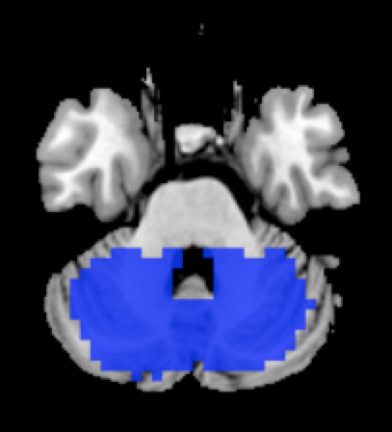
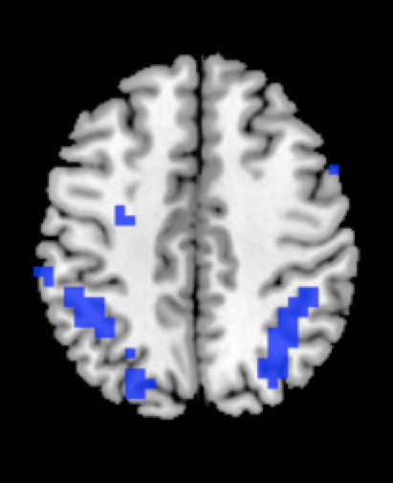
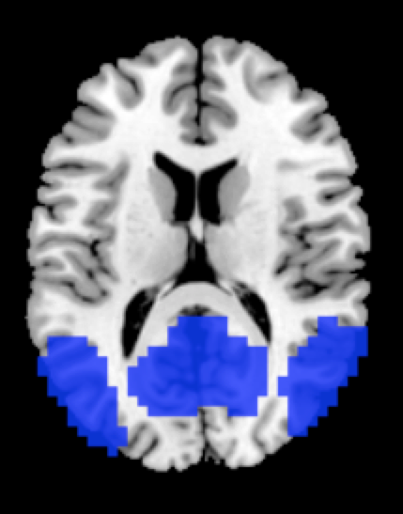
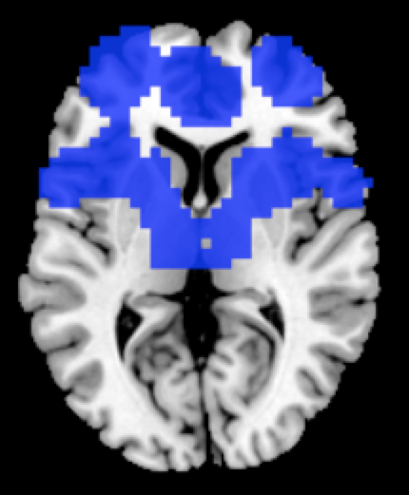
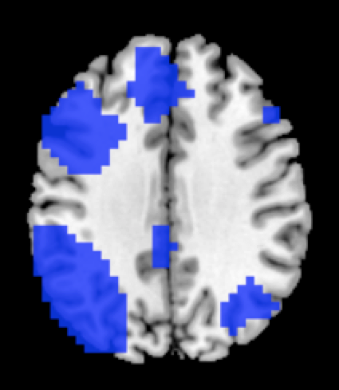
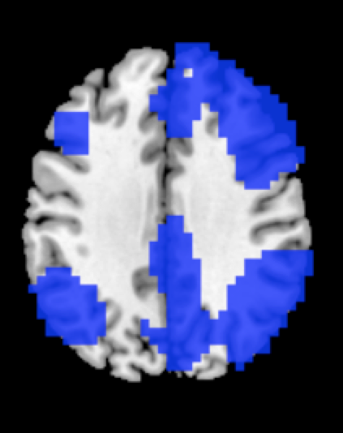
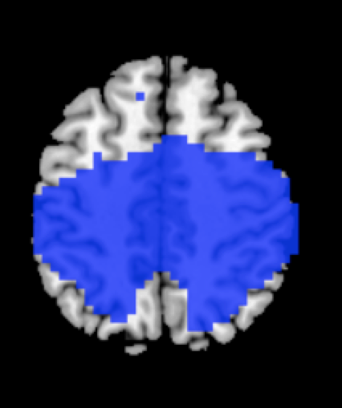
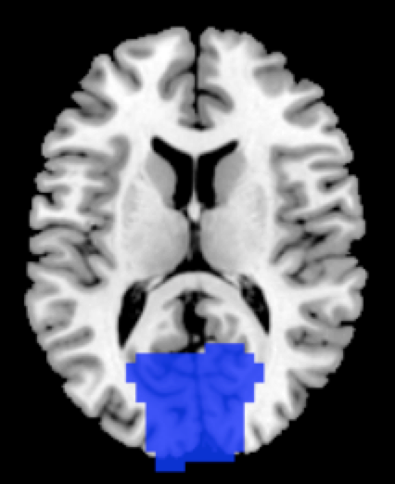
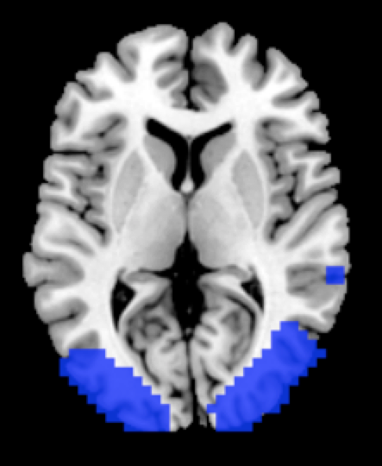
L
R
AUD
CEREB
D-ATT
DMN
FR-STR
LFP
RFP
SM
VIS
ASS-VIS
Figure A.1. Independent components (IC) of interest identified by ICA. Red rectangles highlights the fronto-connected networks of interest. IC binary masks are overlaid on the 3D Montreal Neurological Institute template in neurological convention (right is right). Abbreviations: AUD=auditory; CEREB=cerebellar; D-ATT=dorsal attention; DMN=default mode; FR-STR=fronto-striatal; L=left; LFP=left frontoparietal; RFP=right frontoparietal; SM=sensorimotor; VIS=primary visual; ASS-VIS=associative visual.

Slide 2
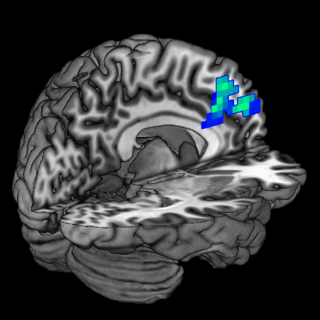
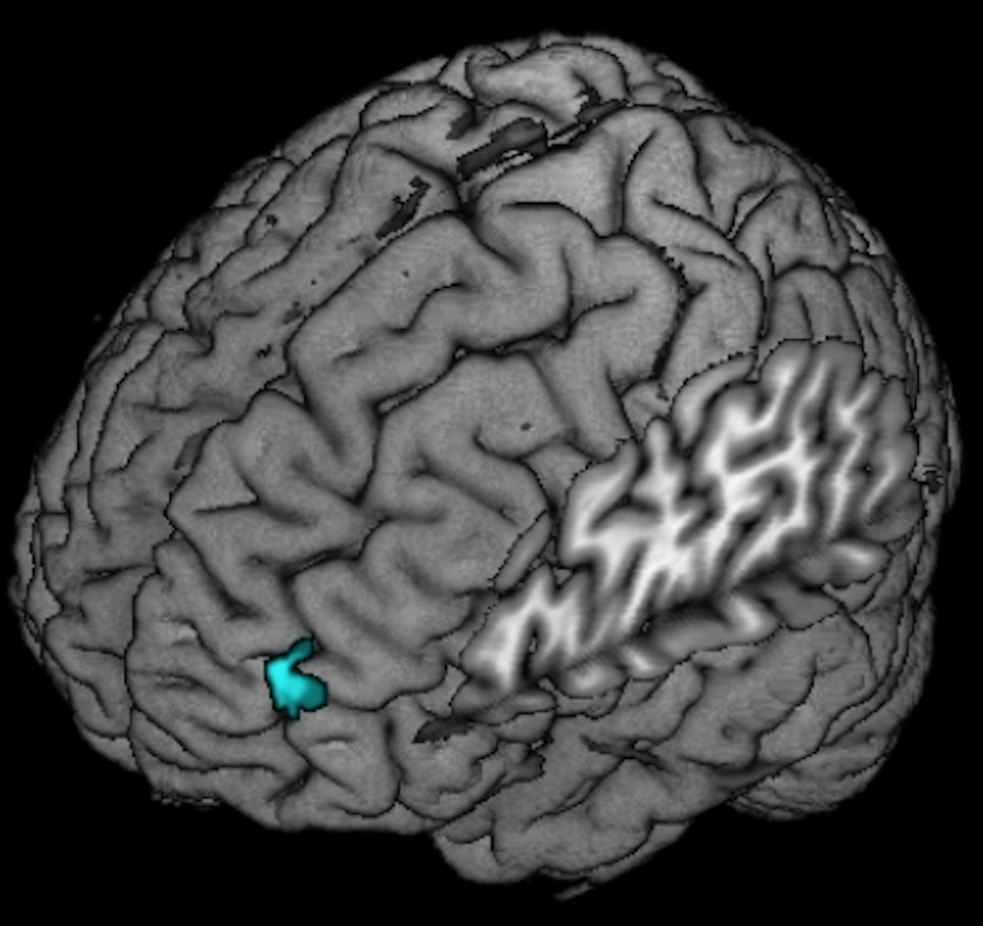
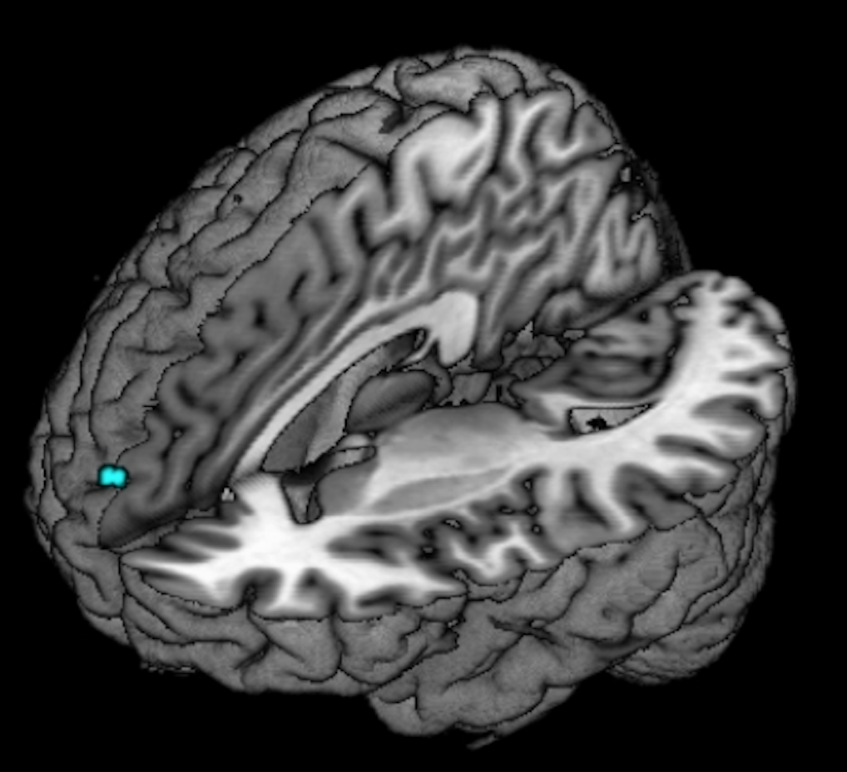
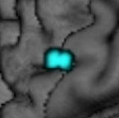
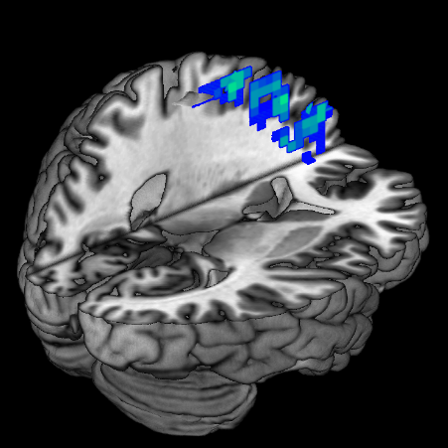
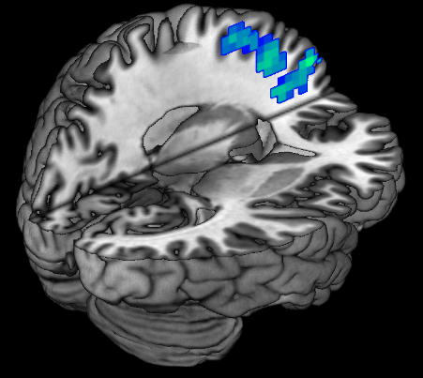
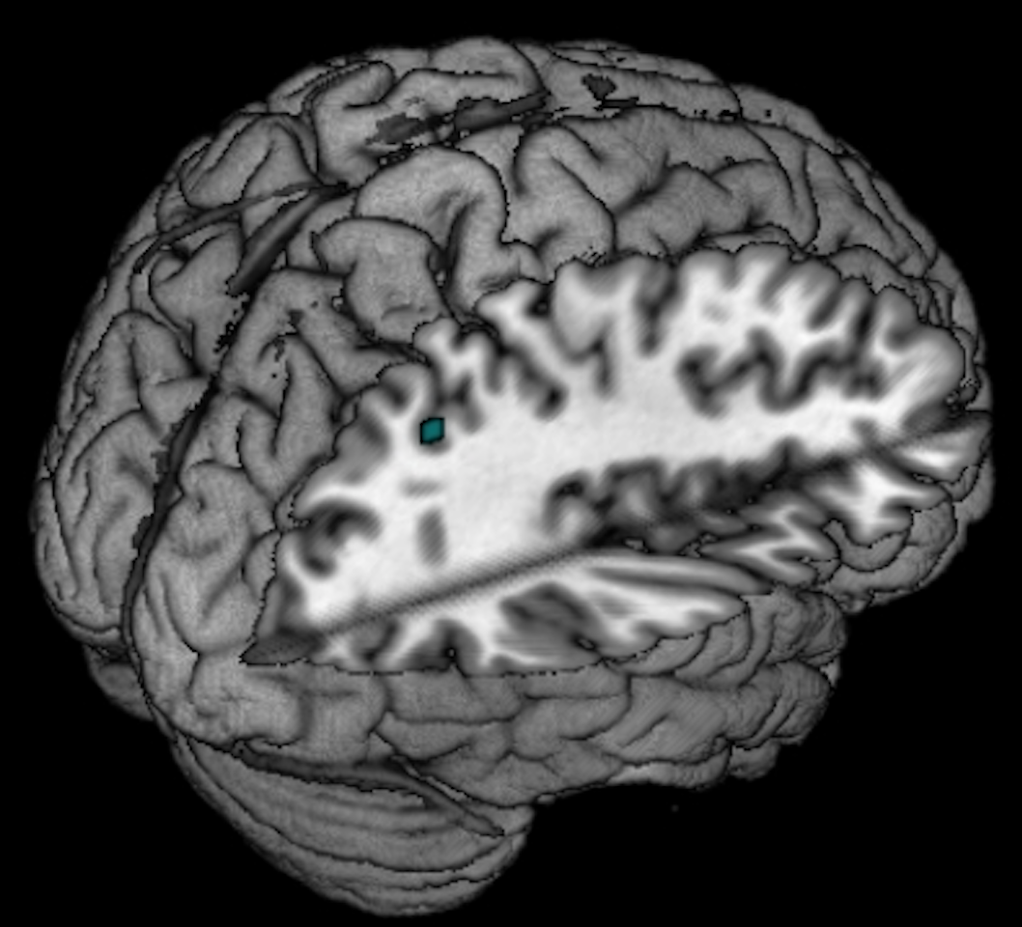
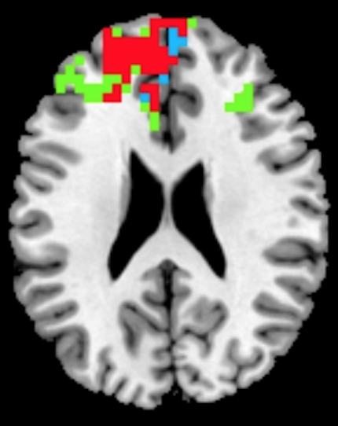
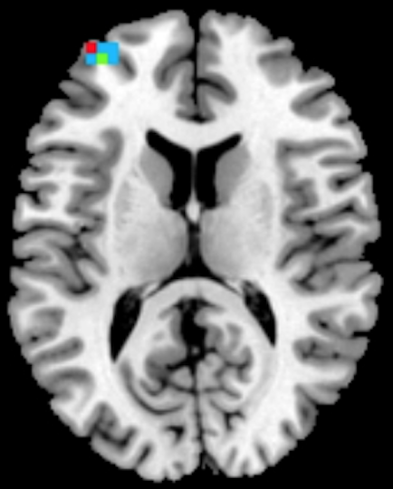
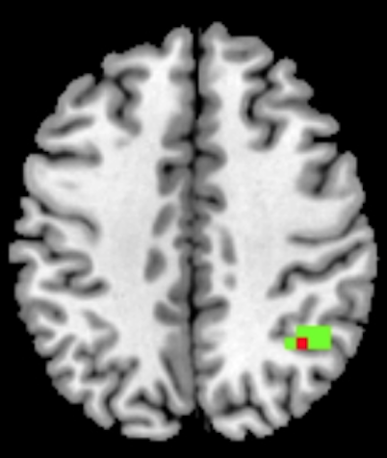
A
Frontostriatal network
Left frontoparietal network
B
Cognitive-fMRI correlation
L
x=-6
Middle frontal
x=-54
L
Dorsal ant.
cingulum
MFG
x=6
R
Supplementary motor
Middle and superior frontal
x=-22
x=-18
x=38
Angular
L
L
L
p<0.001; R=-0.822
0.05 <0.001
0.05 <0.001
C
D
Overlap
20 ALS
25 ALS
Figure A.2. Independent component analysis rerun excluding 2 patients with C9orf72 mutation and 3 patients with behavioral impairment. Increased resting-state functional connectivity in ALS patients after six months accounting for changes at the ALS Functional Rating Scale Revised (ALSFRS-R), time between scans and grey matter density (A). Worse performance at baseline TAP divided attention subtest related with increased functional connectivity over time in the most rostral part of middle frontal gyrus, MFG within the frontostriatal network in ALS patients. Results are overlaid on the Montreal Neurological Institute (MNI) standard brain and displayed at p<0.05 Family-wise error corrected for multiple comparisons. X values denotes x-MNI coordinates. Color bar represents p values (B). Overlay between the significance maps of the frontostriatal (C) and left frontoparietal (D) networks.

Slide 3
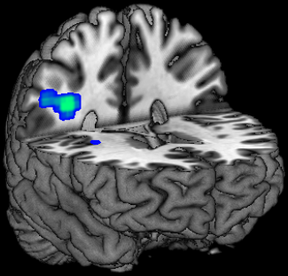
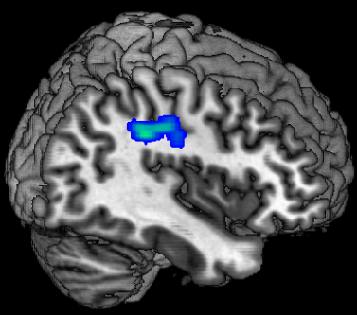
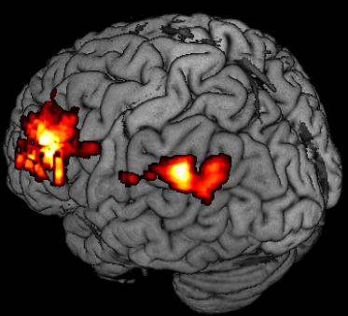
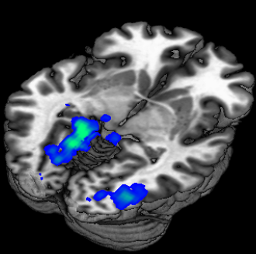
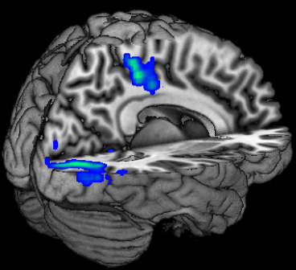
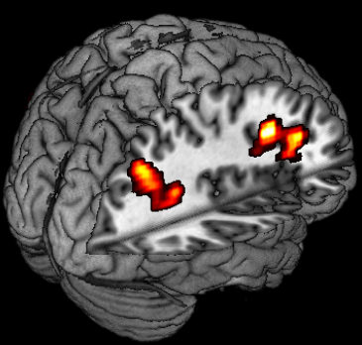

A
Left MFG
B
Right MFG
y=-38
x=38
x=-54; z=14
R
R
L
Pars
opercularis
Primary motor
Supramarginal
Primary
somatosensory
Pars triangularis
Right MFG
Angular
Parahippocampal
z=-4
x=6; z=4
Ventral ant. cingulum
x=36
L
L
L
Dorsal post.
cingulum
Lingual
Inferior occipital
Primary visual
2.3 3.5
2.3 4.0
Figure A.3. Seed-based functional connectivity analysis rerun excluding 2 patients with C9orf72 mutation and 3 patients with behavioral impairment. Regions where ALS patients showed enhanced (cold colors) or reduced (warm colors) functional connectivity with the left and right middle frontal gyrus (MFG) compared to healthy controls at baseline (A) and at follow-up (6 month) (B). Results are overlaid on the Montreal Neurological Institute (MNI) standard brain and displayed at p<0.05 Family-wise error corrected for multiple comparisons at a cluster level. X,y,z values denotes MNI coordinates. Color bar represents Z values.

Slide 4
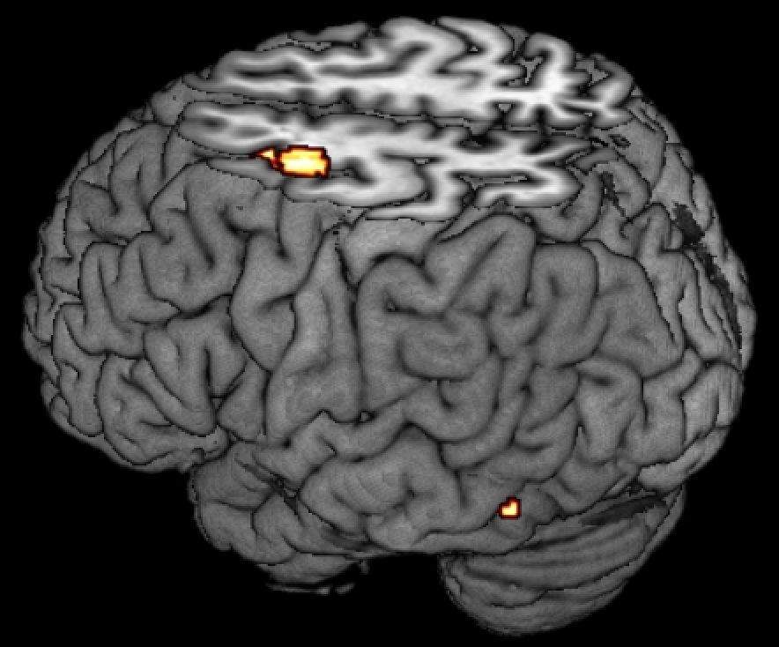
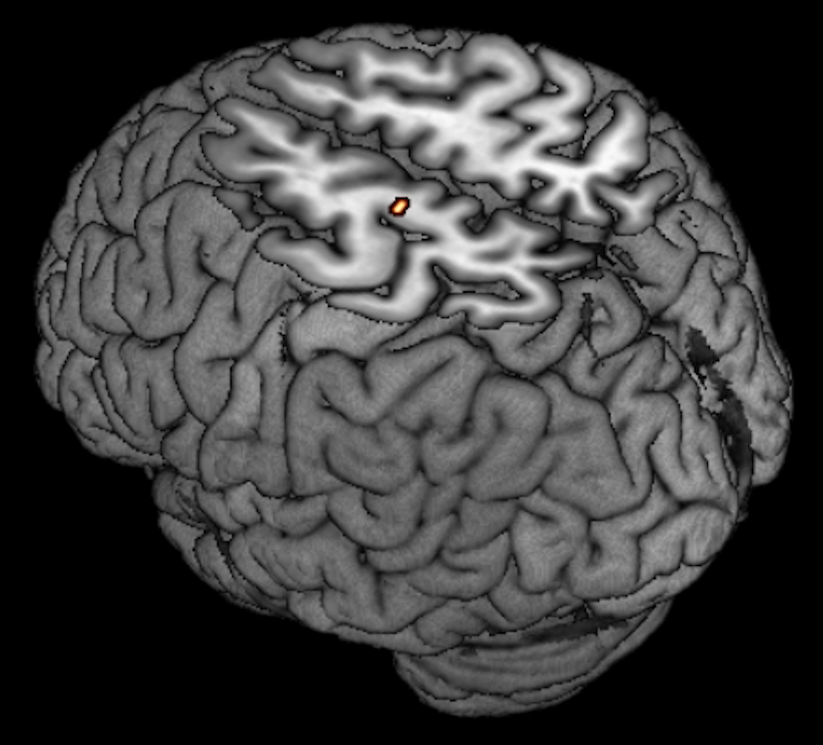
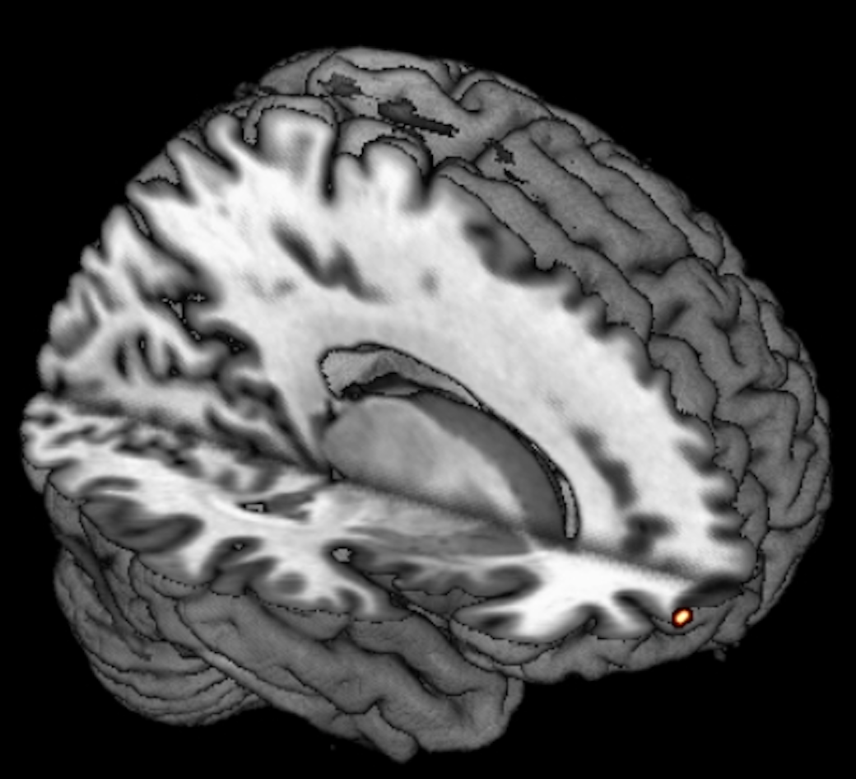
A
Left MFG
B
Right MFG
Premotor and supplementary motor cortices
L
x=-28
Premotor and supplementary motor cortices
x=-14
L
Fusiform gyrus
Right MFG
x=30
R
Rostral superior and middle frontal gyri
0.05 <0.001
Figure A.4. Seed-based functional connectivity analysis rerun comparing the 25 ALS patients with 10 HC who performed the same MRI scan both at baseline and follow-up. (A) Regions where ALS patients showed reduced functional connectivity with the left and right middle frontal gyrus (MFG) compared to healthy controls at follow-up (month 6). (B) Regions where ALS patients showed reduced functional connectivity with the left and right middle frontal gyrus (MFG) compared to healthy controls over time. Results are overlaid on the Montreal Neurological Institute (MNI) standard brain and displayed at p<0.05 Family-wise error corrected for multiple comparisons. X values denotes x-MNI coordinates. Color bar represents p values.

