Slide 1
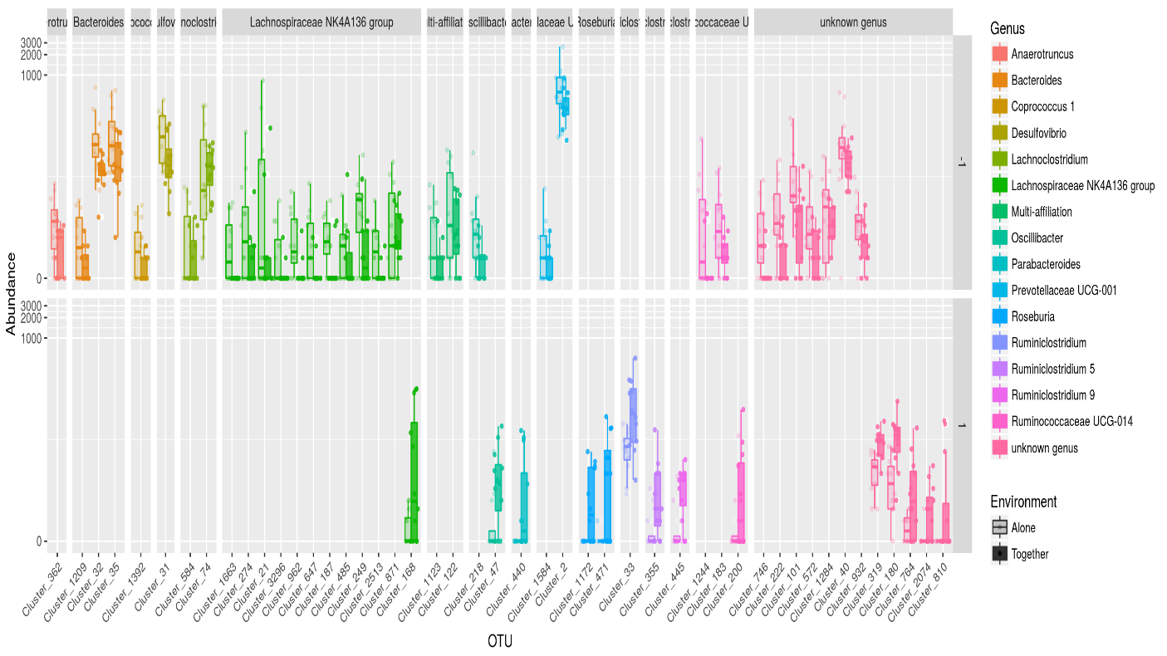
Figure S4
Effect of maternal deprivation (alone) on fecal microbial abundance in Long-Evans rats. The figure shows boxplots of the normalized abundances, on a log-scale, of several OTUs of interest across samples. The results are expressed as the median and interquartile range. Normalized abundances are also plotted as points on top of each boxplot, with a small amount of horizontal jitter.

