Slide 1
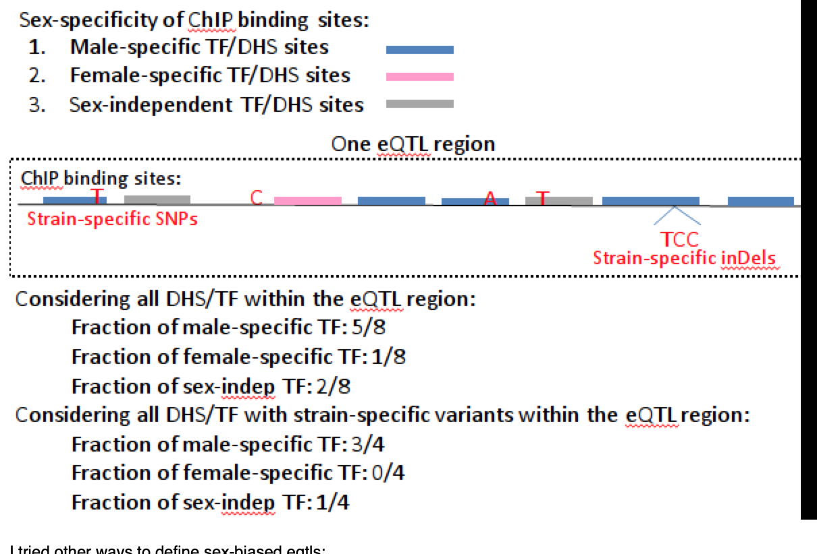
S6 Fig
(for analysis in Fig. 4)

