Slide 1
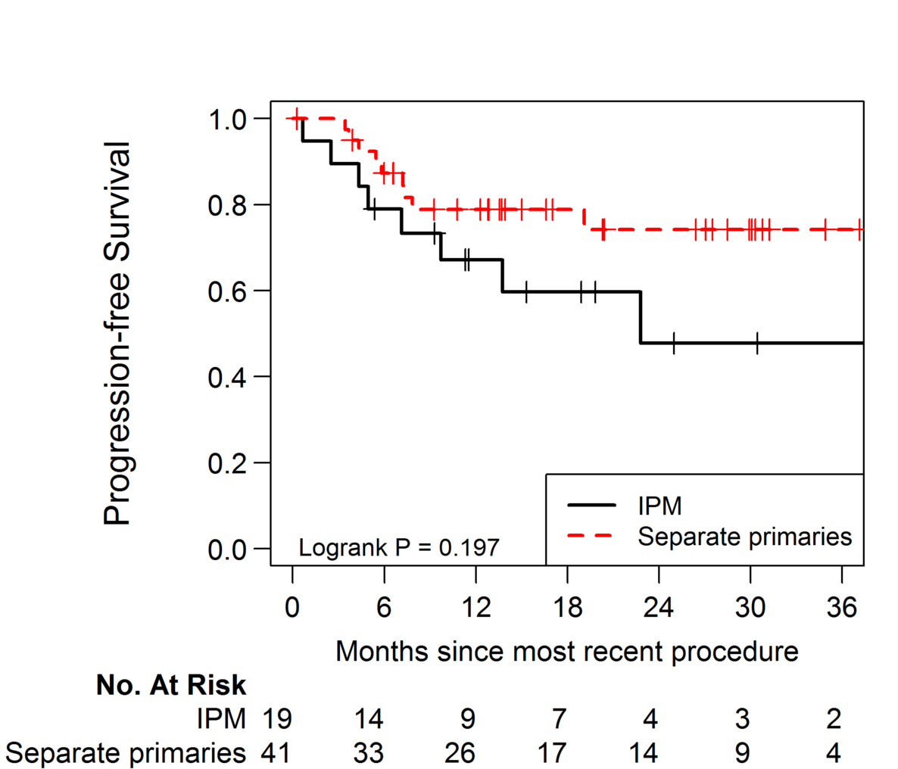
Supplemental Figure 2. Progression-free survival (PFS) for patients with IPMs and patients with SPLCs

